Slide 1
MobiHoc 2023 Keynote

Slide 2

A Journey from
Wireless Networks to Distributed Optimization
Nitin Vaidya
Georgetown University

Slide 3
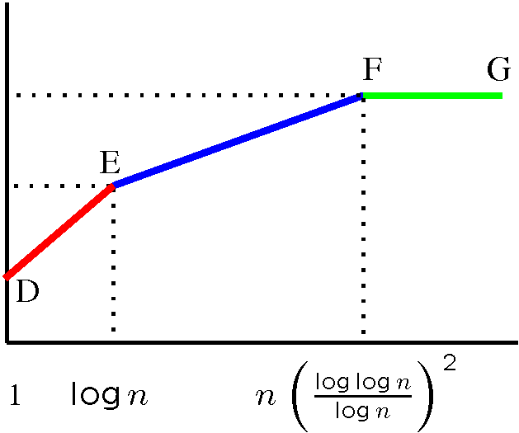
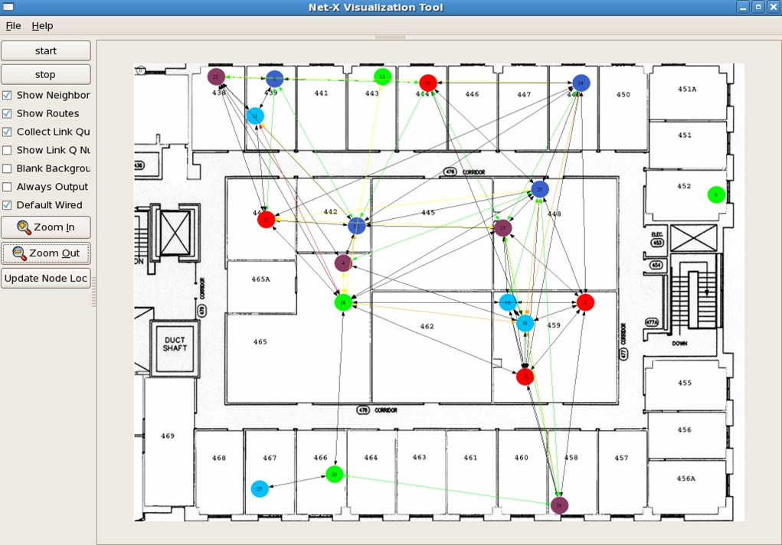
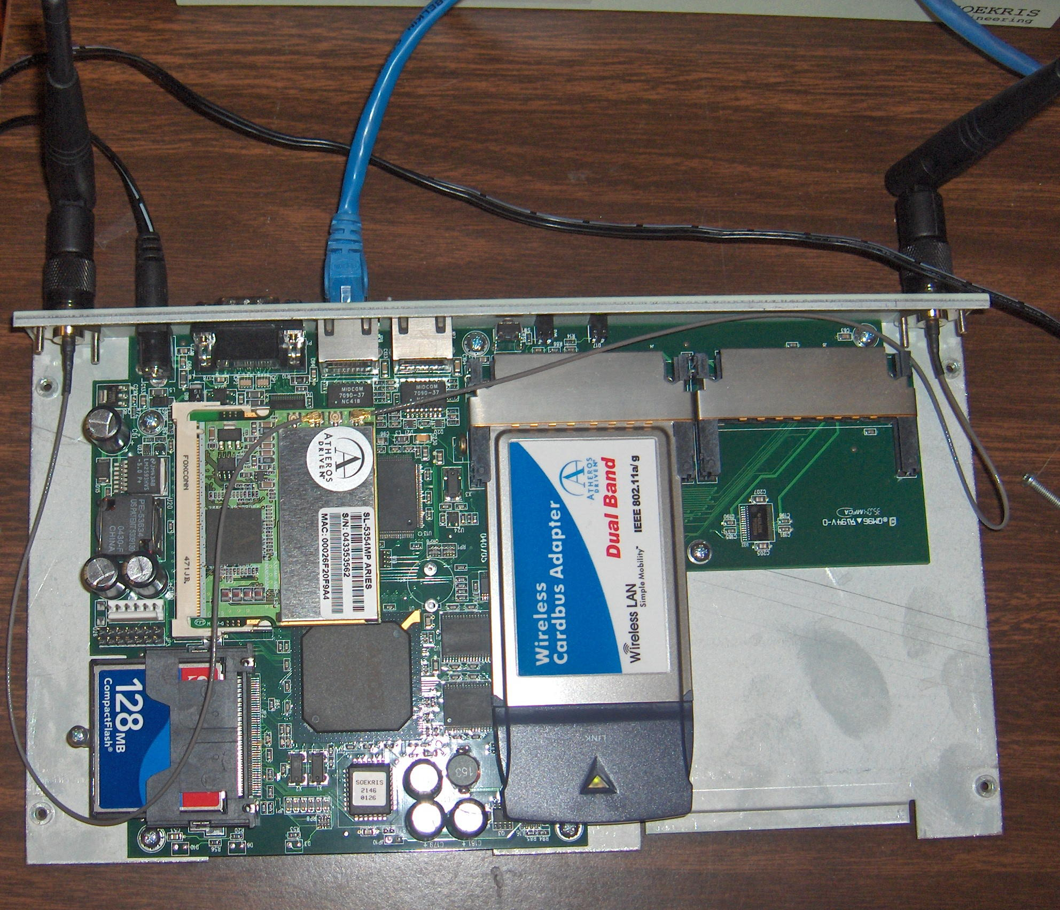
Net-X
Multi-Channel Mesh
Theory to Practice
(2006)
D
Fixed
E
F
B
capacity
A
Switchable
C
channels
Insights on
protocol design
Capacity
bounds
Net-X
testbed
OS improvements
Software architecture
User
Applications
Multi-channel
protocol
IP Stack
ARP
Channel Abstraction Module
Interface
Device Driver
Interface
Device Driver
Linux box
CSL

Slide 4
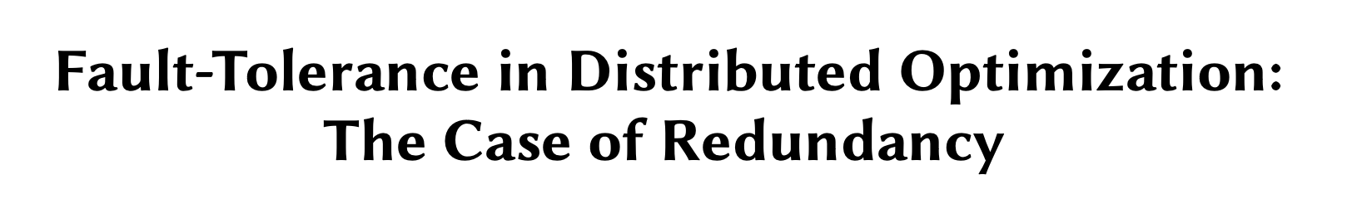
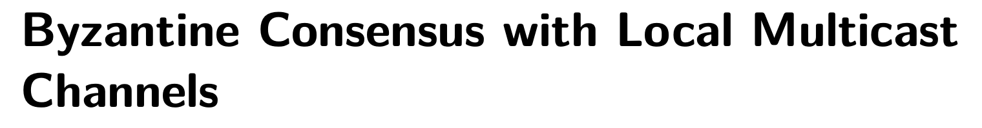
More Recently …

Slide 5
From there to here …
Through a few short-term, somewhat accidental, interactions
I will discuss one example

Slide 6
Takeaway …

Slide 7
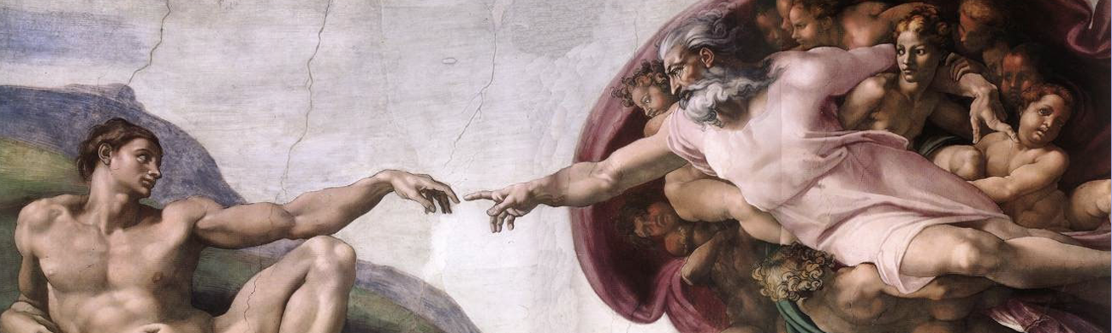
Moral of the Story #1
Natural, unanswered questions at the intersection of previously explored problem spaces
Picture from Wikipedia

Slide 8
Moral of the Story #2
Academia lets you work on things for which
you may have no competence
Make the best use of the freedom

Slide 9
A Journey from
Wireless Networks to Distributed Optimization
Consensus

Slide 10
Consensus, consensus, everywhere …

Slide 11

Consensus, consensus …
Commit or abort ?
Network of databases …
agree on a common action

Slide 12
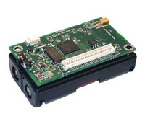
Consensus, consensus …
What is the temperature?
Network of sensors …
agree on current temperature

Slide 13

Consensus, consensus …
Should we trust ?
Web of trust …
agree whether is good or evil

Slide 14
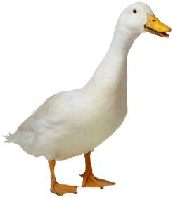

Consensus, consensus …
Which way?

Slide 15
Consensus
“Local” Algorithms

Slide 16
Consensus … Local Averaging
Initially, state = input
b
c
a

Slide 17
Consensus … Local Averaging
Initially, state = input
2
1
6

Slide 18
Consensus … Local Averaging
Initially, state = input
b
b = (b+c)/2
c
c = (a+b+c)/3
a
a = (a+c)/2

Slide 19
Consensus … Local Averaging
2
b = (1+2)/2 = 3/2
1
c = (1+2+6)/3 = 3
6
a = (1+6)/2 = 7/2

Slide 20
=
new values
M
old values
b
b = (b+c)/2
c
c = (a+b+c)/3
a
a = (a+c)/2

Slide 21
=
= M
new values
M
old values
b
b = (b+c)/2
c
c = (a+b+c)/3
a
a = (a+c)/2

Slide 22
after 1 iteration
after 2 iterations
= M M
= M²
new values
old values
b
b = (b+c)/2
c
c = (a+b+c)/3
a
a = (a+c)/2

Slide 23
after k iterations
= M^{k}
b
b = (b+c)/2
c
c = (a+b+c)/3
a
a = (a+c)/2

Slide 24
after k iterations
k → ∞
= M^{k}
final
initial
b
b = (b+c)/2
c
c = (a+b+c)/3
a
a = (a+c)/2

Slide 25
after k iterations
k → ∞
= M^{k}
final
initial
b
Consensus !
b = (b+c)/2
c
c = (a+b+c)/3
a
a = (a+c)/2

Slide 26
Graph Condition for Consensus
At least one node must be able to influence all nodes
b
b
c
c
a
a

Slide 27
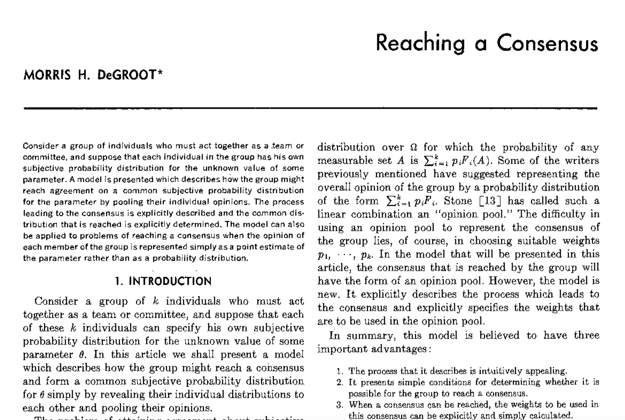
1974

Slide 28
Change of Weights
b
b = 3b/4+ c/4
c
c = a/4+b/4+c/2
a
a = 3a/4+ c/4

Slide 29
=
= M
M
b
b = 3b/4+ c/4
c
c = a/4+b/4+c/2
a
a = 3a/4+ c/4

Slide 30
after k iterations
k → ∞
= M^{k}
➔
final
initial
b
b = 3b/4+ c/4
c
c = a/4+b/4+c/2
a
a = 3a/4+ c/4

Slide 31
after k iterations
k → ∞
= M^{k}
➔
final
initial
Average
Consensus
b
b = 3b/4+ c/4
c
c = a/4+b/4+c/2
a
a = 3a/4+ c/4

Slide 32
Graph Condition for Average Consensus
Every node must be able to influence all others
      Strong connectivity
b
b
c
c
a
a

Slide 33
Lossy Wireless Links
(2012)

Slide 34
Average consensus over lossy wireless links?
b
c
a
Photo courtesy Alejandro Dominguez-Garcia

Slide 35
Implementation
Each node “transfers mass” to neighbors via messages
Next state = Total received mass
b
b = 3b/4+ c/4
c/4
c
c/2
c/4
c = a/4+b/4+c/2
a = 3a/4+ c/4
a

Slide 36
Implementation
Each node “transfers mass” to neighbors via messages
Next state = Total received mass
b
3b/4
b = 3b/4+ c/4
c/4
c
c/2
b/4
c/4
c = a/4+b/4+c/2
a/4
3a/4
a = 3a/4+ c/4
a

Slide 37
Conservation of Mass
a+b+c constant after each iteration
b
3b/4
b = 3b/4+ c/4
c/4
c
c/2
b/4
c/4
c = a/4+b/4+c/2
a/4
3a/4
a = 3a/4+ c/4
a

Slide 38
Wireless Transmissions Lossy
b
X
b = 3b/4+ c/4
c/4
c
X
c = a/4+b/4+c/2
c/4
a = 3a/4+ c/4
a

Slide 39
Conservation of Mass
X
=
b
X
b = 3b/4+ c/4
c/4
c
X
c = a/4+b/4+c/2
c/4
a = 3a/4+ c/4
a

Slide 40
Average Consensus over Lossy Links
Sender and receiver views potentially inconsistent
… message delivered or not?
Average consensus fails
b
X
b = 3b/4+ c/4
c/4
c
X
c = a/4+b/4+c/2
c/4
a = 3a/4+ c/4
a

Slide 41
Average Consensus over Lossy Links
(2012)
Solution …
a different algorithm that can
tolerate lossy links
without explicit knowledge of lost messages

Slide 42
Long-term benefit for me …
Exposure to a new class of problems
New mathematical tools for analyzing algorithms
➔ Impacted a large fraction of my work since

Slide 43
Consensus
Hajnal 1958
Weak ergodicity
of nonhomogeneous Markov chains
Distributed
Computing
DeGroot 1974
Reaching a consensus
1980: Pease, Shostak, Lamport
Byzantine consensus
Distributed
Control
1983: Fischer, Lynch, Paterson
Asynchronous consensus
impossibility result
Tsitsiklis 1984
Decentralized control
1986: Dolev et al.
Approximate
Byzantine consensus
Jadbabaei 2003
Flocking problem

Slide 44
Consensus
Distributed Computing
Faults
Scalar inputs
Undirected graphs, often complete
Global algorithms
Exact consensus in
synchronous systems

Slide 45
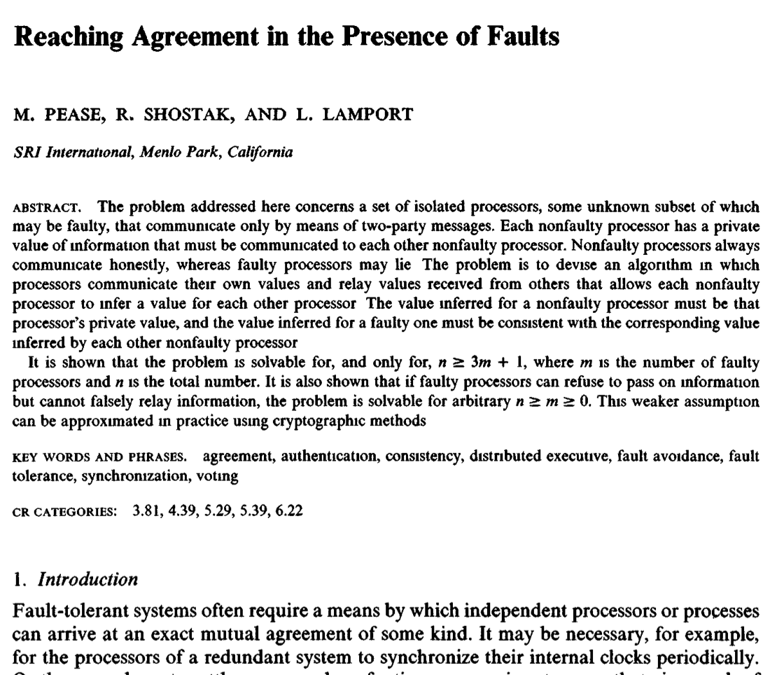
1980

Slide 46
Consensus
Distributed Computing
Faults
Scalar inputs
Undirected graphs, often complete
Global algorithms
Exact consensus in
synchronous systems

Slide 47
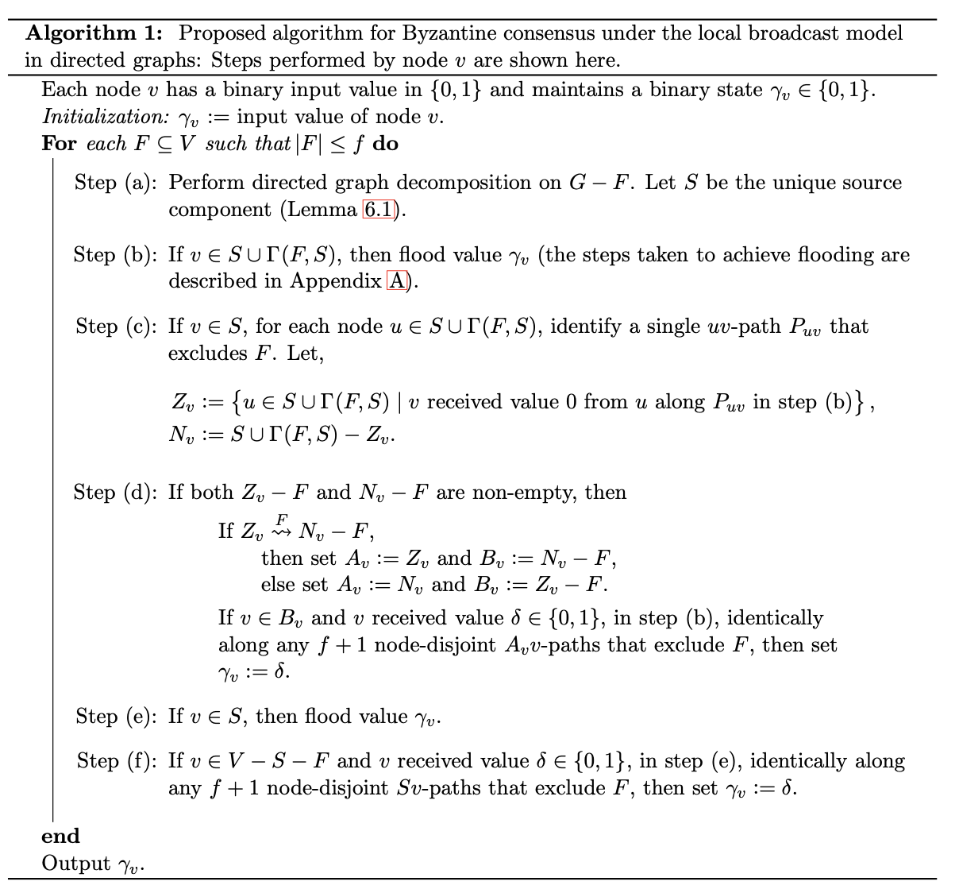
Global Algorithm
Exact Consensus

Slide 48





Consensus
Distributed Computing
Faults
Scalar inputs
Undirected graphs,
often complete
Global algorithms
Exact consensus in
synchronous systems
Distributed Control
No faults
Vector inputs
Incomplete
(directed) graphs
Local algorithms
Approximate consensus
$$f_{1}$$
$$f_{3}$$
$$f_{5}$$
$$f_{2}$$
$$f_{4}$$

Slide 49
Many problems should have been solved decades ago … but were not
Borrowing assumptions from the other domain
New network models

Slide 50
Many problems should have been solved decades ago … but were not
Local algorithms
  Average consensus over lossy links
  Byzantine consensus over point-to-point channels
  Byzantine consensus over broadcast channels
Global algorithm
  Byzantine consensus over directed graphs
  Byzantine consensus over broadcast channels
and more …

Slide 51
Fault-Tolerant Consensus with Local Algorithms

Slide 52
Local Averaging
Initially, state = input
b
b = (b+c)/2
c
c = (a+b+c)/3
a
a = (a+c)/2

Slide 53
Graph Condition for Consensus
At least one node must be able to influence all nodes
b
b
c
c
a
a

Slide 54
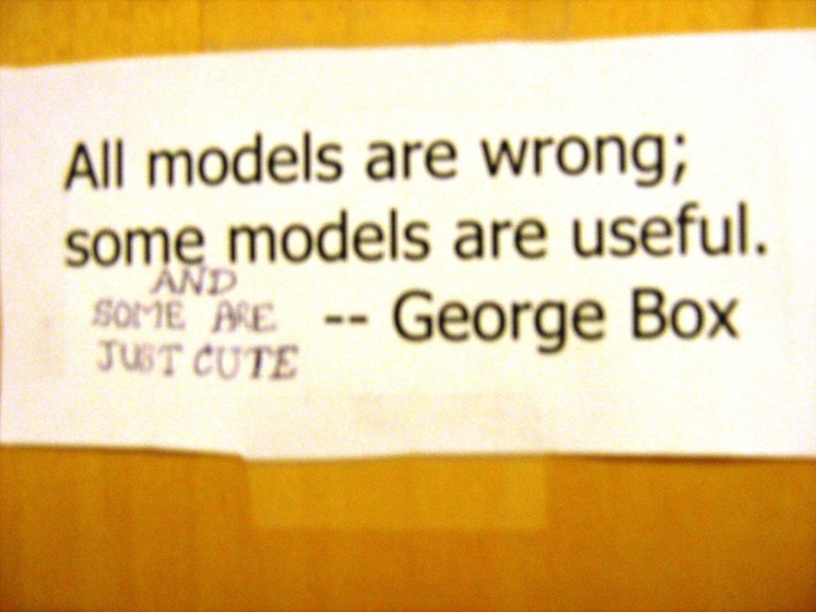
Byzantine Fault Model
No constraint
on misbehavior
of faulty agents

Slide 55
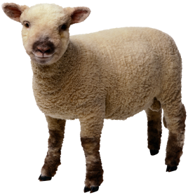
Local Averaging
Initially, state = input
b
b = (b+c)/2
Byzantine
node
C
c = 2
c =1
a
a = (a+c)/2

Slide 56
Local Averaging
Initially, state = input
No consensus !
b
b = (b+c)/2
Byzantine
node
C
c = 2
c =1
a
a = (a+c)/2

Slide 57
Graph Condition for Consensus with Byzantine faults
Goal is to achieve consensus among
the non-faulty agents

Slide 58
Graph Condition for Consensus with Byzantine faults
At least one node must be able to influence all nodes
Insufficient with faults
b
b
c
c
a
a

Slide 59
Graph condition for local Byzantine consensus algorithms is now known (2012)
b
c = 2
Byzantine
node
C
c =1
a

Slide 60
Fault-Tolerant Consensus over Broadcast Channels

Slide 61
Wireless Broadcast
Wireless transmissions (potentially) received by all neighbors of the sender
Does this benefit Byzantine consensus?

Slide 62
Wireless Broadcast
b
c = 2
Byzantine
node
C
c =1
a
Misbehavior can be detected

Slide 63
Graph Condition for Byzantine Consensus
Global Algorithms
Point-to-point networks (1982)
2f + 1 connectivity
3f + 1 nodes
f faulty
nodes

Slide 64
Graph Condition for Byzantine Consensus
Global Algorithms
Point-to-point networks (1982)
2f + 1 connectivity
3f + 1 nodes
Broadcast channels (2018)
3f/2 + 1 connectivity
2f node degree
f faulty
nodes

Slide 65
Fault-Tolerant
Distributed Optimization

Slide 66

Averaging
Input of node i = $a_{i}$
Compute average of $a_{i}^{′}s$
a₁
S
a₁
a₂
a₂
S is a trusted server

Slide 67
Fault-Tolerant Averaging
What to do if some nodes send bogus values?
a₁
S
a₁
z
a₂
Byzantine

Slide 68


Averaging ➔ Optimization
Input of node i = $a_{i}$
Average of $a_{i}^{′}s$ =
where
i
$$f_{i}\left(x\right)={(x−a_{i})}^{2}$$

Slide 69
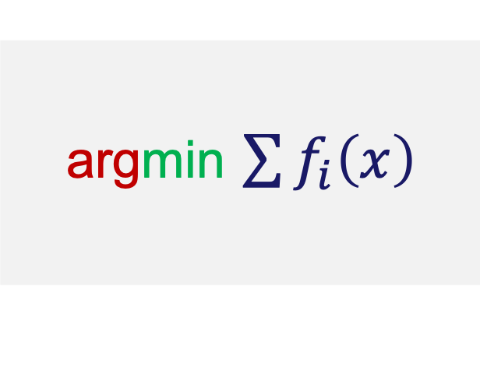
Many Applications
argmin $\sum{f_{i}\left(x\right)}$

Slide 70

Rendezvous

Slide 71



Rendezvous
$$f_{1}\left(x\right)$$
$$f_{2}\left(x\right)$$
X
$$f_{3}\left(x\right)$$

Slide 72
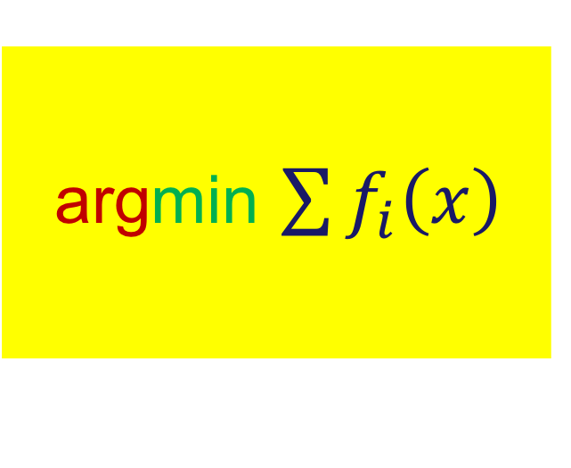
argmin $\sum{f_{i}\left(x\right)}$

Slide 73
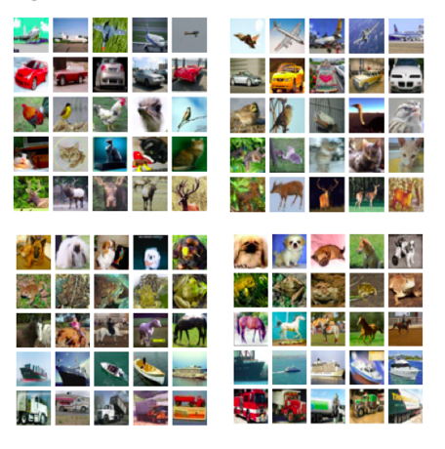
Machine Learning
Data is distributed
across different
agents
Agent 1
Agent 2
Agent 3
Agent 4

Slide 74
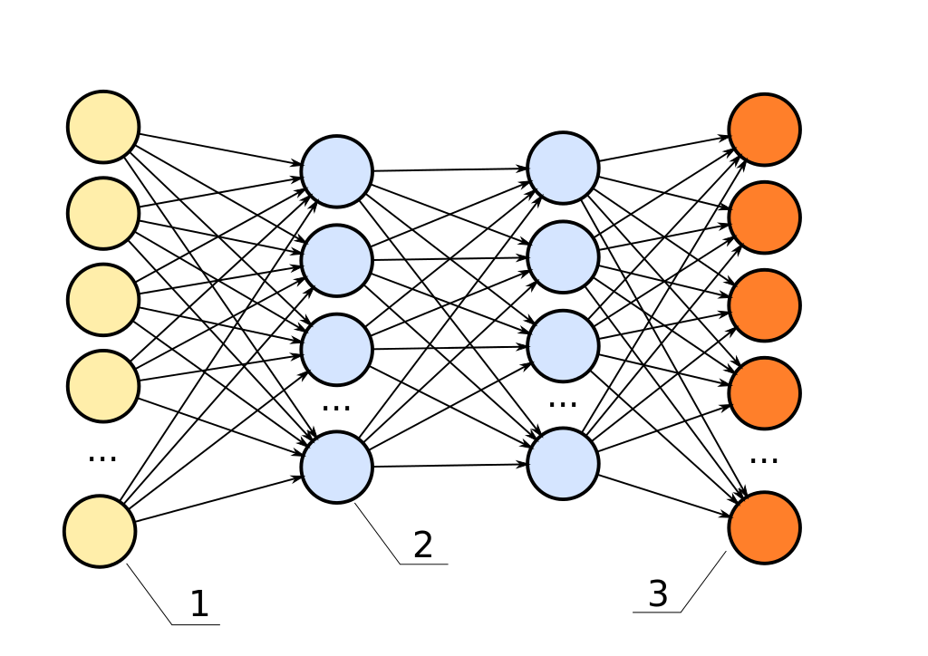
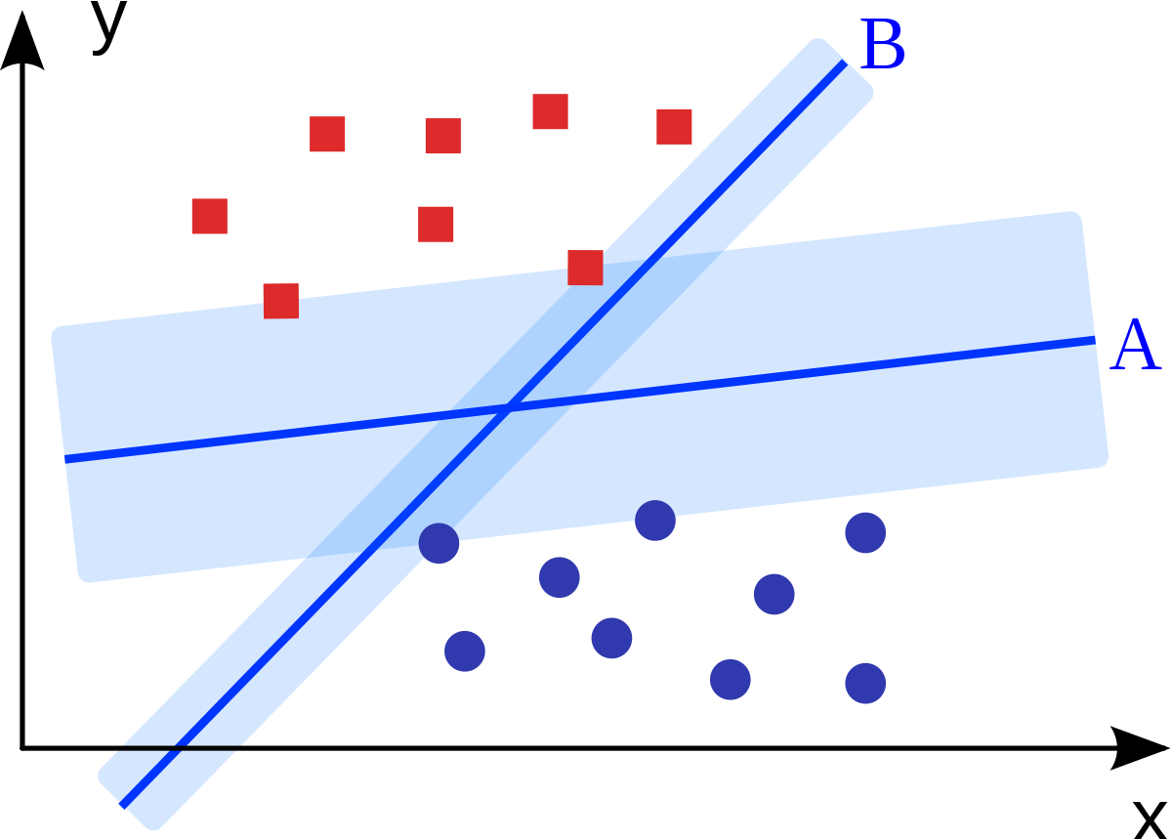
Data is distributed
across different ➔ Collaborate to learn
agents

Slide 75
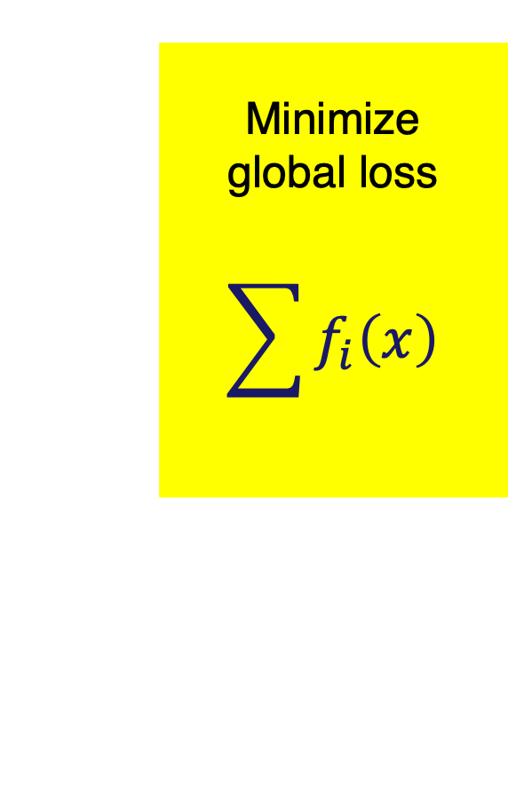




Machine Learning
$$f_{1}\left(x\right)$$
$$f_{2}\left(x\right)$$
Minimize
global loss
$$\sum{f_{i}\left(x\right)}$$
$$f_{3}\left(x\right)$$
$$f_{4}\left(x\right)$$

Slide 76
argmin $\sum{f_{i}\left(x\right)}$

Slide 77
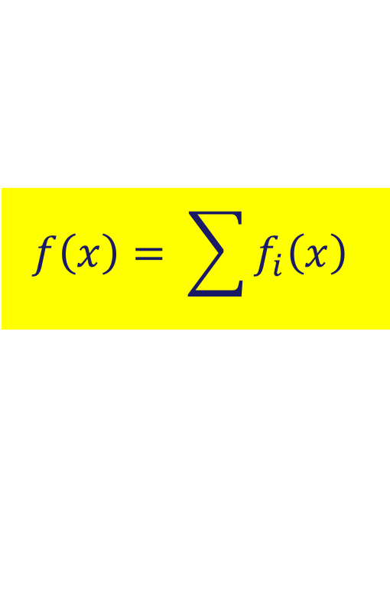
Gradient Method
$$f\left(x\right)= \sum{f_{i}\left(x\right)}$$
x₀
x₁
x₂
x₃

Slide 78
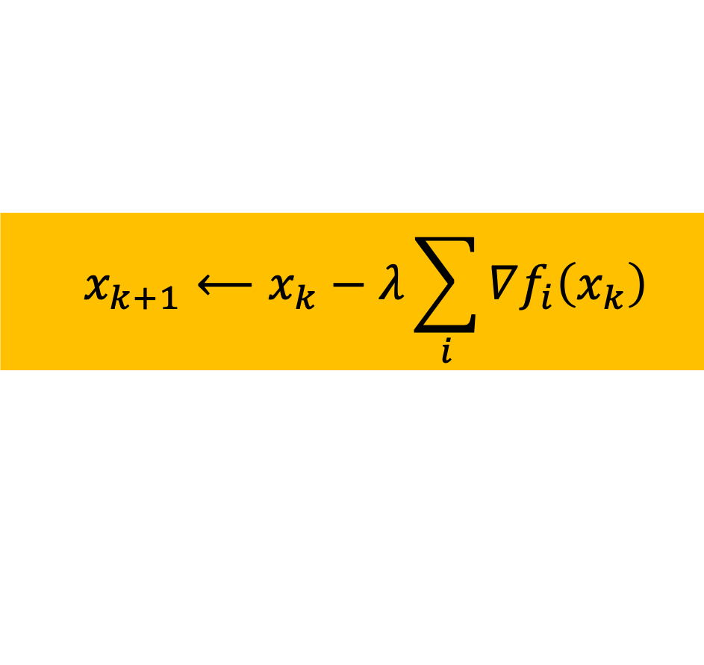
Gradient Method
$$f\left(x\right)= \sum{f_{i}\left(x\right)}$$
x₀
x₁
x₂
x₃
  $$x_{k+1}⟵x_{k}−λ\sum_{i}{∇f_{i}\left(x_{k}\right)}$$

Slide 79
Gradient Method
$$f\left(x\right)= \sum{f_{i}\left(x\right)}$$
x₀
x₁
x₂
x₃
  $$x_{k+1}⟵x_{k}−λ\sum_{i}{∇f_{i}\left(x_{k}\right)}$$

Slide 80
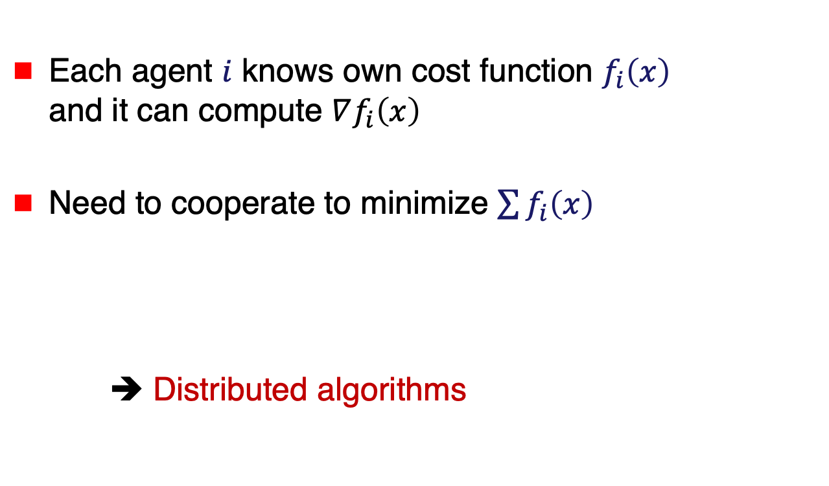
Distributed Optimization
Each agent $i$ knows own cost function $f_{i}\left(x\right)$
and it can compute $∇f_{i}\left(x\right)$
Need to cooperate to minimize $\sum{f_{i}\left(x\right)}$
➔ Distributed algorithms

Slide 81







Architectures
$$1$$
$$3$$
$$5$$
$$2$$
$$4$$
Server
1
$$2$$
$$3$$

Slide 82

Parameter Server
Server maintains estimate $x_{k}$
$$x_{k}$$
Server

Slide 83



Parameter Server
Server maintains estimate $x_{k}$
In each iteration
Agent i
  Receives $x_{k}$ from server
$$x_{k}$$
Server
$x_{k}$
$x_{k}$

Slide 84



Parameter Server
Server maintains estimate $x_{k}$
In each iteration
Agent i
  Receives $x_{k}$ from server
  Uploads gradient $∇f_{i}(x_{k})$
$$x_{k}$$
Server
$∇f_{1}(x_{k})$
$∇f_{3}(x_{k})$

Slide 85
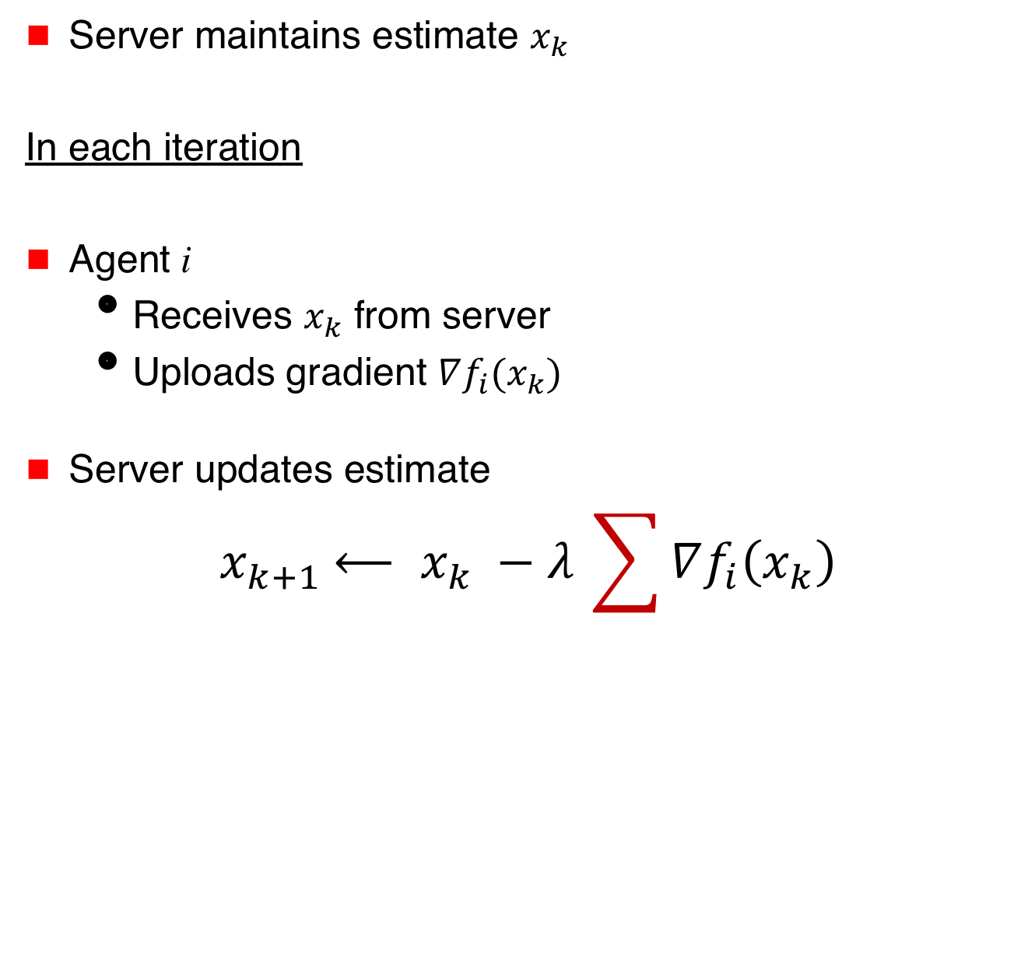



Parameter Server
Server maintains estimate $x_{k}$
In each iteration
Agent i
  Receives $x_{k}$ from server
  Uploads gradient $∇f_{i}(x_{k})$
Server updates estimate
$${ x}_{k+1} ⟵ x_{k} −λ_{ }\sum{∇f_{i}\left(x_{k}\right)}$$
$$x_{k}$$
Server
$∇f_{1}(x_{k})$
$∇f_{3}(x_{k})$

Slide 86
Many Variations
… stochastic optimization
… asynchronous
… gradient compression
… acceleration
… shared memory
Server

Slide 87



Adversarial Agents
Fault-tolerant
distributed optimization
How to optimize
if agents inject
bogus information?
Server
$∇f_{1}(x_{k})$
$∇f_{3}(x_{k})$
f₁(x) + f₂(x) + f₃(x)

Slide 88
Fault-Tolerant Optimization
2015 …

Slide 89
Rendezvous
$$f_{1}\left(x\right)$$
$$f_{2}\left(x\right)$$
X
$$f_{3}\left(x\right)$$

Slide 90

Rendezvous
$$f_{1}\left(x\right)$$
$$f_{2}\left(x\right)$$
X
$$f_{3}\left(x\right)$$

Slide 91
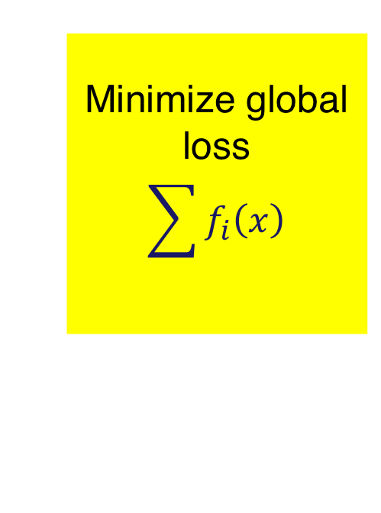




Machine Learning
Faulty agent can
adversely affect
model parameters
$$f_{1}\left(x\right)$$
$$f_{2}\left(x\right)$$
Minimize global loss
$$\sum{f_{i}\left(x\right)}$$
$$f_{3}\left(x\right)$$
$$f_{4}\left(x\right)$$

Slide 92

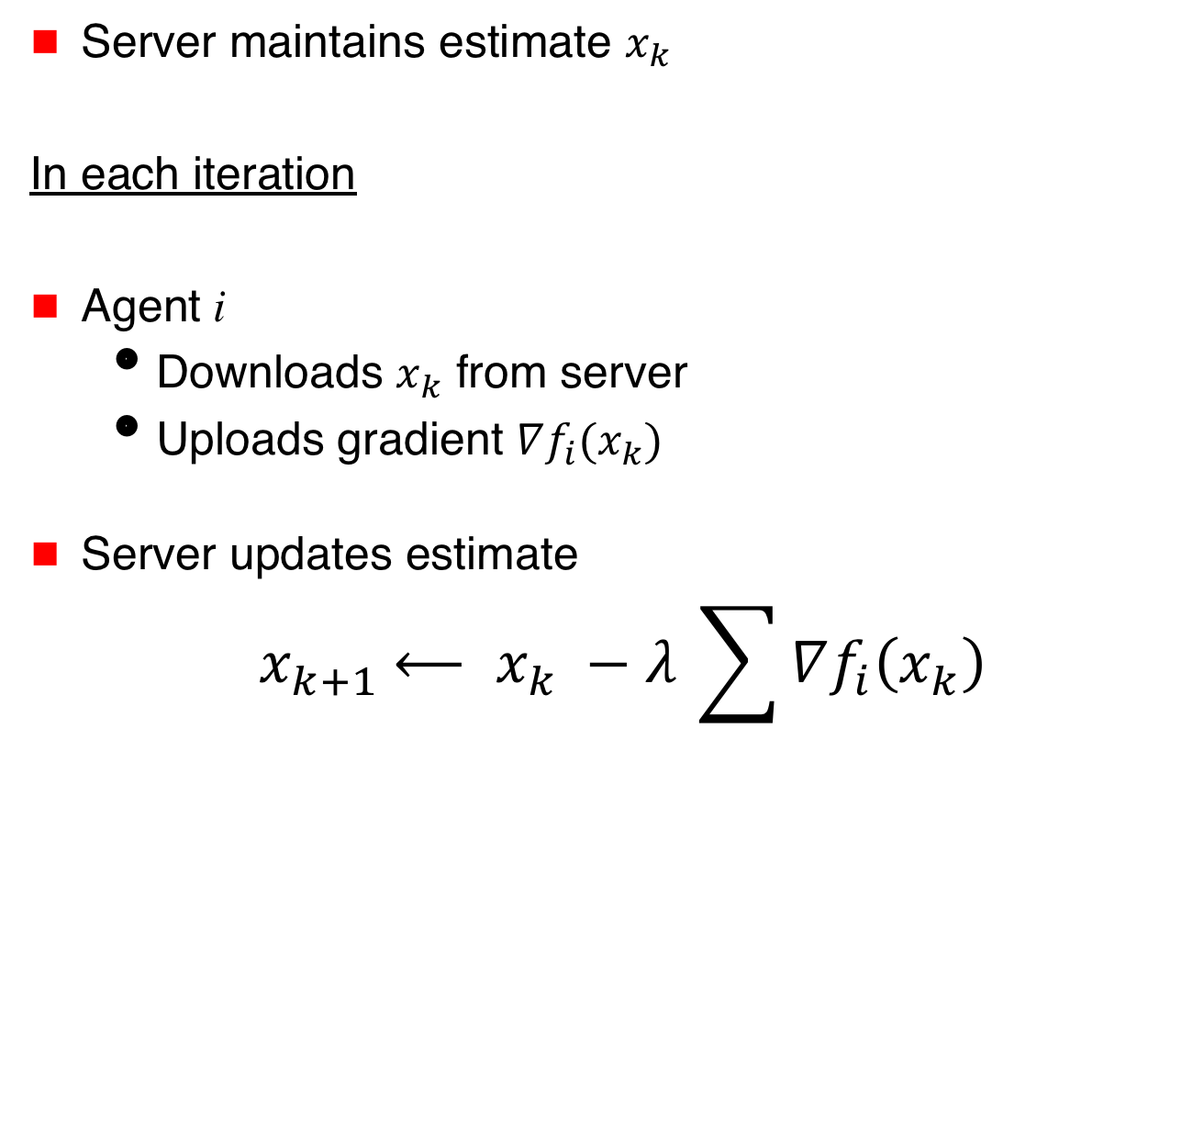
Parameter Server
Server maintains estimate $x_{k}$
In each iteration
Agent i
  Downloads $x_{k}$ from server
  Uploads gradient $∇f_{i}(x_{k})$
Server updates estimate
$${ x}_{k+1} ⟵ x_{k} −λ_{ }\sum{∇f_{i}\left(x_{k}\right)}$$
$$x_{k}$$
Server
$∇f_{1}(x_{k})$
$∇f_{3}(x_{k})$

Slide 93
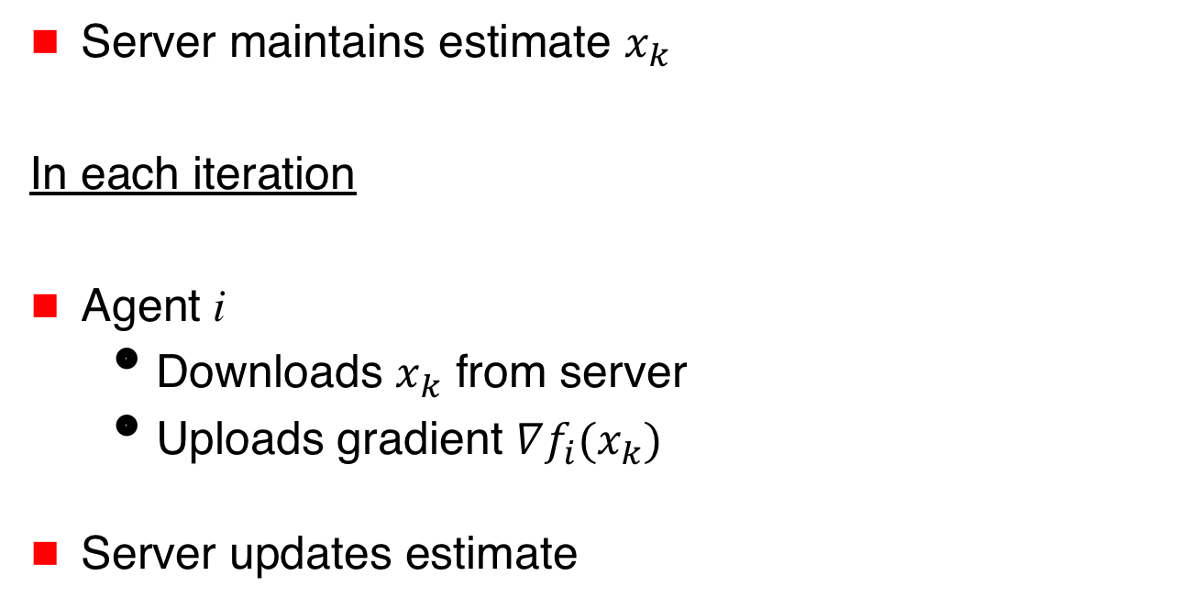
Parameter Server
Server maintains estimate $x_{k}$
In each iteration
Agent i
  Downloads $x_{k}$ from server
  Uploads gradient $∇f_{i}(x_{k})$
Server updates estimate
$$x_{k}$$
Server
$∇f_{1}(x_{k})$
$∇f_{3}(x_{k})$
$${ x}_{k+1} ⟵ x_{k} −λ_{ }\text{Filtered}\text{−}\text{Gradient}$$

Slide 94
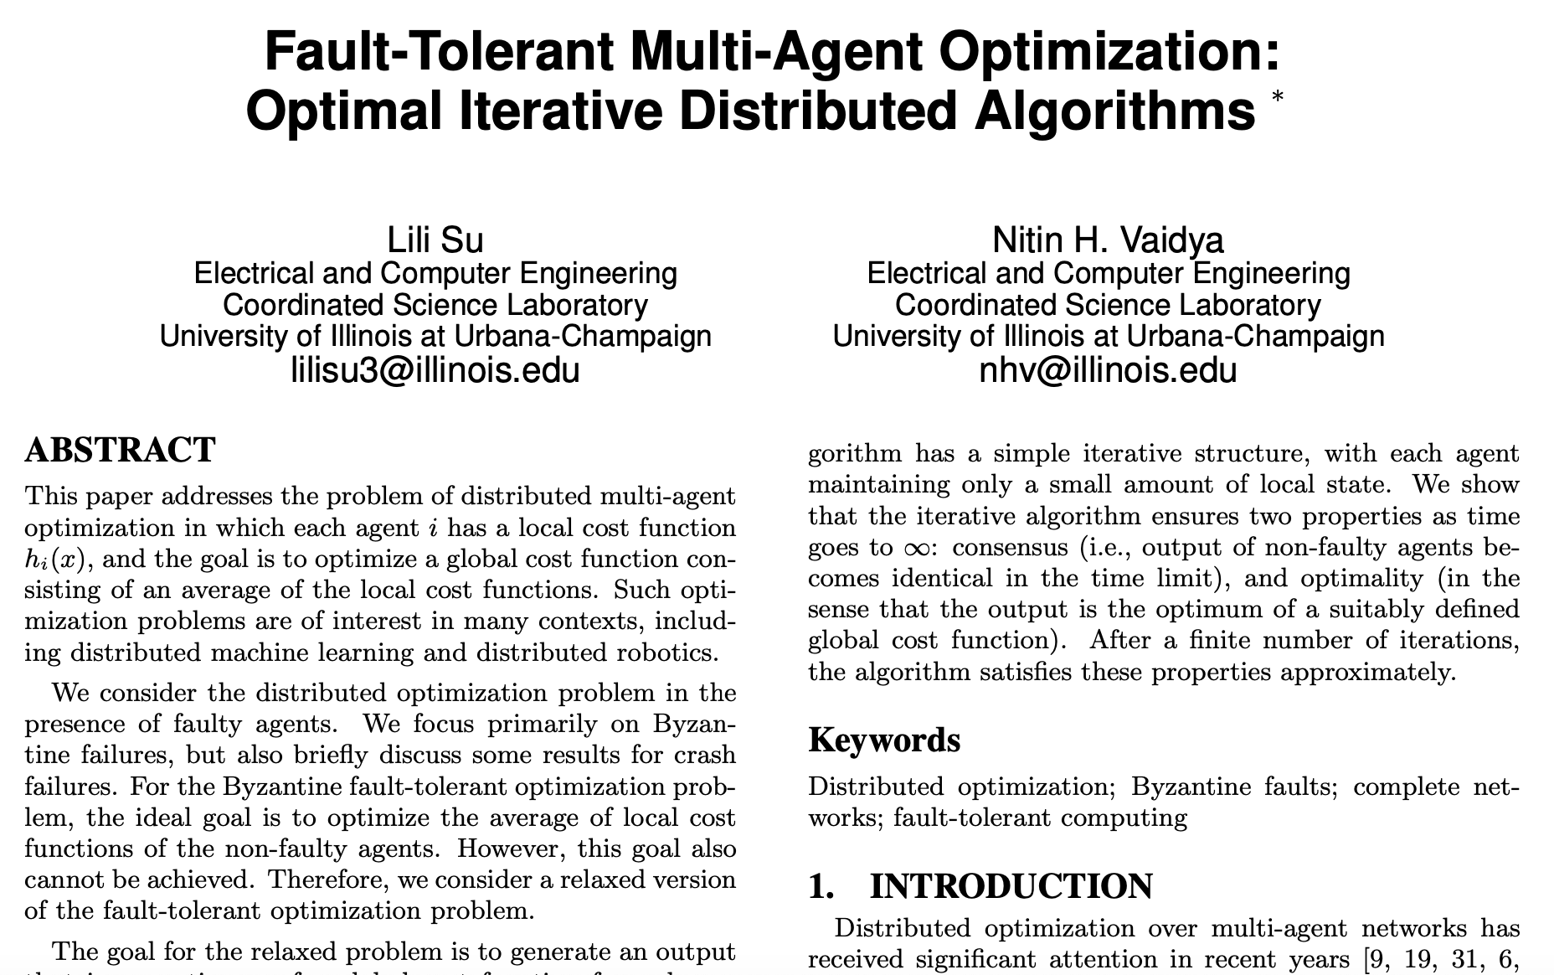
2016

Slide 95
But what do we mean by fault-tolerance?

Slide 96
Fault-Tolerance
Optimize over only good agents … set G

Slide 97
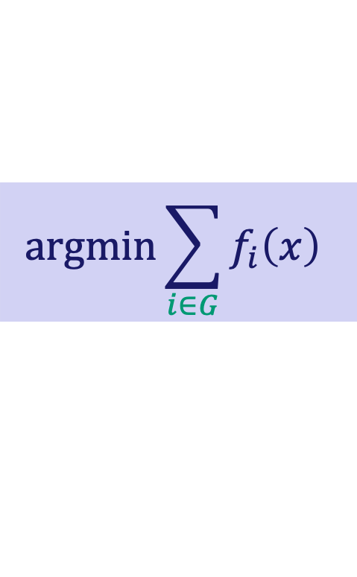
Fault-Tolerance
Optimize over only good agents … set G
$$\text{argmin}\sum_{i∈G}{f_{i}\left(x\right)}$$

Slide 98
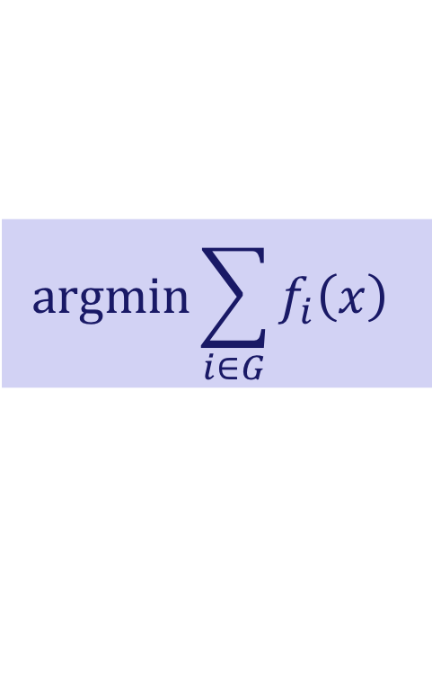
$$\text{argmin}\sum_{i∈G}{f_{i}\left(x\right)}$$
Is this achievable?
Depends on redundancy
in agents’ cost functions

Slide 99
$$\text{argmin}\sum_{i∈G}{f_{i}\left(x\right)}$$
Is this achievable?
It Depends
Depends on redundancy
in agents’ cost functions

Slide 100
$$\text{argmin}\sum_{i∈G}{f_{i}\left(x\right)}$$
Is this achievable?
It Depends
Independent
functions
“Enough”
redundancy

Slide 101
$$\text{argmin}\sum_{i∈G}{f_{i}\left(x\right)}$$
Is this achievable?
Is this achievable?
Independent
functions
“Enough”
redundancy
Approximate

Slide 102
2016

Slide 103
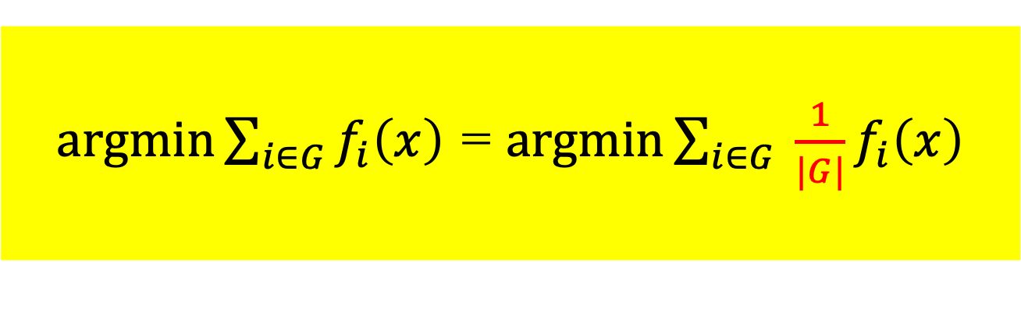
Approximation
$\text{argmin}\sum_{i∈G}{f_{i}\left(x\right)}$ = $\text{argmin}\sum_{i∈G}{ \frac{1}{|G|}f_{i}\left(x\right)}$

Slide 104
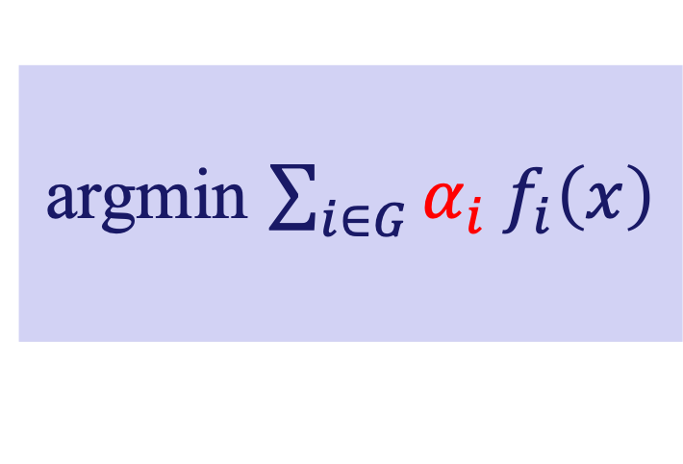
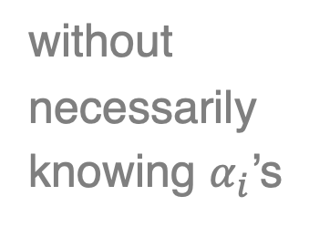
Approximation
$\text{argmin}\sum_{i∈G}{f_{i}\left(x\right)}$ = $\text{argmin}\sum_{i∈G}{ \frac{1}{|G|}f_{i}\left(x\right)}$
argmin $\sum_{i∈G}{{α_{i} f}_{i}\left(x\right)}$
without
necessarily
knowing $α_{i}$’s

Slide 105
$$\text{argmin}\sum_{i∈G}{f_{i}\left(x\right)}$$
Is this achievable?
Is this achievable?
Independent
functions
“Enough”
redundancy
Approximate

Slide 106
$$\text{argmin}\sum_{i∈G}{f_{i}\left(x\right)}$$
Is this achievable?
Is this achievable?
Independent
functions
“Enough”
redundancy
Approximate
Exact

Slide 107
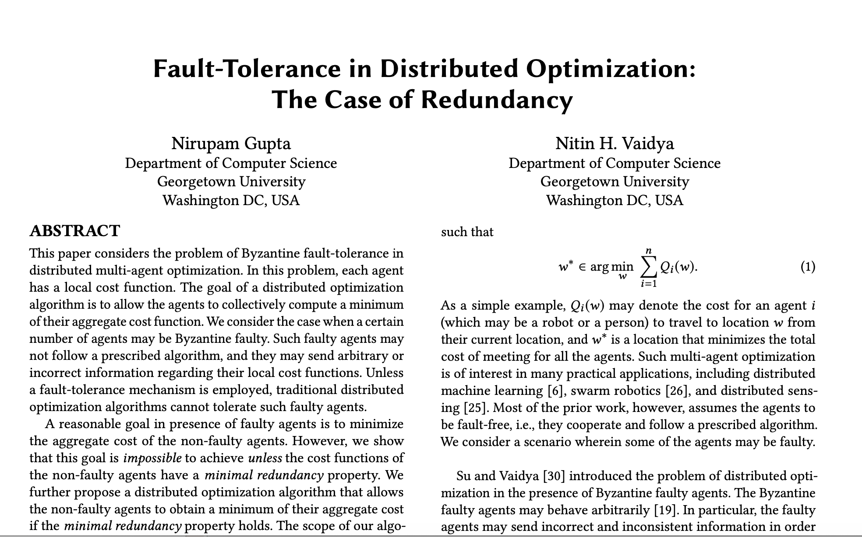
(2020)

Slide 108
An “Extreme” Example
Stochastic machine learning
Agents draw samples from
identical data distribution
Filter on stochastic gradients
Agent 1
Agent 2

Slide 109
$$\text{argmin}\sum_{i∈G}{f_{i}\left(x\right)}$$
Is this achievable?
Is this achievable?
Independent
functions
“Enough”
redundancy
Approximate
Exact

Slide 110
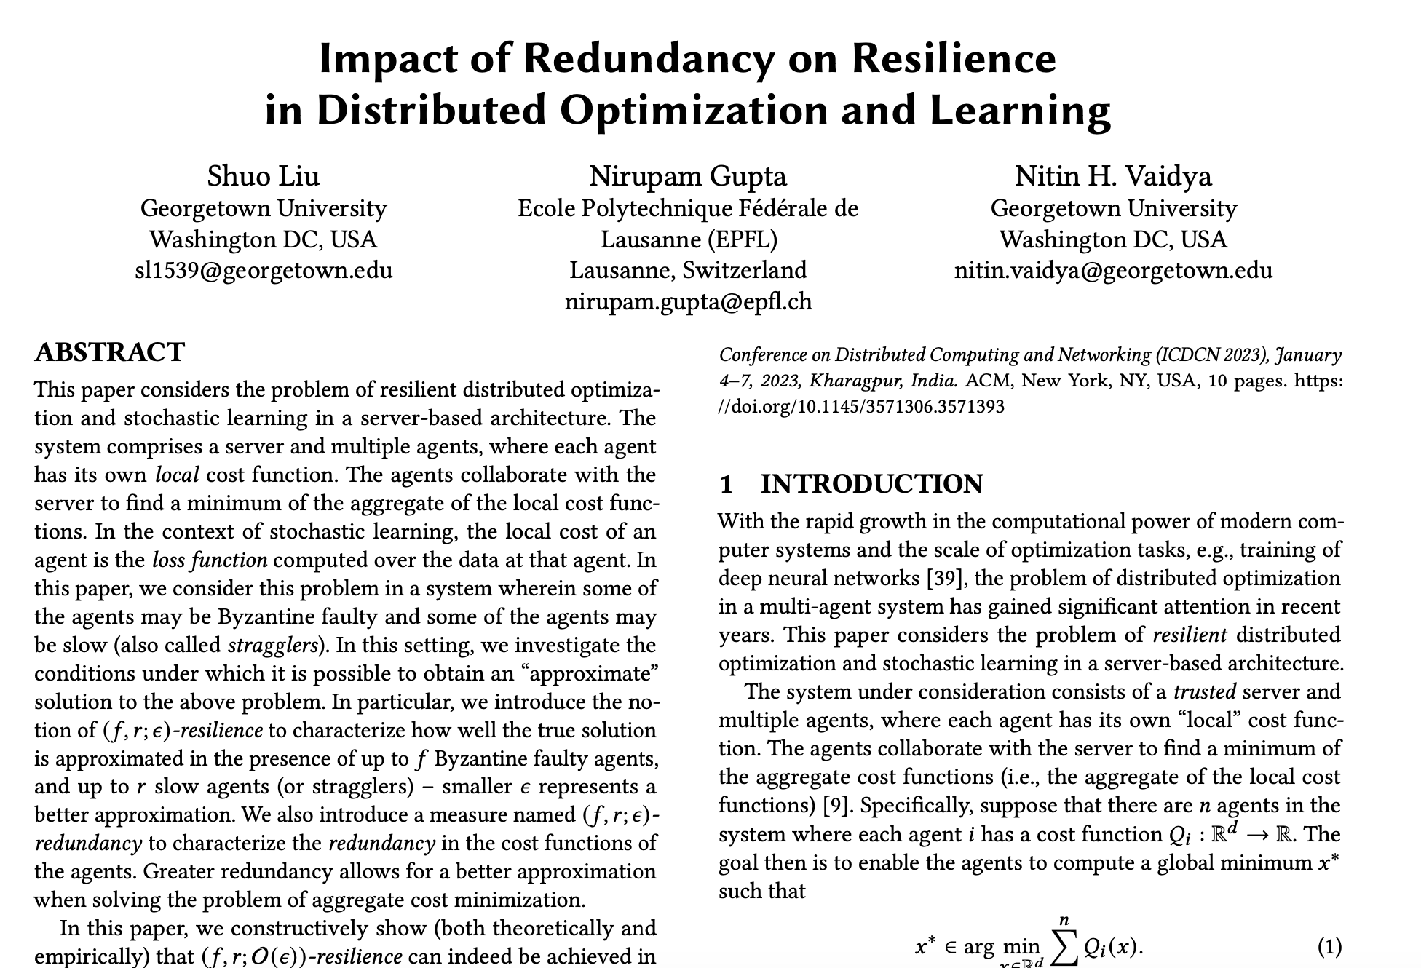
(2023)

Slide 111
Status
Many papers, various groups
... particularly fault-tolerant stochastic learning
      Various filters for gradients
      Variations on underlying assumptions
A tutorial available from my website
A survey to be available soon (from another group)

Slide 112
Moral of the Story #1
Natural, unanswered questions at the intersection of previously explored problem spaces
Picture from Wikipedia

Slide 113
Moral of the Story #2
Academia lets you work on things for which
you may have no competence
Make the best use of the freedom

Slide 114
Thanks! disc.georgetown.domains

Slide 115
Thanks! disc.georgetown.domains

Slide 116
Independent Functions
a
b
c

Slide 117
Independent Functions
a
b
c

Slide 118
Independent Functions
a
b
c

Slide 119
Independent Functions
a
b
c

Slide 120
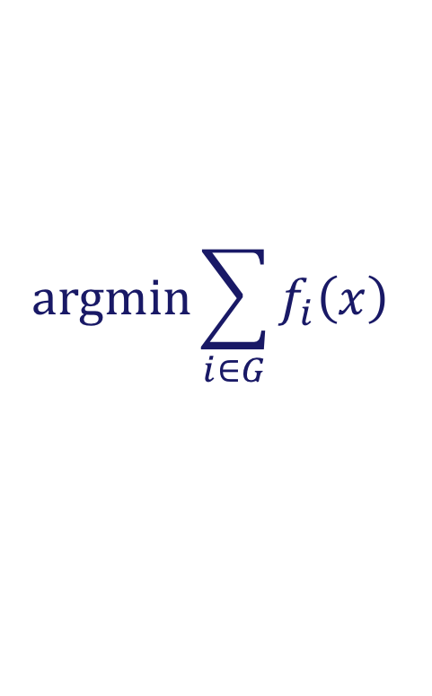
Independent Functions
Provably impossible to compute
$$\text{argmin}\sum_{i∈G}{f_{i}\left(x\right)}$$

Slide 121




Norm Filter
Clip the largest $t$ norms to equal $t+1$^{th} norm
$\left|∇f_{1}\left(x_{k}\right)\right|=1$
$\left|∇f_{2}\left(x_{k}\right)\right|=3$
$\left|∇f_{3}\left(x_{k}\right)\right|=2$

Slide 122




Norm Filter
Clip the largest $t$ norms to equal $t+1$^{th} norm
Filtered gradient =
$\left|∇f_{1}\left(x_{k}\right)\right|=1$
$\left|∇f_{2}\left(x_{k}\right)\right|=3$
$\left|∇f_{3}\left(x_{k}\right)\right|=2$
$∇f_{1}(x_{k})$
$+ \frac{2}{3}∇f_{2}(x_{k})$
$+ ∇f_{3}(x_{k})$

Slide 123

Norm Filter
Clip the largest $t$ norms to equal $t+1$^{th} norm
Filtered gradient =
$\left|∇f_{1}\left(x_{k}\right)\right|=1$
$\left|∇f_{2}\left(x_{k}\right)\right|=3$
$\left|∇f_{3}\left(x_{k}\right)\right|=2$
$∇f_{1}(x_{k})$
$+ \frac{2}{3}∇f_{2}(x_{k})$
$+ ∇f_{3}(x_{k})$
Exact optimum computed despite faulty agents

Slide 124
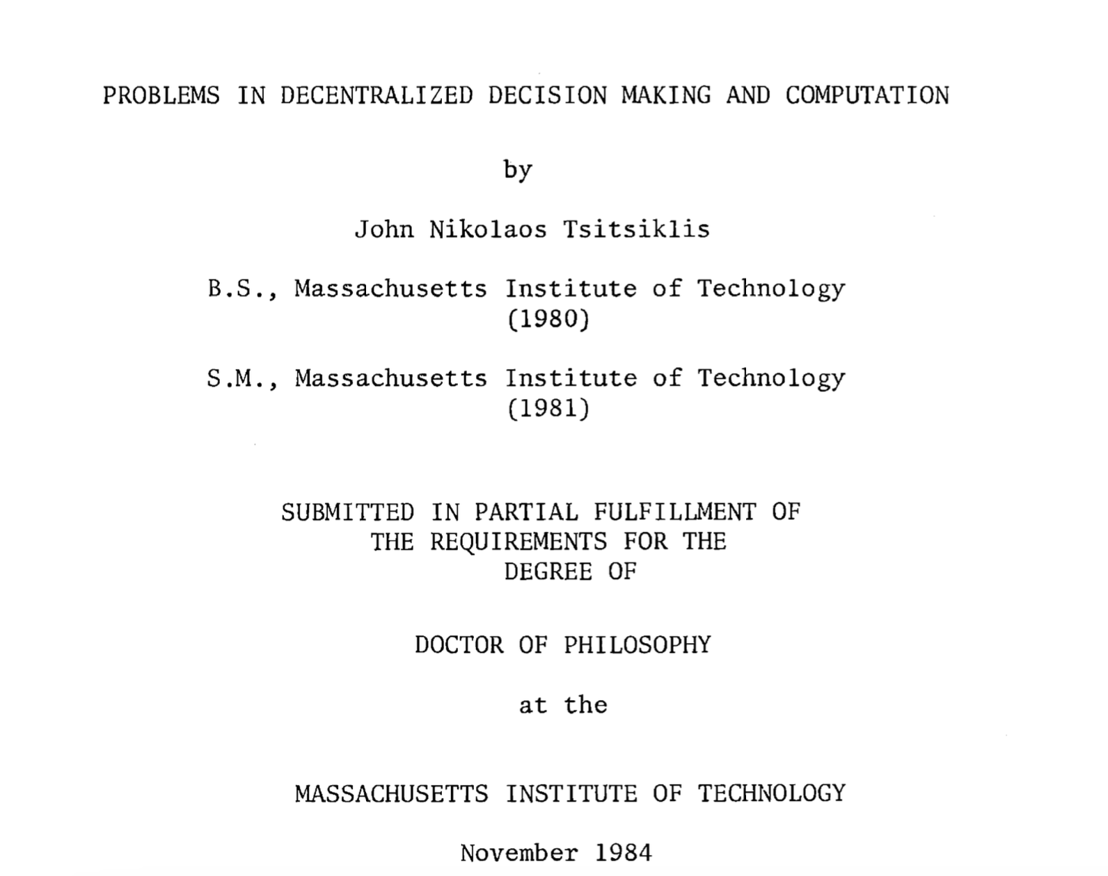
1984

Slide 125
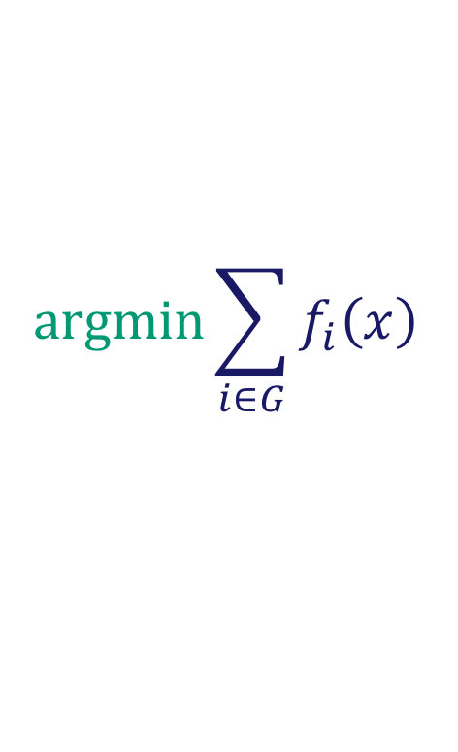
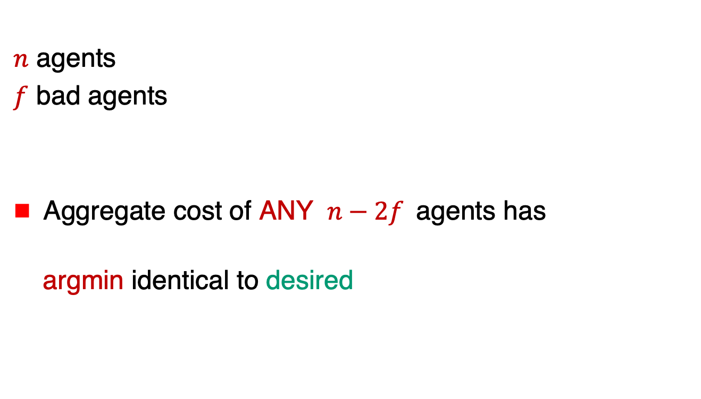
An Example of Redundancy
$n$ agents
$f$ bad agents
Aggregate cost of ANY $n−2f$agents has
argmin identical to desired
$$\text{argmin}\sum_{i∈G}{f_{i}\left(x\right)}$$

Slide 126
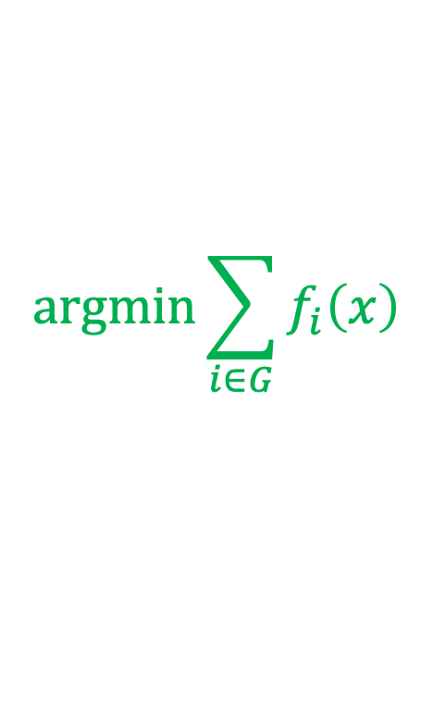
Another Approximation
Relax the notion of “enough redundancy”
Produce output within distance ε of “true” minimum
$$\text{argmin}\sum_{i∈G}{f_{i}\left(x\right)}$$

Slide 127
Challenges
Privacy-preserving
distributed optimization
How to collaborate
without revealing
own cost function?
$∇f_{1}(x_{k})$
$∇f_{3}(x_{k})$

