Slide 1
CS Seminar
Georgetown University
October 16, 2020

Slide 2

How to Read, Write and Present Papers
Nitin Vaidya
Georgetown University

Slide 3
Caveats
Your advisor may not agree
Use advise at your own risk
I do not always follow my advise
My thoughts, in somewhat random order

Slide 4
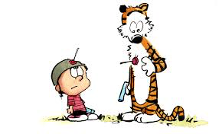
Secret to happiness is to lower your expectations to the point where they're already met
- Hobbes (paraphrased)
Bill Waterson

Slide 5
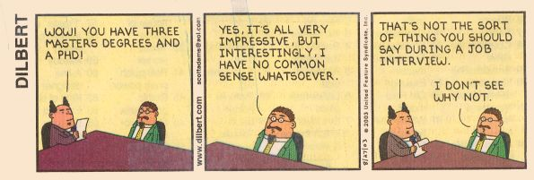
Summary
Use common sense
Learn from experience

Slide 6
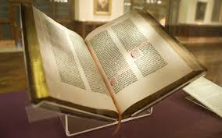

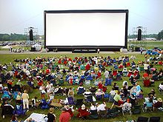
Outline

Slide 7
Why read papers
So you know what’s happening
Avoid reinventing the wheel
  does happen, lot of wheels already
Find interesting research topics

Slide 8
Why not to read papers
Cannot read everything
Not everything is worth reading
Can suppress innovation
    once you see a theme,
    can be difficult to think differently

Slide 9
Read or not to read, that is the question
Read, of course
Know what’s important
Know what can be ignored

Slide 10
What to read
Major conferences … journals are years behind
Tech reports from active research groups
  need to know which groups to look up
Survey papers

Slide 11
Breadth matters
Read wide range of topics
Interesting ideas at intersection of disparate areas
Attend talks & courses outside your comfort zone

Slide 12
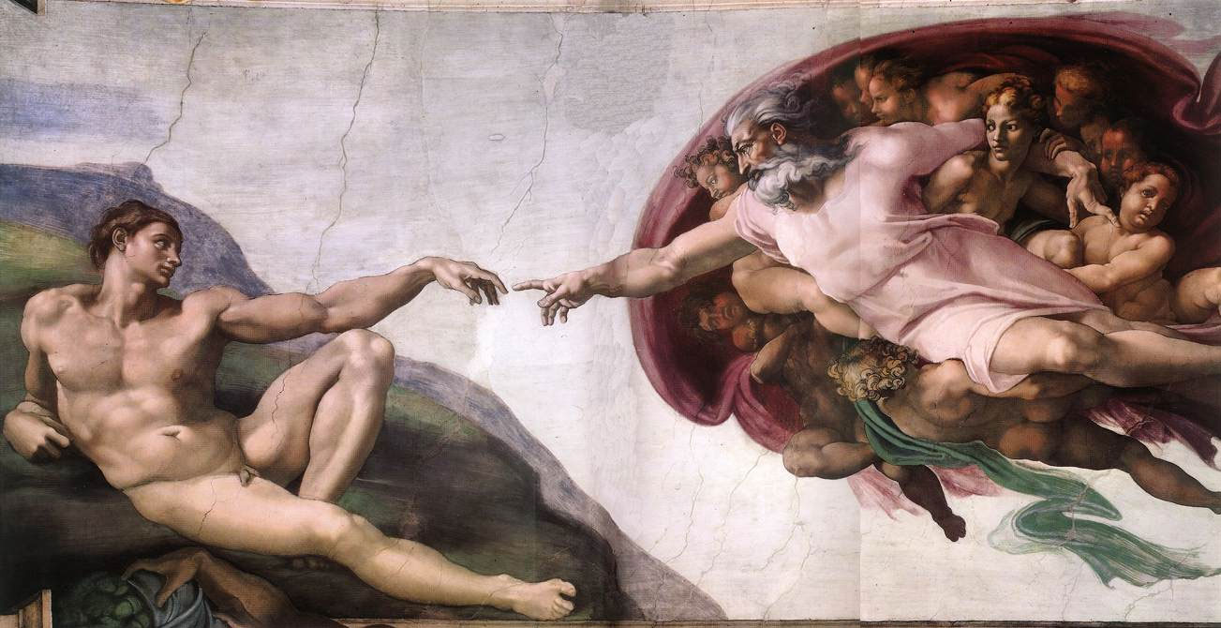
Decentralized
Control
Distributed
Computing
Picture from Wikipedia

Slide 13
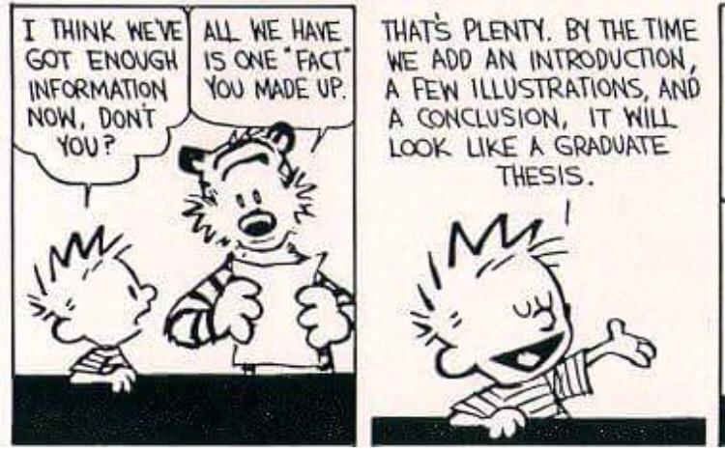
So, what’s in a paper?
Bill Waterson

Slide 14
What to read in a paper?
To learn what’s going on
  title, authors, abstract
Papers in your broad research area
  introduction, motivation, solution description, conclusions
Papers you may want to improve on
  read entire paper carefully

Slide 15
What to note
Authors, research group
  remember who to look up in the future
Solution theme
Evaluation approach
Shortcomings

Slide 16
What to note
As you read more papers, try to see …
  The “big picture”
  The problem space
  The solution space
  The missing pieces

Slide 17
Learn from their mistakes
Note what you dislike
and don’t do it yourself
Adopt good ideas in writing

Slide 18
Questions to ponder
How do you decide which papers to read?
What fraction of papers do you read?
How many of your papers do you expect
someone to read in a given year?

Slide 20
How to write a paper
Do unto others as you would have them do unto you

Slide 21
How to write a paper
When you have truly exceptional results
  P = NP
probably doesn’t matter how you write

Slide 22
How to write a paper
Most papers not that exceptional
Good writing makes all the difference

Slide 23
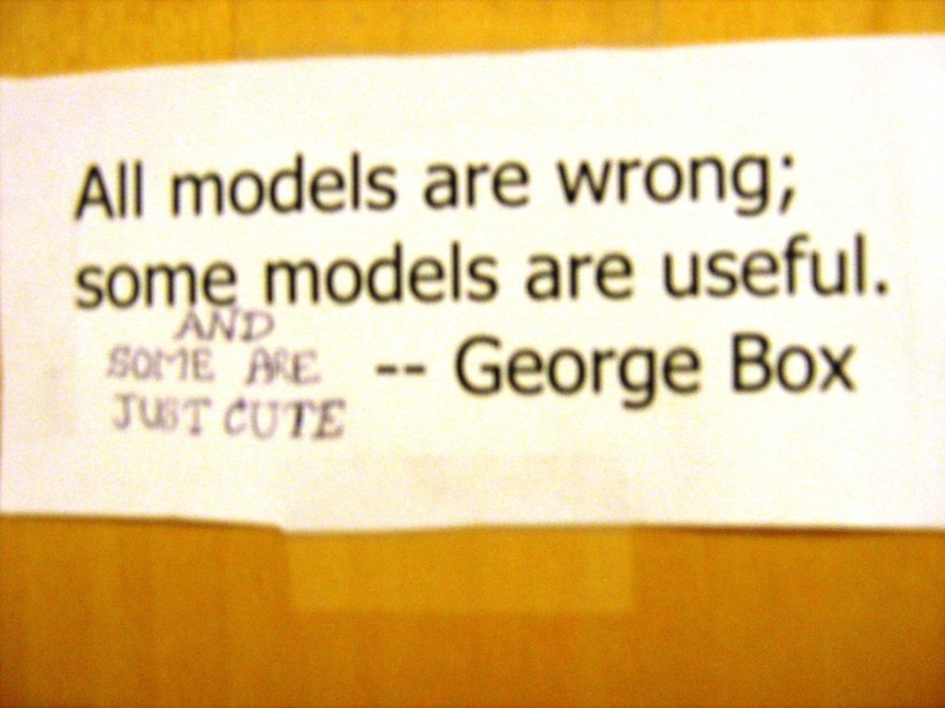

Slide 24
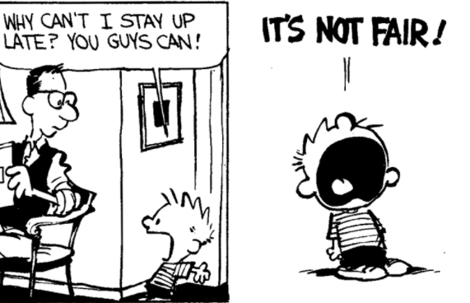
Rules of thumb
3 pages is all you get to convince readers
Bill Waterson

Slide 25
Rules of thumb
Ease of reading … no ambiguities
No unnecessary words
Easy on the eye
Quality beats quantity

Slide 26
How to write a theory paper
Unreadability ≠ Formalism
Explain contributions intuitively before formalitlies
Make poofs easy to follow
Unimportant proofs should be in an appendix
  Proofs not as worthy as new proof techniques

Slide 27
How to write a systems paper
Provide sufficient information for reproducibility
Do not provide wrong information
If space insufficient, provide the essentials
… cite a tech report for the rest

Slide 28
Discuss related work
Discuss relevant work by others too
They may be reviewing your paper
  Avoid: Scheme by Vaidya is terrible
    Prefer: Scheme by Vaidya under-performs in scenario X
Avoid offending people, unless you must

Slide 29
Do not irritate the reader
Use intuitive notation, make it easy to find
Avoid Too Many Acronyms … ATMA ?
Avoid long sentences
Do not hide weak results behind poor writing
Bill Waterson

Slide 30
Tell them your shortcomings
If your ideas don’t work well in interesting scenarios, tell the reader
Readers appreciate a balanced presentation

Slide 31
Technical reports
Useful to get early feedback
Puts a timestamp on your work
Can include more information than might fit in a paper

Slide 32
Quality versus quantity
Fewer good papers better than more mundane ones
… even if in “top-tier” venues

Slide 33
Quality versus quantity
Fewer good papers better than more mundane ones
… even if in “top-tier” venues
How many of your papers do you expect
someone to read in a given year?

Slide 34
Quality versus quantity
If a paper is easy to write …
Is it worth writing?
Is it the best use of your time & talents?

Slide 36
How to present a paper
Do unto others as you would have them do unto you

Slide 37
Goals
Advertise your work, not necessarily comprehensively
Don’t try to impress the audience
Aim for a clear, engaging talk
and let your results speak for themselves

Slide 38
Objectives … in decreasing order of importance
Keep people awake
  humor helps
Get the problem definition across
Main claims

Slide 39
Objectives … in decreasing order of importance
Explain your approach (intuitively)
  most productive use of your time
Dirty details
  most audience probably doesn’t care

Slide 40
The slides & you
Job of the slides is to aid in your presentation
Your job is to use the slides to deliver a clear talk

Slide 41
Talk outline or not ?
Short talks … skip
Long talks … include
Make the outline interesting

Slide 42
Outline … a bad one
Introduction
Background
Problem Overview
Solution
Performance Evaluation
Conclusions
This describes every
talk ever given

Slide 43
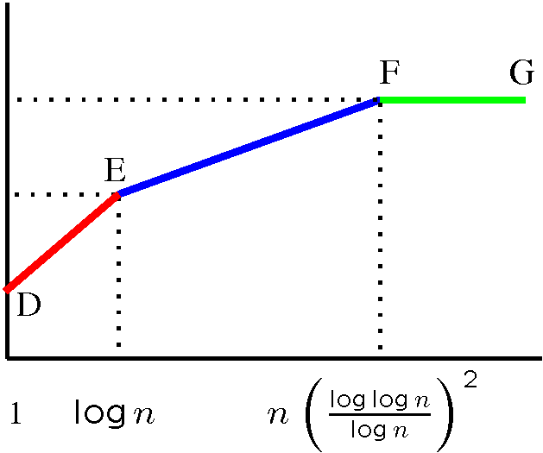
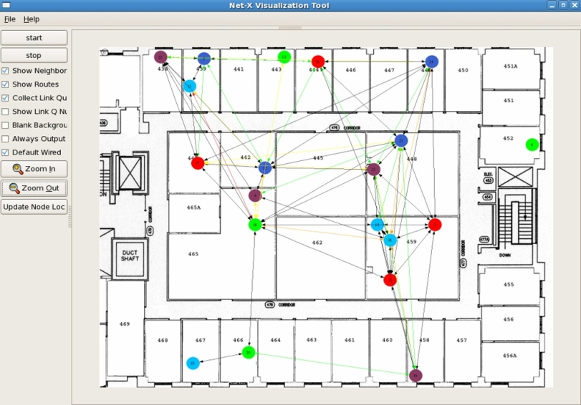
Multi-Channel Wireless Mesh
Talk Outline
D
Fixed
capacity
E
F
B
A
Switchable
C
channels
Capacity &
Scheduling
Insights on
protocol design
Net-X
testbed
OS improvements
Software architecture
User
Applications
Multi-channel
protocol
IP Stack
ARP
Channel Abstraction Module
Interface
Device Driver
Interface
Device Driver

Slide 44
Multi-Channel Wireless Mesh
Talk Outline
D
Fixed
capacity
E
F
B
A
Switchable
C
channels
Capacity &
Scheduling
Insights on
protocol design
Net-X
testbed
OS improvements
Software architecture
User
Applications
Multi-channel
protocol
IP Stack
ARP
Channel Abstraction Module
Interface
Device Driver
Interface
Device Driver

Slide 45
Slides
They must be able to read it all while listening to you

Slide 46
Explicit Loss Notification [Balakrishnan98] when MH is the TCP sender
This is a bad slide
…. too dense
Wireless link first on the path from sender to receiver
The base station keeps track of holes in the packet sequence received from the sender
When a dupack is received from the receiver, the base station compares the dupack sequence number with the recorded holes
  if there is a match, an ELN bit is set in the dupack
When sender receives dupack with ELN set, it retransmits packet, but does not reduce congestion window
Record
hole at 2
MH
4
3
2
1
BS
4
3
1
FH
wireless
1
1
1
1
Dupack with ELN set

Slide 47
Hand-waving alright … but not excessively
If you spend much time
on one slide,
break into multiple slide

Slide 48
Slides
Slides need not be grammatically accurate
Use big enough fonts, dark enough colors
Use good color schemes
not light blue on yellow

Slide 49
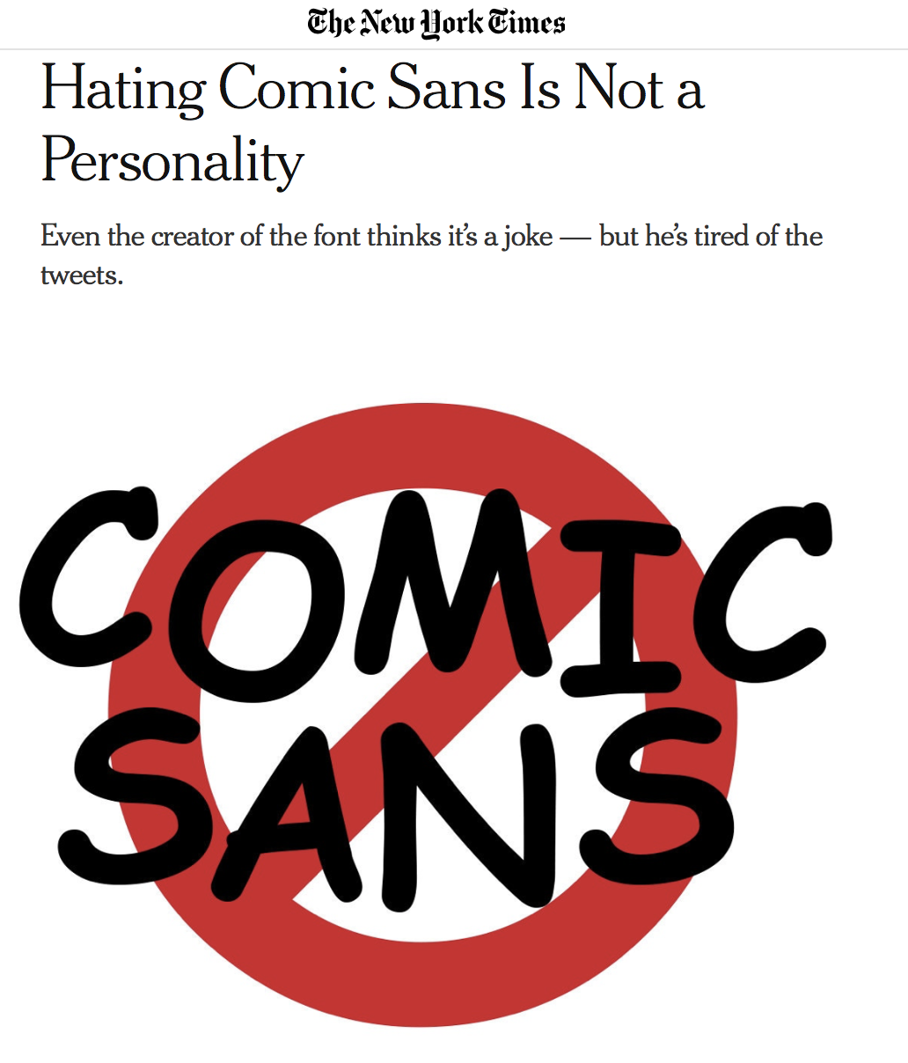
October 9, 2019

Slide 50
Slides
Avoid fancy backgrounds
Avoid gratuitous animation
Avoid blocking the screen

Slide 51
Break lines properly
Aim for a clear, engaging talk
and let your results speak for themselves
Aim for a clear, engaging talk, and let your results speak for themselves
versus

Slide 52
Picture is worth 1000 words
Use illustrations when possible

Slide 53
Distributed classification
G. Renee Guzlas

Slide 54




Distributed optimization
$$f_{1}\left(x\right)$$
$$f_{2}\left(x\right)$$
X
$$f_{3}\left(x\right)$$

Slide 55
Hajnal 1958
Weak ergodicity
of nonhomogeneous Markov chains
Distributed
Computing
DeGroot 1974
Reaching a consensus
1980: Pease, Shostak, Lamport
Byzantine consensus
1983: Fischer, Lynch, Paterson
Asynchronous consensus
impossibility result
Decentralized
Control
Tsitsiklis 1984
1986: Dolev et al.
Approximate
Byzantine consensus
Jadbabaei, Lin, Morse 2003
Flocking problem
Nedich, Ozdaglar 2009

Slide 56
How many slides?
Depends on personal style
  know your pace
I make a lot of slides with low per-slide content
Anticipate questions, and prepare explanatory slides

Slide 57
Practice, practice …
Practice makes perfect (or tolerable)
May need several tries to fit in available time

Slide 58
Be ready to adapt
Know which slides you can skip dynamically
Be prepared to handle aggressive questions
Defer answers if needed

Slide 59
If you have an accent like mine …
Talk slower
Easier said than done
  I have a tough time slowing down myself
Pause once in a while

Slide 60
Q & A
Need to understand audience questions
even if posed vaguely
Answering the wrong question bad

Slide 61
No substitute for experience
Nothing like a terrible presentation to learn
what not to do
Learn from other people’s mistakes,
instead of waiting for your own

Slide 62
Summary
Use common sense
Learn from experience
Papers can be fun!

Slide 63
Another preachy talk
How to succeed in academia without really trying
Slides
https://disc.georgetown.domains/

Slide 64
Thanks! disc.georgetown.domains

