Slide 1
Security and Privacy for
Distributed Optimization and Learning
Nitin Vaidya
Georgetown University

Slide 2
Secret to happiness is to lower your expectations to the point where they're already met

Slide 3
So the secret to good self-esteem is to lower your expectations to the point where they're already met?
- Hobbes

Slide 4
Goals of the Talk
Background
Problem definitions
Very brief solution sketch
No theorems / proofs

Slide 5















argmin
$$h_{1}$$
$$h_{3}$$
$$h_{1}$$
$$h_{3}$$
$$h_{1}$$
$$h_{3}$$
$$h_{5}$$
$$h_{2}$$
$$h_{5}$$
$$h_{2}$$
$$h_{5}$$
$$h_{2}$$
$$h_{4}$$
$$h_{4}$$
$$h_{4}$$
Distributed
Optimization
Security
Privacy

Slide 6
argmin

Slide 7
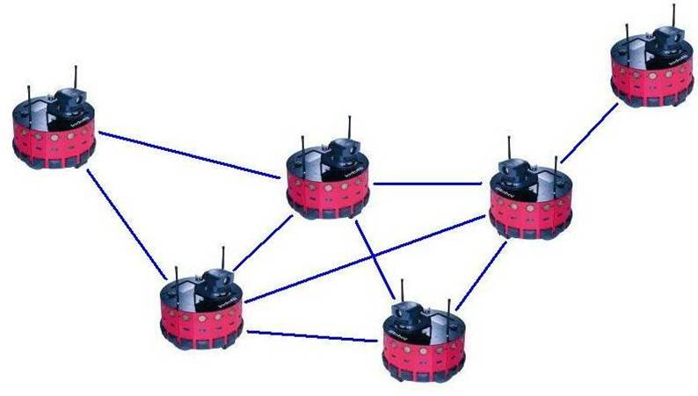
Application
h_{i}(x) = cost of robot i to go to location x
Minimize total cost of rendezvous
2
6
1
5
3
4
Notes:
Other examples may be: resource allocation (which is similar to robotic rendezvous problems), large-scale distributed machine learning, where data are generated at different locations

Slide 8
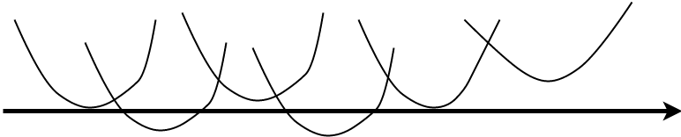
1 2 3 4 5 6

Slide 9
What does this have to do with learning?
argmin

Slide 10
Deep
Neural Networks
neuron
layer 1
a₁
x₁
W111
1
a₂
x₂
2
a₃
x₃
3
W132
a₄

Slide 11

input
parameters
output
layer 1
0.8
dog
x₁
W111
1
0.1
cat
x₂
2
0.09
ship
x₃
3
W132
0.01
car

Slide 12
How to train your network
Given a machine structure
parameters are the only free variables
➔ Choose parameters that maximize accuracy
Optimize
cost function h(w)
to find w

Slide 13
h(w)
Training
➔
Optimize
cost function
h(w)
Machine parameters
w

Slide 14
Distributed Training
Data is distributed
across different
agents

Slide 15
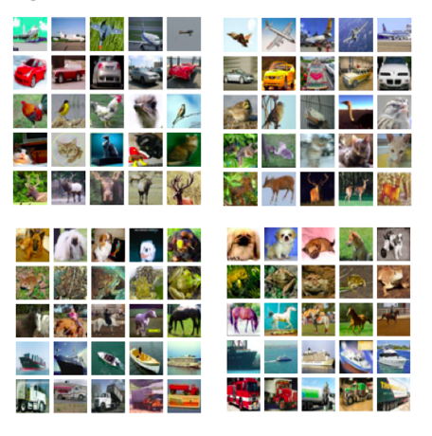
Distributed Training
Data is distributed
across different
agents
Agent 1
Agent 2
Agent 3
Agent 4

Slide 16
Distributed Training
Data is distributed
across different ➔ Collaborate to learn
agents

Slide 17
Distributed Training
Data is distributed
across different ➔ Collaborate to learn
agents
h₁(w)
h₂(w)
Training
➔
Optimize
cost function
Σ h_{i}(w)
i
h₃(w)
h₄(w)

Slide 18
Distributed Classification
Many agents collect inputs
Agents = sensors
Inputs = features
Collaboratively classify object

Slide 19
Many applications
argmin

Slide 20
argmin
$$h_{1}$$
$$h_{3}$$
$$h_{1}$$
$$h_{3}$$
$$h_{1}$$
$$h_{3}$$
$$h_{5}$$
$$h_{2}$$
$$h_{5}$$
$$h_{2}$$
$$h_{5}$$
$$h_{2}$$
$$h_{4}$$
$$h_{4}$$
$$h_{4}$$
Distributed
Optimization
Security
Privacy

Slide 21
argmin
$$h_{1}$$
$$h_{3}$$
$$h_{5}$$
$$h_{2}$$
$$h_{4}$$
Distributed
Optimization

Slide 22
Convex Optimization
x = [a,b]
h(x)
a
b
Wikipedia

Slide 23
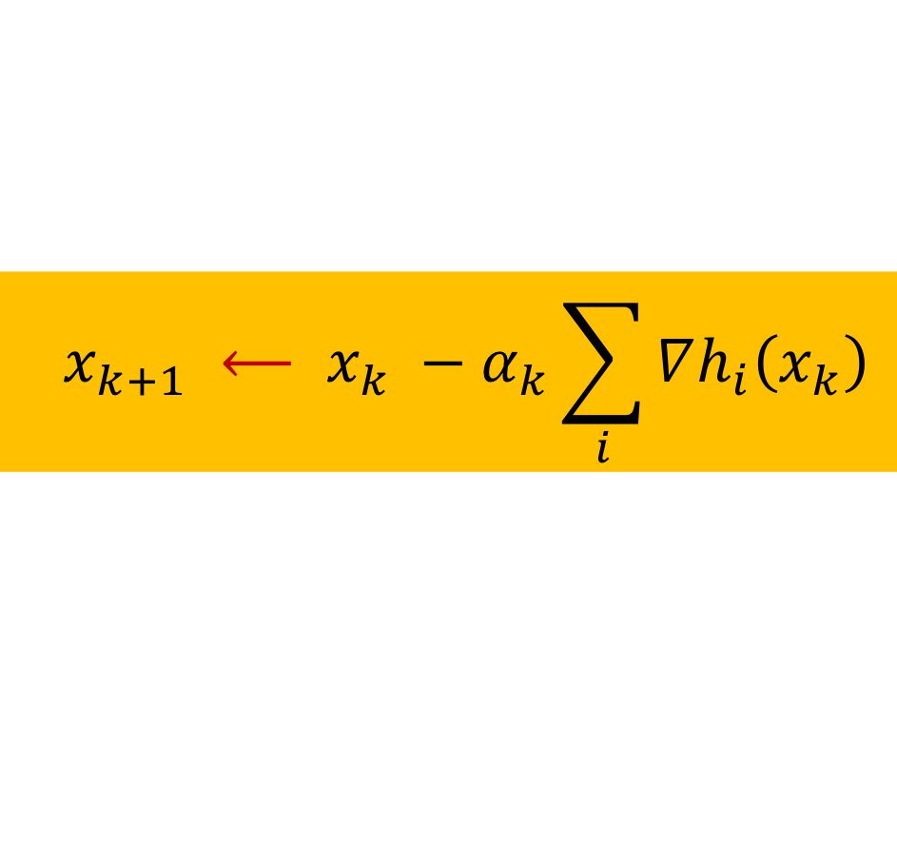
Gradient Method
x₀
x₁
x₂
x₃
  $$x_{k+1} ⟵ x_{k} −α_{k}\sum_{i}{∇h_{i}\left(x_{k}\right)}$$

Slide 24
Gradient Method
x₀
x₁
x₂
x₃
  $$x_{k+1} ⟵ x_{k} −α_{k}\sum_{i}{∇h_{i}\left(x_{k}\right)}$$

Slide 25
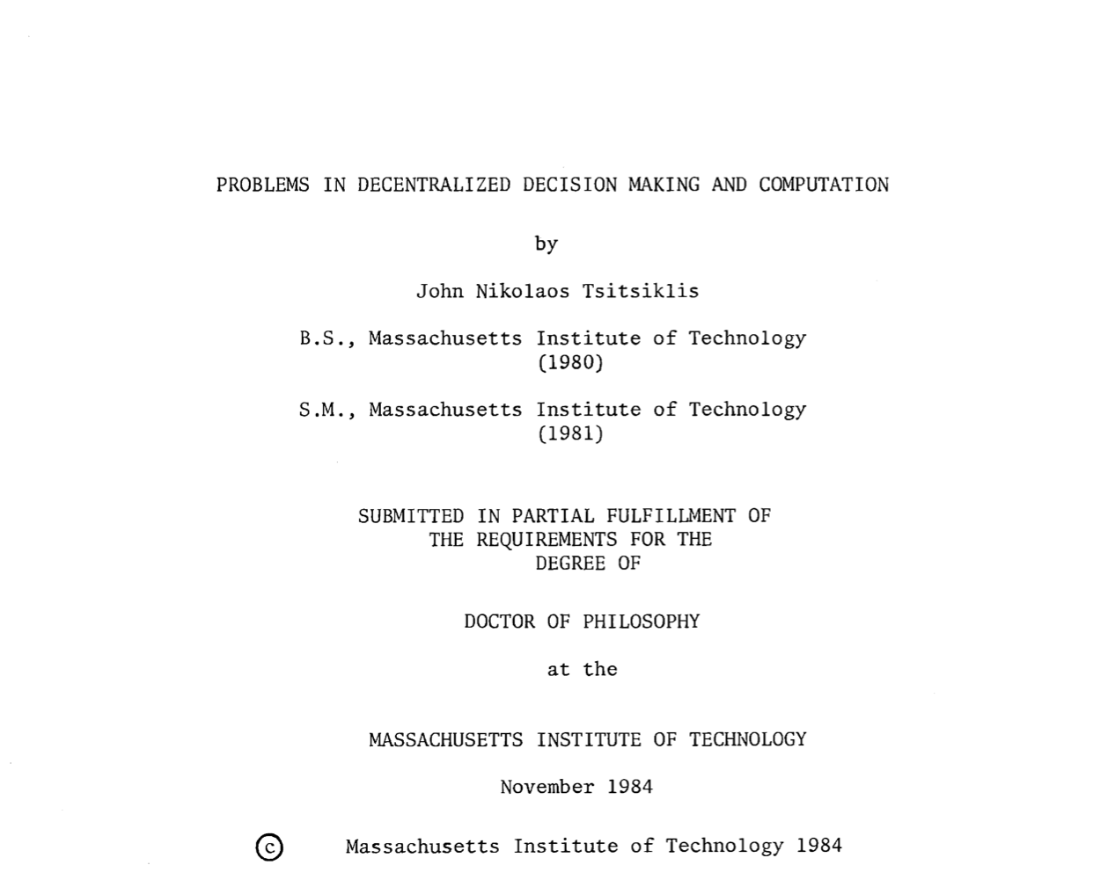
1984

Slide 26
Distributed Optimization
Each agent maintains local estimate of optimum x
Iterative computation
Local estimates shared with neighbors
in each iteration
Local estimates converge to optimum

Slide 27
x₁
x₂
x₃
x₃
x₃
Example based on [Nedic and Ozdaglar, 2009]

Slide 28
x₁
x₂
x₃
x₃
x₃

Slide 29
x₁
x₂
x₃
x₃
x₃
Local cost only

Slide 30
x₁
x₂
x₃
x₃
x₃

Slide 33
M doubly-stochastic

Slide 34
M doubly-stochastic
t

Slide 35
Distributed Optimization
In the limit as t → ∞
Consensus: All agents converge to same estimate
Optimality

Slide 36
Why does this work?

Slide 37
argmin
$$h_{1}$$
$$h_{3}$$
$$h_{1}$$
$$h_{3}$$
$$h_{1}$$
$$h_{3}$$
$$h_{5}$$
$$h_{2}$$
$$h_{5}$$
$$h_{2}$$
$$h_{5}$$
$$h_{2}$$
$$h_{4}$$
$$h_{4}$$
$$h_{4}$$
Distributed
Optimization
Security
Privacy

Slide 38
argmin
$$h_{1}$$
$$h_{3}$$
$$h_{5}$$
$$h_{2}$$
$$h_{4}$$
Security

Slide 39
Security / Fault-Tolerance
What if some of the agents are faulty or adversarial ?

Slide 40
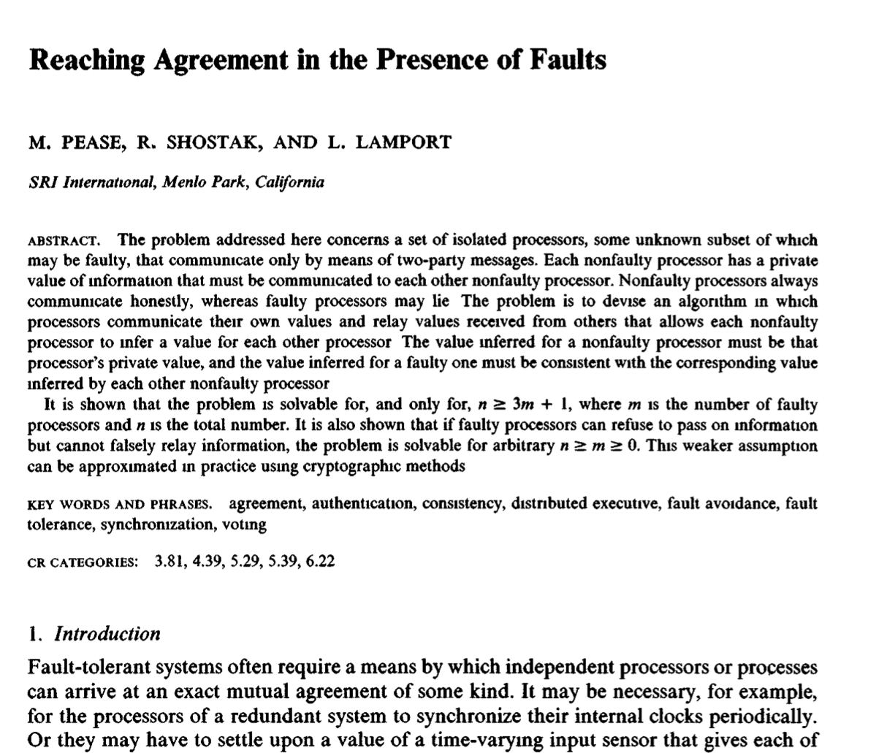
1980

Slide 41
Byzantine Fault Model
No constraint
on misbehavior
of faulty agent

Slide 42
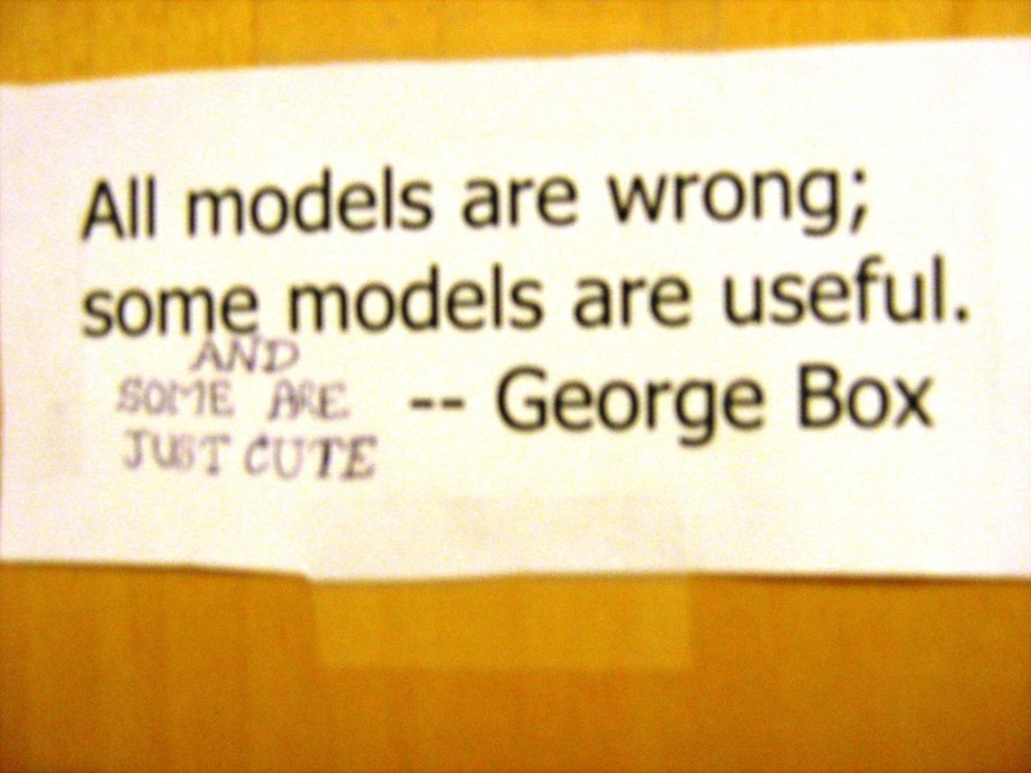
Byzantine Fault Model
No constraint
on misbehavior
of faulty agent

Slide 43
Distributed Optimization
x₁
x₂
y
z
x₃
Faulty agents can send arbitrary values
~

Slide 44
Distributed Optimization
f_{i}(x) = cost of robot i to go to location x
Faulty agent may choose arbitrary cost function
2
6
1
5
3
4
Notes:
Other examples may be: resource allocation (which is similar to robotic rendezvous problems), large-scale distributed machine learning, where data are generated at different locations

Slide 45
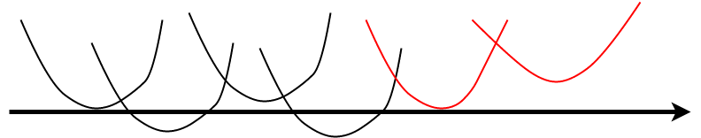
h₂(x)
x

Slide 46
Fault-Tolerant Optimization
The original problem not meaningful
since it includes cost of faulty agents

Slide 47
Better Goal
N = Non-faulty agents
Optimize only over non-faulty agents

Slide 48
x
Non-faulty set N

Slide 49
Better Goal
N = Non-faulty agents
Optimize only over non-faulty agents
… but this is provably impossible

Slide 50
Fault-Tolerant Optimization
Instead of uniform weights
allow unequal weights

Slide 51
Fault-Tolerant Optimization
Instead of uniform weights
allow unequal weights
but as close to uniform as possible

Slide 52
Fault-Tolerant Optimization
Find x_{opt} such that
x_{opt} = arg min
for some weight vector ⍺

Slide 53
Fault-Tolerant Optimization
Find x_{opt} such that
x_{opt} = arg min
for some weight vector ⍺
How close to uniform weight vector can we get?

Slide 54
Results
Answer depends on
Network topology
Redundancy (in functions)
Goal: Identify tight necessary/sufficient conditions

Slide 55
Intuition behind Solutions
Must filter bad behavior

Slide 56
Intuition behind Solutions
Must filter bad behavior
Outliers defined using gradients
… discard extreme gradients

Slide 57
Fault-Tolerant Classification
When can we classify correctly despite adversaries?

Slide 58
Example: Fault-Tolerant Classification
Can good agents in this system classify correctly?
1
2
3

Slide 59
Results
Answer depends on
Network topology
Redundancy (in observations)
Goal: Identify tight necessary/sufficient conditions

Slide 60
argmin
$$h_{1}$$
$$h_{3}$$
$$h_{1}$$
$$h_{3}$$
$$h_{1}$$
$$h_{3}$$
$$h_{5}$$
$$h_{2}$$
$$h_{5}$$
$$h_{2}$$
$$h_{5}$$
$$h_{2}$$
$$h_{4}$$
$$h_{4}$$
$$h_{4}$$
Distributed
Optimization
Security
Privacy

Slide 61
argmin
$$h_{1}$$
$$h_{3}$$
$$h_{5}$$
$$h_{2}$$
$$h_{4}$$
Privacy

Slide 62
Privacy
Cooperate without divulging information
Agent 1
Agent 2
2
6
1
5
3
4
Agent 3
Agent 4

Slide 63
Enhancing Privacy
Basic principle
… add balanced noise that
cancels over the network
x₁
x₂
x₃+n
x₃ - n
x₃

Slide 64
Distributed Optimization
With balanced noise, the estimates converge to optimal of the original optimization problem
argmin

Slide 65
Summary
argmin
$$h_{1}$$
$$h_{3}$$
$$h_{1}$$
$$h_{3}$$
$$h_{1}$$
$$h_{3}$$
$$h_{5}$$
$$h_{2}$$
$$h_{5}$$
$$h_{2}$$
$$h_{5}$$
$$h_{2}$$
$$h_{4}$$
$$h_{4}$$
$$h_{4}$$
Distributed
Optimization
Security
Privacy

Slide 66
Open Problems:
Fault-Tolerant Learning/Optimization
Vector arguments for fault-tolerant algorithms
Noisy observations … random noise versus adversarial
Topology adaptation
Dynamic topologies
Continuous learning

Slide 70
Distributed Optimization
Topic of much research … including recent work
[Tsitsiklis, 1984]
…
[Nedic and Ozdaglar, 2009]
[Duchi et al., 2012]
[Tsianos et al., 2012]
...

Slide 71
Fault-Tolerant Optimization
Optimize weighted cost over only non-faulty agents
𝛂_{i}
i good
Lower bounds on number and value of
of non-zero weights 𝛂_{i}

Slide 72
Lower Bounds
good - f nodes guaranteed non-zero weight
Non-zero weights > 1 / 2good

Slide 74
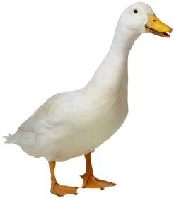
Consensus: “Flocking problem”
Initial state a, b, c = input
b
c
a

Slide 75
Local Averaging
b
b = 3b/4+ c/4
c
c = a/4+b/4+c/2
a = 3a/4+ c/4
a

Slide 76
:=
= M
M
b
b = 3b/4+ c/4
c
c = a/4+b/4+c/2
a = 3a/4+ c/4
a

Slide 77
after 2 iterations
after 1 iteration
:= M M
= M²
b
b = 3b/4+ c/4
c
c = a/4+b/4+c/2
a = 3a/4+ c/4
a

Slide 78
after k iterations
:= M^{k}
b
b = 3b/4+ c/4
c
c = a/4+b/4+c/2
a = 3a/4+ c/4
a

Slide 79
:= M^{k}
➔
b
b = 3b/4+ c/4
c
c = a/4+b/4+c/2
a = 3a/4+ c/4
a

Slide 81
x₂
W131
x₃
3
W132
σ(X₂W₁₃₁+X₃W₁₃₂+b₁₃)

Slide 82
σ(z)
Rectifier
Linear
Unit
x₂
z
W131
x₃
3
W132
σ(X₂W₁₃₁+X₃W₁₃₂+b₁₃)
z

Slide 83
Pre-history
Hajnal 1958 (weak ergodicity of
non-homogeneous
Markov chains)
1980: Byzantine exact consensus, 3f+1 nodes
1983: Impossibility of exact consensus
with asynchrony & failure
Tsitsiklis 1984:
Decentralized control
[Jadbabaei 2003]
(Approximate)
1986: Approximate consensus
with asynchrony & failure

Slide 84





Distributed Optimization
$$h_{1}$$
$$h_{3}$$
$$h_{5}$$
$$h_{2}$$
$$h_{4}$$

Slide 85
Byzantine Fault-Tolerant Optimization
There exist weights (α_{i}’s) such that
output = arg min
With up to f Byzantine faulty agents:
at most |N| - f weights can be guaranteed to be > 0

Slide 86
Byzantine Fault-Tolerant Optimization
There exist weights (α_{i}’s) such that
output = arg min
With up to f Byzantine faulty agents:
at most |N| - f weights can be guaranteed to be > 0
Can we match this bound?
How large are non-zero weights?

Slide 87
Note
Weights are non-negative and add to 1
h(x) is convex combination of non-faulty functions

Slide 88
Centralized Algorithm

Slide 89
Centralized Algorithm
How to filter cost functions of faulty agents?
(without knowing their identity)
Of the n agents, any f may be faulty

Slide 90
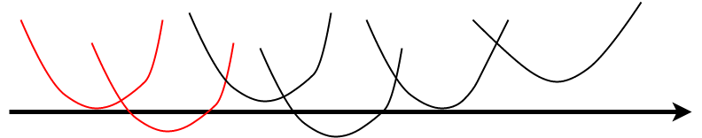
Centralized Algorithm
How to filter cost functions of faulty agents?
(without knowing their identity)
Of the n agents, any f may be faulty
X

Slide 91
Observations
Optima of in
convex hull of optima of non-faulty cost functions
Potential solution:
* Compute optima of each cost function
* Drop largest & smallest f such optima
* Output within convex hull of the rest
- example : average

Slide 92
Potential Solution
f = 2
X
Discard
Discard
Optima of local cost functions

Slide 93
Potential Solution
f = 2
Average of
remaining
optima
X
Discard
Discard
Optima of local cost functions

Slide 94
Potential Solution
* Compute optima of each cost function
* Drop largest & smallest f such optima
* Output within convex hull of the rest
- example : average
Average of optima can be much worse than
optima of average cost

Slide 95
Centralized Algorithm
Define a virtual function G(x) whose gradient is
obtained as follows

Slide 96
Centralized Algorithm
Define a virtual function G(x) whose gradient is
obtained as follows
At a given x
Sort the gradients of the n local cost functions
Discard smallest f and largest f gradients
Mean of remaining gradients = Gradient of G at x
Virtual function G(x) is convex

Slide 97
G(x) is Convex
Gradient of continuously differentiable convex functions is non-decreasing and continuous
➔ Gradient computed for G(x) is non-decreasing and
continuous
➔ G(x) is convex
➔ Use convex optimization techniques on G(x)
(e.g., gradient descent)

Slide 98
Centralized Algorithm
Gradient G’(x) = 0 at optimum of G(x)
… presently assume smooth functions

Slide 99
Centralized Algorithm
The faulty gradients that are not discarded can be expressed as convex combination of gradients of non-faulty functions
grad
Discard
Discard
Gradients of local cost functions

Slide 100
Centralized Algorithm
Gradient G’(x) = 0 at optimum of G(x)
0 = G’(x) can be expressed as
such that at least |N|-f weights are > max(1/n, ½ (|N|-f))

Slide 101
Centralized Algorithm
Gradient G’(x) = 0 at optimum of G(x).
Optimum of G(x) also optimizes
such that at least |N|-f weights are > max(1/n, ½ (|N|-f))

Slide 102
Distributed Algorithms

Slide 103
Distributed Algorithms
Several different version that impose somewhat
different requirements on the cost functions
(Lipschitz continuity versus Lipschitz gradient)
and achieve different convergence properties …

Slide 104
Valid Global Cost Functions
Consider the set Y of optima of all functions of the form
such that at least |N|-f weights are > ½ (|N|-f)
Set Y is convex … when x is scalar

Slide 105
Asymptotic Behavior
Consensus … |x_{i}[t] – x_{j}[t]| → 0
Validity … distance(x_{i}[t], Y) → 0
Limit may or may not exist … algorithm-dependent

Slide 106
Distributed Algorithm
Each agent i maintains local estimate x_{i}[t]

Slide 107
Distributed Algorithm
Each agent i maintains local estimate x_{i}[t]
In each iteration:
Send x_{i}[t] and gradient h’_{i}(x_{i}[t]) to all agents

Slide 108
Distributed Algorithm
Each agent i maintains local estimate x_{i}[t]
In each iteration:
Send x_{i}[t] and gradient h’_{i}(x_{i}[t]) to all agents
x_{i}[t+1] ← filter {x[t]} − λ[t] * filter {h’[t]}
filter : drop smallest f, largest f values,
mean of (max,min) of the rest

Slide 109
Distributed Algorithm
Faulty agents can send different messages to
different agents
Filtering limits the impact of misbehavior

Slide 110
Distributed Algorithm
Faulty agents can send different messages to
different agents
Filtering limits the impact of misbehavior
vector of local gradients
at local estimates

Slide 111
Distributed Algorithm
Faulty agents can send different messages to
different agents
Filtering limits the impact of misbehavior
where x[t] vector contains state of
only non-faulty agents

Slide 112
Distributed Algorithm
Faulty agents can send different messages to
different agents
Filtering limits the impact of misbehavior
where x[t] vector contains state of
only non-faulty agents
vector of valid combinations
of local gradients

Slide 115
Distributed Algorithm
Faulty agents can prevent convergence
… but not consensus
Filtering ➔ “effective gradient” at each agent is “comparable” to the gradient of
a valid function
Estimates are eventually trapped in Y
Y

Slide 116
Distributed Algorithm
If faulty agents are prevented from sending
different messages to different agents
(using Byzantine broadcast)
Consensus & Convergence …. at higher cost

