Slide 1
ECE @ NYU Brooklyn
September 19, 2019

Slide 2
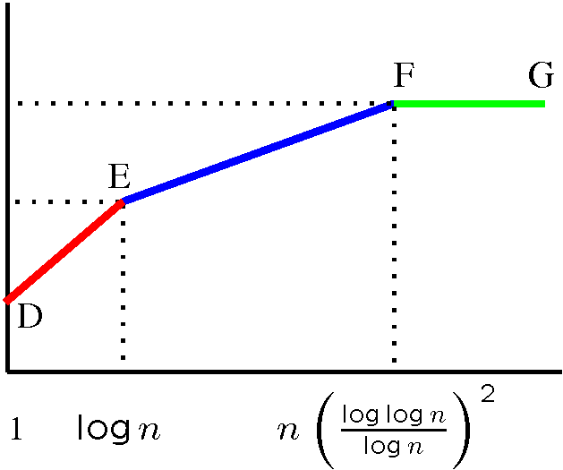
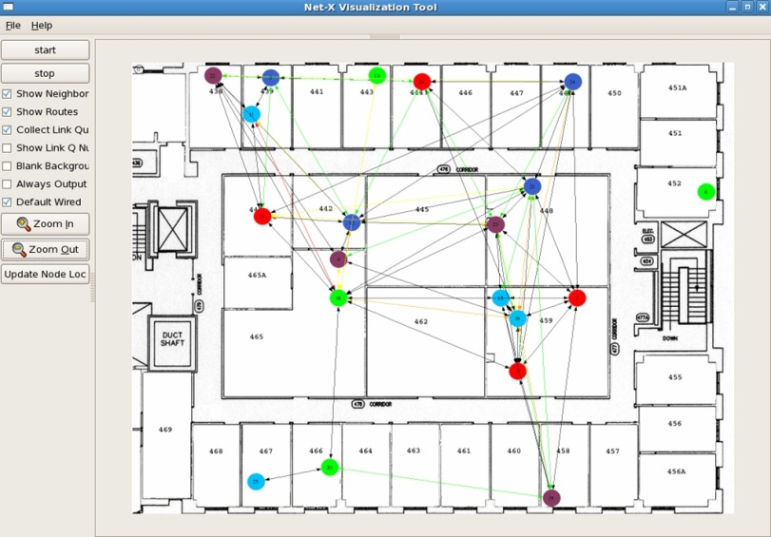
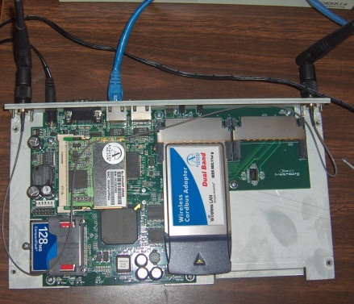
Net-X: Multi-Channel Mesh
Theory to Practice
D
Fixed
capacity
E
F
B
A
Switchable
C
channels
Capacity
bounds
Insights on
protocol design
Net-X
testbed
OS improvements
Software architecture
User
Applications
Multi-channel
protocol
IP Stack
ARP
Channel Abstraction Module
Interface
Device Driver
Interface
Device Driver
Linux box
CSL

Slide 3
Security and Privacy for
Distributed Optimization and Learning
Nitin Vaidya
Georgetown University

Slide 4

Secret to happiness is to lower your expectations to the point where they're already met
- Hobbes (paraphrased)
Bill Waterson

Slide 5

Goals
Background
Problem formulation
Intuition
No theorems / proofs

Slide 6
Hajnal 1958
Weak ergodicity
of nonhomogeneous Markov chains
DeGroot 1974
Reaching a consensus
1980: Pease, Shostak, Lamport
Byzantine consensus
1983: Fischer, Lynch, Paterson
Asynchronous consensus
impossibility result
Tsitsiklis 1984
1986: Dolev et al.
Approximate
Byzantine consensus
Jadbabaei, Lin, Morse 2003
Flocking problem
Nedich, Ozdaglar 2009

Slide 7
Hajnal 1958
Weak ergodicity
of nonhomogeneous Markov chains
Distributed
Computing
DeGroot 1974
Reaching a consensus
1980: Pease, Shostak, Lamport
Byzantine consensus
1983: Fischer, Lynch, Paterson
Asynchronous consensus
impossibility result
Decentralized
Control
Tsitsiklis 1984
1986: Dolev et al.
Approximate
Byzantine consensus
Jadbabaei, Lin, Morse 2003
Flocking problem
Nedich, Ozdaglar 2009

Slide 8
Brief History
Consensus ➔ Average ➔ Distributed ➔ Distributed
Consensus Optimization Learning

Slide 9
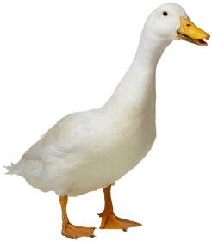
Consensus
convex
hull

Slide 10
Average Consensus
X

Slide 11
Optimization
X
Wind

Slide 12
Consensus
Initially, state = input
b
b = (b+c)/2
c
c = (a+b+c)/3
a
a = (a+c)/2

Slide 13
Consensus
2
b = (1+2)/2 = 3/2
1
c = (1+2+6)/3 = 3
6
a = (1+6)/2 = 7/2

Slide 14
Consensus
As time → ∞, values become identical
2
b = (1+2)/2 = 3/2
1
c = (1+2+6)/3 = 3
6
a = (1+6)/2 = 7/2

Slide 15
Average Consensus
Change of Weights
b
b = 3b/4+ c/4
c
c = a/4+b/4+c/2
a
a = 3a/4+ c/4

Slide 16
Average Consensus
2
b = (6/4+1/4)=7/4
1
c = (2/4+6/4+1/2) = 10/4
6
a = (18/4+1/4) = 19/4

Slide 17
Average Consensus
Values converge to average of inputs
2
b = (6/4+1/4)=7/4
1
c = (2/4+6/4+1/2) = 10/4
6
a = (18/4+1/4) = 19/4

Slide 18
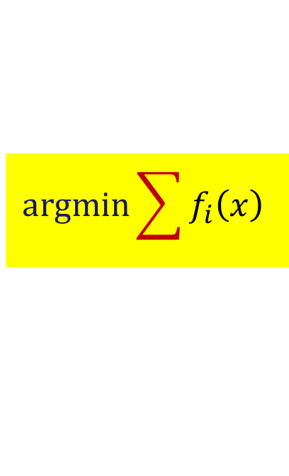
Optimization
f_{i}(x) = cost for robot i
to go to location x
Minimize total cost
of rendezvous
f₁(x)
x
x₁
f₂(x)
x₂
$$\text{argmin}\sum{f_{i}\left(x\right)}$$
Notes:
Other examples may be: resource allocation (which is similar to robotic rendezvous problems), large-scale distributed machine learning, where data are generated at different locations

Slide 19
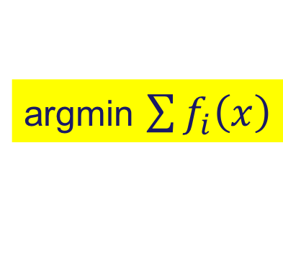
Many Applications
Robotics
Power systems
Machine learning / classification
argmin $\sum{f_{i}\left(x\right)}$

Slide 20
Distributed Classification
G. Renee Guzlas

Slide 21
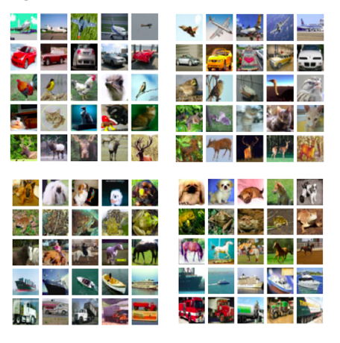
Distributed Machine Learning
Data is distributed
across different
agents
Agent 1
Agent 2
Agent 3
Agent 4

Slide 22
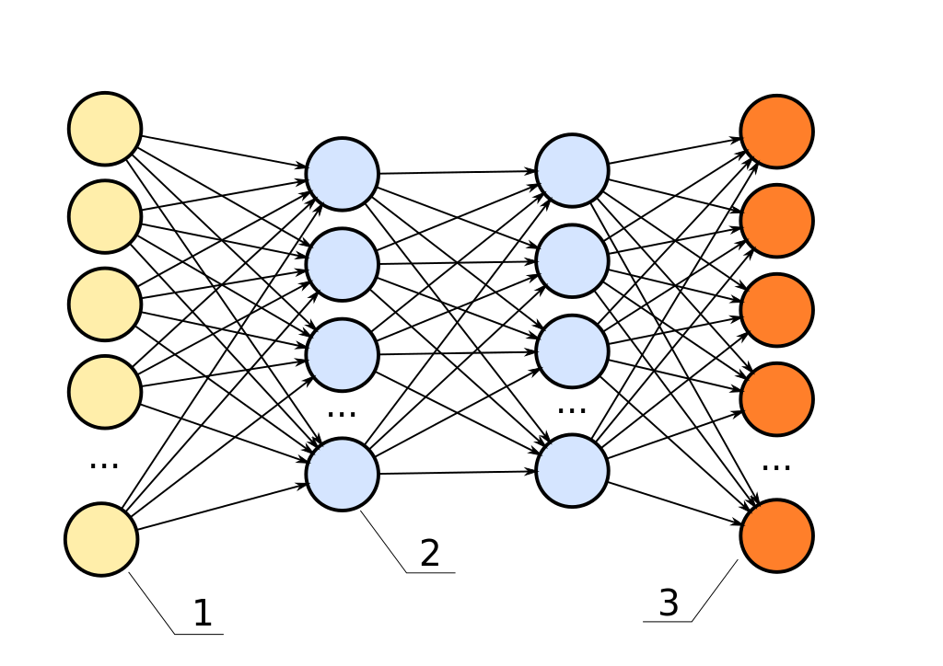
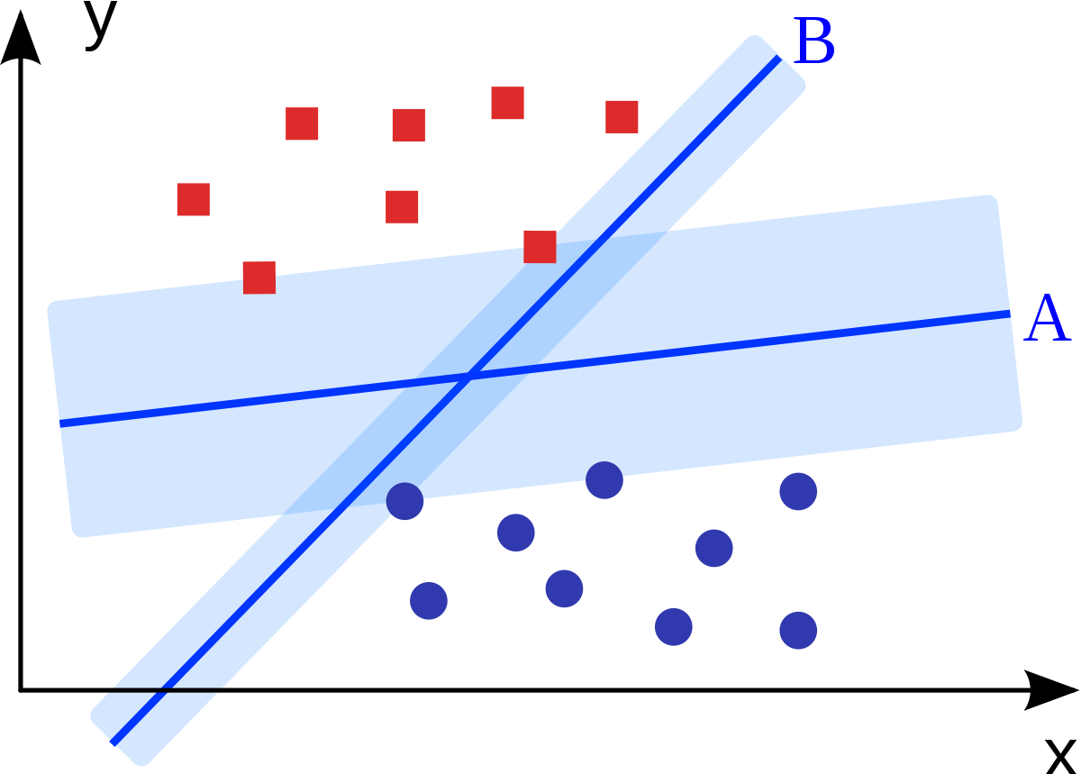
Data is distributed
across different ➔ Collaborate to learn
agents

Slide 23
Average Consensus
Each agent computes its own machine parameters
Average consensus to compute average of the machine parameters
Agent 1
Agent 2
Agent 3
Agent 4

Slide 24
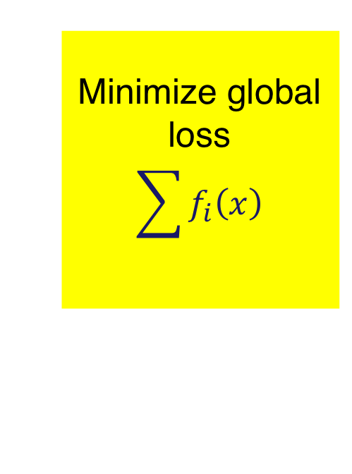




Distributed Optimization
$$f_{1}\left(x\right)$$
$$f_{2}\left(x\right)$$
Minimize global loss
$$\sum{f_{i}\left(x\right)}$$
$$f_{3}\left(x\right)$$
$$f_{4}\left(x\right)$$

Slide 25
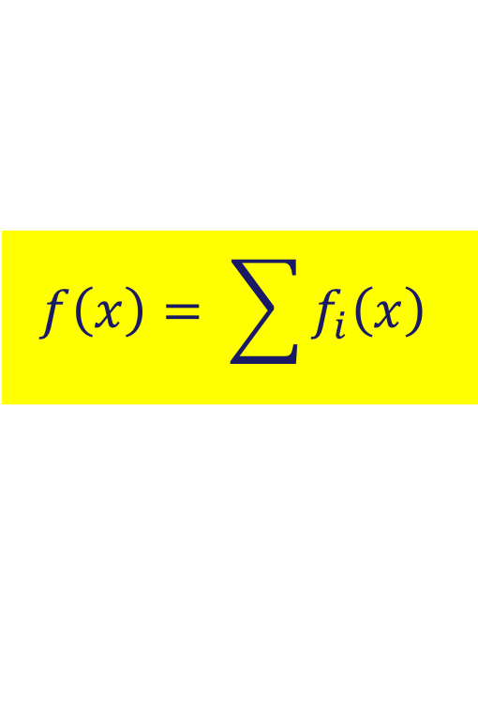
Gradient Method
$$f\left(x\right)= \sum{f_{i}\left(x\right)}$$
x[0]
x[1]
x[2]
x[3]

Slide 26
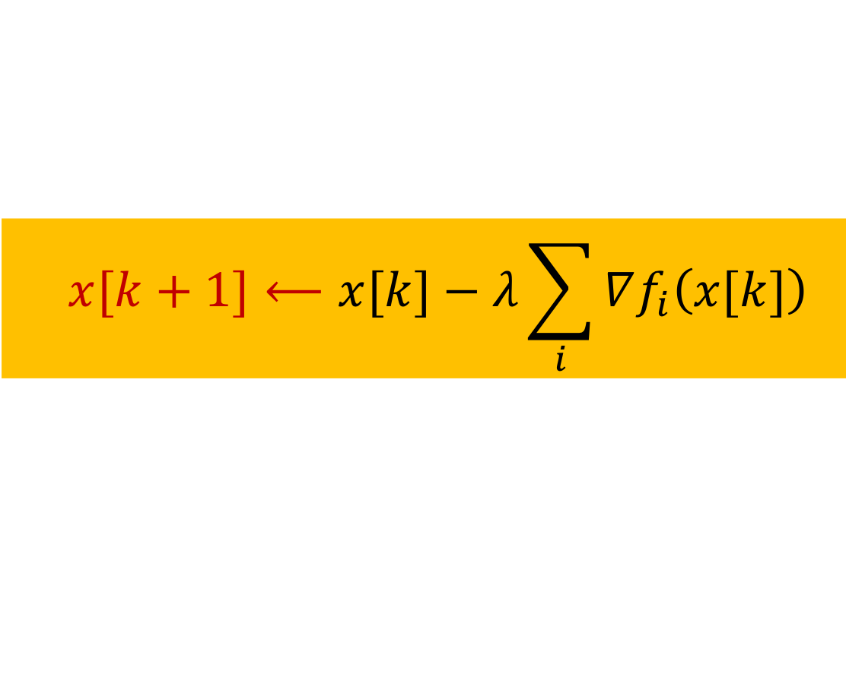
Gradient Method
$$f\left(x\right)= \sum{f_{i}\left(x\right)}$$
x[0]
x[1]
x[2]
x[3]
  $$x[k+1]⟵x[k]−λ\sum_{i}{∇f_{i}\left(x[k]\right)}$$

Slide 27
Gradient Method
$$f\left(x\right)= \sum{f_{i}\left(x\right)}$$
x[0]
x[1]
x[2]
x[3]
  $$x[k+1]⟵x[k]−λ\sum_{i}{∇f_{i}\left(x[k]\right)}$$

Slide 28
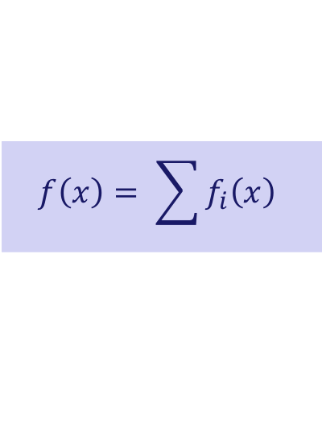
Distributed Optimization
$$f\left(x\right)= \sum{f_{i}\left(x\right)}$$
Each agent maintains an estimate
Local estimates shared with neighbors & updated
Estimates converge to optimum

Slide 29
x₁
x₂
x₃
x₃
x₃
Example based on [Nedic and Ozdaglar, 2009]

Slide 30

x₁
x₂
x₃
x₃
x₃
  $$x_{1}⟵ \frac{2}{3}x_{1}+\frac{1}{3}x_{3} − α ∇f_{1}\left(x_{1}\right)$$

Slide 31
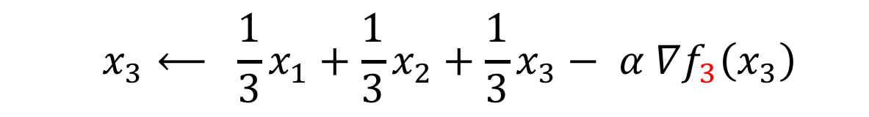
x₁
x₂
x₃
x₃
x₃
  $$x_{1}⟵ \frac{2}{3}x_{1}+\frac{1}{3}x_{3} − α ∇f_{1}\left(x_{1}\right)$$
  $$x_{3}⟵ \frac{1}{3}x_{1}+\frac{1}{3}x_{2}+\frac{1}{3}x_{3}− α ∇f_{3}\left(x_{3}\right)$$

Slide 32
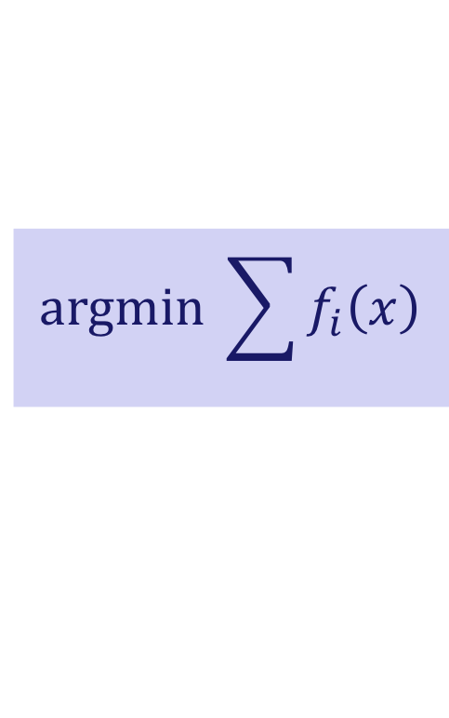
Distributed Optimization
As time → ∞
Consensus: All agents converge to same estimate
Optimality
$$\text{argmin} \sum{f_{i}\left(x\right)}$$

Slide 33
Why does this work?

Slide 34







Many Variations
Server
… stochastic optimization
… asynchronous
… gradient compression
… acceleration
… shared memory
1
$$2$$
$$3$$
$$1$$
$$3$$
$$5$$
$$2$$
$$4$$

Slide 35
Challenges

Slide 36
Challenges
Fault-tolerant
distributed optimization
How to optimize
if agents inject
bogus information?
f₁(x)
x
x₁
f₁(x) + f₂(x) + f₃(x)
f₂(x)

Slide 37
Challenges
Privacy-preserving
distributed optimization
How to collaborate
without revealing
own cost function?
f₁(x)
x
x₁
f₂(x)
x₂

Slide 38

Communication Leaks Information
x₁
x₂
x₁
x₃
x₃
  $$x_{1}⟵ \frac{2}{3}x_{1}+\frac{1}{3}x_{3} − α ∇f_{1}\left(x_{1}\right)$$

Slide 39
Communication Leaks Information
x₁
x₂
Agent 3 can infer
gradients at Agent 1
x₁
x₃
x₃
  $$x_{1}⟵ \frac{2}{3}x_{1}+\frac{1}{3}x_{3} − α ∇f_{1}\left(x_{1}\right)$$

Slide 40
Communication Leaks Information
x₁
x₂
Agent 3 can infer
gradients at Agent 1
➔ Infer polynomial
cost function
(up to a constant)
x₁
x₃
x₃
  $$x_{1}⟵ \frac{2}{3}x_{1}+\frac{1}{3}x_{3} − α ∇f_{1}\left(x_{1}\right)$$

Slide 41
Privacy-Preserving Optimization

Slide 42
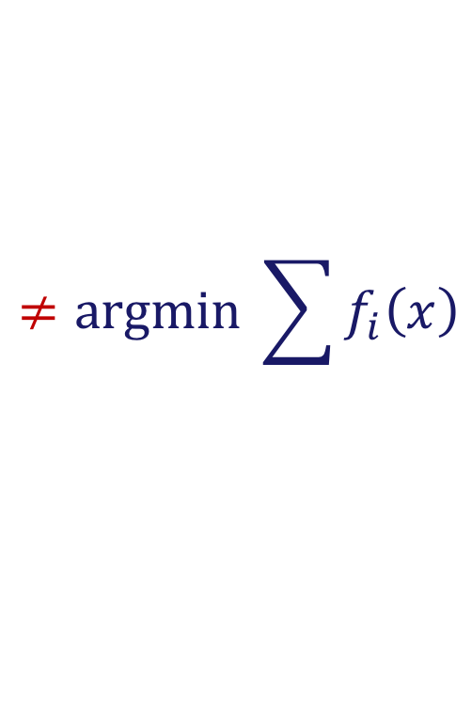
Privacy Techniques
Differential privacy … add noise ε
Optimality compromised
due to the noise
x₁
x₂
x₁ + ε
x₃
$$≠\text{argmin} \sum{f_{i}\left(x\right)}$$

Slide 43
Privacy Techniques
Homomorphic encryption
Expensive

Slide 44
Our Approach
Motivated by secret sharing & differential privacy
➔ Add cancellable noise

Slide 45

Noise Cancellation
x₁
x₂
x₄
ε₁ + ε₂ + ε₄ = 0
over time
x₃+ ε₂
x₃+ ε₁
x₃+ ε₄
x₃
  $$x_{1}⟵ \frac{2}{3}x_{1}+\frac{1}{3}x_{3} − α ∇f_{1}\left(x_{1}\right)$$

Slide 46
Noise Cancellation
x₁
x₂
Correctness preserved
Privacy can be
preserved if at least
one neighbor is
non-adversarial
x₄
ε₁ + ε₂ + ε₄ = 0
over time
x₃+ ε₂
x₃+ ε₁
x₃+ ε₄
x₃
  $$x_{1}⟵ \frac{2}{3}x_{1}+\frac{1}{3}x_{3} − α ∇f_{1}\left(x_{1}\right)$$

Slide 47
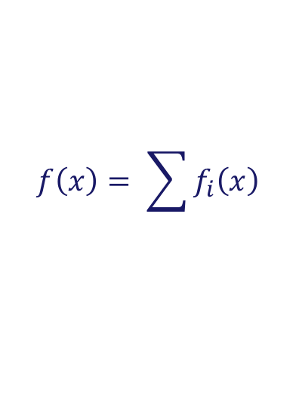
Technical Aside
Distributed
optimization works
even if cost functions
not convex
... so long as
aggregate is convex
x₁
x₂
x₁
x₃
x₃
  $$x_{1}⟵ \frac{2}{3}x_{1}+\frac{1}{3}x_{3} − α ∇f_{1}\left(x_{1}\right)$$
$$f\left(x\right)= \sum{f_{i}\left(x\right)}$$

Slide 48
Parameter Servers

Slide 49


Parameter Server
Server maintains estimate $x_{k}$
$$x_{k}$$
Server

Slide 50



Parameter Server
Server maintains estimate $x_{k}$
In each iteration
Agent i
  Downloads $x_{k}$ from server
  Uploads gradient $∇f_{i}(x_{k})$
$$x_{k}$$
Server
$∇f_{1}(x_{k})$
$∇f_{3}(x_{k})$

Slide 51
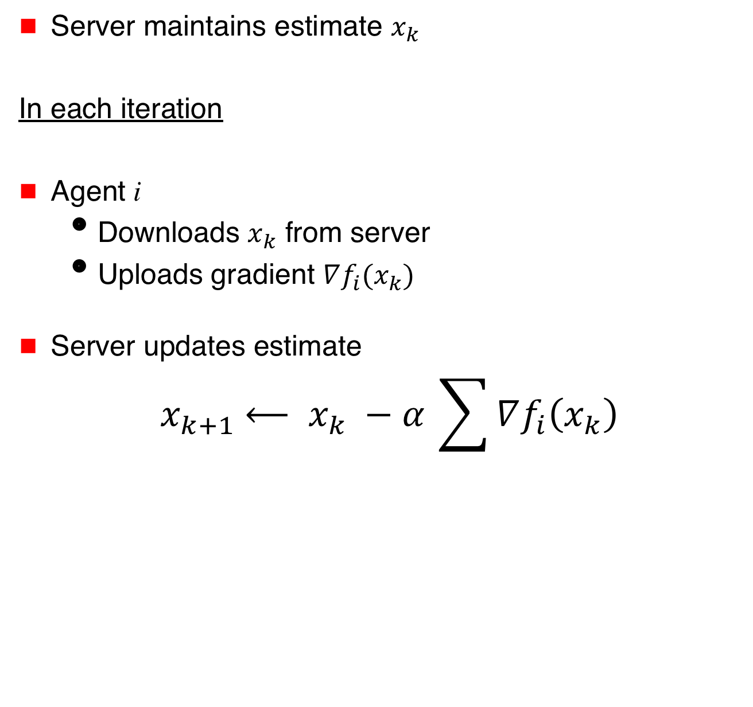
Parameter Server
Server maintains estimate $x_{k}$
In each iteration
Agent i
  Downloads $x_{k}$ from server
  Uploads gradient $∇f_{i}(x_{k})$
Server updates estimate
$${ x}_{k+1} ⟵ x_{k} −α_{ }\sum{∇f_{i}\left(x_{k}\right)}$$
$$x_{k}$$
Server
$∇f_{1}(x_{k})$
$∇f_{3}(x_{k})$

Slide 52

Multiple Parameter Servers
consensus step
Server 1
Server 2
$$∇f_{1}(x_{k})$$

Slide 53


Privacy
Server 1
Server 2
$$∇f_{1}(x_{k})\text{+ }\text{ε}\text{2}$$
$$∇f_{1}(x_{k})\text{+ }\text{ε}\text{1}$$
ε₁ + ε₂ = 0
over time

Slide 54
Privacy
Server 1
Server 2
$$∇f_{1}(x_{k})\text{+ }\text{ε}\text{2}$$
Privacy can be
preserved if at least
one server is
non-adversarial
$$∇f_{1}(x_{k})\text{+ }\text{ε}\text{1}$$
ε₁ + ε₂ = 0
over time

Slide 55
Fault-Tolerant Optimization

Slide 56
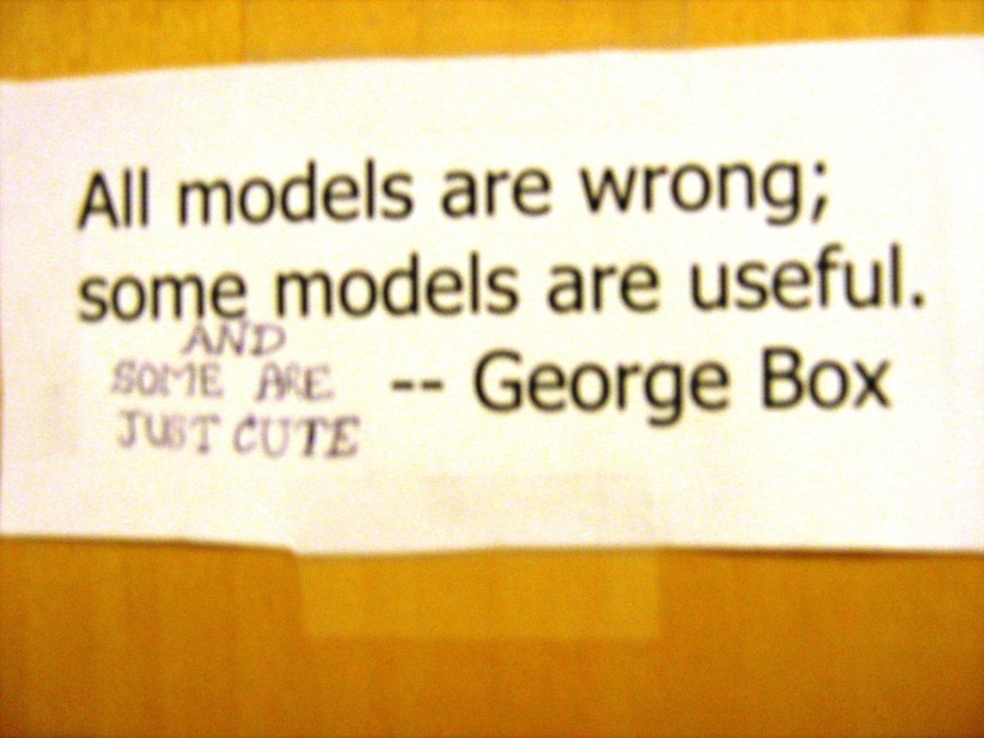
Byzantine Fault Model
No constraint
on misbehavior
of faulty agents

Slide 57






Faulty agent may provide gradients based on falsified data
Adversely affect model parameters
$$f_{1}\left(x\right)$$
$$f_{2}\left(x\right)$$
Minimize global loss
$$\sum{f_{i}\left(x\right)}$$
$$f_{3}\left(x\right)$$
$$f_{4}\left(x\right)$$

Slide 58
Fault-Tolerance
What should be the objective of fault-tolerant optimization?

Slide 59
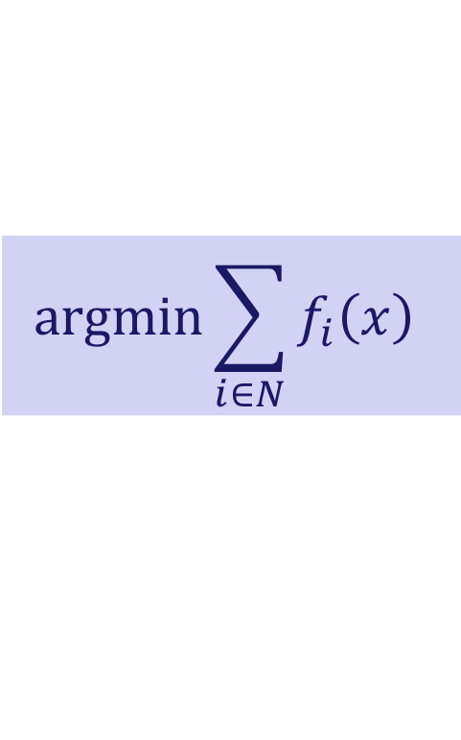
Fault-Tolerance
What should be the objective of fault-tolerant optimization?
Optimize over only non-faulty agents … set N
$$\text{argmin}\sum_{i∈N}{f_{i}\left(x\right)}$$

Slide 60
Fault-Tolerance
What should be the objective of fault-tolerant optimization?
Optimize over only non-faulty agents … set N
$$\text{argmin}\sum_{i∈N}{f_{i}\left(x\right)}$$
Is this achievable?

Slide 61
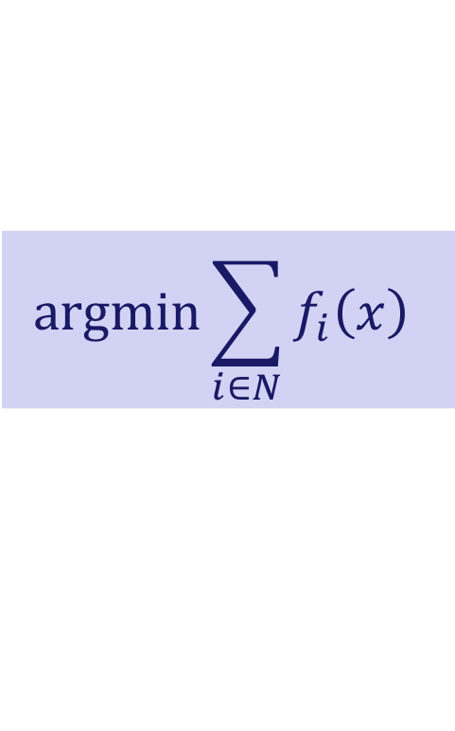
$$\text{argmin}\sum_{i∈N}{f_{i}\left(x\right)}$$
Is this achievable?
It Depends
Depends on redundancy
in agents’ cost functions

Slide 62
$$\text{argmin}\sum_{i∈N}{f_{i}\left(x\right)}$$
Is this achievable?
It Depends
Independent
functions
“Enough”
redundancy
Depends on redundancy
in agents’ cost functions

Slide 63
Independent Functions
a
b
c

Slide 64
Independent Functions
a
b
c

Slide 65
Independent Functions
a
b
c

Slide 66
Independent Functions
a
b
c

Slide 67
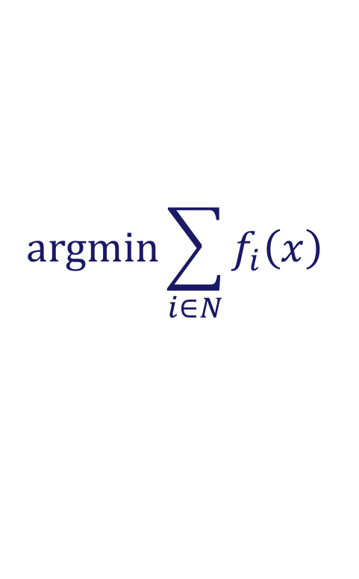
Independent Functions
Provably impossible to compute
$$\text{argmin}\sum_{i∈N}{f_{i}\left(x\right)}$$

Slide 68
$$\text{argmin}\sum_{i∈N}{f_{i}\left(x\right)}$$
Is this achievable?
Is this achievable?
Independent
functions
“Enough”
redundancy
Approximation
Exact

Slide 69


Parameter Server
Server maintains estimate $x_{k}$
In each iteration
Agent i
  Downloads $x_{k}$ from server
  Uploads gradient $∇f_{i}(x_{k})$
Server updates estimate
$${ x}_{k+1} ⟵ x_{k} −α_{ }\sum{∇f_{i}\left(x_{k}\right)}$$
$$x_{k}$$
Server
$∇f_{1}(x_{k})$
$∇f_{3}(x_{k})$

Slide 70
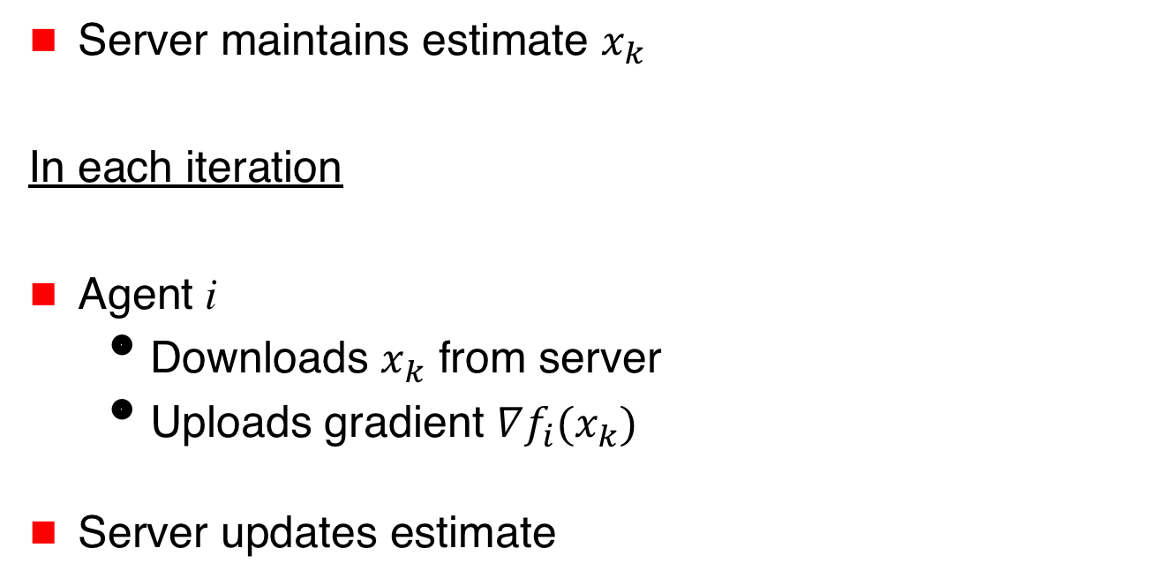

Parameter Server
Server maintains estimate $x_{k}$
In each iteration
Agent i
  Downloads $x_{k}$ from server
  Uploads gradient $∇f_{i}(x_{k})$
Server updates estimate
$$x_{k}$$
Server
$∇f_{1}(x_{k})$
$∇f_{3}(x_{k})$
$${ x}_{k+1} ⟵ x_{k} −α_{ }\text{Filtered}\text{−}\text{Gradient}$$

Slide 71
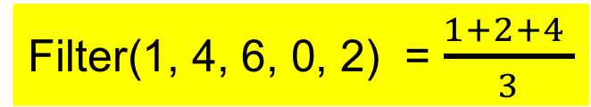

Filter for Scalar Parameter $x$
t faulty agents
Discard smallest t and largest t gradients
Average the rest
t = 1
Filter(1, 4, 6, 0, 2) = $\frac{1+2+4 }{3}$

Slide 72
Filter for Scalar Parameter $x$
t faulty agents
Discard smallest t and largest t gradients
Average the rest
t = 1
What does this achieve?
Filter(1, 4, 6, 0, 2) = $\frac{1+2+4 }{3}$

Slide 73
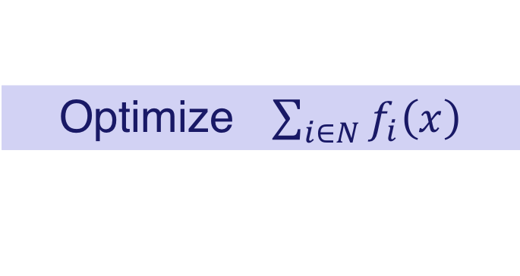

Our Ideal Goal
Equal importance to each good agent’s cost
Each $f_{i}$ has identical weight in the aggregate cost
Optimize $\sum_{i∈N}{f_{i}\left(x\right)}$

Slide 74
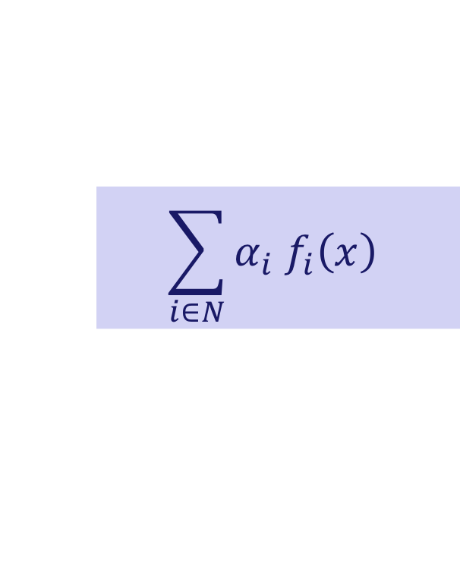
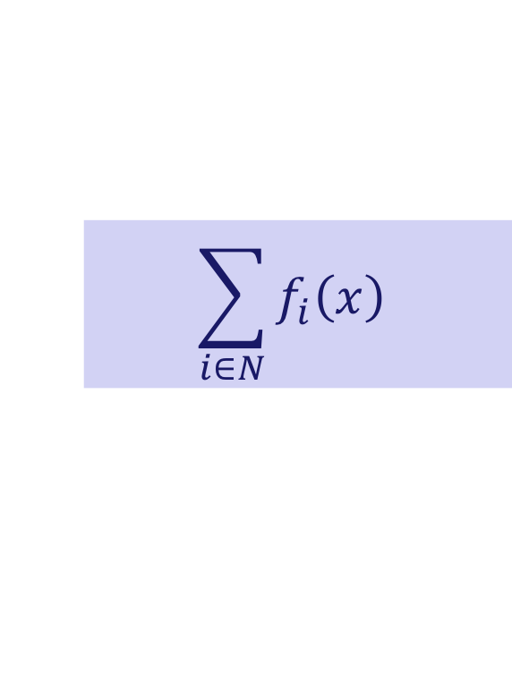
Independent Functions
How good an approximation?
Instead of uniform weights
the filter achieves unequal weights
$$\sum_{i∈N}{f_{i}\left(x\right)}$$
$$\sum_{i∈N}{{α_{i} f}_{i}\left(x\right)}$$

Slide 75
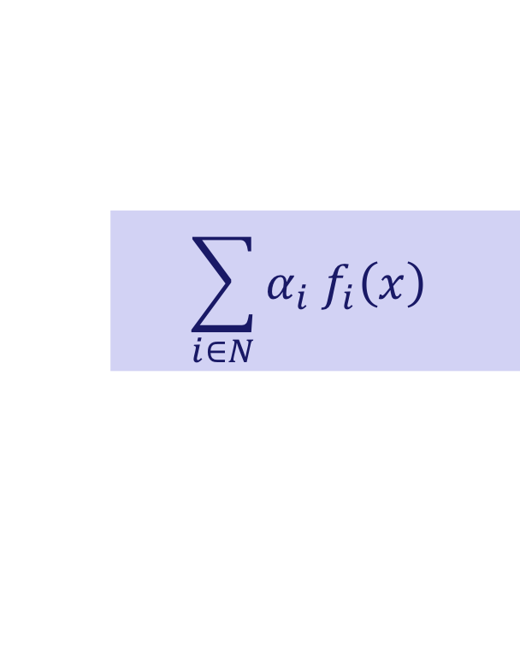
Independent Functions
$$\sum_{i∈N}{{α_{i} f}_{i}\left(x\right)}$$
Cost functions of faulty nodes “filtered away”

Slide 76
Independent Functions
$$\sum_{i∈N}{{α_{i} f}_{i}\left(x\right)}$$
Cost functions of faulty nodes “filtered away”
At most t good cost functions also filtered away

Slide 77
Independent Functions
$$\sum_{i∈N}{{α_{i} f}_{i}\left(x\right)}$$
Cost functions of faulty nodes “filtered away”
At most t good cost functions also filtered away
Nearly uniform importance to the remaining costs

Slide 78

Independent Functions
Necessary condition in general
$n>\left(d+1\right)t$ for $d$-dimensional parameter x
Bad news for large d

Slide 79
Good News
Cost functions often naturally redundant

Slide 80
Good News
Cost functions often naturally redundant
Data sets at different agents may be drawn from same distribution
➔ In expectation, all cost functions are identical

Slide 81
Good News
Cost functions often naturally redundant
Data sets at different agents may be drawn from same distribution
➔ In expectation, all cost functions are identical
Observations by different agents conditioned on the same ground truth

Slide 82
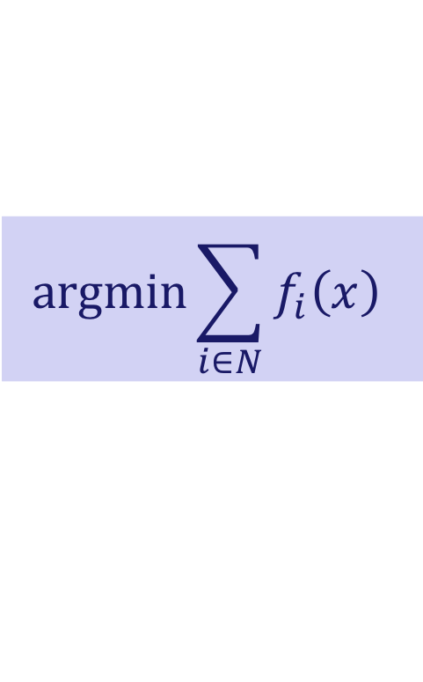

Good News
Cost functions often naturally redundant
With redundancy in functions, possible to compute
with far fewer than $\left(d+1\right)t$ agents
$$\text{argmin}\sum_{i∈N}{f_{i}\left(x\right)}$$

Slide 83

Example of Redundancy
2t-redundancy (any dimension d)
Aggregate cost functions of any $n−2t$agents
have identical minimum

Slide 84
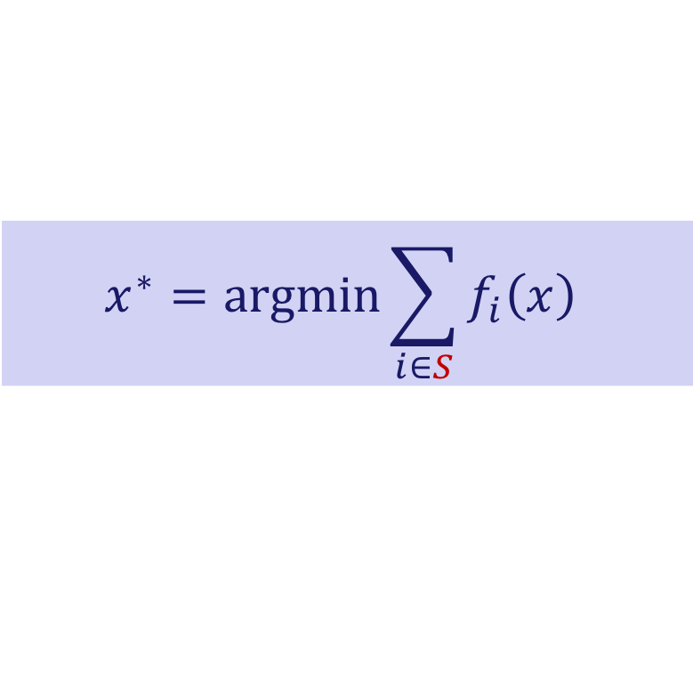
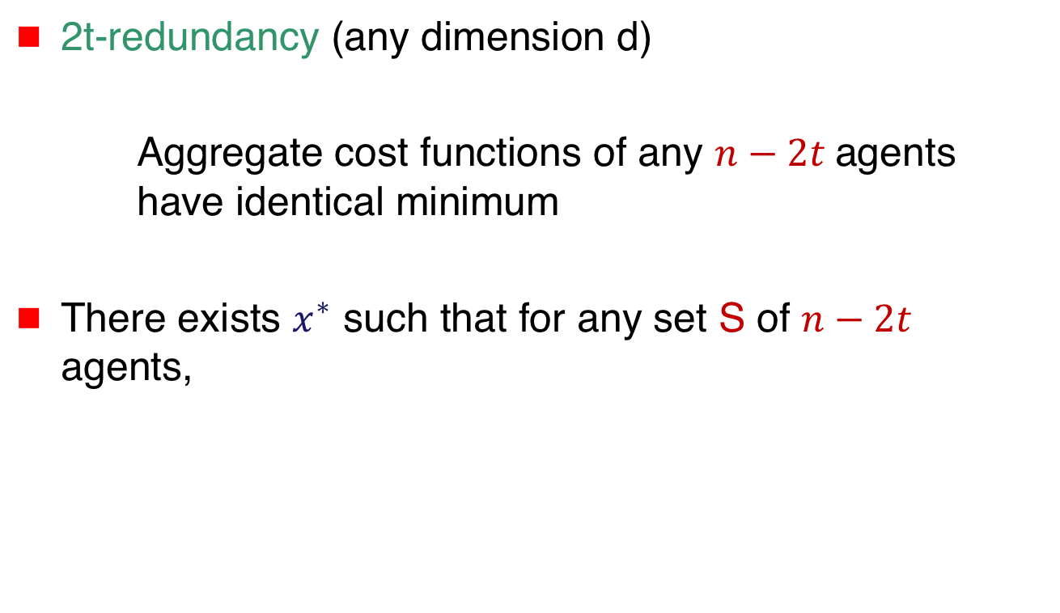
Example of Redundancy
2t-redundancy (any dimension d)
Aggregate cost functions of any $n−2t$agents
have identical minimum
There exists $x^{∗}$ such that for any set S of $n−2t$ agents,
$$x^{∗}=\text{argmin}\sum_{i∈S}{f_{i}\left(x\right)}$$

Slide 85

2t-Redundancy … Linear Regression
$d$-dimensional${ x}^{∗}$
$n$-by-$d$ matrix $A$

Slide 86

2t-Redundancy … Linear Regression
$d$-dimensional${ x}^{∗}$
$n$-by-$d$ matrix $A$
Agent $i$ knows $A_{i}$ and $y_{i}$ where
$y_{i}= A_{i}{ x}^{∗}$

Slide 87
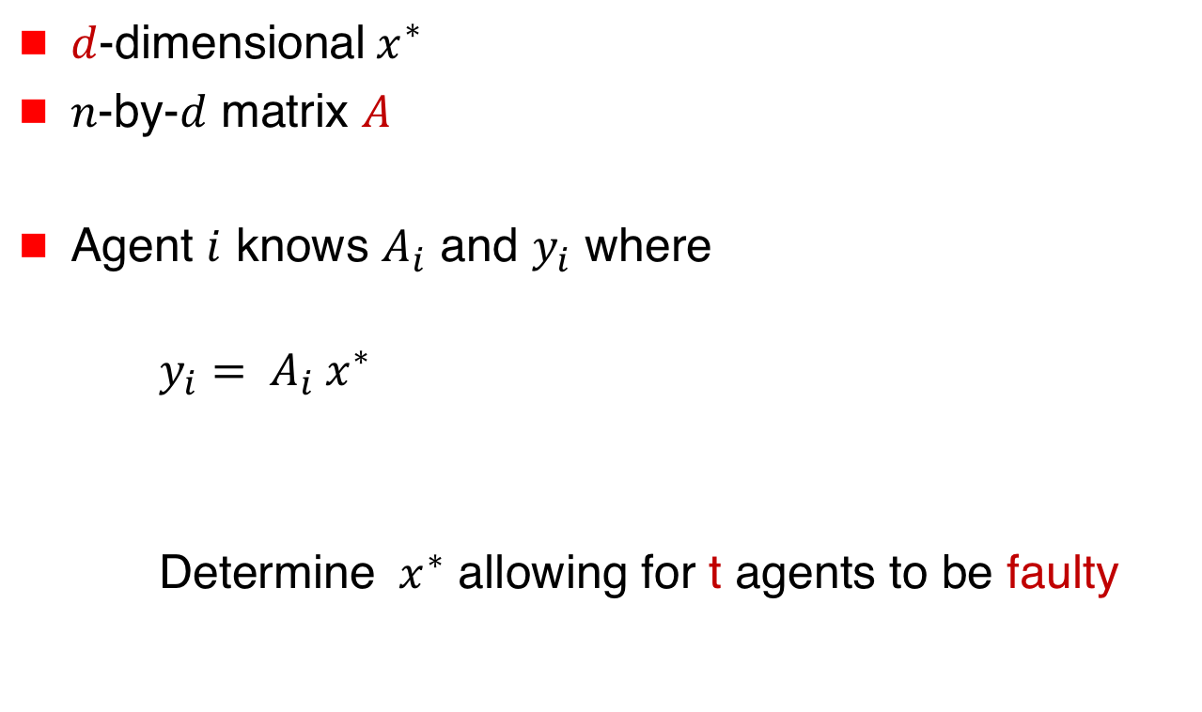
2t-Redundancy … Linear Regression
$d$-dimensional${ x}^{∗}$
$n$-by-$d$ matrix $A$
Agent $i$ knows $A_{i}$ and $y_{i}$ where
$y_{i}= A_{i}{ x}^{∗}$
Determine ${ x}^{∗}$ allowing for t agents to be faulty

Slide 88

2t-Redundancy … Linear Regression
Requires that any $n−2t$ agents have enough information to compute ${ x}^{∗}$

Slide 89
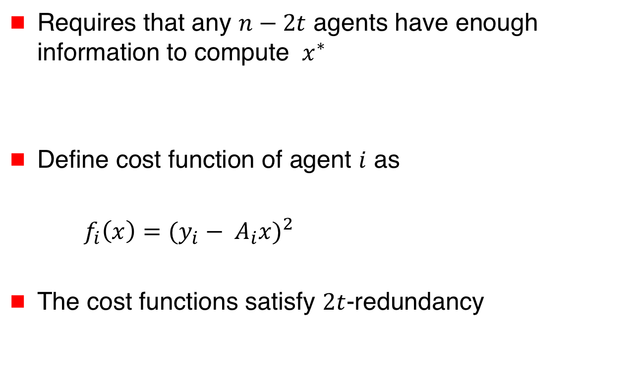
2t-Redundancy … Linear Regression
Requires that any $n−2t$ agents have enough information to compute ${ x}^{∗}$
Define cost function of agent $i$ as
$f_{i}\left(x\right)={(y_{i}− A_{i}x)}^{2}$
The cost functions satisfy $2t$-redundancy

Slide 90
Parameter Server
Server maintains estimate $x_{k}$
In each iteration
Agent i
  Downloads $x_{k}$ from server
  Uploads gradient $∇f_{i}(x_{k})$
Server updates estimate
$$x_{k}$$
Server
$∇f_{1}(x_{k})$
$∇f_{3}(x_{k})$
$${ x}_{k+1} ⟵ x_{k} −α_{ }\text{Filtered}\text{−}\text{Gradient}$$

Slide 91
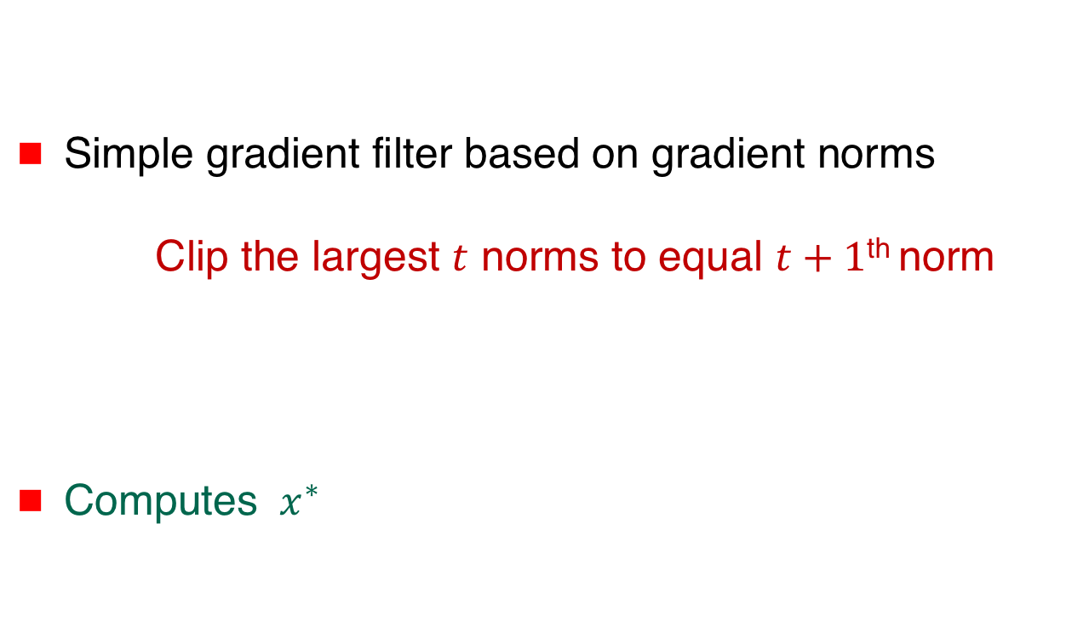
2t-Redundancy … Linear Regression
Simple gradient filter based on gradient norms
Clip the largest $t$ norms to equal $t+1$^{th} norm
Computes ${ x}^{∗}$

Slide 92
$$\text{argmin}\sum_{i∈N}{f_{i}\left(x\right)}$$
Is this achievable?
Is this achievable?
Independent
functions
“Enough”
Redundancy
Approximation
Exact

Slide 93
Summary
Consensus ➔ Average ➔ Distributed ➔
Consensus Optimization
Privacy
Fault-Tolerance

Slide 94
Open Problems
Plenty!
Byzantine consensus for dimension > 1
Impact of redundancy
Stochastic fault-tolerant optimization
Notions of privacy

Slide 95
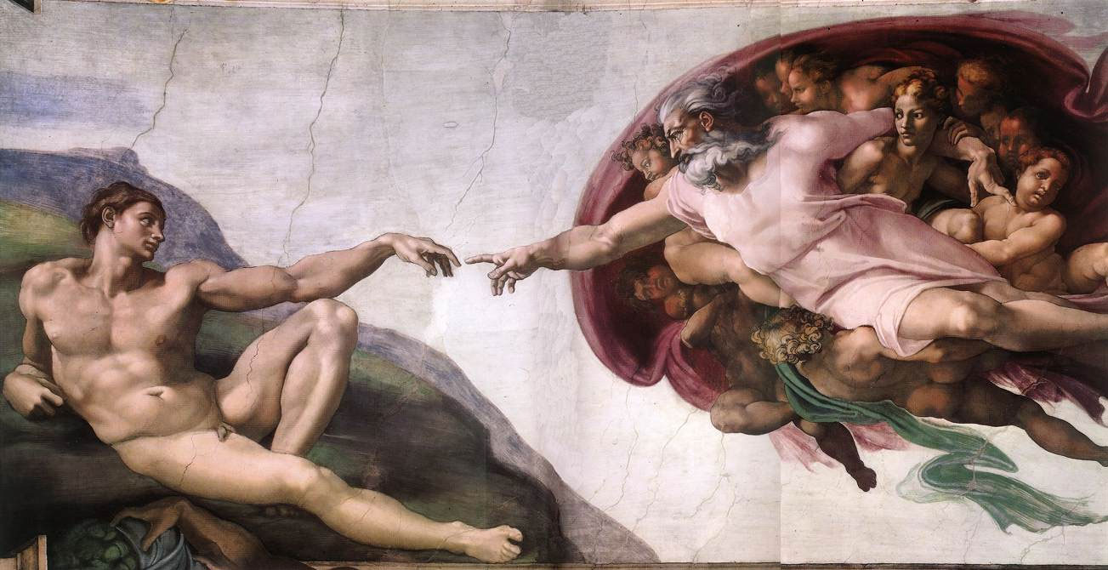
Moral of the Story
Decentralized
Control
Distributed
Computing
Picture from Wikipedia

Slide 96




Acknowledgements
Shripad Gade
Lili Su
Nirupam Gupta

Slide 97
Thanks!
disc.georgetown.domains

Slide 98
Thanks!
disc.georgetown.domains

Slide 99

Averaging ➔ Optimization
Input of agent i = $a_{i}$
Average of $a_{i}^{′}s$

Slide 100
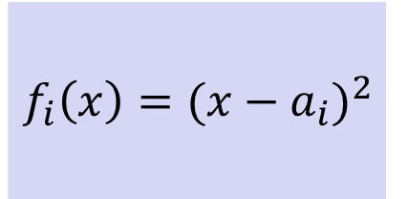

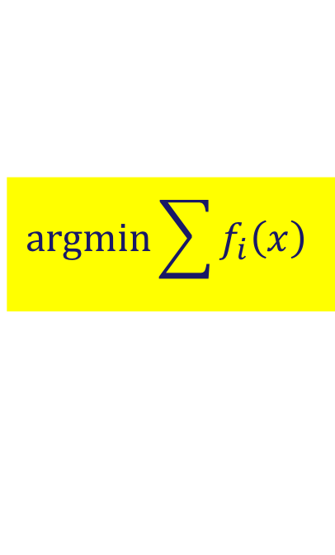
Averaging ➔ Optimization
Input of agent i = $a_{i}$
Average of $a_{i}^{′}s$ =
where
$$\text{argmin}\sum{f_{i}\left(x\right)}$$
$f_{i}\left(x\right)={(x−a_{i})}^{2}$

Slide 101
Quick Detour … Byzantine Consensus
“good”
convex
hull

Slide 102

$t$faults, $d$-dimensional input
➔ need $>\left(d+1\right)t$ agents
“good”
convex
hull
safe
region

Slide 103
Challenge
How to optimize
if faulty agents
inject
bogus information?
f₁(x)
x
x₁
f₂(x)

