Slide 1
Research Interests

Slide 2
My Research Interests
Distributed algorithms
Distributed shared memory systems
Distributed computations over wireless networks
Distributed optimization/machine learning

Slide 3
My Research Interests
Distributed algorithms
Distributed shared memory systems
Distributed computations over wireless networks
Distributed optimization/machine learning

Slide 4
Deep Neural Networks
neuron
layer 1
a₁
x₁
W111
1
a₂
x₂
2
a₃
x₃
3
W132
a₄

Slide 5
input
parameters
output
layer 1
0.8
dog
x₁
W111
1
0.1
cat
x₂
2
0.09
ship
x₃
3
W132
0.01
car

Slide 6
Deep Neural Networks
layer 1
a₁
x₁
1
a₂
x₂
2
a₃
x₃
3
W132
a₄

Slide 7
x₂
W131
x₃
3
W132
σ(X₂W₁₃₁+X₃W₁₃₂+b₁₃)

Slide 8
σ(z)
Rectifier Linear
Unit
x₂
z
W131
x₃
3
W132
σ(X₂W₁₃₁+X₃W₁₃₂+b₁₃)
z

Slide 9
How to train your dragon
network
Given a machine structure
Parameters are the only free variables
➔ Choose parameters that maximize accuracy

Slide 10
How to train your network
Given a machine structure
Parameters are the only free variables
➔ Choose parameters to maximize accuracy
Optimize a suitably defined cost function h(w) to find the right parameter vector w

Slide 11
So far …
h(w)
Training ➔ Optimize cost function
h(w)
Machine parameters
w

Slide 12
Distributed Machine Learning
Data is distributed across different agents
Mobile users
Hospitals
Competing vendors

Slide 13
Distributed Machine Learning
Data is distributed across different agents
Mobile users
Hospitals
Competing vendors
Agent 1
Agent 2
Agent 3
Agent 4

Slide 14
Distributed Machine Learning
Data is distributed across different ➔ Collaborate to learn agents

Slide 15
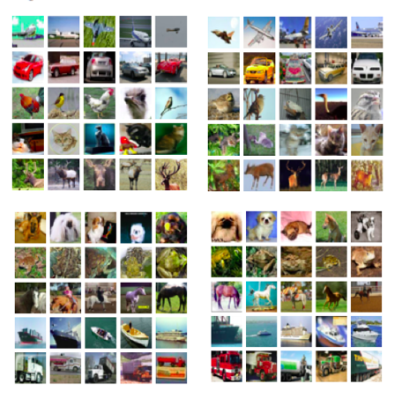
Distributed Machine Learning
Data is distributed across different ➔ Collaborate to learn agents
h₁(w)
h₂(w)
Training ➔ Optimize cost function
Σ h_{i}(w)
i
Machine parameters
w
h₃(w)
h₄(w)

Slide 16
Distributed Machine Learning
Research problems
Privacy-preserving distributed optimization
Robustness to adversarial agents

