Slide 1

Privacy and Fault-Tolerance in Distributed Optimization
Nitin Vaidya
University of Illinois at Urbana-Champaign

Slide 2

Acknowledgements
Shripad Gade
Lili Su

Slide 3
i

Slide 4
Applications
f_{i}(x) = cost for robot i
to go to location x
Minimize total cost
of rendezvous
f₁(x)
x
x₁
x₂
f₂(x)
i
Notes:
Other examples may be: resource allocation (which is similar to robotic rendezvous problems), large-scale distributed machine learning, where data are generated at different locations

Slide 5
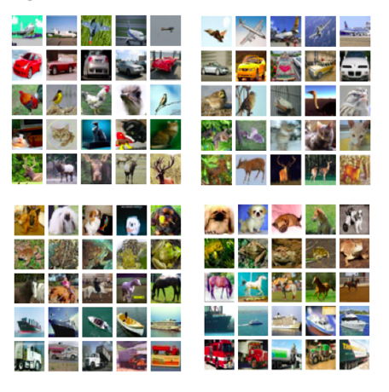
Applications
f₁(x)
f₂(x)
Learning
Minimize cost
Σ f_{i}(x)
i
f₃(x)
f₄(x)

Slide 6











Outline
i
$$f_{1}$$
$$f_{3}$$
$$f_{1}$$
$$f_{3}$$
$$f_{1}$$
$$f_{3}$$
$$f_{5}$$
$$f_{2}$$
$$f_{5}$$
$$f_{2}$$
$$f_{5}$$
$$f_{2}$$
$$f_{4}$$
$$f_{4}$$
$$f_{4}$$
Distributed
Optimization
Privacy
Fault-tolerance

Slide 7
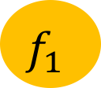
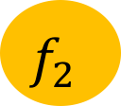
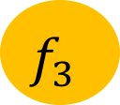
Distributed Optimization
Server
$$f_{1}$$
$$f_{3}$$
$$f_{5}$$
$$f_{2}$$
$$f_{1}$$
$$f_{2}$$
$$f_{3}$$
$$f_{4}$$

Slide 8



Client-Server Architecture
Server
f₁(x)
f₂(x)
$$f_{1}$$
$$f_{2}$$
$$f_{3}$$
f₃(x)
f₄(x)

Slide 9





Client-Server Architecture
Server maintains estimate $x_{k}$
Client i knows $f_{i}(x)$
$$x_{k}$$
Server
$$f_{1}$$
$$f_{2}$$
$$f_{3}$$

Slide 10


Client-Server Architecture
Server maintains estimate $x_{k}$
Client i knows $f_{i}(x)$
In iteration k+1
Client i
  Download $x_{k}$ from server
  Upload gradient $∇f_{i}(x_{k})$
$$x_{k}$$
Server
$∇f_{i}(x_{k})$
$$f_{1}$$
$$f_{2}$$
$$f_{3}$$

Slide 11
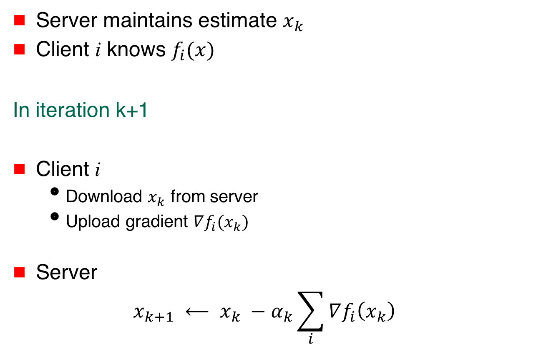
Client-Server Architecture
Server maintains estimate $x_{k}$
Client i knows $f_{i}(x)$
In iteration k+1
Client i
  Download $x_{k}$ from server
  Upload gradient $∇f_{i}(x_{k})$
Server
  $$x_{k+1} ⟵ x_{k} −α_{k}\sum_{i}{∇f_{i}\left(x_{k}\right)}$$
Server
$∇f_{i}(x_{k})$
$$f_{1}$$
$$f_{2}$$
$$f_{3}$$

Slide 12
Variations
Stochastic
Asynchronous
…

Slide 13
Peer-to-Peer Architecture
f₁(x)
f₂(x)
$$f_{1}$$
$$f_{3}$$
$$f_{5}$$
$$f_{2}$$
$$f_{4}$$
f₃(x)
f₄(x)

Slide 14

Peer-to-Peer Architecture
Each agent maintains local estimate x
Consensus step with neighbors
Apply own gradient to own estimate
  $$x_{k+1} ⟵ x_{k} −α_{k}∇f_{i}\left(x_{k}\right)$$
$$f_{1}$$
$$f_{3}$$
$$f_{5}$$
$$f_{2}$$
$$f_{4}$$

Slide 15
Outline
i
$$f_{1}$$
$$f_{3}$$
$$f_{1}$$
$$f_{3}$$
$$f_{1}$$
$$f_{3}$$
$$f_{5}$$
$$f_{2}$$
$$f_{5}$$
$$f_{2}$$
$$f_{5}$$
$$f_{2}$$
$$f_{4}$$
$$f_{4}$$
$$f_{4}$$
Distributed
Optimization
Privacy
Fault-tolerance

Slide 16




Server
$∇f_{i}(x_{k})$
$$f_{1}$$
$$f_{2}$$
$$f_{3}$$

Slide 17
Server observes gradients ➔ privacy compromised
Server
$∇f_{i}(x_{k})$
$$f_{1}$$
$$f_{2}$$
$$f_{3}$$

Slide 18
Server
$∇f_{i}(x_{k})$
$$f_{1}$$
$$f_{2}$$
$$f_{3}$$
Server observes gradients ➔ privacy compromised
Achieve privacy and yet collaboratively optimize

Slide 19
Related Work
Cryptographic methods (homomorphic encryption)
Function transformation
Differential privacy

Slide 20

Differential Privacy
Server
$$∇f_{i}\left(x_{k}\right)+εk$$
$$f_{1}$$
$$f_{2}$$
$$f_{3}$$

Slide 21
Differential Privacy
Server
$$∇f_{i}\left(x_{k}\right)+εk$$
$$f_{1}$$
$$f_{2}$$
$$f_{3}$$
Trade-off privacy with accuracy

Slide 22
Proposed Approach
Motivated by secret sharing
Exploit diversity … Multiple servers / neighbors

Slide 23



Proposed Approach
Server 1
Server 2
$$f_{1}$$
$$f_{2}$$
$$f_{3}$$
Privacy if subset of servers adversarial

Slide 24
Proposed Approach
$$f_{1}$$
$$f_{3}$$
$$f_{5}$$
$$f_{2}$$
$$f_{4}$$
Privacy if subset of neighbors adversarial

Slide 25
Proposed Approach
Structured noise that
“cancels” over servers/neighbors

Slide 26



Intuition
x¹
x²
Server 1
Server 2
$$f_{1}$$
$$f_{2}$$
$$f_{3}$$

Slide 27






Intuition
x¹
x²
Server 1
Server 2
$$f_{11}$$
$$f_{12}$$
$$f_{21}$$
$$f_{22}$$
$$f_{31}$$
$$f_{32}$$
Each client
simulates
multiple clients

Slide 28
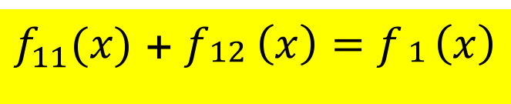
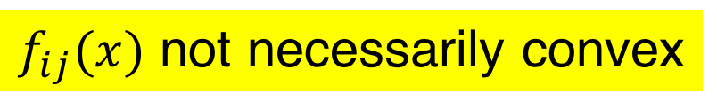
Intuition
x¹
x²
Server 1
Server 2
$$f_{11}$$
$$f_{12}$$
$$f_{21}$$
$$f_{22}$$
$$f_{31}$$
$$f_{32}$$
$f_{11}(x)$ + $f_{\begin{aligned}12 \\ \end{aligned}}\left(x\right)=f_{\begin{aligned}1 \\ \end{aligned}}\left(x\right)$
$f_{ij}(x)$ not necessarily convex

Slide 29
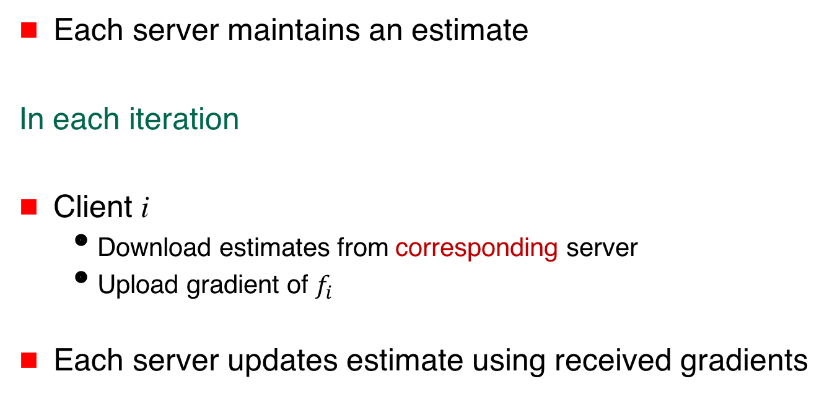
Algorithm
Each server maintains an estimate
In each iteration
Client i
  Download estimates from corresponding server
  Upload gradient of $f_{i}$
Each server updates estimate using received gradients

Slide 30
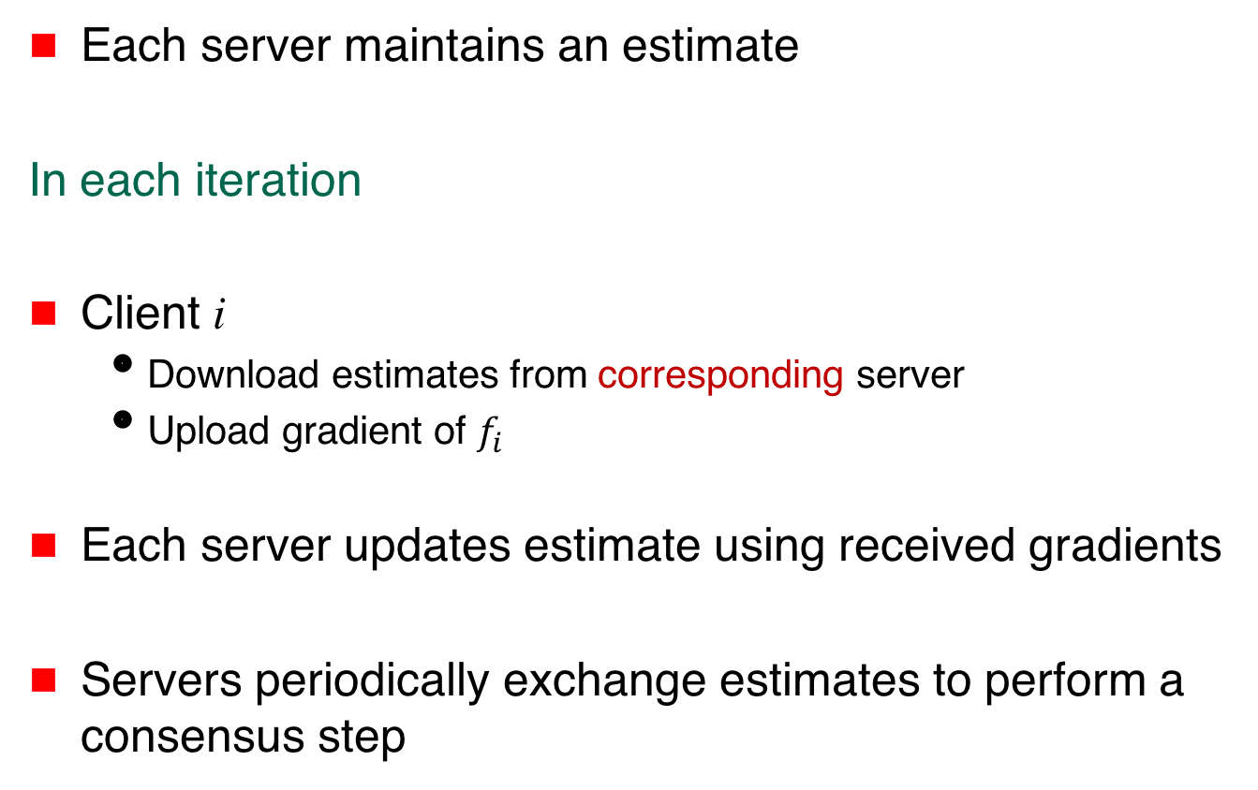
Algorithm
Each server maintains an estimate
In each iteration
Client i
  Download estimates from corresponding server
  Upload gradient of $f_{i}$
Each server updates estimate using received gradients
Servers periodically exchange estimates to perform a consensus step

Slide 31
Claim
Under suitable assumptions, servers eventually reach consensus in
i

Slide 32






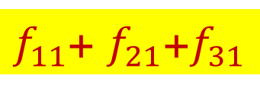
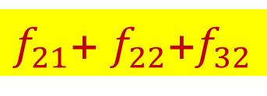
Privacy
$f_{11}$+ $f_{21}$+$f_{31}$
$f_{21}$+ $f_{22}$+$f_{32}$
Server 1
Server 2
$$f_{11}$$
$$f_{12}$$
$$f_{21}$$
$$f_{22}$$
$$f_{31}$$
$$f_{32}$$

Slide 33

Privacy
$f_{11}$+ $f_{21}$+$f_{31}$
$f_{21}$+ $f_{22}$+$f_{32}$
Server 1 may learn $f_{11},$ $f_{21}, f_{31}$, $f_{21}$+ $f_{22}$+$f_{32}$
Not sufficient to learn $f_{i}$
Server 1
Server 2
$$f_{11}$$
$$f_{12}$$
$$f_{21}$$
$$f_{22}$$
$$f_{31}$$
$$f_{32}$$

Slide 34
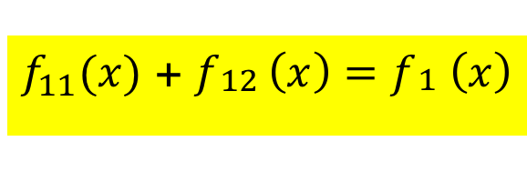
$f_{11}(x)$ + $f_{\begin{aligned}12 \\ \end{aligned}}\left(x\right)=f_{\begin{aligned}1 \\ \end{aligned}}\left(x\right)$
Function splitting not necessarily practical
Structured randomization as an alternative

Slide 35
Structured Randomization
Multiplicative or additive noise in gradients
Noise cancels over servers

Slide 36


Multiplicative Noise
x¹
x²
Server 1
Server 2
$$f_{1}$$
$$f_{2}$$
$$f_{3}$$

Slide 37
Multiplicative Noise
x¹
x²
Server 1
Server 2
$$f_{1}$$
$$f_{2}$$
$$f_{3}$$

Slide 38
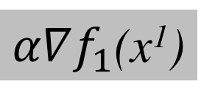

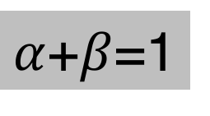
Multiplicative Noise
x¹
x²
Server 1
Server 2
$α∇f_{1}$(x¹)
$$β∇f_{1}(x2)$$
$$f_{1}$$
$$f_{2}$$
$$f_{3}$$
$α$+$β$=1

Slide 39
Multiplicative Noise
x¹
x²
Server 1
Server 2
$α∇f_{1}$(x¹)
$$β∇f_{1}(x2)$$
$$f_{1}$$
$$f_{2}$$
$$f_{3}$$
Suffices for this invariant to hold
over a larger number of iterations
$α$+$β$=1

Slide 40
Multiplicative Noise
x¹
x²
Server 1
Server 2
$α∇f_{1}$(x¹)
$$β∇f_{1}(x2)$$
$$f_{1}$$
$$f_{2}$$
$$f_{3}$$
$α$+$β$=1
Noise from client i to server j
not zero-mean

Slide 41
Claim
Under suitable assumptions, servers eventually reach consensus in
i

Slide 42
Peer-to-Peer Architecture
$$f_{1}$$
$$f_{3}$$
$$f_{5}$$
$$f_{2}$$
$$f_{4}$$

Slide 43
Reminder …
Each agent maintains local estimate x
Consensus step with neighbors
Apply own gradient to own estimate
  $$x_{k+1} ⟵ x_{k} −α_{k}∇f_{i}\left(x_{k}\right)$$
$$f_{1}$$
$$f_{3}$$
$$f_{5}$$
$$f_{2}$$
$$f_{4}$$

Slide 44
Proposed Approach
Each agent shares noisy estimate with neighbors
    Scheme 1 – Noise cancels over neighbors
    Scheme 2 – Noise cancels network-wide
$$f_{1}$$
$$f_{3}$$
$$f_{5}$$
$$f_{2}$$
$$f_{4}$$

Slide 45
Proposed Approach
Each agent shares noisy estimate with neighbors
    Scheme 1 – Noise cancels over neighbors
    Scheme 2 – Noise cancels network-wide
x + ε₁
ε₁ + ε₂ = 0 (over iterations)
$$f_{1}$$
$$f_{3}$$
$$f_{2}$$
x + ε₂
$$f_{5}$$
$$f_{4}$$

Slide 46
Peer-to-Peer Architecture
Poster today
Shripad Gade

Slide 47
Outline
i
$$f_{1}$$
$$f_{3}$$
$$f_{1}$$
$$f_{3}$$
$$f_{1}$$
$$f_{3}$$
$$f_{5}$$
$$f_{2}$$
$$f_{5}$$
$$f_{2}$$
$$f_{5}$$
$$f_{2}$$
$$f_{4}$$
$$f_{4}$$
$$f_{4}$$
Distributed
Optimization
Privacy
Fault-tolerance

Slide 48
Fault-Tolerance
Some agents may be faulty
Need to produce “correct” output despite the faults

Slide 49
Byzantine Fault Model
No constraint on misbehavior of a faulty agent
May send bogus messages
Faulty agents can collude

Slide 50
Peer-to-Peer Architecture
f_{i}(x) = cost for robot i
to go to location x
Faulty agent may choose
arbitrary cost function
f₁(x)
x
x₁
x₂
f₂(x)
Notes:
Other examples may be: resource allocation (which is similar to robotic rendezvous problems), large-scale distributed machine learning, where data are generated at different locations

Slide 51

Peer-to-Peer Architecture
$$f_{1}$$
$$f_{3}$$
$$f_{5}$$
$$f_{2}$$
$$f_{4}$$

Slide 52


Client-Server Architecture
Server
$∇f_{i}(x_{k})$
$$f_{1}$$
$$f_{2}$$
$$f_{3}$$

Slide 53
Fault-Tolerant Optimization
The original problem is not meaningful
i

Slide 54
Fault-Tolerant Optimization
The original problem is not meaningful
Optimize cost over only non-faulty agents
i
i good

Slide 55
Fault-Tolerant Optimization
The original problem is not meaningful
Optimize cost over only non-faulty agents
i
Impossible!
i good

Slide 56
Fault-Tolerant Optimization
Optimize weighted cost over only non-faulty agents
With 𝛂_{i} as close to 1/ good as possible
𝛂_{i}
i good

Slide 57
Fault-Tolerant Optimization
Optimize weighted cost over only non-faulty agents
𝛂_{i}
i good
With t Byzantine faulty agents:
t weights may be 0

Slide 58
Fault-Tolerant Optimization
Optimize weighted cost over only non-faulty agents
𝛂_{i}
i good
t Byzantine agents, n total agents
At least n-2t weights guaranteed to be > 1/2(n-t)

Slide 59
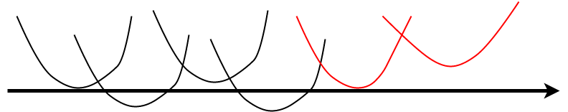
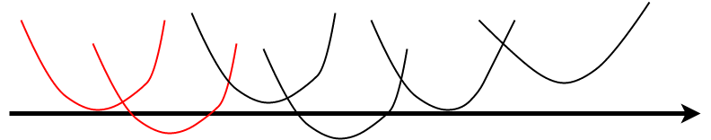
Centralized Algorithm
Of the n agents, any t may be faulty
How to filter cost functions of faulty agents?
X

Slide 60
Centralized Algorithm: Scalar argument x
Define a virtual function G(x) whose gradient is
obtained as follows

Slide 61
Centralized Algorithm: Scalar argument x
Define a virtual function G(x) whose gradient is
obtained as follows
At a given x
Sort the gradients of the n local cost functions

Slide 62
Centralized Algorithm: Scalar argument x
Define a virtual function G(x) whose gradient is
obtained as follows
At a given x
Sort the gradients of the n local cost functions
Discard smallest t and largest t gradients

Slide 63
Centralized Algorithm: Scalar argument x
Define a virtual function G(x) whose gradient is
obtained as follows
At a given x
Sort the gradients of the n local cost functions
Discard smallest t and largest t gradients
Mean of remaining gradients = Gradient of G at x

Slide 64
Centralized Algorithm: Scalar argument x
Define a virtual function G(x) whose gradient is
obtained as follows
At a given x
Sort the gradients of the n local cost functions
Discard smallest t and largest t gradients
Mean of remaining gradients = Gradient of G at x
Virtual function G(x) is convex

Slide 65
Centralized Algorithm: Scalar argument x
Define a virtual function G(x) whose gradient is
obtained as follows
At a given x
Sort the gradients of the n local cost functions
Discard smallest t and largest t gradients
Mean of remaining gradients = Gradient of G at x
Virtual function G(x) is convex → Can optimize easily

Slide 66
Peer-to-Peer Fault-Tolerant Optimization
Gradient filtering similar to centralized algorithm
… require “rich enough” connectivity
… correlation between functions helps
Vector case harder
… redundancy between functions helps

Slide 67
Summary
i
$$f_{1}$$
$$f_{3}$$
$$f_{1}$$
$$f_{3}$$
$$f_{1}$$
$$f_{3}$$
$$f_{5}$$
$$f_{2}$$
$$f_{5}$$
$$f_{2}$$
$$f_{5}$$
$$f_{2}$$
$$f_{4}$$
$$f_{4}$$
$$f_{4}$$
Distributed
Optimization
Privacy
Fault-tolerance

Slide 68
Thanks!
disc.ece.illinois.edu

Slide 71
Distributed Peer-to-Peer Optimization
Each agent maintains local estimate x
In each iteration
Compute weighted average with neighbors’ estimates
$$f_{1}$$
$$f_{3}$$
$$f_{5}$$
$$f_{2}$$
$$f_{4}$$

Slide 72

Distributed Peer-to-Peer Optimization
Each agent maintains local estimate x
In each iteration
Compute weighted average with neighbors’ estimates
Apply own gradient to own estimate
  $$x_{k+1} ⟵ x_{k} −α_{k}∇f_{i}\left(x_{k}\right)$$
$$f_{1}$$
$$f_{3}$$
$$f_{5}$$
$$f_{2}$$
$$f_{4}$$

Slide 73

Distributed Peer-to-Peer Optimization
Each agent maintains local estimate x
In each iteration
Compute weighted average with neighbors’ estimates
Apply own gradient to own estimate
Local estimates converge to
  $$x_{k+1} ⟵ x_{k} −α_{k}∇f_{i}\left(x_{k}\right)$$
i
$$f_{1}$$
$$f_{3}$$
$$f_{5}$$
$$f_{2}$$
$$f_{4}$$

Slide 74

RSS – Locally Balanced
Perturbations
Add to zero (locally per node)
Bounded ($≤Δ$)
Algorithm
Node j selects $d_{k}^{j,i}$ such that $\sum_{i}{d_{k}^{j,i}}=0$ and $\left|d_{k}^{j,i}\right|≤Δ$
Share $w_{k}^{j,i}=x_{k}^{j}+d_{k}^{j,i}$ with node i
Consensus and (Stochastic) Gradient Descent

Slide 75
RSS – Network Balanced
Perturbations
Add to zero (over network)
Bounded ($≤Δ$)
Algorithm
Node j computes perturbation $d_{k}^{j}$
  - sends $s^{j,i}$ to i
  - add received $s^{i,j}$ and subtract sent $s^{j,i}$ $⇒d_{k}^{j}=\sum{rcvd −\sum{sent}}$
Obfuscate state $w_{k}^{j}=x_{k}^{j}+d_{k}^{j}$ shared with neighbors
Consensus and (Stochastic) Gradient Descent

Slide 76
Convergence
Let ${{\hat{x}}^{j}}_{T}=\sum^{T}{α_{k} x_{k}^{j}}/\sum^{T}{α_{k}}$ and $α_{k}=1/\sqrt{k}$
$$f\left({{\hat{x}}^{j}}_{T}\right) −f\left(x^{∗}\right)≤𝒪\left(\frac{\log\left(T\right)}{\sqrt{T}}\right)+𝒪\left(\frac{Δ^{2}log\left(T\right)}{\sqrt{T}}\right)$$
Asymptotic convergence of iterates to optimum
Privacy-Convergence Trade-off
Stochastic gradient updates work too

Slide 77
Function Sharing
Let $f_{i}(x)$ be bounded degree polynomials
Algorithm
Node j shares $s^{j,i}\left(x\right)$ with node i
Node j obfuscates using $p_{j}\left(x\right)=∑s^{i,j}\left(x\right) −∑s^{j,i}(x)$
Use ${\hat{f}}_{j}\left(x\right)=f_{j}\left(x\right)+p_{j}(x)$and use distributed gradient descent

Slide 78
Function Sharing - Convergence
Function Sharing iterates converge to correct optimum ($∑{\hat{f}}_{i}\left(x\right)=f(x)$)
Privacy:
If vertex connectivity of graph $≥$f then no group of f nodes can estimate true functions $f_{i}$ (or any good subset)
$p_{j}(x)$ is also similar to $f_{j}(x)$ then it can hide $f_{i}\left(x\right)$ well

