Slide 1

Equality Function Computation
(How to make simple things complicated)
Nitin Vaidya
University of Illinois at Urbana-Champaign
Joint work with Guanfeng Liang
Research supported in part by National Science Foundation and Army Research Office

Slide 2
Background

Slide 3
Equality Function
A
B
K-valued input
K-valued input
Determine whether the two inputs are identical

Slide 4
Communication cost of an algorithm:
# bits of communication required
in the worst case (over all possible inputs)

Slide 5
Communication cost of an algorithm:
# bits of communication required
in the worst case (over all possible inputs)
Communication complexity of a problem:
Minimum communication cost
over all algorithms to solve the problem
[Andrew Yao, STOC 1979]

Slide 6
Equality Function
A
B
K-valued input
K-valued input

Slide 7
Upper Bound
A
log K
Proof by construction
B

Slide 8
Lower Bound
log K
Proof by fooling set argument
A
B

Slide 9
Generalization to n parties

Slide 10
The MEQ(n,K) Problem
n nodes each given x_{i} from {1,…,K},
to check if all x_{i} are equal
Each node i computes EQ_{i}
“Everyone detects” (MEQ-ED)
Notes:
The multiparty equality function problem is defined as this. There are n nodes, each is given a value from 1 to M, and they want to know whether their values are equal or not, by communicating with each other. If the values are not all the same, then at least one of the nodes will know/detect that. If the values are all equal, then no one detects.

Slide 11
The MEQ(n,K) Problem
n nodes each given x_{i} from {1,…,K},
to check if all x_{i} are equal
Each node i computes EQ_{i}
“Anyone detects” (MEQ-AD)
Notes:
The multiparty equality function problem is defined as this. There are n nodes, each is given a value from 1 to M, and they want to know whether their values are equal or not, by communicating with each other. If the values are not all the same, then at least one of the nodes will know/detect that. If the values are all equal, then no one detects.

Slide 12
n-Node Equality Problem
A
B
Network
C

Slide 13
Number-in-Hand Model
K-valued
input
A
B
Broadcast
Channel
C
Node i initially knows Xi

Slide 14
n-Party Equality : Complexity
Broadcast channel + Number-in-hand model
log K bits

Slide 15
Number-on-Forehead Model
A
B
Broadcast
Channel
C
Node i initially knows everything except Xi

Slide 16
n-Party Equality : Complexity
Broadcast channel + Number-on-forehead model
2 bits when n > 2

Slide 17
Point-to-Point Networks
Private channels & number-in-hand
A
B
n = 3
C

Slide 18
Upper Bound
Emulate broadcast channel using p2p links
➔ (n-1) * complexity with broadcast channel

Slide 19
Upper Bound = 2 log K
K-valued
input
log K bits
A
B
log K bits
C

Slide 20
Lower Bound = log K
K-valued input
A
B
cut log K
by 2-node
lower bound
identical value
at B and C
C

Slide 21
1.5 log K Complexity 2 log K
A
B
C
Neither bound tight
in general

Slide 22
1.5 log K Not Tight
A
B
K = 2
Requires at least 2 bits
C

Slide 23
2 log K Not Tight
A
B
Proof by construction
for K = 6
2 log K = log 36
C

Slide 24
K = 6
x
y
A
B
C
z
 | 1 | 2 | 3 | 4 | 5 | 6
AB | 1 | 1 | 2 | 2 | 3 | 3
AC | 1 | 2 | 2 | 3 | 3 | 1
BC | 1 | 2 | 3 | 1 | 2 | 3

Slide 25
Example
3
4
A
B
C
3
 | 1 | 2 | 3 | 4 | 5 | 6
AB | 1 | 1 | 2 | 2 | 3 | 3
AC | 1 | 2 | 2 | 3 | 3 | 1
BC | 1 | 2 | 3 | 1 | 2 | 3

Slide 26
Example
3
4
2
A
B
C
3
 | 1 | 2 | 3 | 4 | 5 | 6
AB | 1 | 1 | 2 | 2 | 3 | 3
AC | 1 | 2 | 2 | 3 | 3 | 1
BC | 1 | 2 | 3 | 1 | 2 | 3

Slide 27
Example
3
4
2
A
B
2
C
3
 | 1 | 2 | 3 | 4 | 5 | 6
AB | 1 | 1 | 2 | 2 | 3 | 3
AC | 1 | 2 | 2 | 3 | 3 | 1
BC | 1 | 2 | 3 | 1 | 2 | 3

Slide 28
Example
3
4
2
A
B
2
1
C
3
 | 1 | 2 | 3 | 4 | 5 | 6
AB | 1 | 1 | 2 | 2 | 3 | 3
AC | 1 | 2 | 2 | 3 | 3 | 1
BC | 1 | 2 | 3 | 1 | 2 | 3

Slide 29
Example
3
4
2
A
B
AB(4) = 2
AC(2) = 3
BC(3) = 1
2
1
C
3
 | 1 | 2 | 3 | 4 | 5 | 6
AB | 1 | 1 | 2 | 2 | 3 | 3
AC | 1 | 2 | 2 | 3 | 3 | 1
BC | 1 | 2 | 3 | 1 | 2 | 3

Slide 30
Communication Cost
3 log 3 = log 27 < log 36 = 2 log K
Can be generalized to large K and n to yield communication cost approximately
0.92 (n-1) log K

Slide 31
Communication Cost
3 log 3 = log 27 < log 36 = 2 log K
Can be generalized to large K and n to yield communication cost approximately
0.92 (n-1) log K
Cost of informing outcome to each other negligible for large K

Slide 32
 | 1 | 2 | 3 | 4 | 5 | 6
AB | 1 | 1 | 2 | 2 | 3 | 3
AC | 1 | 2 | 2 | 3 | 3 | 1
BC | 1 | 2 | 3 | 1 | 2 | 3

Slide 33
Reduce Search Space
“Static” Protocols
Node transmitting in round R &
its output function in round R
pre-determined
  Output … function of initial input, and history

Slide 34
Static Protocol: Directed Graph Representation
y
B
1, f₁
4, f₄
5, f₅
2, f₂
6, f₆
A
x
3, f₃
C
z
Round number R , function f used in round R
Notes:
Any protocol that solves the meq problem can be represented as a directed multi graph. Each link represents the symbol begin sent in each step. The numbers next to the links denotes which step this link represents, and the f_i is the function according to which the sender of each step compute what symbol to send.
We can show that, any protocol that solves the meq problem can be transformed to one that the graph is acyclic, and every node only transits to nodes with larger indices.

Slide 35
Static Protocol: Directed Graph Representation
y
B
1, f₁
4, f₄
5, f₅
2, f₂
6, f₆
A
x
3, f₃
C
z
Round number R , function f used in round R
Notes:
Any protocol that solves the meq problem can be represented as a directed multi graph. Each link represents the symbol begin sent in each step. The numbers next to the links denotes which step this link represents, and the f_i is the function according to which the sender of each step compute what symbol to send.
We can show that, any protocol that solves the meq problem can be transformed to one that the graph is acyclic, and every node only transits to nodes with larger indices.

Slide 36
Equivalent Protocol: Directed Acyclic Graph
y
B
1, f₁
4, f₄
5, f₅
2, f₂
6, f₆
A
x
3, f₃
C
z
Round number R , function f used in round R
Notes:
Any protocol that solves the meq problem can be represented as a directed multi graph. Each link represents the symbol begin sent in each step. The numbers next to the links denotes which step this link represents, and the f_i is the function according to which the sender of each step compute what symbol to send.
We can show that, any protocol that solves the meq problem can be transformed to one that the graph is acyclic, and every node only transits to nodes with larger indices.

Slide 37
Equivalent Protocol
Acyclic graph
Output depends only on initial input
B
F_{AB}
F_{BC}
A
F_{AC}
C

Slide 38
Mapping to a Bipartite Graph
Each such protocol can be mapped to a bipartite graph representation
B
F_{AB}
F_{BC}
A
F_{AC}
C

Slide 39
Example
 | 1 | 2 | 3 | 4 | 5 | 6
AB | 1 | 1 | 2 | 2 | 3 | 3
AC | 1 | 2 | 2 | 3 | 3 | 1
BC | 1 | 2 | 3 | 1 | 2 | 3
1,2
3,4
5,6
_{AB}

Slide 40
Example
 | 1 | 2 | 3 | 4 | 5 | 6
AB | 1 | 1 | 2 | 2 | 3 | 3
AC | 1 | 2 | 2 | 3 | 3 | 1
BC | 1 | 2 | 3 | 1 | 2 | 3
1,2
6,1
3,4
2,3
5,6
4,5
_{AB}
_{AC}

Slide 41
Example
 | 1 | 2 | 3 | 4 | 5 | 6
AB | 1 | 1 | 2 | 2 | 3 | 3
AC | 1 | 2 | 2 | 3 | 3 | 1
BC | 1 | 2 | 3 | 1 | 2 | 3
1,2
1
6,1
2
3,4
3
2,3
6
4
5,6
5
4,5
_{AB}
_{AC}

Slide 42
Example
 | 1 | 2 | 3 | 4 | 5 | 6
AB | 1 | 1 | 2 | 2 | 3 | 3
AC | 1 | 2 | 2 | 3 | 3 | 1
BC | 1 | 2 | 3 | 1 | 2 | 3
1,2
1
6,1
2
3,4
3
2,3
6
4
5,6
5
4,5
_{BC}
3
2
1
_{AC}
_{AB}
_{BC}

Slide 43
BC assigns colors to edges
 | 1 | 2 | 3 | 4 | 5 | 6
AB | 1 | 1 | 2 | 2 | 3 | 3
AC | 1 | 2 | 2 | 3 | 3 | 1
BC | 1 | 2 | 3 | 1 | 2 | 3
1,2
1
6,1
2
3,4
3
2,3
6
4
5,6
5
4,5
_{BC}
3
2
1
_{AC}
_{AB}
_{BC}

Slide 44
U : # nodes on left
V : # colors
W : # nodes on right
U V W
3 3 3
1,2
1
6,1
2
3,4
3
2,3
6
4
5,6
5
4,5
_{BC}
3
2
1
_{AC}
_{AB}
_{BC}

Slide 45
Equality ⬅➔ Bipartite Graph
A colored bipartite graph corresponds to a
fixed protocol for 3-node equality with
cost log UVW
if and only if
distance-2 colored (strong edge coloring)
Number of edges = K
U x V ≥ K
U x W ≥ K
V x W ≥ K

Slide 46
Fixed Protocol Design
Find a suitable bipartite graph
Our protocol
➔ 6-cycle

Slide 47
Lower Bounds
The mapping can be used to prove lower bounds for small K
For K = 6
Least cost over all fixed protocols is
log 27

Slide 48
Detour … an open conjecture
A bipartite graph with
D1 = maximum degree on left
D2 = maximum degree on right
can be distance-2 colored with D1 * D2 colors

Slide 49
Why is equality interesting ?

Slide 50
Lower Bound on Consensus
Mapping between Byzantine broadcast
and multiple instances of equality

Slide 51
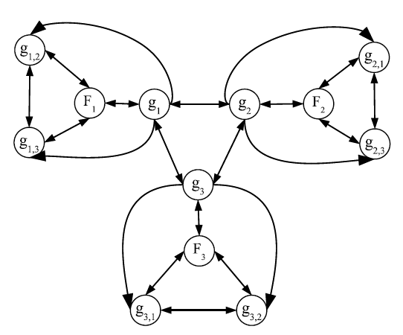
g₁ – g₃ are good peers
F₁ – F₃ are virtual bad sources acting with different inputs
g_{i,j} are virtual good peer of node j to node i

Slide 52
Byzantine Broadcast: n nodes, f faults
Broadcast algorithm solves Equality (MEQ-AD)problem for each subset of (n-f) nodes
n-choose-(n-f) such subsets
Each link belongs to (n-2)-choose-(n-f-2) such subsets
Complexity of broadcast lower bounded by
EQ * n-choose-(n-f) / (n-2)-choose-(n-f-2)

Slide 53
Open Problems

Slide 54
Open Problems
Characterizations of communication complexity for point-to-point networks
  Alternatives to Yao model seem more appropriate
Equality for larger networks
Lower bounds on
  Equality
  Byzantine consensus
  Byzantine broadcast …

Slide 55
Thanks !

Slide 56
Thanks !

Slide 62
The MEQ(n,M) Problem
n nodes each given x_{i} from {1,…,M}, to check if all x_{i} are equal
Each node i computes EQ_{i}
“Anyone detects” (MEQ-AD)
Notes:
The multiparty equality function problem is defined as this. There are n nodes, each is given a value from 1 to M, and they want to know whether their values are equal or not, by communicating with each other. If the values are not all the same, then at least one of the nodes will know/detect that. If the values are all equal, then no one detects.

Slide 63
Graph Representation an Algorithm
2
1, f₁
4, f₄
5, f₅
2, f₂
6, f₆
1
3, f₃
3
Transform to a partially ordered DAG
Notes:
Any protocol that solves the meq problem can be represented as a directed multi graph. Each link represents the symbol begin sent in each step. The numbers next to the links denotes which step this link represents, and the f_i is the function according to which the sender of each step compute what symbol to send.
We can show that, any protocol that solves the meq problem can be transformed to one that the graph is acyclic, and every node only transits to nodes with larger indices.

Slide 64
Graph Representation an Algorithm
2
F_{1,2}
F_{2,3}
1
F_{1,3}
3
F_{i,j} depends on x_{i} only
Notes:
Also, we prove that it’s sufficient for each node to compute the messages it sent only with its input value x. then we can pack the symbol sent in all steps into 1, and the graph looks like this.

Slide 65
Definition of Complexity
Complexity of an algorithm
Complexity of MEQ(n,M)
Notes:
Then the complexity of a protocol is defined as the sum of number of bits communicated between every pair of nodes
And the complexity of a meq problem is the minimum over all protocols that solve it.

Slide 66
Upper Bound by Construction
Send x₁,…, x_{n-1} to node n
Set EQ₁ = … = EQ_{n-1} = 0
Compute EQ_{n} = EQ(x₁,…, x_{n})
➔
Notes:
An upper bound of the meq problem is obtained trivially by construction. Just have nodes 1 to n-1 send their x to node n and let node n compare the values. So the upper bound is n-1 times logM

Slide 67
Cut-Set Lower Bound
Fooling Set argument
- Every node must send + receive ≥ log₂M
➔

Slide 68
Neither bound is tight
MEQ(3,6)
2
F_{1,2}
F_{2,3}
1
F_{1,3}
3
Notes:
we can show that the upper bound is not tight with the counter example of MEQ(3,6).

Slide 69
Proof by Strong Edge Coloring
MEQ(3,M) algorithm
= bipartite graph with M edges
+ distance-2 edge coloring scheme
1,2
1
6,1
2
F_{1,2}
2
3,4
3
2,3
F_{2,3}
1
6
4
F_{1,3}
3
5,6
5
4,5
F_{1,2}
F_{2,3}
F_{1,3}

Slide 70
Summary
Introduce the MEQ problem
Existing techniques give loose bounds
New technique to reduce space
Connection among distributed source coding, distributed algorithm, and graph coloring

Slide 71
Future Work
MEQ(3,M) is open
  Optimize over F_{i,j} = find an optimal bipartite graph + strong coloring
Even given |F_{i,j}| is open
Looking for new techniques

Slide 72
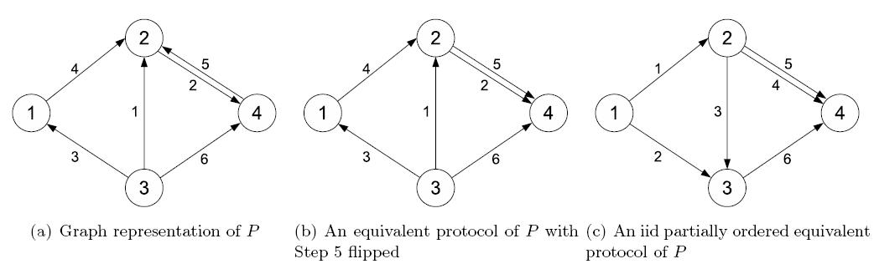

Slide 73
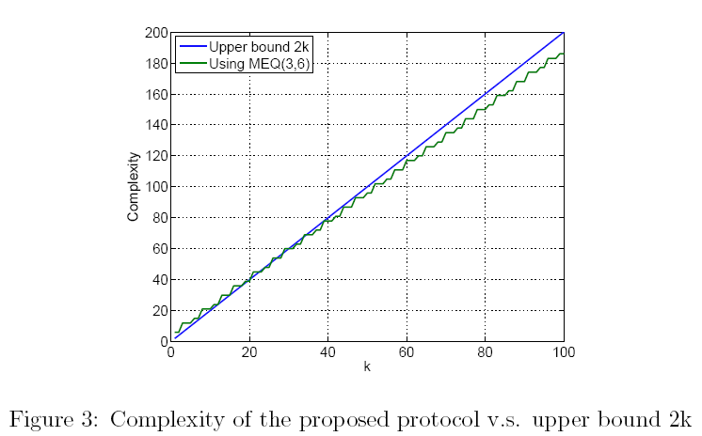

Slide 74
