Slide 1
Tutorial: Part V
Security and Privacy in Distributed Optimization and Learning
Nitin Vaidya
Georgetown University
March 2021

Slide 2
Privacy

Slide 3







Architectures
$$1$$
$$3$$
$$5$$
$$2$$
$$4$$
Server
1
$$2$$
$$3$$

Slide 4



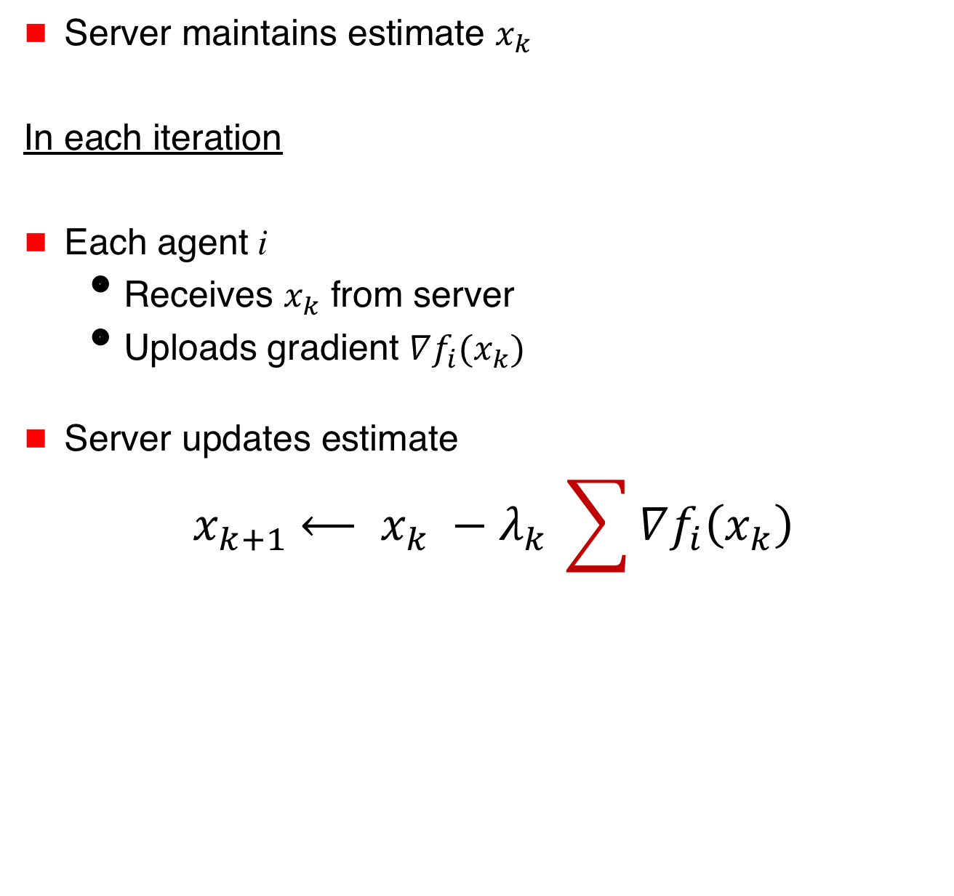

Distributed Optimization
Server maintains estimate $x_{k}$
In each iteration
Each agent i
  Receives $x_{k}$ from server
  Uploads gradient $∇f_{i}(x_{k})$
Server updates estimate
$${ x}_{k+1} ⟵ x_{k} −{λ_{k}}_{ }\sum{∇f_{i}\left(x_{k}\right)}$$
$$x_{k}$$
Server
$∇f_{1}(x_{k})$
$∇f_{3}(x_{k})$

Slide 5



$$x_{k}$$
Server
$∇f_{1}(x_{k})$
$∇f_{3}(x_{k})$
Server observes gradients ➔ privacy compromised

Slide 6
$$x_{k}$$
Server
$∇f_{1}(x_{k})$
$∇f_{3}(x_{k})$
Server observes gradients ➔ privacy compromised
Achieve privacy and yet collaboratively optimize

Slide 7





Decentralized Optimization
Each agent maintains local estimate x
In each iteration
Compute weighted average with neighbors’ estimates
Apply own gradient to own estimate
Local estimates converge to
i
$$f_{1}$$
$$f_{3}$$
$$f_{5}$$
$$f_{2}$$
$$f_{4}$$

Slide 8
x₁
x₂
x₃
x₃
x₃
$$f_{1}$$
$$f_{3}$$

Slide 9
Peer-to-Peer Architecture
Neighbors can potentially learn information about an agent’s cost function
$$f_{1}$$
$$f_{3}$$
$$f_{5}$$
$$f_{2}$$
$$f_{4}$$

Slide 10
Approaches for Privacy

Slide 11
Approaches for Privacy
Cryptographic methods
Differential privacy
Function transformation

Slide 12



Encryption
Basic idea: Agents send encrypted information to the server (or peers)
Server performs computation on encrypted data
Need practical/efficient encryption mechanisms
$$x_{k}$$
Server
$∇f_{1}(x_{k})$
$∇f_{3}(x_{k})$

Slide 13


Differential Privacy
[Shokri, Shmatikov 2015]
Agents add Laplace distributed noise to the gradients
$$x_{k}$$
Server
$$∇f_{1}(x_{k})+εk$$

Slide 14
Differential Privacy for Machine Learning
[Shokri, Shmatikov 2015]
Agents add Laplace distributed noise to the gradients
$$x_{k}$$
Server
$$∇f_{1}(x_{k})+εk$$
Goal: Make it difficult to determine if a particular
data item was used during training

Slide 15




Differential Privacy
Server
$$∇f_{i}\left(x_{k}\right)+εk$$
$$f_{1}$$
$$f_{2}$$
$$f_{3}$$
Trade-off privacy with accuracy

Slide 16
Decentralized Optimization
Each agent maintains local estimate x
In each iteration
Compute weighted average with neighbors’ estimates
Apply own gradient to own estimate
Local estimates converge to
i
$$f_{1}$$
$$f_{3}$$
$$f_{5}$$
$$f_{2}$$
$$f_{4}$$

Slide 17
x₁
x₂
x₃
x₃
x₃
$$f_{1}$$
$$f_{3}$$

Slide 18
Differential Privacy for
Peer-to-Peer Architecture
[Huang, Mitra, Vaidya 2015 , 2014]
Agents add noise to their estimate before sharing with the neighbors

Slide 19
Other Work
Several other papers on differential privacy for optimization (such as Dobbe et al. 2020, Showkatbakhsh et al. 2015)

Slide 20
Federated Architecture
[Kairouz et al 2018]
Server maintains estimate $x_{k}$
$$x_{k}$$
Server

Slide 21

Federated Architecture
[Kairouz et al 2018]
Server maintains estimate $x_{k}$
In each iteration
Each agent i
  Receive $x_{k}$ from server
$$x_{k}$$
Server

Slide 22



Federated Architecture
Server maintains estimate $x_{k}$
In each iteration
Each agent i
  Receive $x_{k}$ from server
  Compute $y_{k}=x_{k}−λ_{k}∇f_{i}(x_{k})$
  Send $y_{k}$ to server
$$x_{k}$$
Server
$$y_{1}$$
$$y_{3}$$

Slide 23
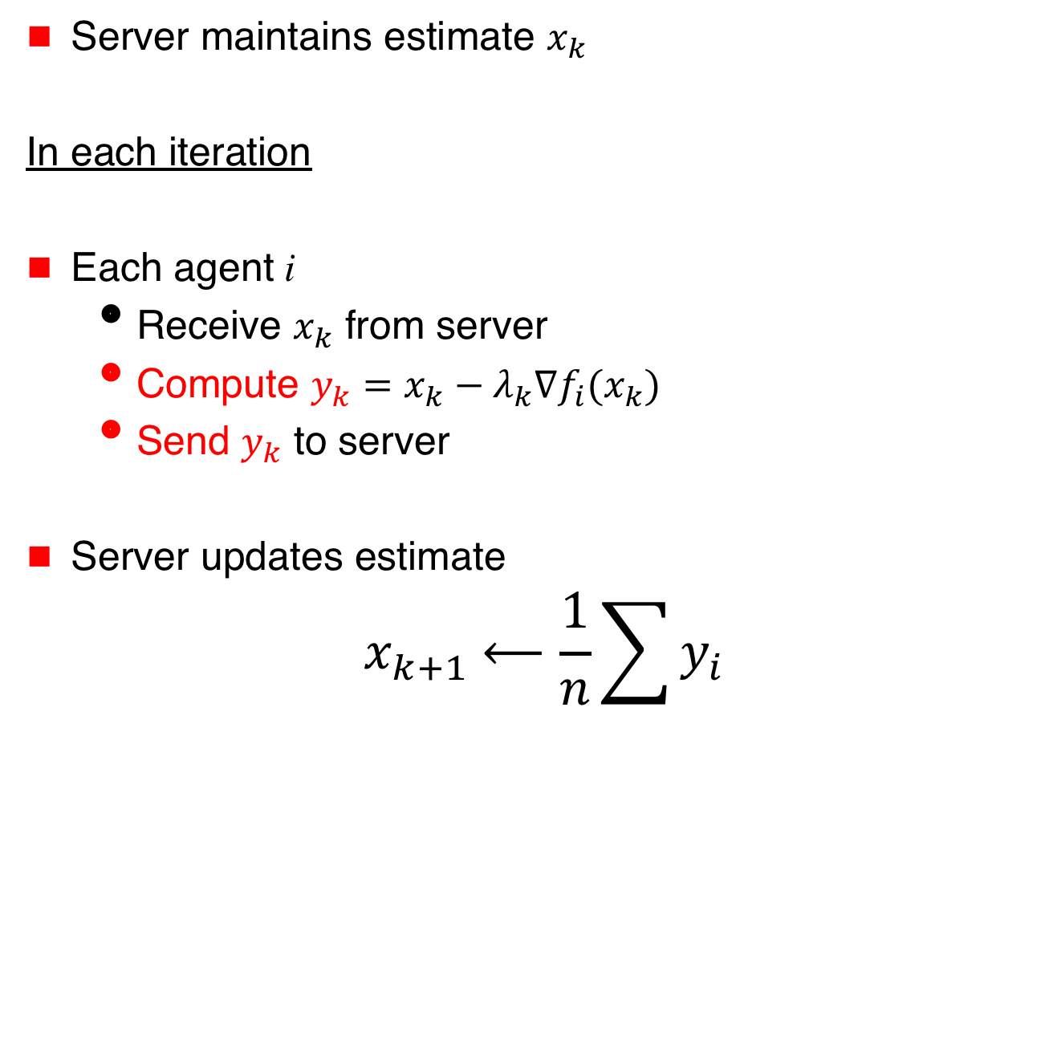
Federated Architecture
Server maintains estimate $x_{k}$
In each iteration
Each agent i
  Receive $x_{k}$ from server
  Compute $y_{k}=x_{k}−λ_{k}∇f_{i}(x_{k})$
  Send $y_{k}$ to server
Server updates estimate
$${ x}_{k+1} ⟵\frac{1}{n}\sum{y_{i}}$$
$$x_{k}$$
Server
$$y_{1}$$
$$y_{3}$$

Slide 24
Federated Architecture
Server maintains estimate $x_{k}$
In each iteration
Each agent i
  Receive $x_{k}$ from server
  Compute $y_{k}=x_{k}−λ_{k}∇f_{i}(x_{k})$
  Send $y_{k}$ to server
Server updates estimate
$${ x}_{k+1} ⟵\frac{1}{n}\sum{y_{i}}$$
$$x_{k}$$
Server
$$y_{1}$$
$$y_{3}$$

Slide 25
Federated Architecture
Server maintains estimate $x_{k}$
In each iteration
Each agent i
  Receive $x_{k}$ from server
  Compute $y_{k}=x_{k}−λ_{k}∇f_{i}(x_{k})$
  Send $y_{k}$ to server
Server updates estimate
$${ x}_{k+1} ⟵\frac{1}{n}\sum{y_{i}}$$
$$x_{k}$$
Server
$$y_{1}$$
$$y_{3}$$
Replace single step
by multiple steps

Slide 26
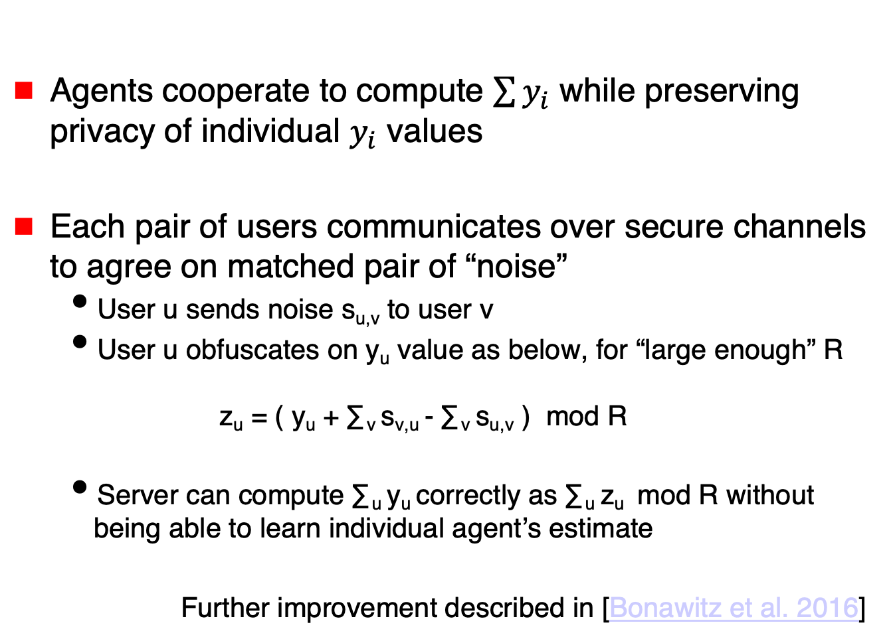
Private Federated Learning
[Bonawitz et al. 2016]
Agents cooperate to compute $\sum{y_{i}}$ while preserving privacy of individual $y_{i}$ values
Each pair of users communicates over secure channels to agree on matched pair of “noise”
  User u sends noise s_{u,v} to user v
  User u obfuscates on y_{u} value as below, for “large enough” R
  z_{u} = ( y_{u} + ∑_{v} s_{v,u} - ∑_{v} s_{u,v} ) mod R
  Server can compute ∑_{u} y_{u} correctly as ∑_{u} z_{u} mod R without being able to learn individual agent’s estimate
  Further improvement described in [Bonawitz et al. 2016]

Slide 27
Secure Sum
Similar concept introduced in [Abbe et al. 2012] for secure aggregation

Slide 28
Balanced Noise
Exploit diversity … Multiple servers / neighbors
Introduce noise that is “cancellable”
  [Bonawitz et al. 2016, Abbe 2012] also introduce balanced noise, but it is utilized differently (also, no modulo operation used in schemes to be presented next)

Slide 29



Server-Based Architecture: Balanced Noise
[Gade,Vaidya 2016, 2016a]
Server 1
Server 2
$$f_{1}$$
$$f_{2}$$
$$f_{3}$$
Privacy if subset of servers adversarial

Slide 30
Balanced Noise
Structured noise that
“cancels” over servers/neighbors

Slide 31



Intuition
x¹
x²
Server 1
Server 2
$$f_{1}$$
$$f_{2}$$
$$f_{3}$$

Slide 32






Intuition
x¹
x²
Server 1
Server 2
$$f_{11}$$
$$f_{12}$$
$$f_{21}$$
$$f_{22}$$
$$f_{31}$$
$$f_{32}$$
Each client
simulates
multiple clients

Slide 33
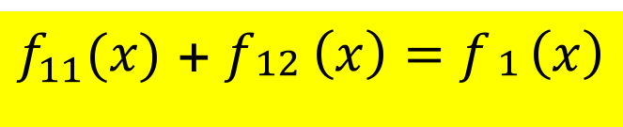
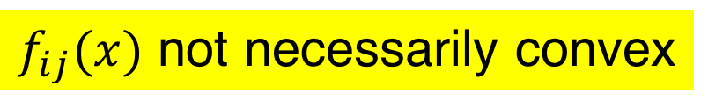
Intuition
x¹
x²
Server 1
Server 2
$$f_{11}$$
$$f_{12}$$
$$f_{21}$$
$$f_{22}$$
$$f_{31}$$
$$f_{32}$$
$f_{11}(x)$ + $f_{\begin{aligned}12 \\ \end{aligned}}\left(x\right)=f_{\begin{aligned}1 \\ \end{aligned}}\left(x\right)$
$f_{ij}(x)$ not necessarily convex

Slide 34
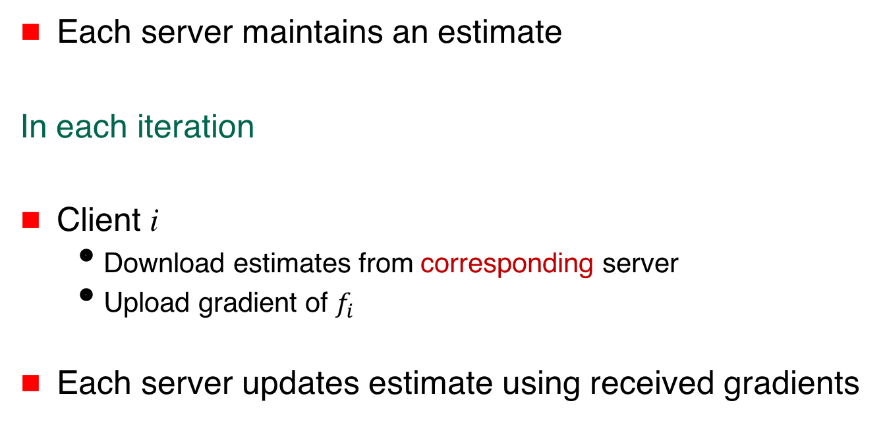
Algorithm
Each server maintains an estimate
In each iteration
Client i
  Download estimates from corresponding server
  Upload gradient of $f_{i}$
Each server updates estimate using received gradients

Slide 35
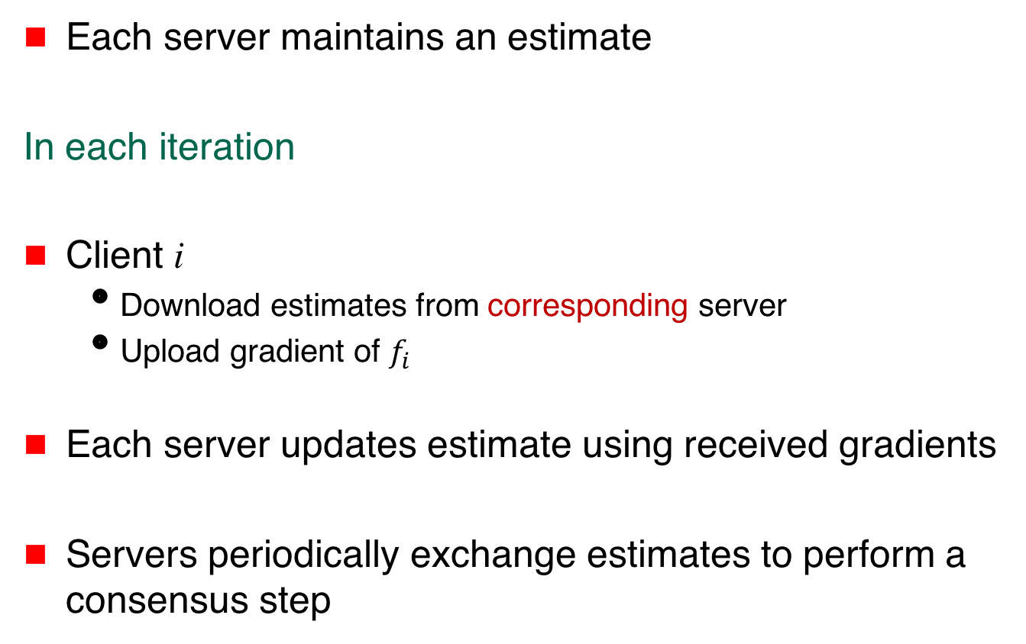
Algorithm
Each server maintains an estimate
In each iteration
Client i
  Download estimates from corresponding server
  Upload gradient of $f_{i}$
Each server updates estimate using received gradients
Servers periodically exchange estimates to perform a consensus step

Slide 36
Claim
Under suitable assumptions, servers eventually reach consensus in
i

Slide 37





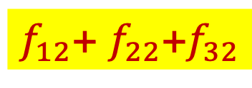

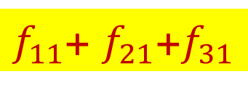
Privacy
$f_{11}$+ $f_{21}$+$f_{31}$
$f_{12}$+ $f_{22}$+$f_{32}$
Server 1
Server 2
$$f_{11}$$
$$f_{12}$$
$$f_{21}$$
$$f_{22}$$
$$f_{31}$$
$$f_{32}$$

Slide 38

Privacy
$f_{11}$+ $f_{21}$+$f_{31}$
$f_{12}$+ $f_{22}$+$f_{32}$
Server 1 may learn $f_{11},$ $f_{21}, f_{31}$, $f_{12}$+ $f_{22}$+$f_{32}$
Not sufficient to learn $f_{i}$
Server 1
Server 2
$$f_{11}$$
$$f_{12}$$
$$f_{21}$$
$$f_{22}$$
$$f_{31}$$
$$f_{32}$$

Slide 39
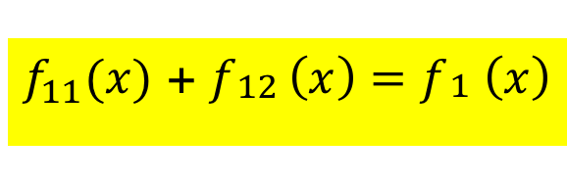
$f_{11}(x)$ + $f_{\begin{aligned}12 \\ \end{aligned}}\left(x\right)=f_{\begin{aligned}1 \\ \end{aligned}}\left(x\right)$
Function splitting not necessarily practical
Structured randomization as an alternative

Slide 40
Structured Randomization
Multiplicative or additive noise in gradients
Noise cancels over servers

Slide 41


Multiplicative Noise
x¹
x²
Server 1
Server 2
$$f_{1}$$
$$f_{2}$$
$$f_{3}$$

Slide 42
Multiplicative Noise
x¹
x²
Server 1
Server 2
$$f_{1}$$
$$f_{2}$$
$$f_{3}$$

Slide 43
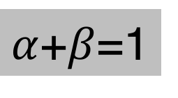

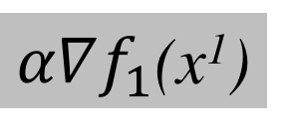
Multiplicative Noise
x¹
x²
Server 1
Server 2
$α∇f_{1}$(x¹)
$$β∇f_{1}(x2)$$
$$f_{1}$$
$$f_{2}$$
$$f_{3}$$
$α$+$β$=1

Slide 44
Multiplicative Noise
x¹
x²
Server 1
Server 2
$α∇f_{1}$(x¹)
$$β∇f_{1}(x2)$$
$$f_{1}$$
$$f_{2}$$
$$f_{3}$$
Suffices for this invariant to hold
over a larger number of iterations
$α$+$β$=1

Slide 45
Multiplicative Noise
x¹
x²
Server 1
Server 2
$α∇f_{1}$(x¹)
$$β∇f_{1}(x2)$$
$$f_{1}$$
$$f_{2}$$
$$f_{3}$$
$α$+$β$=1
Noise from client i to server j
not zero-mean

Slide 46
Claim
Under suitable assumptions, servers eventually reach consensus in
i

Slide 47
Peer-to-Peer Architecture
[Gade, Vaidya 2016, 2017,
Gupta,Chopra 2019, Gupta et al. 2020]
$$f_{1}$$
$$f_{3}$$
$$f_{5}$$
$$f_{2}$$
$$f_{4}$$

Slide 48
Balanced Noise
[Gade, Vaidya 2016, 2017]
Each agent shares noisy estimate with neighbors
    Scheme 1 – Noise cancels over neighbors
    Scheme 2 – Noise cancels network-wide
$$f_{1}$$
$$f_{3}$$
$$f_{5}$$
$$f_{2}$$
$$f_{4}$$

Slide 49
Balanced Noise
[Gade, Vaidya 2016, 2017]
Each agent shares noisy estimate with neighbors
    Scheme 1 – Noise cancels over neighbors
    Scheme 2 – Noise cancels network-wide
x + ε₁
ε₁ + ε₂ = 0 (over iterations)
$$f_{1}$$
$$f_{3}$$
$$f_{2}$$
x + ε₂
$$f_{5}$$
$$f_{4}$$

Slide 50
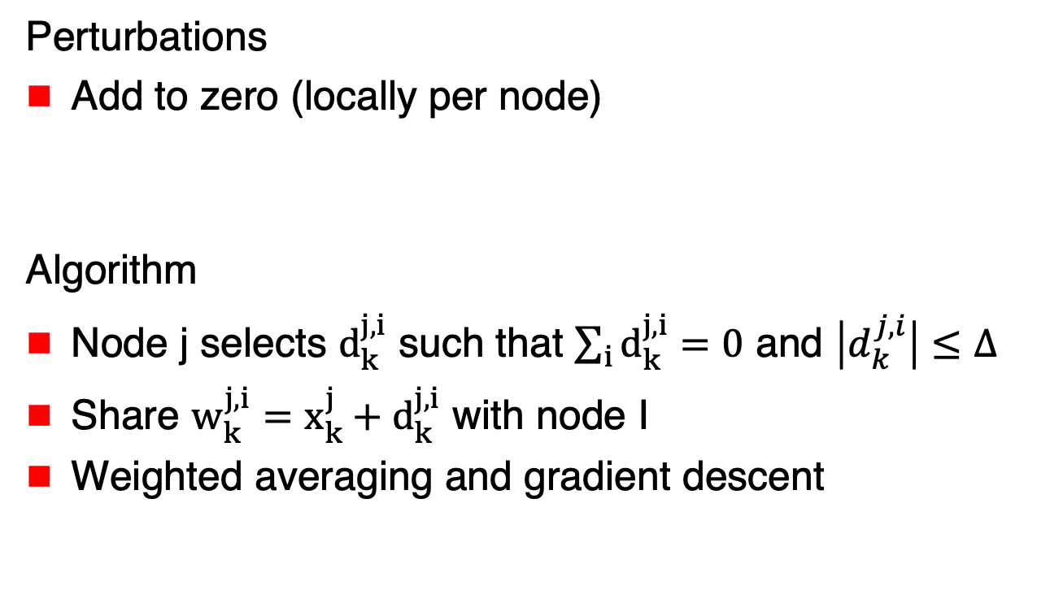
Locally Balanced Noise
Perturbations
Add to zero (locally per node)
Algorithm
Node j selects $d_{k}^{j,i}$ such that $\sum_{i}{d_{k}^{j,i}}=0$ and $\left|d_{k}^{j,i}\right|≤Δ$
Share $w_{k}^{j,i}=x_{k}^{j}+d_{k}^{j,i}$ with node I
Weighted averaging and gradient descent

Slide 51
x₁
x₂
x₃
x₃
x₃
$$f_{1}$$
$$f_{3}$$

Slide 52
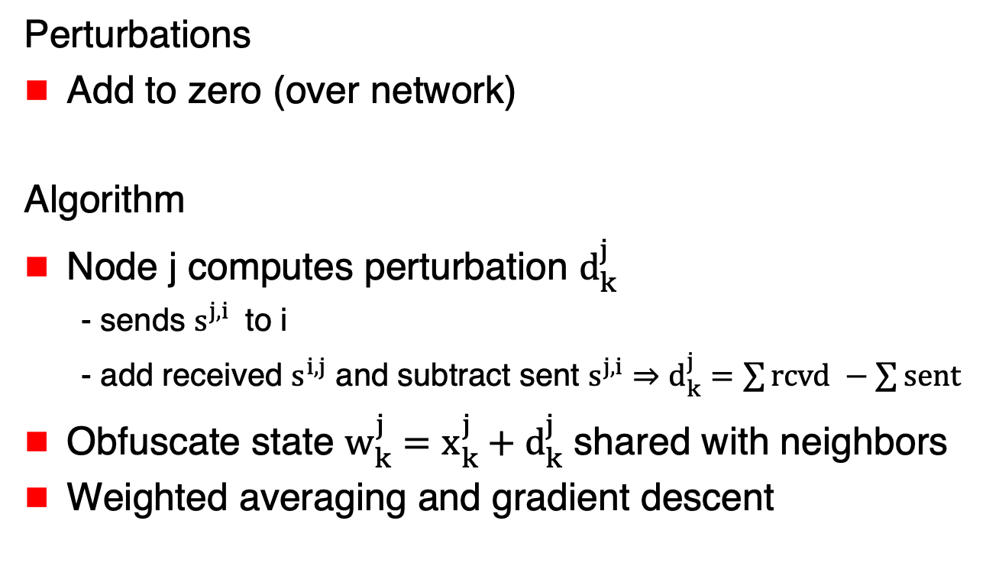
Network Balanced Noise
Perturbations
Add to zero (over network)
Algorithm
Node j computes perturbation $d_{k}^{j}$
  - sends $s^{j,i}$ to i
  - add received $s^{i,j}$ and subtract sent $s^{j,i}$ $⇒d_{k}^{j}=\sum{rcvd −\sum{sent}}$
Obfuscate state $w_{k}^{j}=x_{k}^{j}+d_{k}^{j}$ shared with neighbors
Weighted averaging and gradient descent

Slide 53
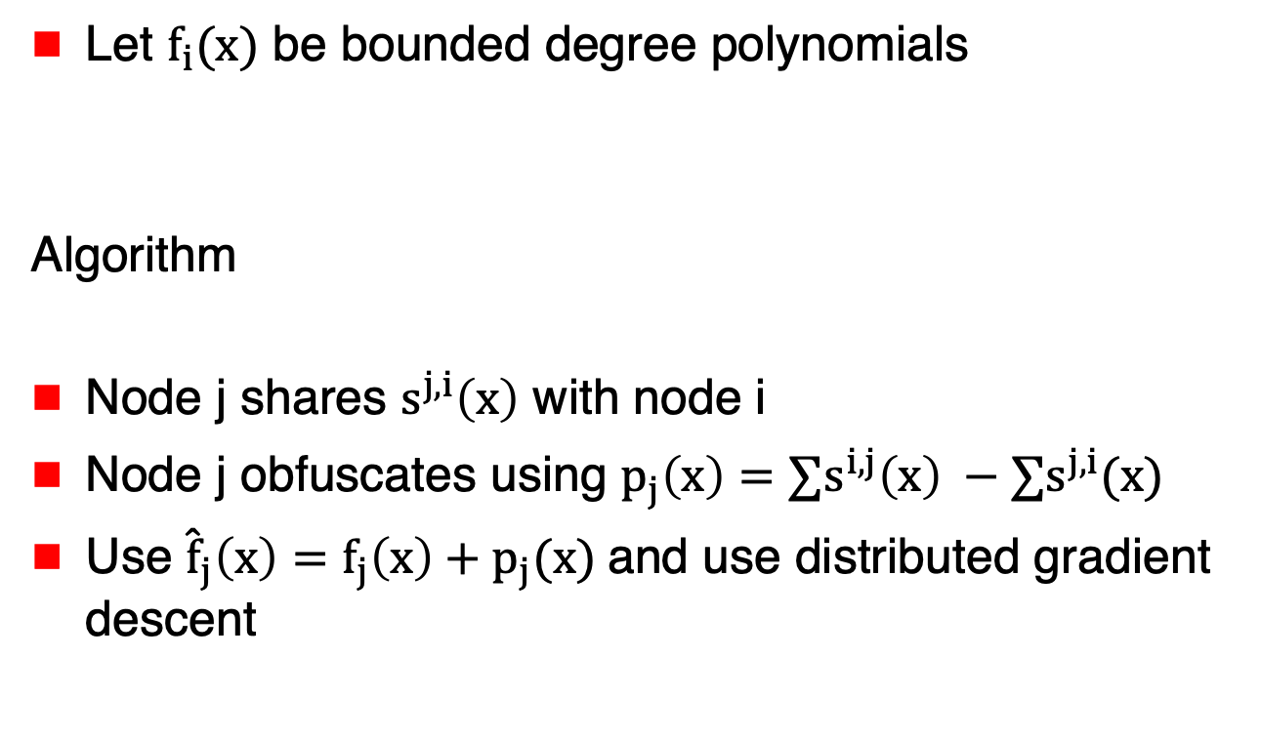
Function Sharing
Let $f_{i}(x)$ be bounded degree polynomials
Algorithm
Node j shares $s^{j,i}\left(x\right)$ with node i
Node j obfuscates using $p_{j}\left(x\right)=∑s^{i,j}\left(x\right) −∑s^{j,i}(x)$
Use ${\hat{f}}_{j}\left(x\right)=f_{j}\left(x\right)+p_{j}(x)$and use distributed gradient descent

Slide 54
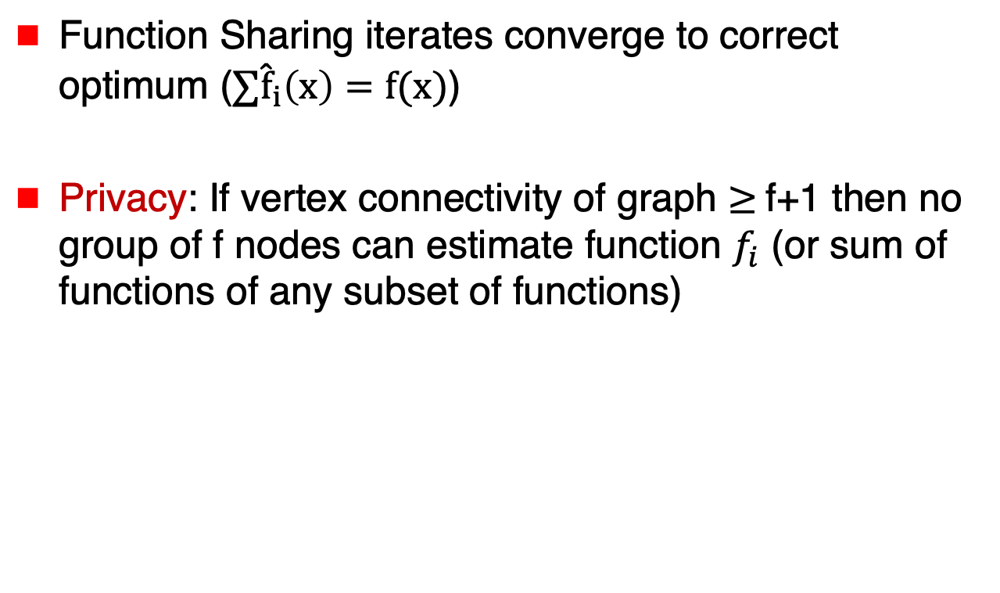
Function Sharing
Function Sharing iterates converge to correct optimum ($∑{\hat{f}}_{i}\left(x\right)=f(x)$)
Privacy: If vertex connectivity of graph $≥$f+1 then no group of f nodes can estimate function $f_{i}$ (or sum of functions of any subset of functions)

Slide 55
Summary
Several different approaches for privacy in optimization/learning
More work needed to develop practical schemes that maintain accuracy and yet achieve strong privacy guarantees

Slide 56
Summary
Tutorial provides only a limited overview of past work
Longer version of the tutorial available from http://disc.georgetown.domains/talks.htm

Slide 57
Acknowledgements
Some of our results presented in the tutorial resulted from work supported in part by the National Science Foundation and Army Research Laboratory. The views and conclusions presented are those of the authors and should not be interpreted as representing the official policies, either expressed or implied, of the Army Research Laboratory, National Science Foundation or the U.S. Government.

Slide 58
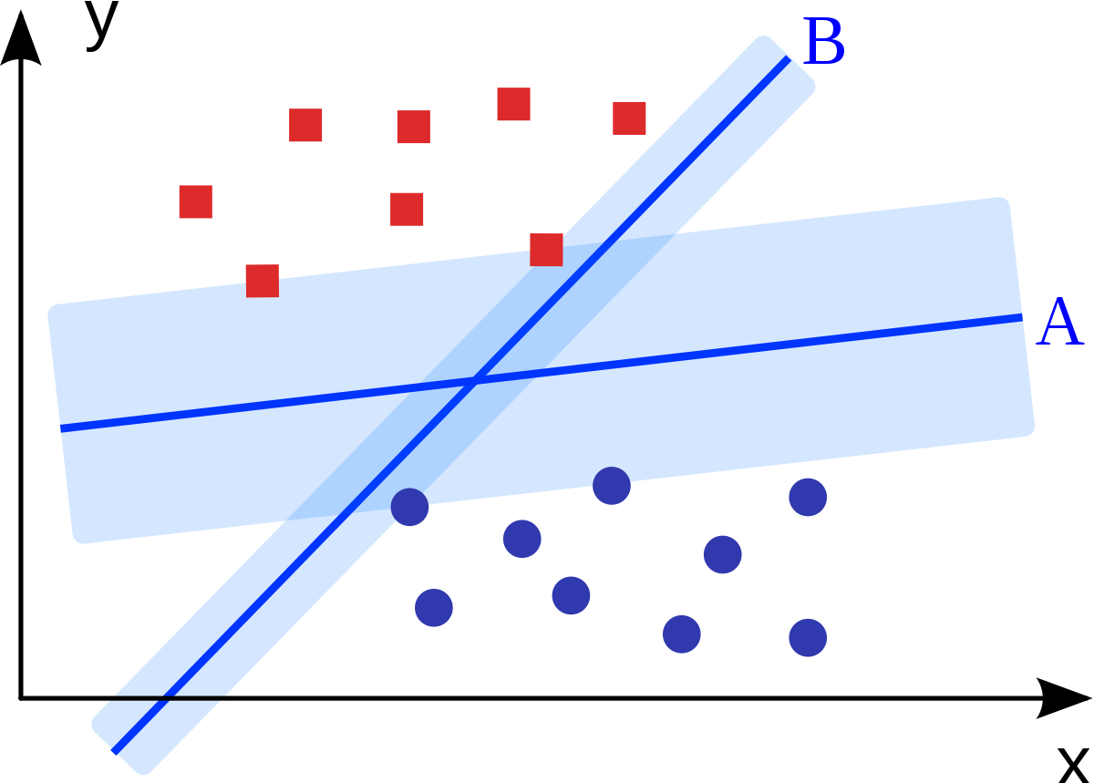
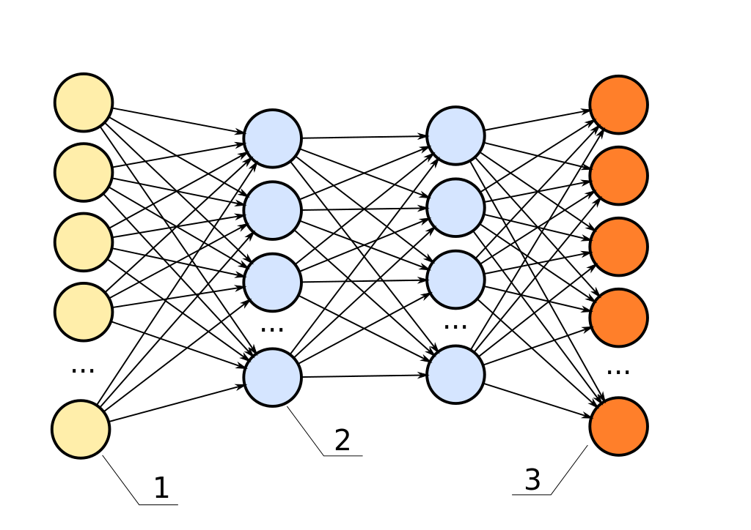
Attribution for Images
Krishnavedala, CC BY-SA 3.0 <https://creativecommons.org/licenses/by-sa/3.0>,
via Wikimedia Commons
https://upload.wikimedia.org/wikipedia/commons/1/12/Paraboloid_of_Revolution.svg
https://commons.wikimedia.org/wiki/File:Paraboloid_of_Revolution.svg
Ennepetaler86, CC BY 3.0 <https://creativecommons.org/licenses/by/3.0>,
via Wikimedia Commons
https://upload.wikimedia.org/wikipedia/commons/f/f2/Svm_intro.svg
https://commons.wikimedia.org/wiki/File:Svm_intro.svg
Zufzzi, Public domain, via Wikimedia Commons
https://commons.wikimedia.org/wiki/File:Neural_network_bottleneck_achitecture.svg
https://upload.wikimedia.org/wikipedia/commons/8/8b/Neural_network_bottleneck_achitecture.svg

