Slide 1
Tutorial : Part IV
Distributed Optimization and Machine Learning:
Security and Privacy
Nitin Vaidya
Georgetown University
March 2021

Slide 2
Fault-Tolerant / Secure
Optimization & Machine Learning
2015 …

Slide 3
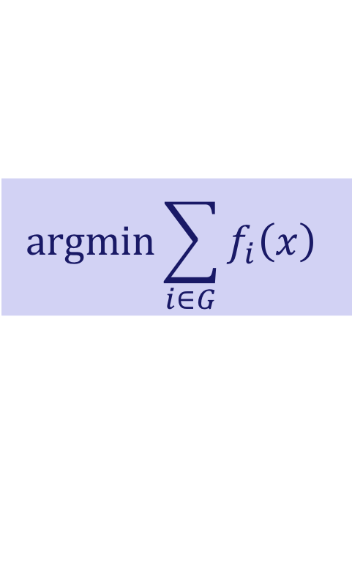
$$\text{argmin}\sum_{i∈G}{f_{i}\left(x\right)}$$
Independent
Functions:
No Redundancy
Functions with
Redundancy
Exact
Resilience
Approximate
Resilience

Slide 4
$$\text{argmin}\sum_{i∈G}{f_{i}\left(x\right)}$$
Functions with
Redundancy
Exact
Resilience

Slide 5
Exact Resilience:
Necessary and Sufficient Condition
[Gupta,Vaidya 2020]
t-Resilience achievable iff
cost functions satisfy
2t-Redundancy

Slide 6

Exact Resilience
t-Resilience
Output in $\text{argmin}\sum_{i∈G}{f_{i}\left(x\right)}$ despite
the presence of up to t faulty agents

Slide 7
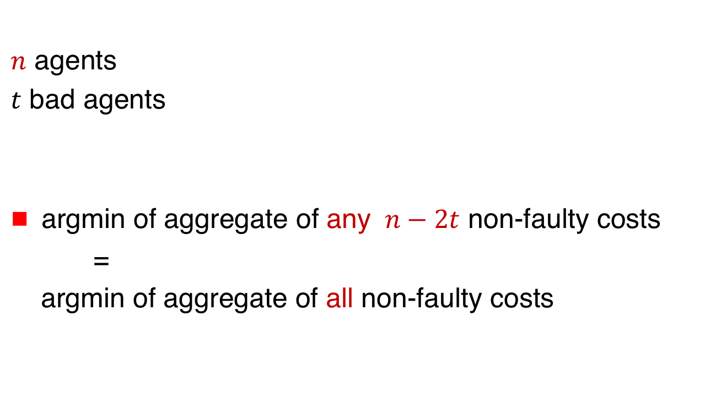
2t-Redundancy
[Gupta,Vaidya 2020]
$n$ agents
$t$ bad agents
argmin of aggregate of any $n−2t$ non-faulty costs
=
argmin of aggregate of all non-faulty costs

Slide 8
$$\text{argmin}\sum_{i∈G}{f_{i}\left(x\right)}$$
Independent
Functions:
No Redundancy
Functions with
Redundancy
Exact
Resilience
Approximate
Resilience

Slide 9
$$\text{argmin}\sum_{i∈G}{f_{i}\left(x\right)}$$
Functions with
Redundancy
Approximate
Resilience
Depends on redundancy
in agents’ cost functions

Slide 10

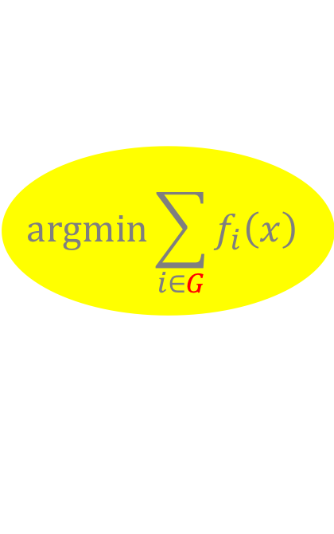
Approximate Resilience
[Liu,Gupta,Vaidya 2021]
Intuition: Compute a point within distance $ε$ of
$\text{argmin}\sum_{i∈G}{f_{i}\left(x\right)}$ $G$ = all good agents
$$\text{argmin}\sum_{i∈G}{f_{i}\left(x\right)}$$
ε

Slide 11

Approximate Resilience
Intuition: Compute a point within distance $ε$ of
$\text{argmin}\sum_{i∈G}{f_{i}\left(x\right)}$ $G$ = all good agents
Potentially, any $n−t$ (or more) agents form set $G$
$$\text{argmin}\sum_{i∈G}{f_{i}\left(x\right)}$$
ε

Slide 12


Approximate Resilience
$(t,ε)$-Resilience
$$\text{argmin}\sum_{i∈S}{f_{i}\left(x\right)}$$
ε

Slide 13

Approximate Resilience
$(t,ε)$-Resilience
Compute a point within distance $ε$ of $\text{argmin}\sum_{i∈S}{f_{i}\left(x\right)}$
for every non-faulty subset $S$of size $n−t$
$$\text{argmin}\sum_{i∈S}{f_{i}\left(x\right)}$$
ε

Slide 14
Approximate Resilience
Similar resilience requirements have been studied in the context of
Robust statistics (e.g., robust mean estimation
e.g., [Charikar et al. 2017][Steinhard et al. 2017])
Fault-tolerant state estimation
(e.g., [Mishra et al 2016, 2015] [Su,Shahramour 2018])

Slide 15

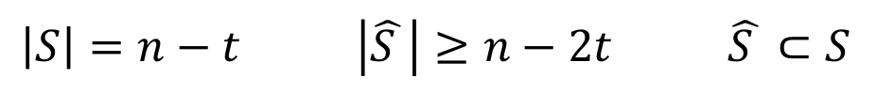
$(2t,ε)$-Redundancy
[Liu,Gupta,Vaidya 2021]
$$\left|S\right|=n−t \left|\hat{S }\right|≥n−2t \hat{S }⊂S$$

Slide 16

$(2t,ε)$-Redundancy
➔
$$\left|S\right|=n−t \left|\hat{S }\right|≥n−2t \hat{S }⊂S$$

Slide 17





Linear Regression
Agent $i$ knows $A_{i}$ and $y_{i}$ where
$y_{i}= A_{i}{ x}^{∗}+{Noise}_{i}$
$$y_{1}$$
$$A_{1}$$
$${ x}^{∗}$$
$$N_{i}$$
=
+

Slide 18

$(2t,ε)$-Redundancy
y_{i}
y

Slide 19
$(2t,ε)$-Redundancy
y_{i}
y
y

Slide 20

$(2t,ε)$-Redundancy
y_{i}
y
$f_{i}\left(x\right)={(B_{i}−A_{i}x)}^{2}$
y
y_{i}

Slide 21

$(2t,ε)$-Redundancy
y_{i}
y
$f_{i}\left(x\right)={(B_{i}−A_{i}x)}^{2}$
y
y_{i}
$$t=1$$
$$ε=0.089$$

Slide 22

Necessary and Sufficient Conditions
[Liu,Gupta,Vaidya 2021]
$(2t,ε)$-Redundancy necessary for $(t,ε)$-Resilience

Slide 23

Necessary and Sufficient Conditions
[Liu,Gupta,Vaidya 2021]
$(2t,ε)$-Redundancy necessary for $(t,ε)$-Resilience
$(2t,ε)$-Redundancy sufficient for $(t,2ε)$-Resilience

Slide 24

Centralized Algorithm
Achieving $(t,2ε)$-Resilience
Agents provide their cost functions to the server: Faulty agents may provide incorrect information

Slide 25

Centralized Algorithm
Achieving $(t,2ε)$-Resilience
Agents provide their cost functions to the server: Faulty agents may provide incorrect information
Consider each subset $T$ of $(n−t)$ agents
and each of its subset of size $(n−2t)$

Slide 26

Centralized Algorithm
Achieving $(t,2ε)$-Resilience
Agents provide their cost functions to the server: Faulty agents may provide incorrect information
Consider each subset $T$ of $(n−t)$ agents
and each of its subset of size $(n−2t)$
choose any

Slide 27
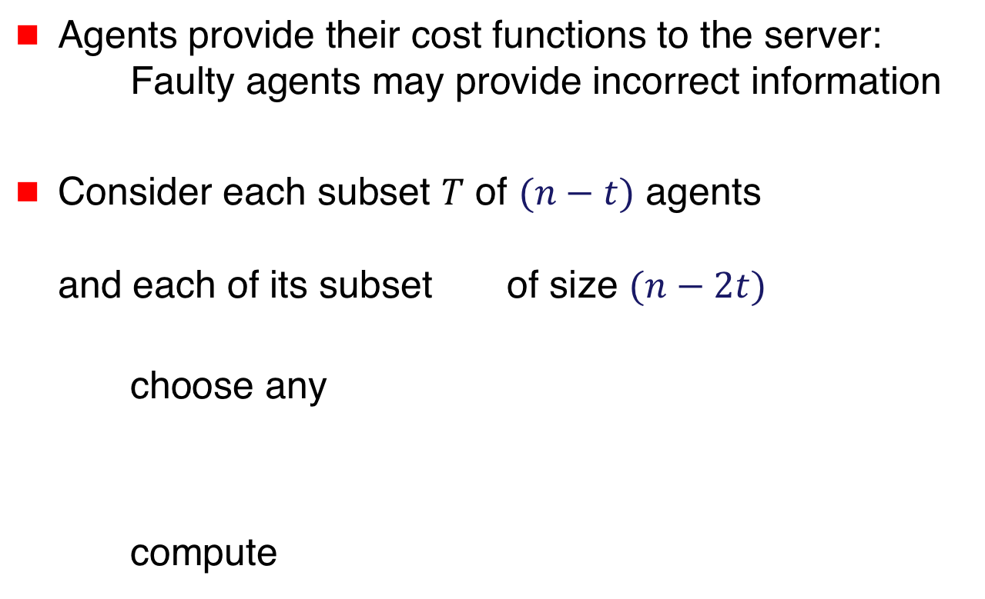
Centralized Algorithm
Achieving $(t,2ε)$-Resilience
Agents provide their cost functions to the server: Faulty agents may provide incorrect information
Consider each subset $T$ of $(n−t)$ agents
and each of its subset of size $(n−2t)$
choose any
compute

Slide 28

$$r_{T}=\max{}$$
argmin T
argmin
for
various
choices
of

Slide 29

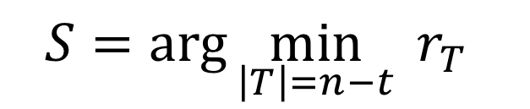
Centralized Algorithm
Achieving $(t,2ε)$-Resilience
Output $x_{s}=$argmin over set S
where S has the smallest radius (among all T)
$$S=\arg{\min_{\left|T\right|=n−t}{r_{T}}}$$

Slide 30

Centralized Algorithm
Achieving $(t,2ε)$-Resilience
Output $x_{s}=$argmin over set S
where S has the smallest radius (among all T)
$(2t,ε)$-Redundancy ➔ $(t,2ε)$-Resilience
$$S=\arg{\min_{\left|T\right|=n−t}{r_{T}}}$$

Slide 31
Distributed Algorithm
Later in the tutorial …

Slide 32
Alternate Notions of
Approximate Fault-Tolerance

Slide 33
Alternate Notions of
Approximate Fault-Tolerance
Nonuniform weighs
  Discussed in the context of independent functions
Distance between output and “true argmin’’
  Earlier slides discussed this approach
Distance between cost at the output and
the “true minimum cost’’ [Jerry Li 2018]

Slide 34
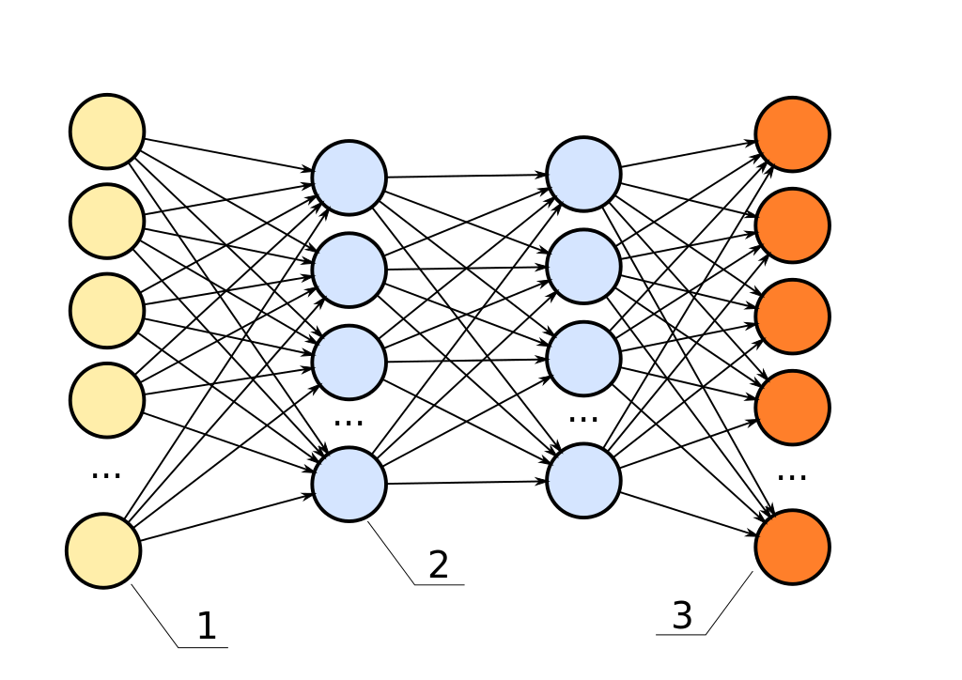


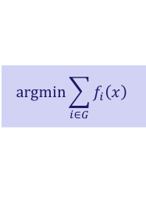



Outline
Basics
Fault-Tolerant
Algorithms
$$\text{argmin}\sum_{i∈G}{f_{i}\left(x\right)}$$
Independent
Functions:
No Redundancy
Functions with
Redundancy
Exact
Resilience
Approximate
Resilience
$$x_{k}$$
Server
$∇f_{1}(x_{k})$
$∇f_{3}(x_{k})$

Slide 35







Architectures
$$1$$
$$3$$
$$5$$
$$2$$
$$4$$
Server
1
$$2$$
$$3$$

Slide 36
Server-Based Architecture
Trusted server
Agents possibly faulty
Server
1
$$2$$
$$3$$

Slide 37
Peer-to-Peer Network:
Special case of complete graph
No trusted nodes
1
2
3
4

Slide 38



Peer-to-Peer (p2p) Network:
Special case of complete graph
Faulty nodes may equivocate
1
2
$$x_{4}=0$$
$$x_{4}=5$$
3
4
$$x_{4}=2$$

Slide 39



Peer-to-Peer (p2p) Network:
Special case of complete graph
Byzantine broadcast [Lamport,Shostak,Pease 1982]
overcomes equivocation
$$x_{4}=0$$
1
2
$$x_{4}=0$$
$$x_{4}=0$$
$$x_{4}=5$$
3
4
$$x_{4}=0$$
$$x_{4}=2$$

Slide 40
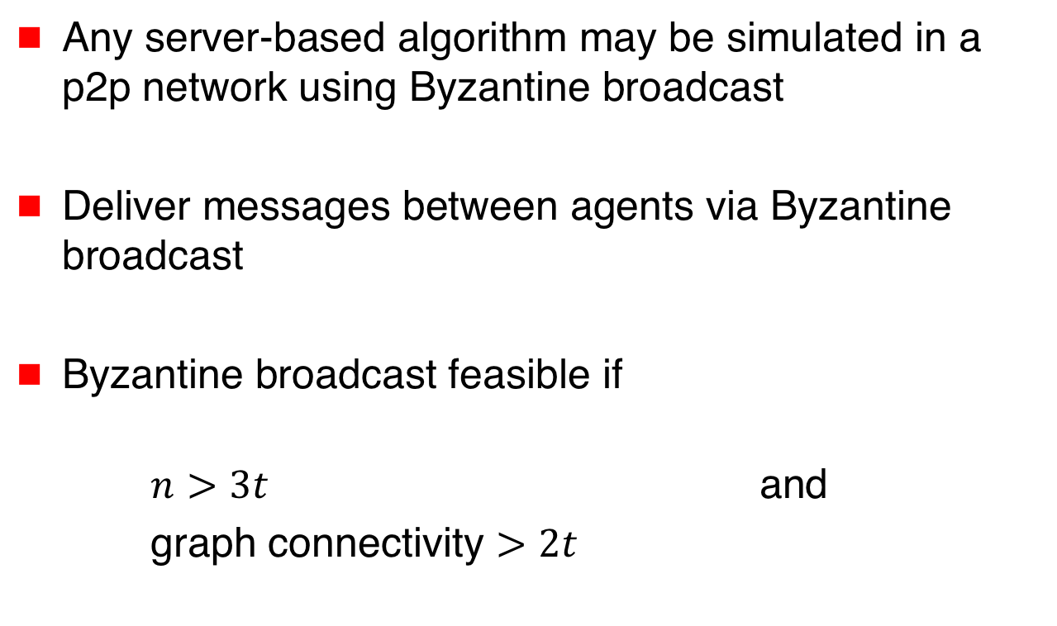
Simulating a Server
Any server-based algorithm may be simulated in a p2p network using Byzantine broadcast
Deliver messages between agents via Byzantine broadcast
Byzantine broadcast feasible if
$n>3t$ and
graph connectivity $>2t$

Slide 41
Simulating a Server
Byzantine broadcast has high communication cost
Fault-tolerant optimization algorithms that do not rely on such broadcast in p2p networks of interest
[Su Vaidya 2016, Gupta-Vaidya 2021]

Slide 42
This Tutorial
We will mostly focus on the server-based architecture

Slide 43

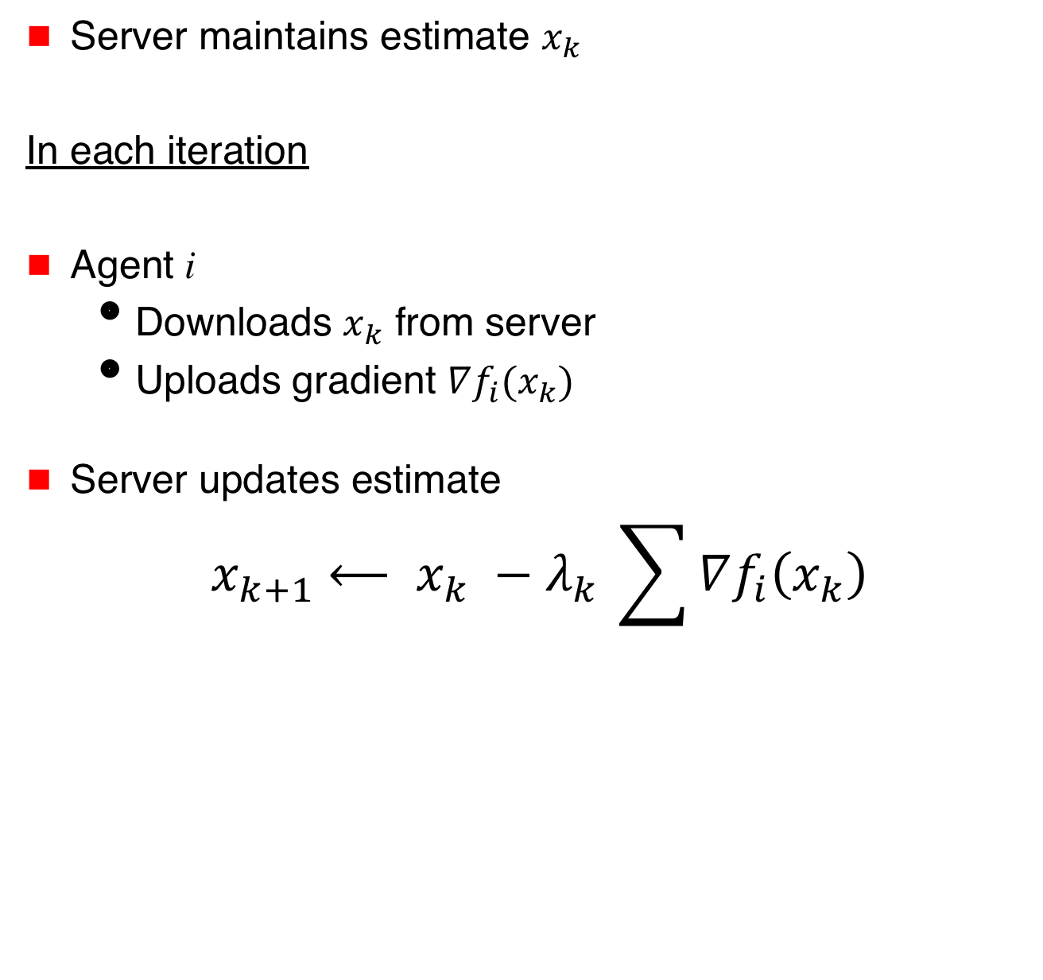


Distributed Optimization
Server maintains estimate $x_{k}$
In each iteration
Agent i
  Downloads $x_{k}$ from server
  Uploads gradient $∇f_{i}(x_{k})$
Server updates estimate
$${ x}_{k+1} ⟵ x_{k} −{λ_{k}}_{ }\sum{∇f_{i}\left(x_{k}\right)}$$
$$x_{k}$$
Server
$∇f_{1}(x_{k})$
$∇f_{3}(x_{k})$

Slide 44
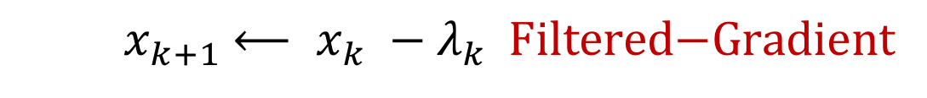
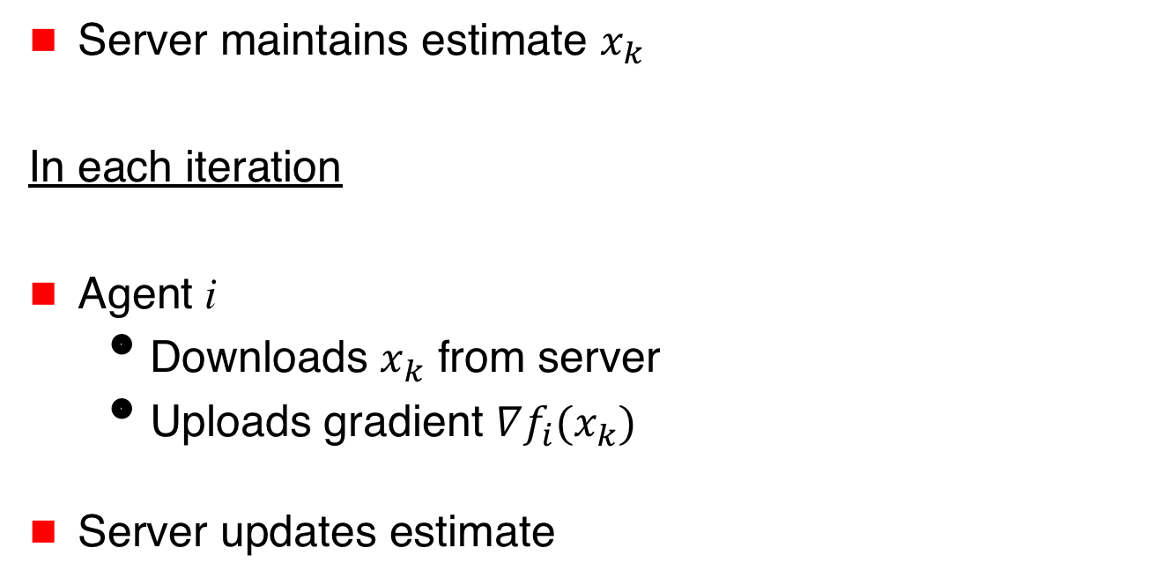
Fault-Tolerant Distributed Optimization
Server maintains estimate $x_{k}$
In each iteration
Agent i
  Downloads $x_{k}$ from server
  Uploads gradient $∇f_{i}(x_{k})$
Server updates estimate
$$x_{k}$$
Server
$∇f_{1}(x_{k})$
$∇f_{3}(x_{k})$
$${ x}_{k+1} ⟵ x_{k} −{λ_{k}}_{ } \text{Filtered}\text{−}\text{Gradient}$$

Slide 45
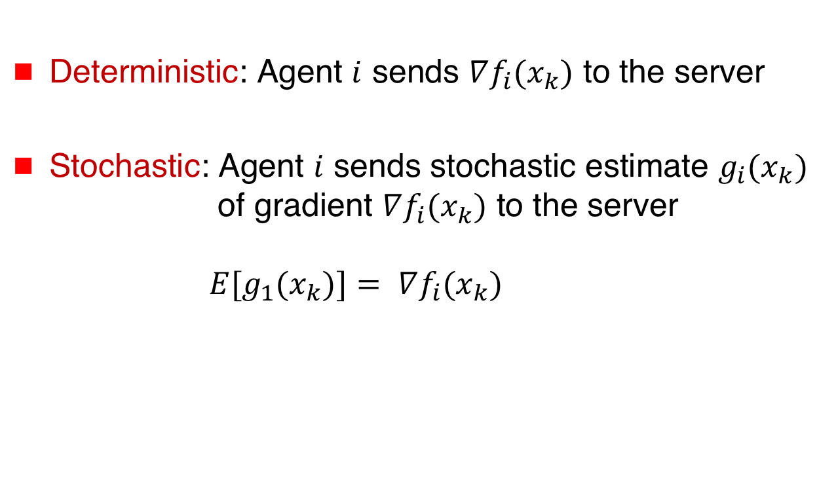
Deterministic versus Stochastic Gradients
Deterministic: Agent $i$ sends $∇f_{i}(x_{k})$ to the server
Stochastic: Agent $i$ sends stochastic estimate $g_{i}(x_{k})$ of gradient $∇f_{i}(x_{k})$ to the server
${E[g}_{1}(x_{k})]= ∇f_{i}(x_{k})$

Slide 46

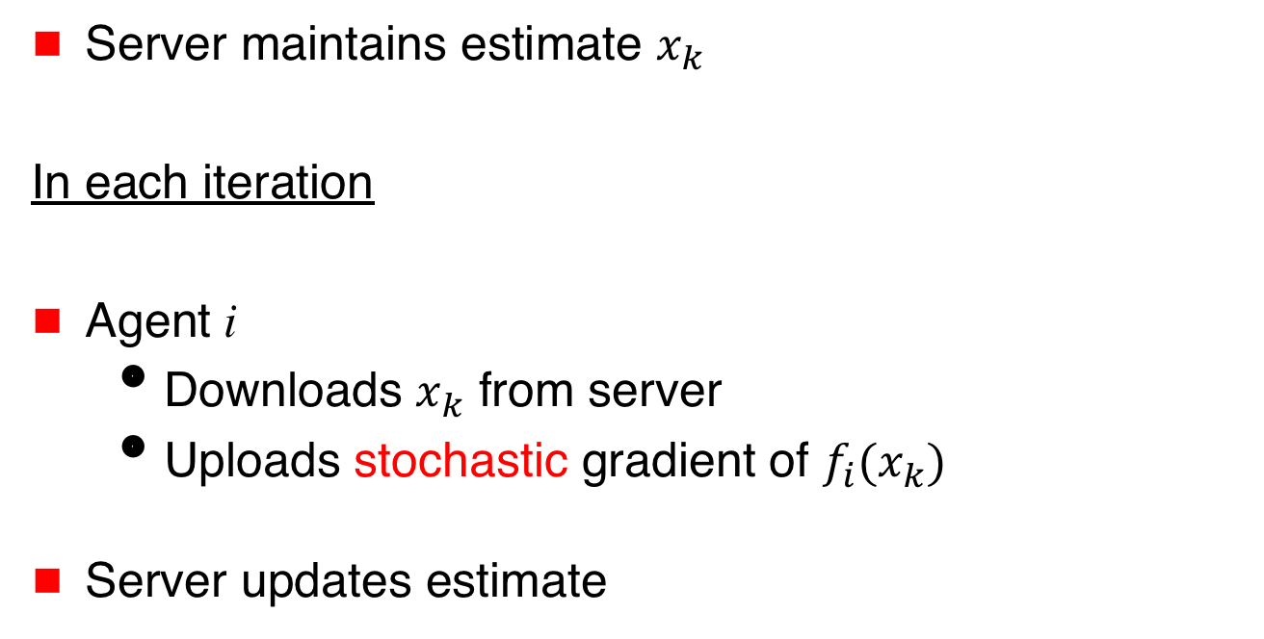


Fault-Tolerant Distributed Optimization
$$x_{k}$$
Server maintains estimate $x_{k}$
In each iteration
Agent i
  Downloads $x_{k}$ from server
  Uploads stochastic gradient of $f_{i}(x_{k})$
Server updates estimate
Server
$g_{1}(x_{k})$
$g_{3}(x_{k})$
$${ x}_{k+1} ⟵ x_{k} −{λ_{k}}_{ } \text{Filtered}\text{−}\text{Stochastic}\text{−}\text{Gradient}$$

Slide 47
Variations
 | Identical cost functions | Non-identical cost functions
Deterministic gradients | Trivial: majority vote on gradients | With or without redundancy
Stochastic gradients | i.i.d. model (commonly assumed in fault-tolerant machine learning) | non-i.i.d. model

Slide 48
Variations
 | Identical cost functions | Non-identical cost functions
Deterministic gradients | Trivial: majority vote on gradients | With or without redundancy
Stochastic gradients | i.i.d. model (commonly assumed in fault-tolerant machine learning) | non-i.i.d. model

Slide 49
Variations
 | Identical cost functions | Non-identical cost functions
Deterministic gradients | Trivial: majority vote on gradients | With or without redundancy
Stochastic gradients | i.i.d. model (commonly assumed in fault-tolerant machine learning) | non-i.i.d. model

Slide 50
Variations
 | Identical cost functions | Non-identical cost functions
Deterministic gradients | Trivial: majority vote on gradients | With or without redundancy
Stochastic gradients | i.i.d. model (commonly assumed in fault-tolerant machine learning) | non-i.i.d. model

Slide 51
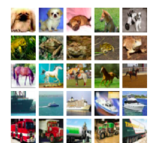
Stochastic Distributed Machine Learning
(i.i.d. model)
Agents draw samples from
identical data distribution
Filter on stochastic gradients
Agent 1
Agent 2

Slide 52
Variations
 | Identical cost functions | Non-identical cost functions
Deterministic gradients | Trivial: majority vote on gradients | With or without redundancy
Stochastic gradients | i.i.d. model (commonly assumed in fault-tolerant machine learning) | non-i.i.d. model

Slide 53
Variations
 | Identical cost functions | Non-identical cost functions
Deterministic gradients | Trivial: majority vote on gradients | With or without redundancy
Stochastic gradients | i.i.d. model (commonly assumed in fault-tolerant machine learning) | non-i.i.d. model

Slide 54
Gradient Filters

Slide 55
Scalar Case
First gradient filter used for scalar argument
[Su & Vaidya 2015]
Extends to vector case by applying the scalar filter elementwise

Slide 56
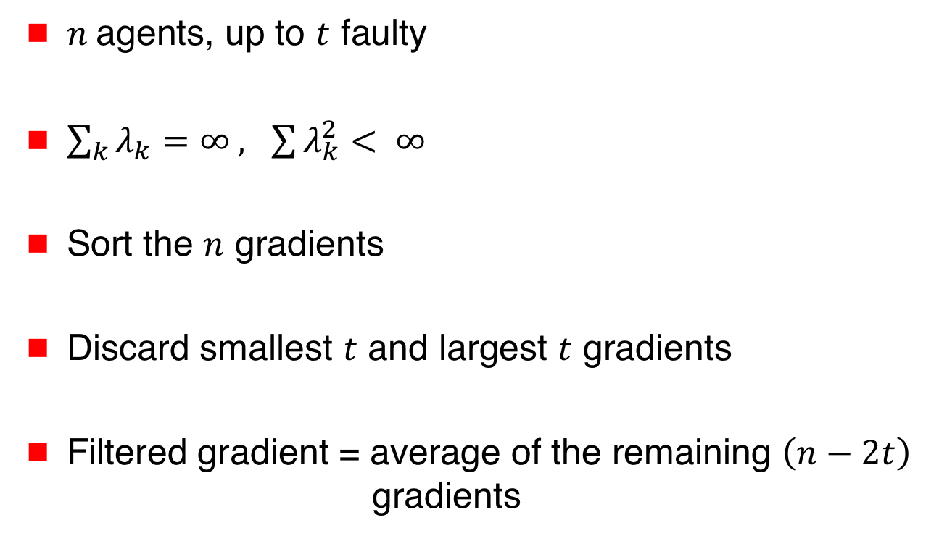
Su and Vaidya [arXiv 2015, PODC 2016]
Scalar Argument
$n$ agents, up to $t$ faulty
$\sum_{k}{λ_{k}=∞ , \sum{λ_{k}^{2}}}< ∞$
Sort the $n$ gradients
Discard smallest $t$ and largest $t$ gradients
Filtered gradient = average of the remaining $\left(n−2t\right)$
gradients

Slide 57
Su and Vaidya [arXiv 2015, PODC 2016]
Scalar Argument
$n$ agents, up to $t$ faulty
$\sum_{k}{λ_{k}=∞ , \sum{λ_{k}^{2}}}< ∞$
Sort the $n$ gradients
Discard smallest $t$ and largest $t$ gradients
Filtered gradient = average of the remaining $\left(n−2t\right)$
gradients
Trimmed mean: Used previously for Byzantine consensus

Slide 58

Su and Vaidya [arXiv 2015, PODC 2016]
Scalar Argument
$$n=7 t=2$$
Gradients received by the server:
-4 -2 0 1 6 8 9

Slide 59

Su and Vaidya [arXiv 2015, PODC 2016]
Scalar Argument
$$n=7 t=2$$
Filtered gradient = $\frac{0+1+6}{3}= \frac{7}{3}$
-4 -2 0 1 6 8 9

Slide 60
Su and Vaidya [arXiv 2015, PODC 2016]
Scalar Argument
[Su Vaidya arXiv 2015] simulates a server-based solution using Byzantine broadcast
[Su Vaidya PODC 2016] does not use Byzantine broadcast

Slide 61
Variations
 | Identical cost functions | Non-identical cost functions
Deterministic gradients | Trivial: majority vote on gradients | With or without redundancy
Stochastic gradients | i.i.d. model (commonly assumed in fault-tolerant machine learning) | non-i.i.d. model

Slide 62
Variations
 | Identical cost functions | Non-identical cost functions
Deterministic gradients | Trivial: majority vote on gradients | With or without redundancy
Stochastic gradients | i.i.d. model (commonly assumed in fault-tolerant machine learning) | non-i.i.d. model
We identify the setting for which each filter
was originally proposed.
The filters may be useful in other settings too.

Slide 63
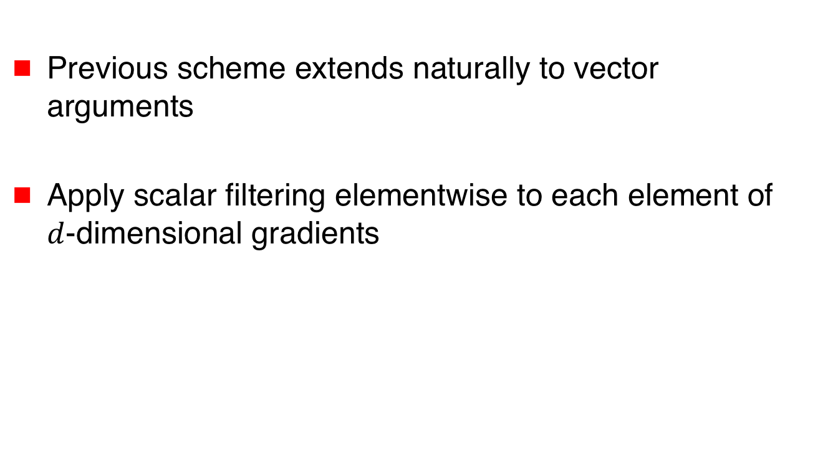
Elementwise Filtering
[Yang,Bajwa 2019, 2019]
Previous scheme extends naturally to vector arguments
Apply scalar filtering elementwise to each element of $d$-dimensional gradients

Slide 64

Elementwise Filtering
[Yang,Bajwa 2019, 2019]
$$n=4 t=1 d=3$$
Gradients received by the server: $\left[\begin{aligned}0 \\ −2 \\ 3\end{aligned}\right],\left[\begin{aligned}−1 \\ 5 \\ 0\end{aligned}\right],$ $\left[\begin{aligned}6 \\ −1 \\ −5\end{aligned}\right]$, $\left[\begin{aligned}7 \\ 8 \\ 2\end{aligned}\right]$

Slide 65
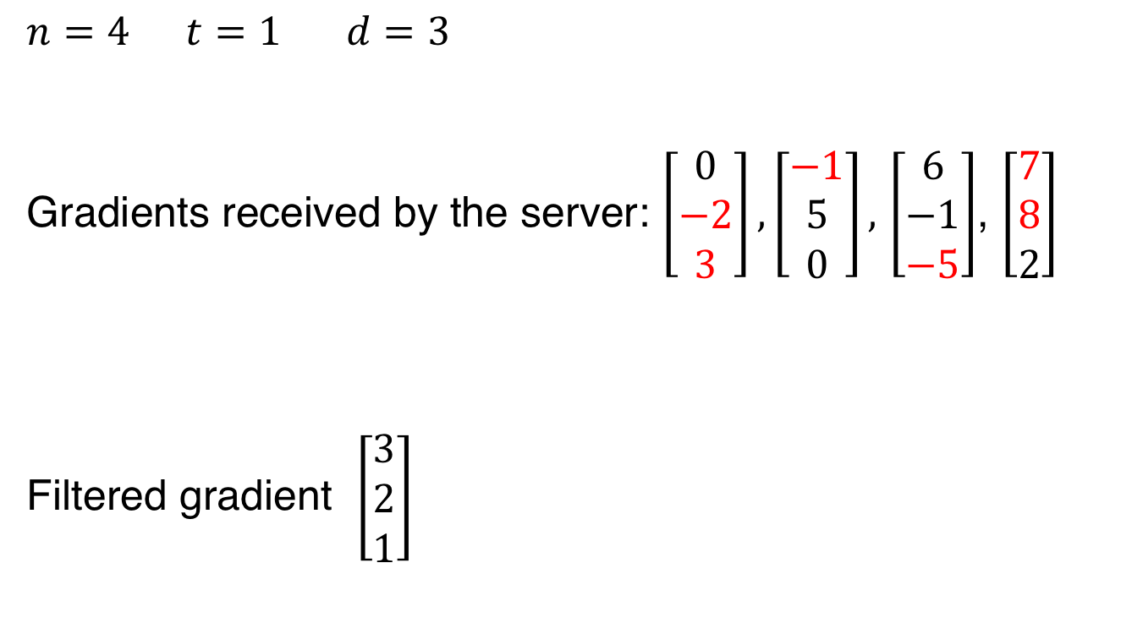
Elementwise Filtering
[Yang,Bajwa 2019, 2019]
$$n=4 t=1 d=3$$
Gradients received by the server: $\left[\begin{aligned}0 \\ −2 \\ 3\end{aligned}\right],\left[\begin{aligned}−1 \\ 5 \\ 0\end{aligned}\right],$ $\left[\begin{aligned}6 \\ −1 \\ −5\end{aligned}\right]$, $\left[\begin{aligned}7 \\ 8 \\ 2\end{aligned}\right]$
Filtered gradient $\left[\begin{aligned}3 \\ 2 \\ 1\end{aligned}\right]$

Slide 66
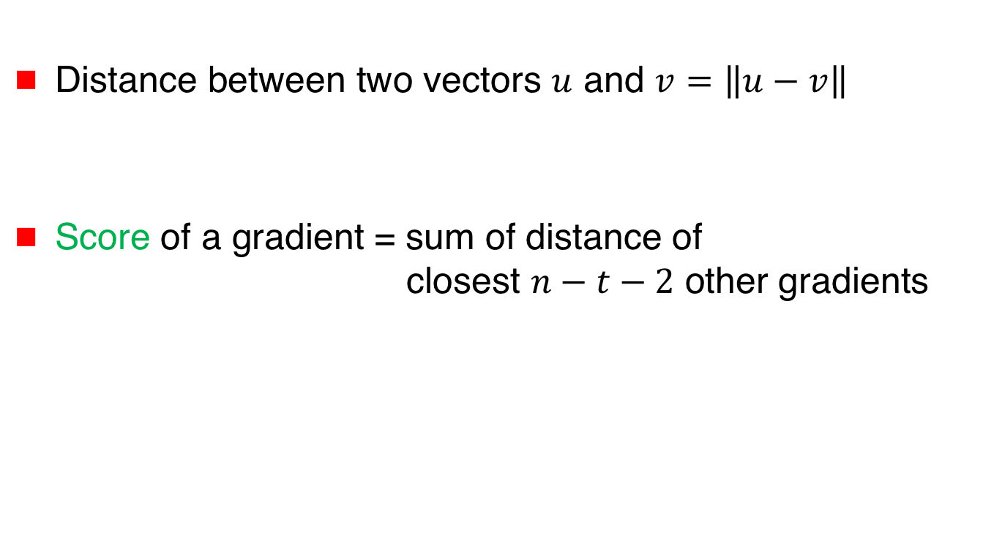
Krum and Multi-Krum
[Blanchard et al NeurIPS 2017]
Distance between two vectors $u$ and $v=$ $\left\|u−v\right\|$
Score of a gradient = sum of distance of
closest $n−t−2$ other gradients

Slide 67
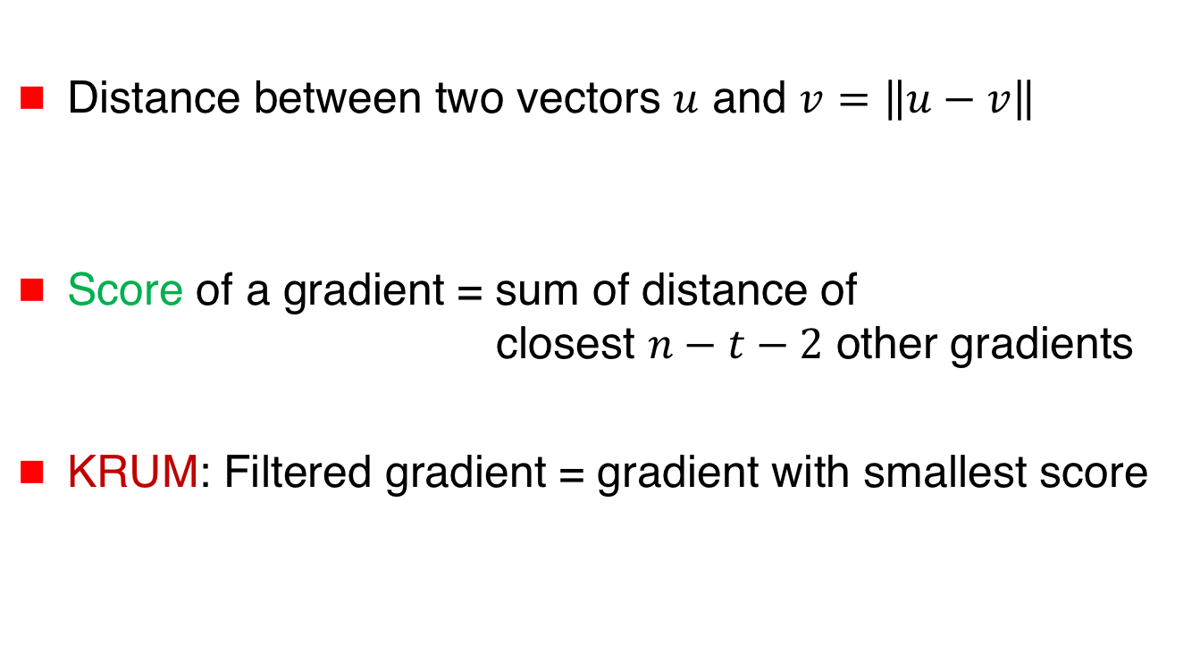
Krum and Multi-Krum
[Blanchard et al NeurIPS 2017]
Distance between two vectors $u$ and $v=$ $\left\|u−v\right\|$
Score of a gradient = sum of distance of
closest $n−t−2$ other gradients
KRUM: Filtered gradient = gradient with smallest score

Slide 68
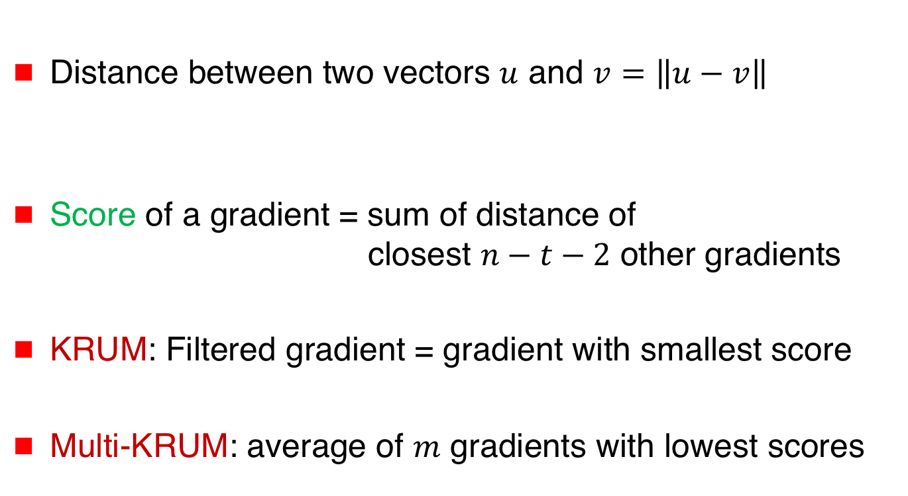
Krum and Multi-Krum
[Blanchard et al NeurIPS 2017]
Distance between two vectors $u$ and $v=$ $\left\|u−v\right\|$
Score of a gradient = sum of distance of
closest $n−t−2$ other gradients
KRUM: Filtered gradient = gradient with smallest score
Multi-KRUM: average of $m$ gradients with lowest scores

Slide 69

Krum and Multi-Krum
[Blanchard et al NeurIPS 2017]
$n=5 t=1 n−t−2=2$

Slide 70
Krum and Multi-Krum
[Blanchard et al NeurIPS 2017]
$n=5 t=1 n−t−2=2$

Slide 71
Krum and Multi-Krum
[Blanchard et al NeurIPS 2017]
 | Identical cost functions | Non-identical cost functions
Deterministic gradients | Trivial: majority vote on gradients | With or without redundancy
Stochastic gradients | i.i.d. model (commonly assumed in fault-tolerant machine learning) | non-i.i.d. model

Slide 72
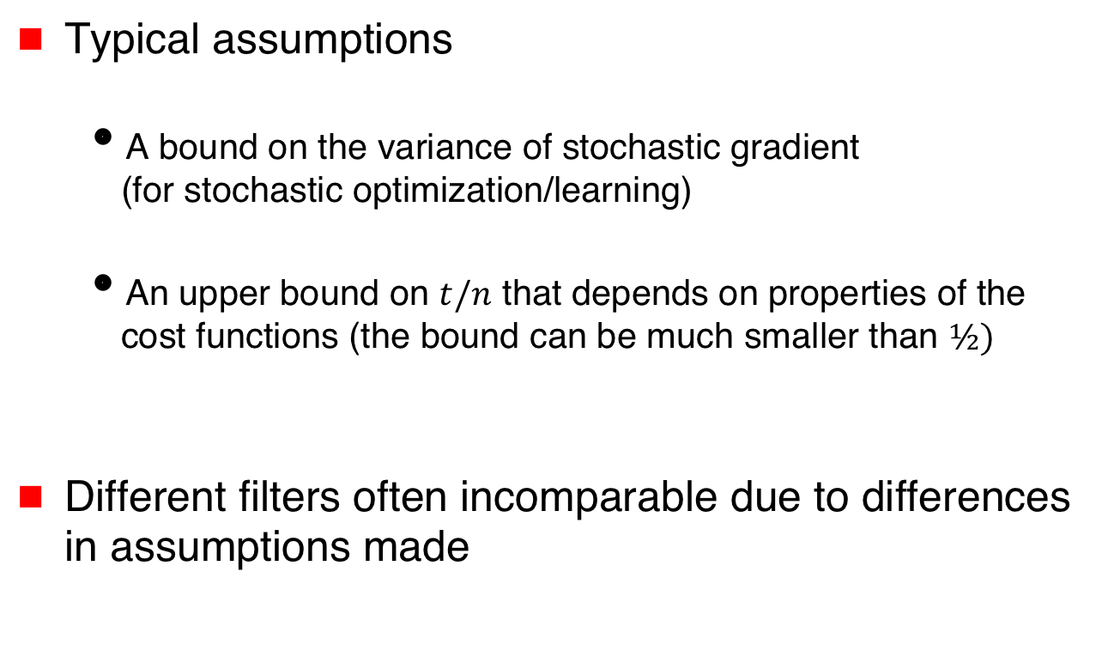
Additional Assumptions
Typical assumptions
  A bound on the variance of stochastic gradient
  (for stochastic optimization/learning)
  An upper bound on $t/n$ that depends on properties of the cost functions (the bound can be much smaller than $½)$
Different filters often incomparable due to differences in assumptions made

Slide 73




Norm-Based Comparative Gradient Elimination
[Gupta,Vaidya 2020, Gupta,Liu,Vaidya 2020]
Clip the largest $t$ norms to equalize with $t+1$^{th} norm
$\left|∇f_{1}\left(x_{k}\right)\right|=1$
$\left|∇f_{2}\left(x_{k}\right)\right|=3$
$\left|∇f_{3}\left(x_{k}\right)\right|=2$

Slide 74




Norm-Based Comparative Gradient Elimination
[Gupta,Vaidya 2020, Gupta,Liu,Vaidya 2020]
Clip the largest $t$ norms to equalize with $t+1$^{th} norm
Filtered gradient =
$\left|∇f_{1}\left(x_{k}\right)\right|=1$
$\left|∇f_{2}\left(x_{k}\right)\right|=3$
$\left|∇f_{3}\left(x_{k}\right)\right|=2$
$∇f_{1}(x_{k})$
$+ \frac{2}{3}∇f_{2}(x_{k})$
$+ ∇f_{3}(x_{k})$

Slide 75
Norm-Based Comparative Gradient Elimination
[Gupta,Vaidya 2020, Gupta,Liu,Vaidya 2020]
 | Identical cost functions | Non-identical cost functions
Deterministic gradients | Trivial: majority vote on gradients | With or without redundancy
Stochastic gradients | i.i.d. model (commonly assumed in fault-tolerant machine learning) | non-i.i.d. model
Under exact &
approximate redundancy
defined earlier

Slide 76
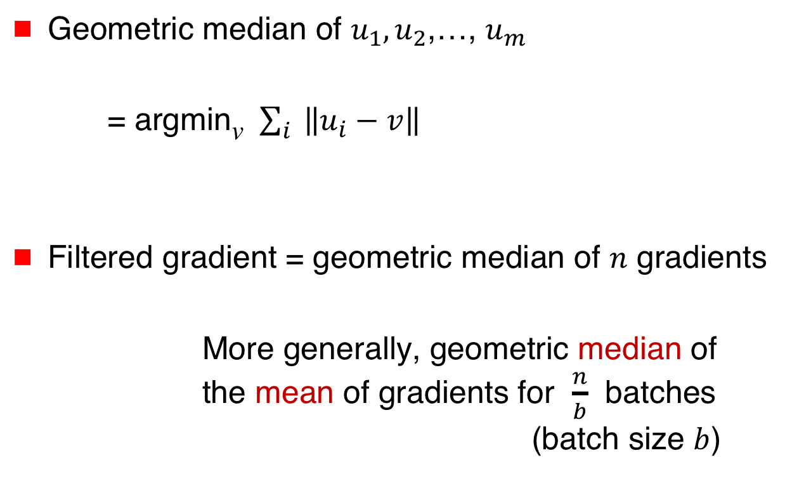
Geometric Median of Means
[Chen,Su,Xu 2017]
Geometric median of $u_{1},u_{2}$,…, $u_{m}$
= argmin_{v} $\sum_{i}{ \left\|u_{i}−v\right\|}$
Filtered gradient = geometric median of $n$ gradients
More generally, geometric median of
the mean of gradients for $\frac{n}{b}$ batches (batch size $b$)

Slide 77
Geometric Median of Means
[Chen,Su,Xu 2017]
 | Identical cost functions | Non-identical cost functions
Deterministic gradients | Trivial: majority vote on gradients | With or without redundancy
Stochastic gradients | i.i.d. model (commonly assumed in fault-tolerant machine learning) | non-i.i.d. model

Slide 78
Robust Mean Estimation
[Data,Diggavi 2020] use a robust mean estimation method from [Steinhardt et al. 2017] as the gradient filter

Slide 79
Fault-Tolerant Optimization & Learning
This is not a comprehensive survey. Other gradient filters and other algorithms have been proposed.
A couple of notable omissions:
  Reactive redundancy [Gupta Vaidya – Reactive 2019]: Deploys redundancy selectively, to reduce overhead significantly
  Learning from history [Kamireddi, He, Jaggi 2020]: Keeping history (memory) helps improve fault tolerance

Slide 80
Trade-Off
“Simpler” filters need to make more stringent assumptions
  Variance of gradients
  Fraction of faulty clients

Slide 81
Summary
Basics
Fault-Tolerant
Algorithms
$$\text{argmin}\sum_{i∈G}{f_{i}\left(x\right)}$$
Independent
Functions:
No Redundancy
Functions with
Redundancy
Exact
Resilience
Approximate
Resilience
$$x_{k}$$
Server
$∇f_{1}(x_{k})$
$∇f_{3}(x_{k})$

Slide 82
Slides & Videos
Slides and videos for the tutorial will be made available online
Visit
disc.georgetown.domains
follow the link for Talks

