Slide 1
Tutorial : Part III
Distributed Optimization and Machine Learning:
Security and Privacy
Nitin Vaidya
Georgetown University
March 2021

Slide 2
Tutorial : Part III
Distributed Optimization and Machine Learning:
Security and Privacy
March 2021

Slide 3




Challenges
What happens if clients are compromised, adversarial or faulty ?
How to perform
optimization
if agents inject
bogus information?
Server
$∇f_{1}(x_{k})$
$∇f_{3}(x_{k})$

Slide 4
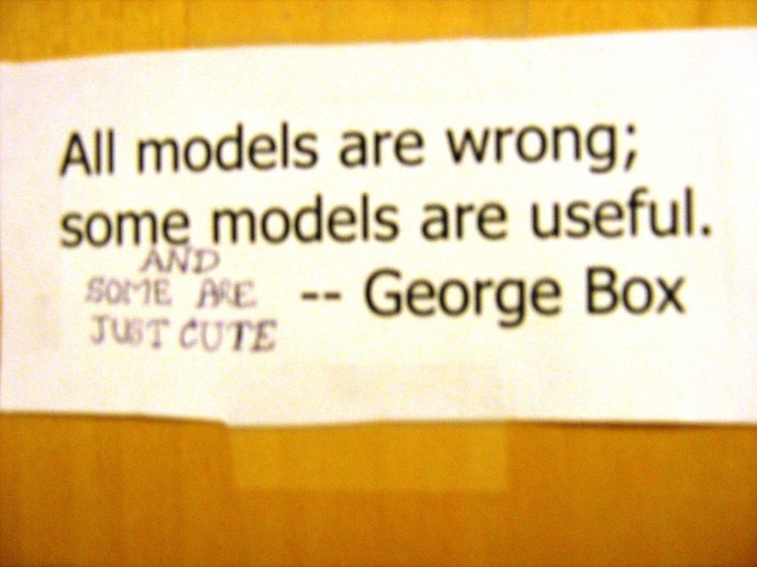
Byzantine Fault Model
No constraint
on misbehavior of faulty agents

Slide 5
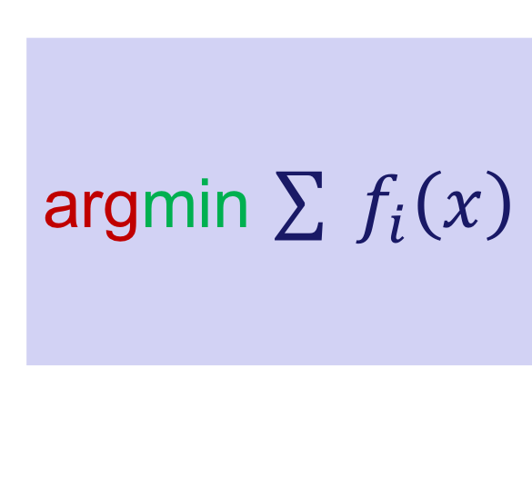
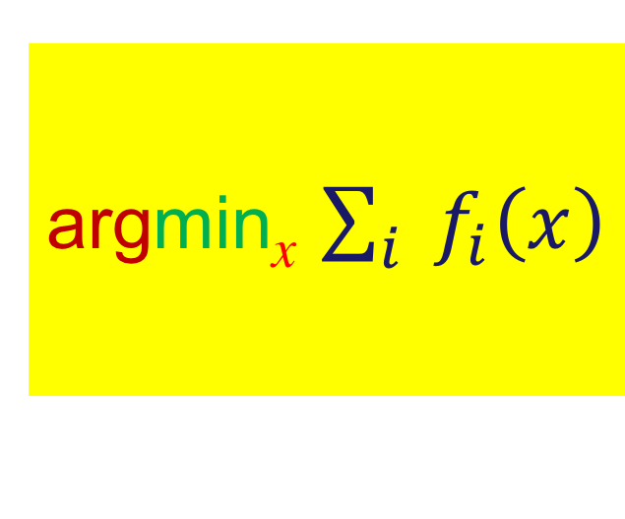
Rendezvous
Determine the location where the total cost of meeting is minimized
argmin_{x} $\sum_{i}{{ f}_{i}\left(x\right)}$
argmin $\sum{{ f}_{i}\left(x\right)}$

Slide 6
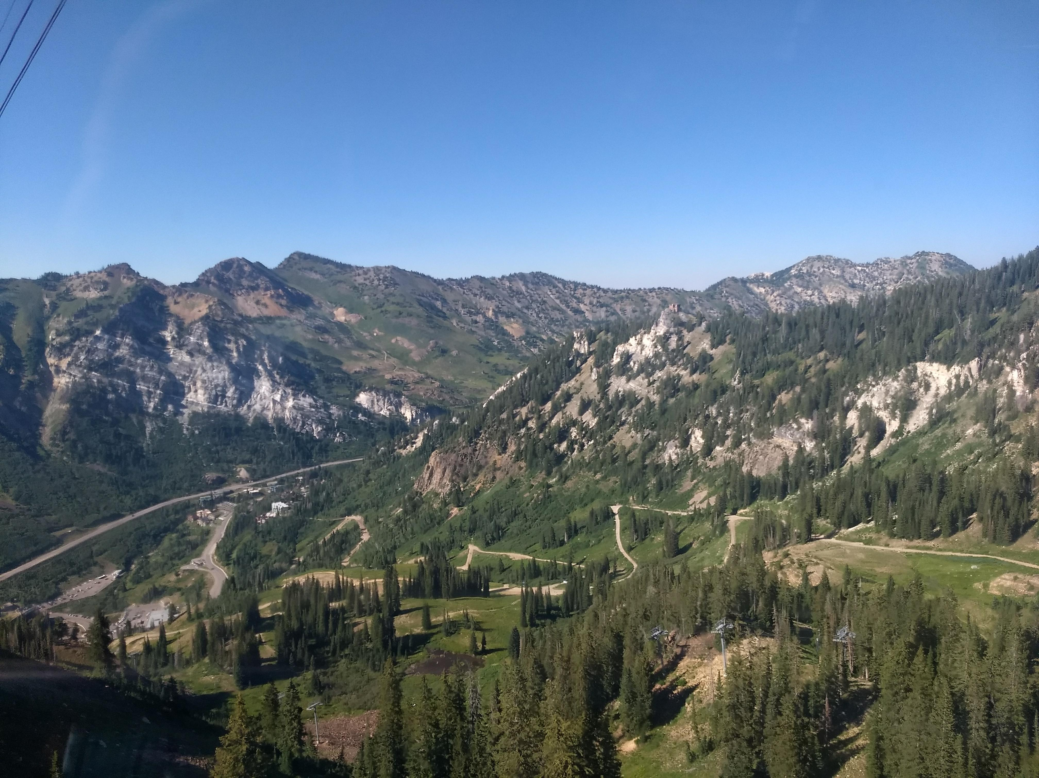



Rendezvous
$$f_{1}\left(x\right)$$
$$f_{2}\left(x\right)$$
X
$$f_{3}\left(x\right)$$

Slide 7

Rendezvous
$$f_{1}\left(x\right)$$
$$f_{2}\left(x\right)$$
X
$$f_{3}\left(x\right)$$

Slide 8
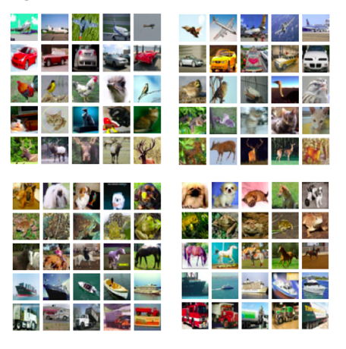
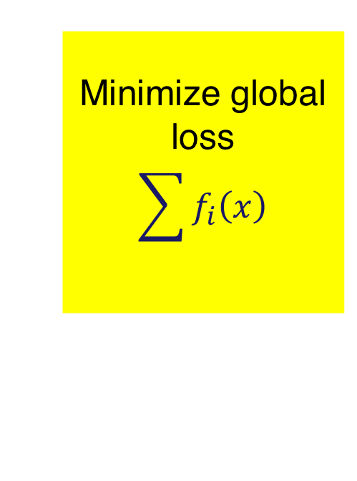




Machine Learning
$$f_{1}\left(x\right)$$
$$f_{2}\left(x\right)$$
Minimize global loss
$$\sum{f_{i}\left(x\right)}$$
$$f_{3}\left(x\right)$$
$$f_{4}\left(x\right)$$

Slide 9
Machine Learning
Faulty agent can
adversely affect
model parameters
$$f_{1}\left(x\right)$$
$$f_{2}\left(x\right)$$
Minimize global loss
$$\sum{f_{i}\left(x\right)}$$
$$f_{3}\left(x\right)$$
$$f_{4}\left(x\right)$$

Slide 10
Fault-Tolerant / Secure
Optimization & Machine Learning
2015 …

Slide 11
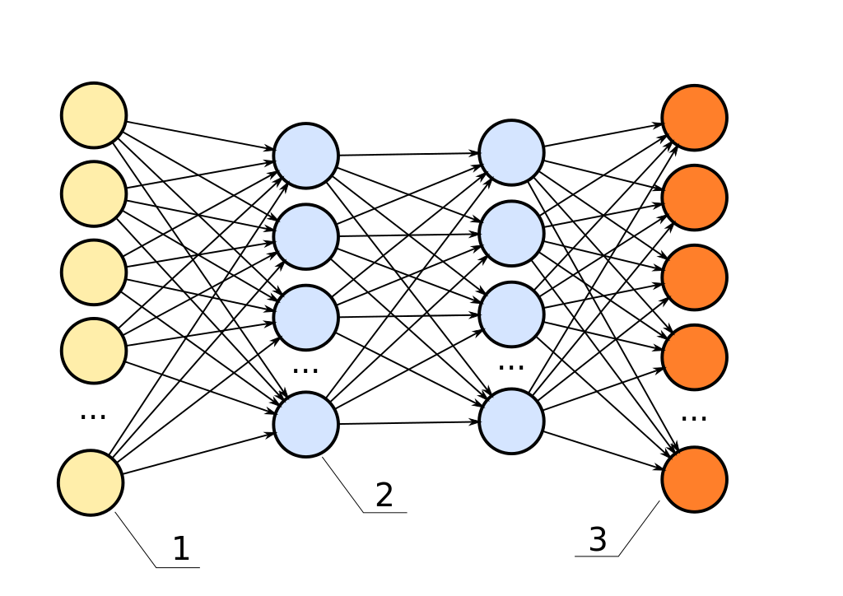
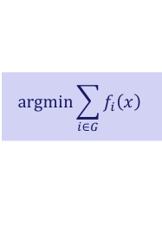



Outline
Basics
Fault-Tolerant
Algorithms
$$\text{argmin}\sum_{i∈G}{f_{i}\left(x\right)}$$
Independent
Functions:
No Redundancy
Functions with
Redundancy
Exact
Resilience
Approximate
Resilience
$$x_{k}$$
Server
$∇f_{1}(x_{k})$
$∇f_{3}(x_{k})$

Slide 12
Fault-Tolerance
What should be the objective of fault-tolerant optimization?

Slide 13
Fault-Tolerance
What should be the objective of fault-tolerant optimization?
Optimize over just the good agents … set G

Slide 14
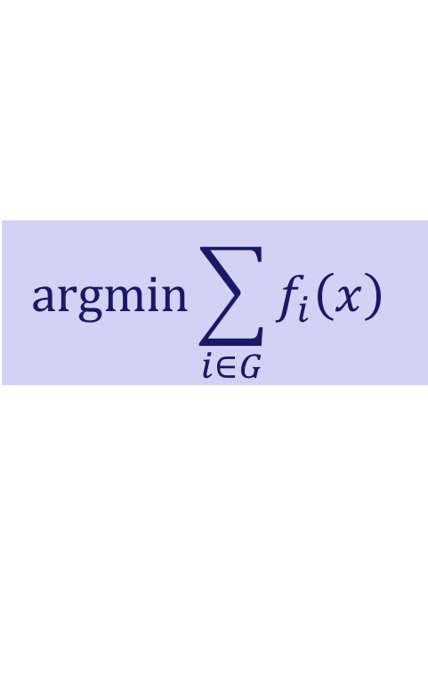
Fault-Tolerance
What should be the objective of fault-tolerant optimization?
Optimize over just the good agents … set G
$$\text{argmin}\sum_{i∈G}{f_{i}\left(x\right)}$$

Slide 15
Rendezvous
$$f_{1}\left(x\right)$$
$$f_{2}\left(x\right)$$
X
$$f_{3}\left(x\right)$$

Slide 16
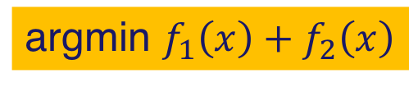
Rendezvous
$$f_{1}\left(x\right)$$
$$f_{2}\left(x\right)$$
argmin $f_{1}\left(x\right)+f_{2}\left(x\right)$

Slide 17
Machine Learning
Faulty agent can
adversely affect
model parameters
$$f_{1}\left(x\right)$$
$$f_{2}\left(x\right)$$
Minimize global loss
$$\sum{f_{i}\left(x\right)}$$
$$f_{3}\left(x\right)$$
$$f_{4}\left(x\right)$$

Slide 18
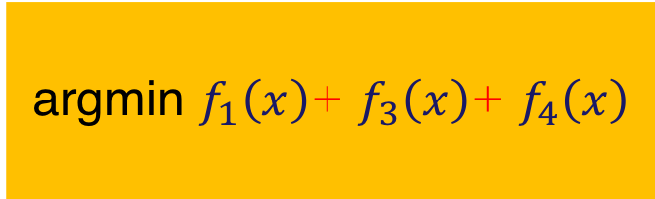
Machine Learning
$$f_{1}\left(x\right)$$
argmin $f_{1}\left(x\right)$+ $f_{3}\left(x\right)$+ $f_{4}\left(x\right)$
$$f_{3}\left(x\right)$$
$$f_{4}\left(x\right)$$

Slide 19
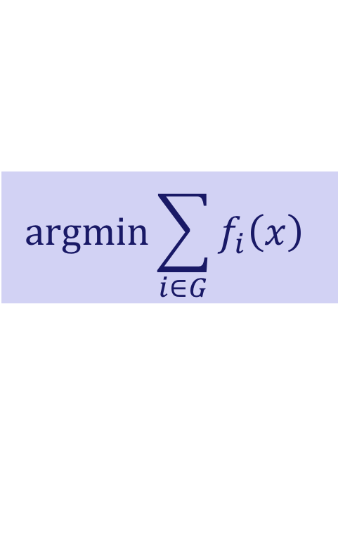
$$\text{argmin}\sum_{i∈G}{f_{i}\left(x\right)}$$
Is this achievable?
Depends on redundancy
in agents’ cost functions

Slide 20
$$\text{argmin}\sum_{i∈G}{f_{i}\left(x\right)}$$
Is this achievable?
The Spectrum
Independent
functions
Redundancy

Slide 21
$$\text{argmin}\sum_{i∈G}{f_{i}\left(x\right)}$$
Independent
Functions:
No Redundancy

Slide 22
$$\text{argmin}\sum_{i∈G}{f_{i}\left(x\right)}$$
Independent
Functions:
No Redundancy
Functions with
Redundancy

Slide 23
$$\text{argmin}\sum_{i∈G}{f_{i}\left(x\right)}$$
Independent
Functions:
No Redundancy
Functions with
Redundancy
Exact
Resilience
Approximate
Resilience

Slide 24
$$\text{argmin}\sum_{i∈G}{f_{i}\left(x\right)}$$
Independent
Functions:
No Redundancy
Depends on redundancy
in agents’ cost functions

Slide 25
Independent Functions
a
b
c
[Su and Vaidya 2015: part 1, part 2, part 3, part 4]

Slide 26
Independent Functions
a
b
c
[Su and Vaidya 2015: part 1, part 2, part 3, part 4]

Slide 27
Independent Functions
a
b
c

Slide 28
Independent Functions
a
b
c

Slide 29
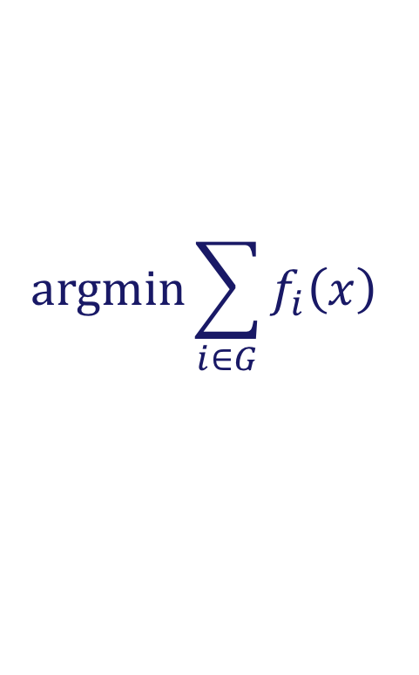
Independent Functions
Provably impossible to compute
$$\text{argmin}\sum_{i∈G}{f_{i}\left(x\right)}$$

Slide 30
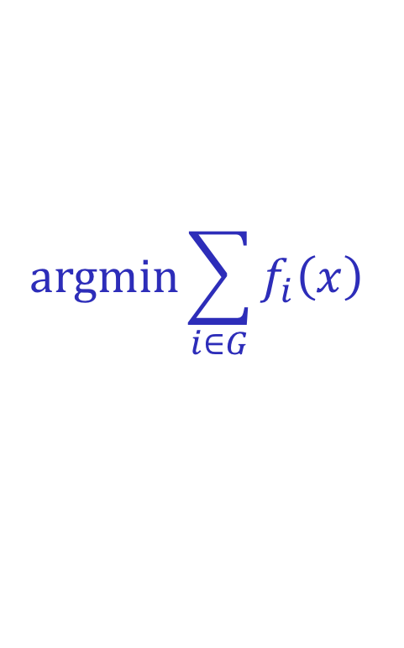
How to Approximate ?
$$\text{argmin}\sum_{i∈G}{f_{i}\left(x\right)}$$
We will discuss different ways to approximate

Slide 31
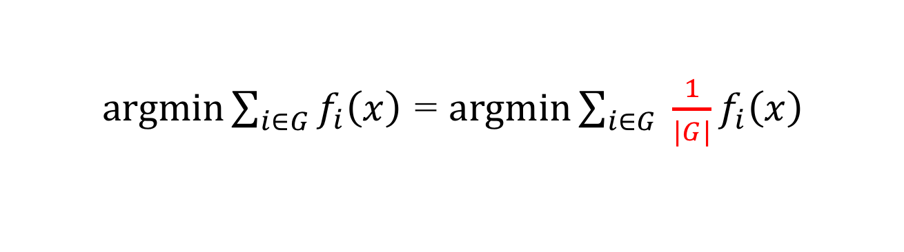
How to Approximate ?
$$\text{argmin}\sum_{i∈G}{f_{i}\left(x\right)}$$
$\text{argmin}\sum_{i∈G}{f_{i}\left(x\right)}$ = $\text{argmin}\sum_{i∈G}{ \frac{1}{|G|}f_{i}\left(x\right)}$

Slide 32
How to Approximate ?
$$\text{argmin}\sum_{i∈G}{f_{i}\left(x\right)}$$
Ideal goal: Equal weight for all non-faulty agents
$\text{argmin}\sum_{i∈G}{f_{i}\left(x\right)}$ = $\text{argmin}\sum_{i∈G}{ \frac{1}{|G|}f_{i}\left(x\right)}$

Slide 33
How to Approximate ?
$$\text{argmin}\sum_{i∈G}{f_{i}\left(x\right)}$$
Ideal goal: Equal weight for all non-faulty agents
Approximation: Unequal weights
$\text{argmin}\sum_{i∈G}{f_{i}\left(x\right)}$ = $\text{argmin}\sum_{i∈G}{ \frac{1}{|G|}f_{i}\left(x\right)}$

Slide 34

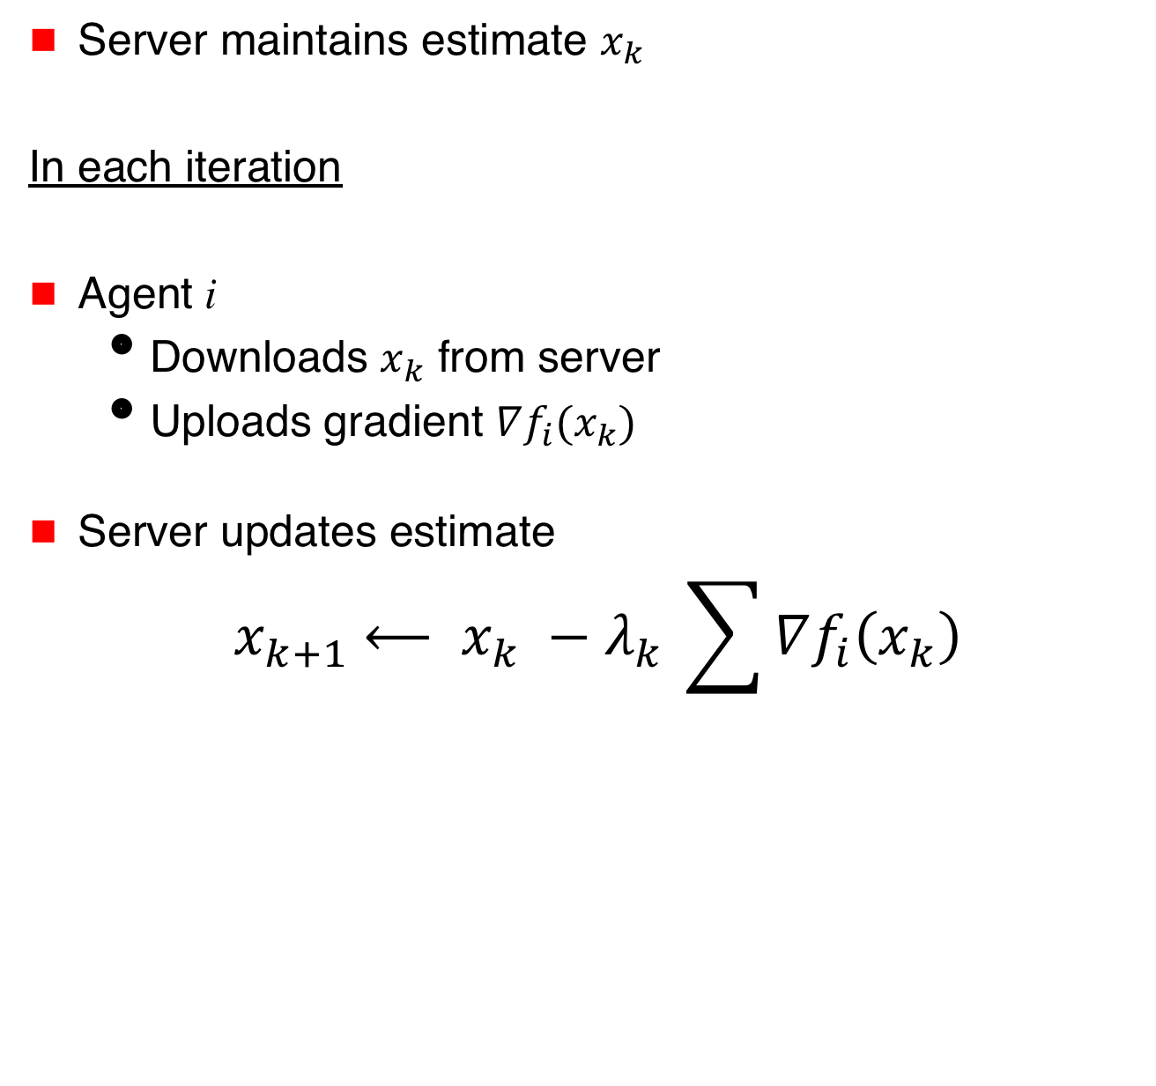


Distributed Optimization
Server maintains estimate $x_{k}$
In each iteration
Agent i
  Downloads $x_{k}$ from server
  Uploads gradient $∇f_{i}(x_{k})$
Server updates estimate
$${ x}_{k+1} ⟵ x_{k} −{λ_{k}}_{ }\sum{∇f_{i}\left(x_{k}\right)}$$
$$x_{k}$$
Server
$∇f_{1}(x_{k})$
$∇f_{3}(x_{k})$

Slide 35
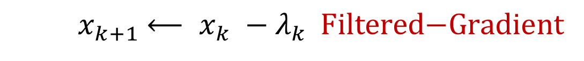
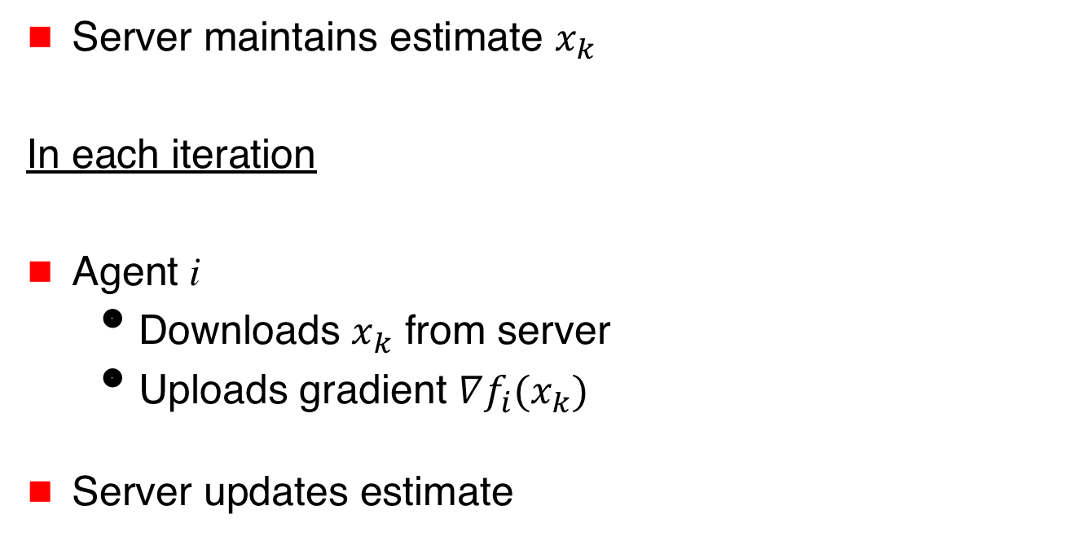
Fault-Tolerant Distributed Optimization
Server maintains estimate $x_{k}$
In each iteration
Agent i
  Downloads $x_{k}$ from server
  Uploads gradient $∇f_{i}(x_{k})$
Server updates estimate
$$x_{k}$$
Server
$∇f_{1}(x_{k})$
$∇f_{3}(x_{k})$
$${ x}_{k+1} ⟵ x_{k} −{λ_{k}}_{ } \text{Filtered}\text{−}\text{Gradient}$$

Slide 36
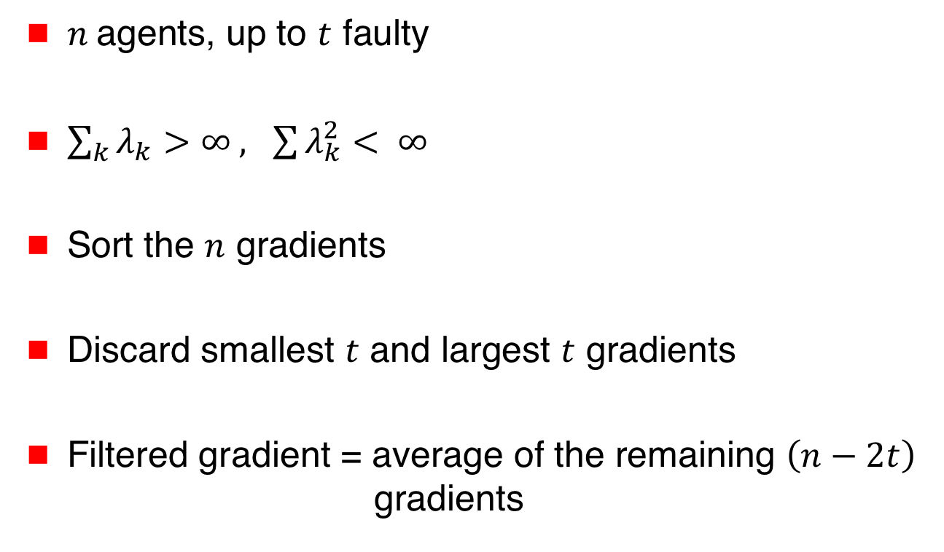
Su and Vaidya [arXiv 2015, PODC 2016]
Scalar Argument
$n$ agents, up to $t$ faulty
$\sum_{k}{λ_{k}>∞ , \sum{λ_{k}^{2}}}< ∞$
Sort the $n$ gradients
Discard smallest $t$ and largest $t$ gradients
Filtered gradient = average of the remaining $\left(n−2t\right)$
gradients

Slide 37


Results for Scalar Argument $\left(x\right)$
For each faulty agent,
a good agent may be sacrificed (i.e., ignored)
➔ $t$ good agents may have weight 0

Slide 38
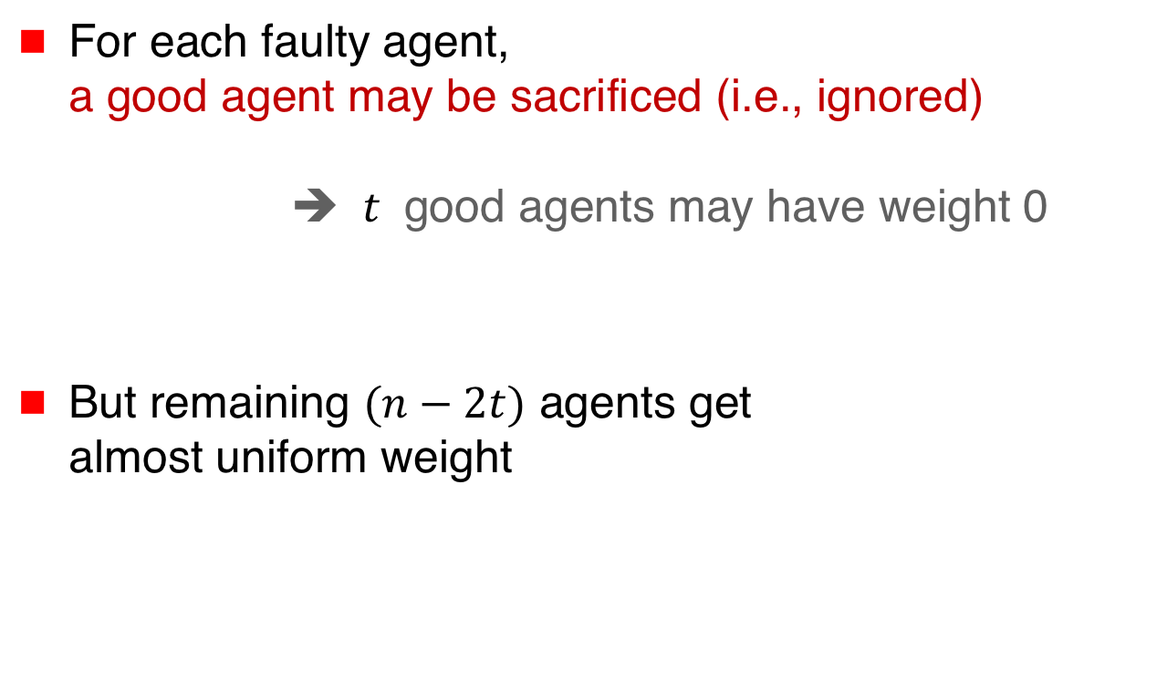
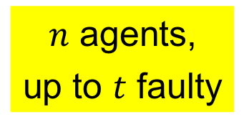
Results for Scalar Argument $\left(x\right)$
For each faulty agent,
a good agent may be sacrificed (i.e., ignored)
➔ $t$ good agents may have weight 0
But remaining $(n−2t)$ agents get
almost uniform weight
$n$ agents,
up to $t$ faulty

Slide 39
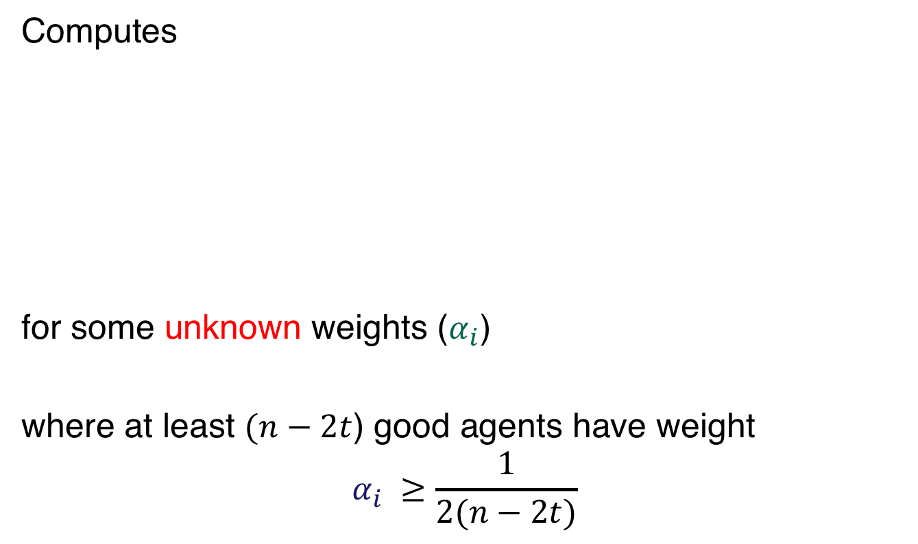
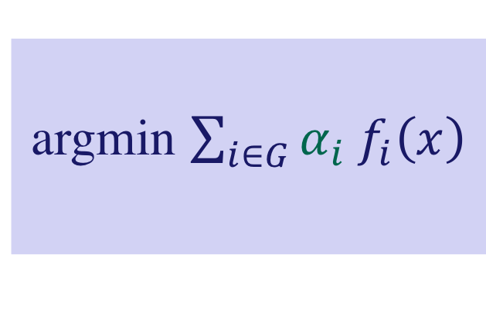
Results for Scalar Argument $\left(x\right)$
Computes
for some unknown weights ($α_{i}$)
where at least $(n−2t$) good agents have weight
$$α_{i} ≥\frac{1}{2(n−2t)}$$
argmin $\sum_{i∈G}{{α_{i} f}_{i}\left(x\right)}$

Slide 40
Results for Scalar Argument $\left(x\right)$
Computes
for some unknown weights ($α_{i}$)
where at least $(n−2t$) good agents have weight
$$α_{i} ≥\frac{1}{2(n−2t)}$$
argmin $\sum_{i∈G}{{α_{i} f}_{i}\left(x\right)}$
Note that weight for
faulty agents is 0

Slide 41

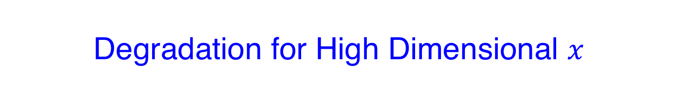
Degradation for High Dimensional $x$
For $d$-dimensional arguments, $dt$ agents may have
to be sacrificed in the worst case
➔ 0 weight for up to $dt$ agents, for arbitrary functions

Slide 42

Degradation for High Dimensional $x$
For $d$-dimensional arguments, $dt$ agents may have
to be sacrificed in the worst case
➔ 0 weight for up to $dt$ agents, for arbitrary functions
In general, the cost functions are not entirely “arbitrary”
➔ With redundancy (or correlation) better outcome

Slide 43
Machine Learning
$$f_{1}\left(x\right)$$
$$f_{2}\left(x\right)$$
Minimize global loss
$$\sum{f_{i}\left(x\right)}$$
$$f_{3}\left(x\right)$$
$$f_{4}\left(x\right)$$

Slide 44
Machine Learning
$$f_{1}\left(x\right)$$
argmin $f_{1}\left(x\right)$+ $f_{3}\left(x\right)$+ $f_{4}\left(x\right)$
$$f_{3}\left(x\right)$$
$$f_{4}\left(x\right)$$

Slide 45
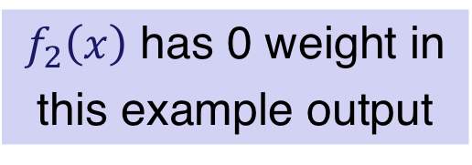
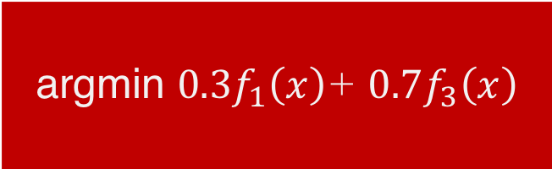
Machine Learning
$$f_{1}\left(x\right)$$
$f_{2}\left(x\right)$ has 0 weight in
this example output
argmin $0.3f_{1}\left(x\right)$+ $0.7f_{3}\left(x\right)$
$$f_{3}\left(x\right)$$
$$f_{4}\left(x\right)$$

Slide 46
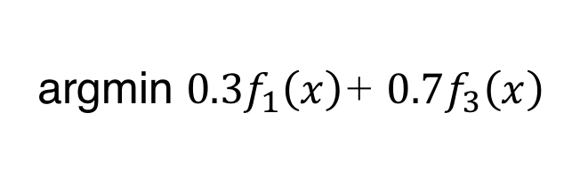
Machine Learning
In general, weight distribution achieved
depends on the cost functions themselves,
and behavior of faulty agents
$$f_{1}\left(x\right)$$
$f_{2}\left(x\right)$ has 0 weight in
this example output
argmin $0.3f_{1}\left(x\right)$+ $0.7f_{3}\left(x\right)$
$$f_{3}\left(x\right)$$
$$f_{4}\left(x\right)$$

Slide 47
$$\text{argmin}\sum_{i∈G}{f_{i}\left(x\right)}$$
Independent
Functions:
No Redundancy
Functions with
Redundancy
Exact
Resilience
Approximate
Resilience

Slide 48
$$\text{argmin}\sum_{i∈G}{f_{i}\left(x\right)}$$
Functions with
Redundancy
Exact
Resilience
Depends on redundancy
in agents’ cost functions

Slide 49

Exact Resilience
t-Resilience
Output in $\text{argmin}\sum_{i∈G}{f_{i}\left(x\right)}$ despite
the presence of up to t faulty agents

Slide 50
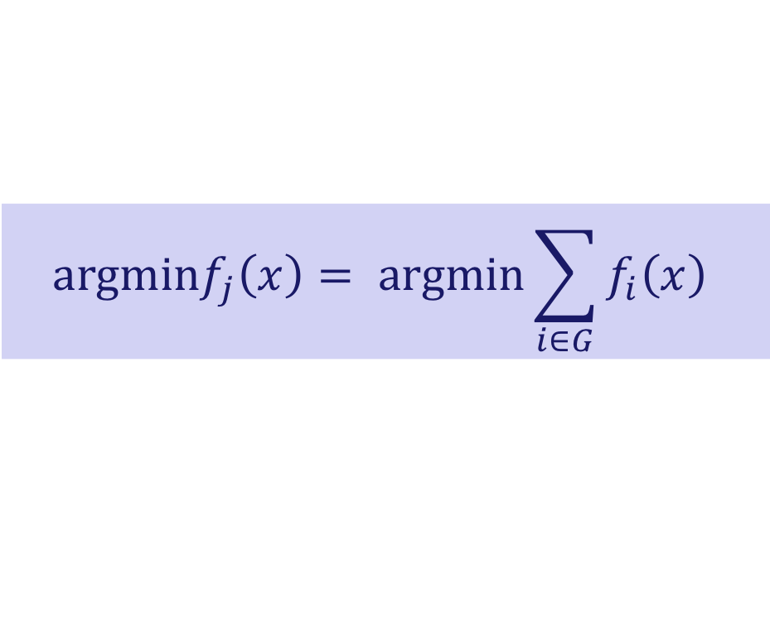
t-Resilience: Extreme Case
Full replication
All agents have identical cost function (identical data)
$$a\text{rgmin}f_{j}\left(x\right)= \text{argmin}\sum_{i∈G}{f_{i}\left(x\right)}$$

Slide 51
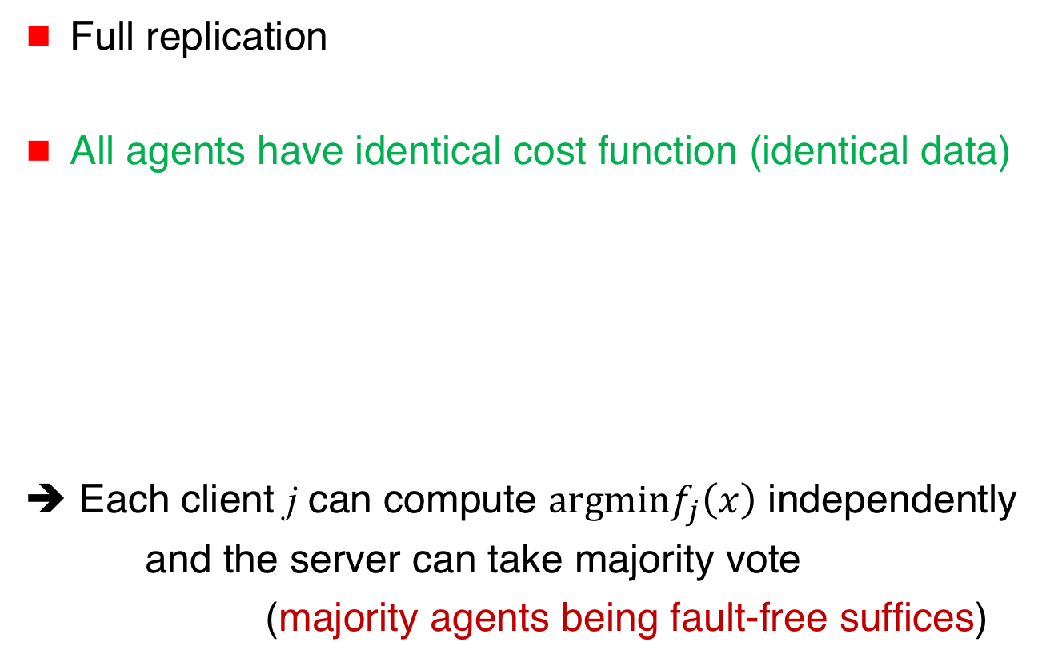
t-Resilience: Extreme Case
Full replication
All agents have identical cost function (identical data)
➔ Each client j can compute $a\text{rgmin}f_{j}\left(x\right)$ independently
and the server can take majority vote
(majority agents being fault-free suffices)
$$a\text{rgmin}f_{j}\left(x\right)= \text{argmin}\sum_{i∈G}{f_{i}\left(x\right)}$$

Slide 52
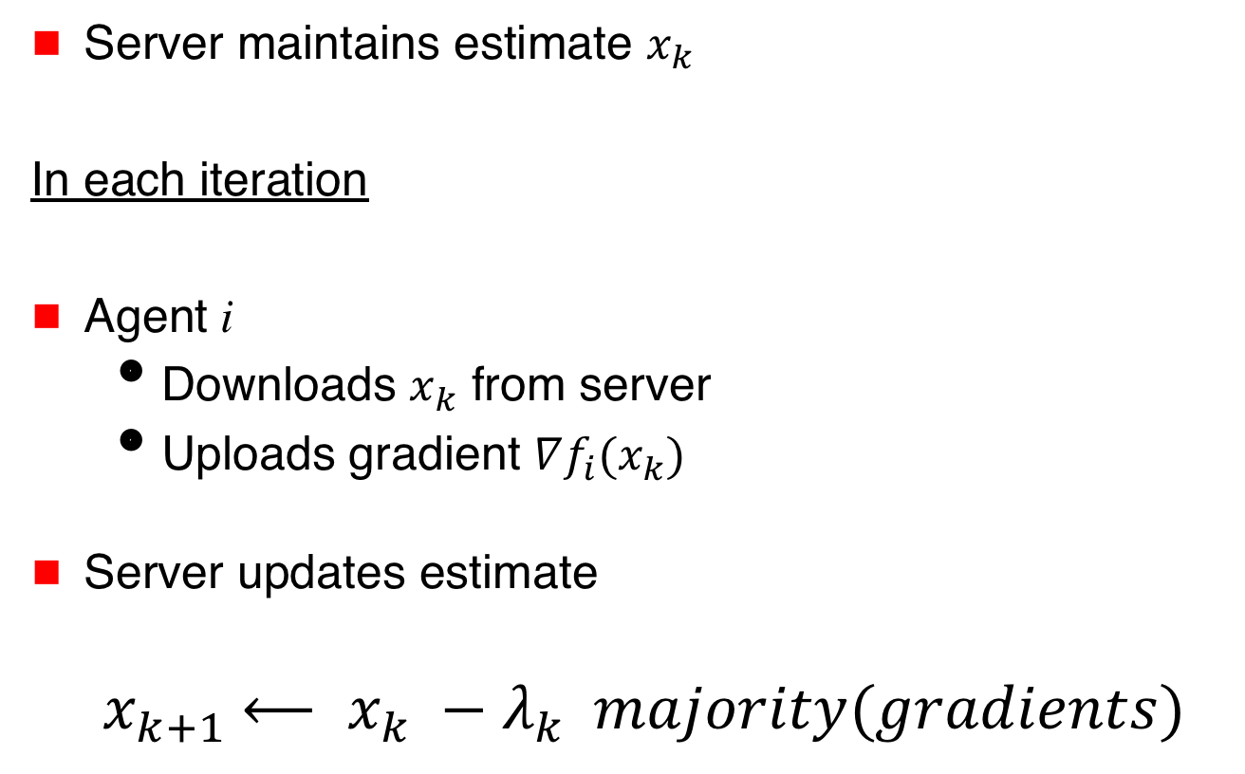
Parameter Server
Server maintains estimate $x_{k}$
In each iteration
Agent i
  Downloads $x_{k}$ from server
  Uploads gradient $∇f_{i}(x_{k})$
Server updates estimate
$${ x}_{k+1} ⟵ x_{k} −{λ_{k} }_{ }majority(gradients)$$
$$x_{k}$$
Server
$∇f_{1}(x_{k})$
$∇f_{3}(x_{k})$

Slide 53
t-Resilience: Extreme Case
We will return to this case later
This extreme form of redundancy assumed in much
of the work on fault-tolerant stochastic learning
Stochastic gradients make this case interesting

Slide 54
Exact Resilience:
Necessary and Sufficient Condition
[Gupta,Vaidya 2020]
t-Resilience achievable iff
cost functions satisfy
2t-Redundancy

Slide 55
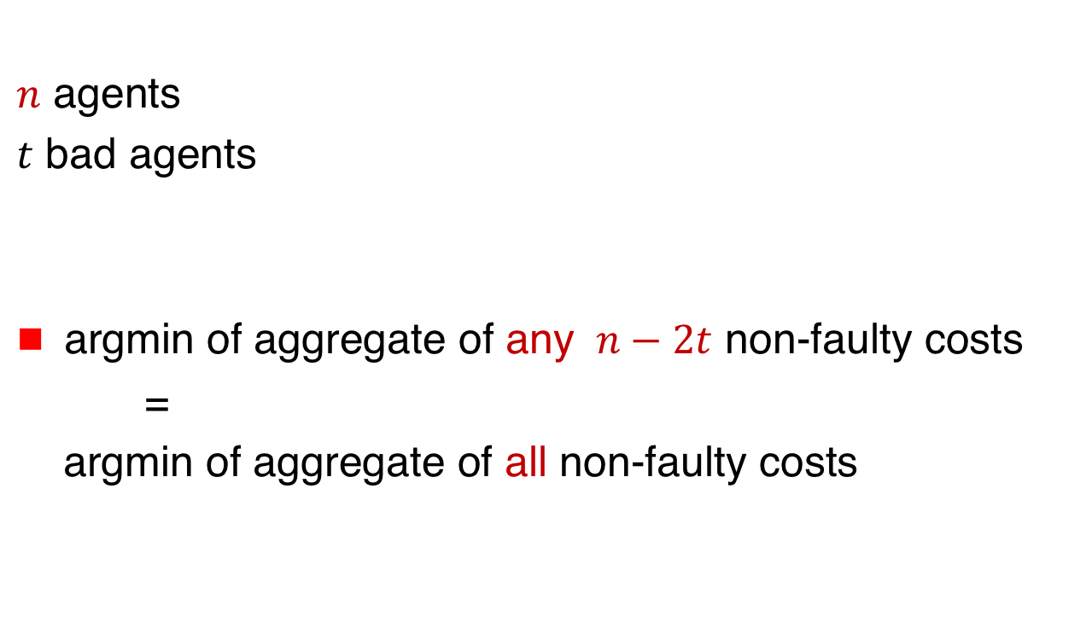
2t-Redundancy
[Gupta,Vaidya 2020]
$n$ agents
$t$ bad agents
argmin of aggregate of any $n−2t$ non-faulty costs
=
argmin of aggregate of all non-faulty costs

Slide 56

2t-Redundancy
[Gupta,Vaidya 2020]
$S$ = all non-faulty agents
$T$ = at least $n−2t$ non-faulty agents
➔ $\text{argmin}\sum_{i∈S}{f_{i}\left(x\right)=\text{argmin}\sum_{i∈T}{f_{i}\left(x\right)}}$

Slide 57
n = 6 (number of agents) t = 1 (faulty agents)
G. Renee Guzlas

Slide 58
n = 6 (number of agents) t = 1 (faulty agents)
G. Renee Guzlas

Slide 59
Linear Regression
$$\left[\begin{aligned}y_{1} \\ y_{2} \\ y_{3} \\ y_{4}\end{aligned}\right]=\left[\begin{matrix}a_{1} & 1 \\ a_{2} & 1 \\ a_{3} & 1 \\ a_{4} & 1\end{matrix}\right]x$$
$y=Ax$
$$\left[\begin{aligned}y_{1} \\ y_{2} \\ y_{3} \\ y_{4}\end{aligned}\right]=\left[\begin{matrix}a_{1} & 1 \\ a_{1} & 1 \\ a_{3} & 1 \\ a_{4} & 1\end{matrix}\right]$$
➔
y₄
y₃
y₂
y₁
$$y_{i}=0.5a_{i}+1$$
$$= \left(a_{i},1\right){(0.5,1)}^{T}$$
$$={ A}_{i}.x^{∗}$$
a₁ a₂ a₃ a₄

Slide 60
Linear Regression
Given $y$ and $A$
determine $x$
such that $y=Ax$
If matrix $A$ full-rank, $x=x^{∗}$ is the unique solution
$A$: $n$-by-$d$ matrix
$x$: $d$-dimensional column vector
$$n≥d$$

Slide 61
Distributed Linear Regression
Agent $i$ knows ${(A}_{i} ,$ $y_{i})$ where $y_{i}= A_{i}x^{∗}$
Define cost
$$f_{i}\left(x\right)={(y_{i}−A_{i}x)}^{2}$$

Slide 62
Distributed Linear Regression
min_{x} $\sum_{i}{{ f}_{i}\left(x\right)}$ = 0
If $A$ full-rank
argmin_{x} $\sum_{i}{{ f}_{i}\left(x\right)}$ = ${ x}^{∗}$ (unique solution)

Slide 63
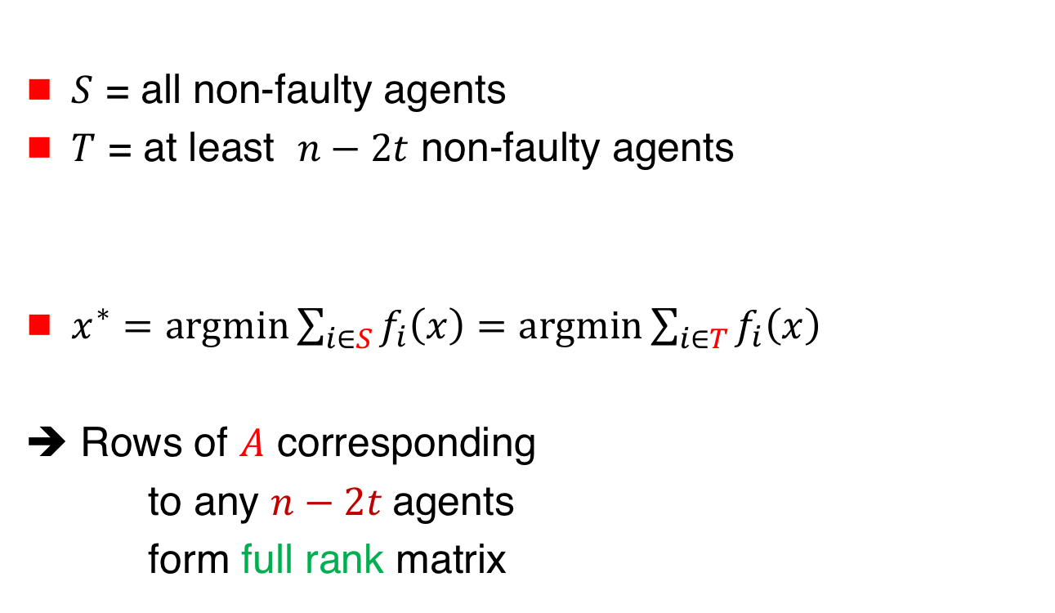
2t-Redundancy for Linear Regression
$S$ = all non-faulty agents
$T$ = at least $n−2t$ non-faulty agents
$x^{∗}=\text{argmin}\sum_{i∈S}{f_{i}\left(x\right)=\text{argmin}\sum_{i∈T}{f_{i}\left(x\right)}}$
➔ Rows of $A$ corresponding
to any $n−2t$agents
form full rank matrix

Slide 64
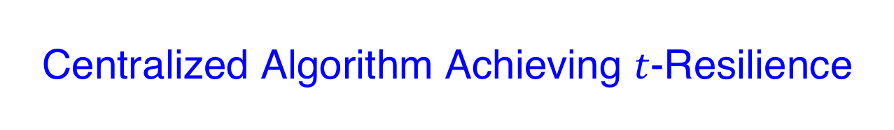
Centralized Algorithm Achieving $t$-Resilience
Agents provide their cost functions to the server: Faulty agents may provide incorrect information

Slide 65
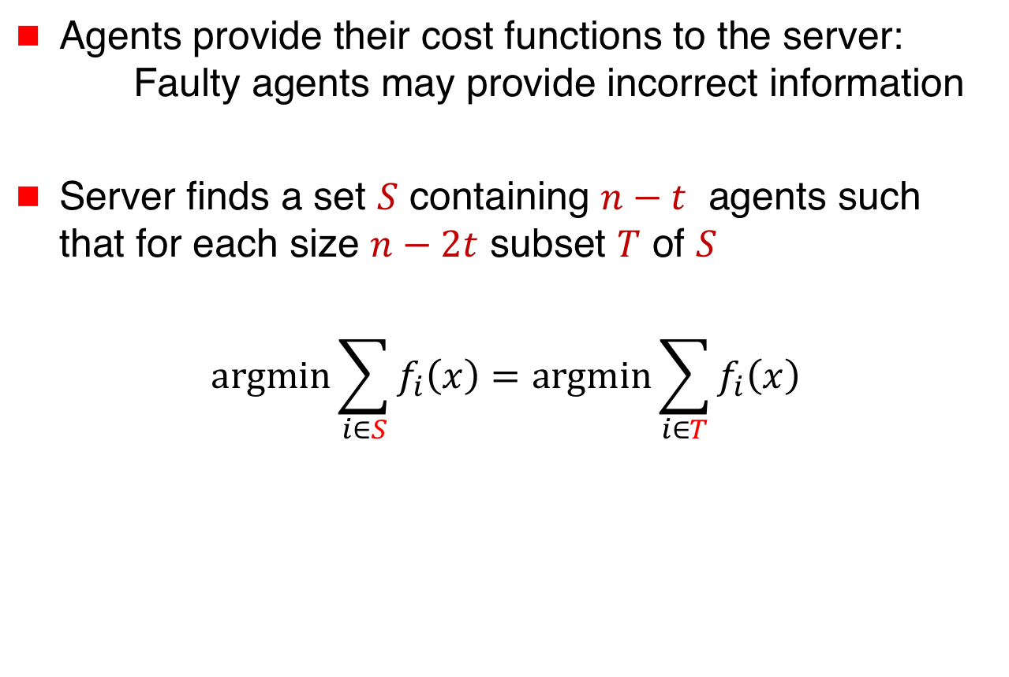
Centralized Algorithm Achieving $t$-Resilience
Agents provide their cost functions to the server: Faulty agents may provide incorrect information
Server finds a set $S$ containing $n−t$ agents such that for each size $n−2t$ subset $T$ of $S$
$$\text{argmin}\sum_{i∈S}{f_{i}\left(x\right)=\text{argmin}\sum_{i∈T}{f_{i}\left(x\right)}}$$

Slide 66
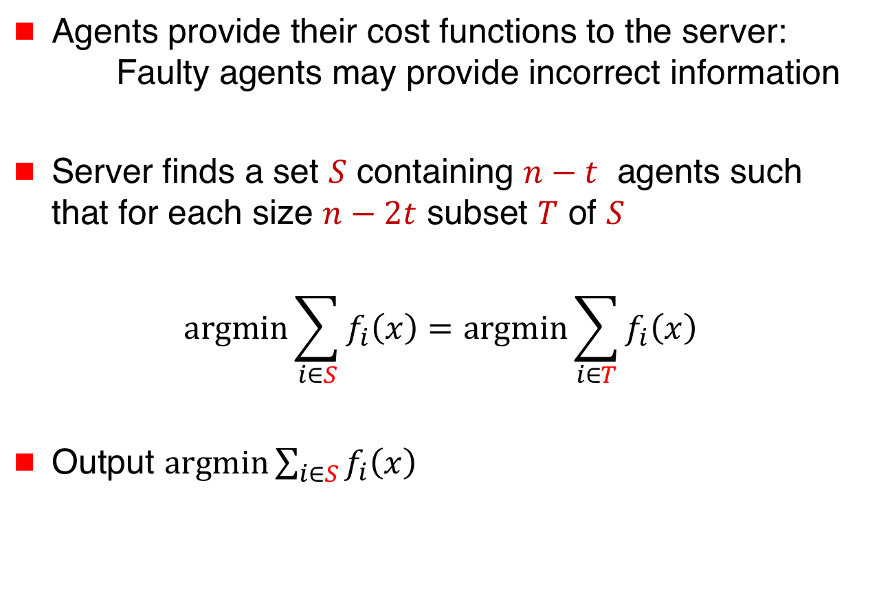
Centralized Algorithm Achieving $t$-Resilience
Agents provide their cost functions to the server: Faulty agents may provide incorrect information
Server finds a set $S$ containing $n−t$ agents such that for each size $n−2t$ subset $T$ of $S$
$$\text{argmin}\sum_{i∈S}{f_{i}\left(x\right)=\text{argmin}\sum_{i∈T}{f_{i}\left(x\right)}}$$
Output $\text{argm}\text{in}\sum_{i∈S}{f_{i}\left(x\right)}$

Slide 67
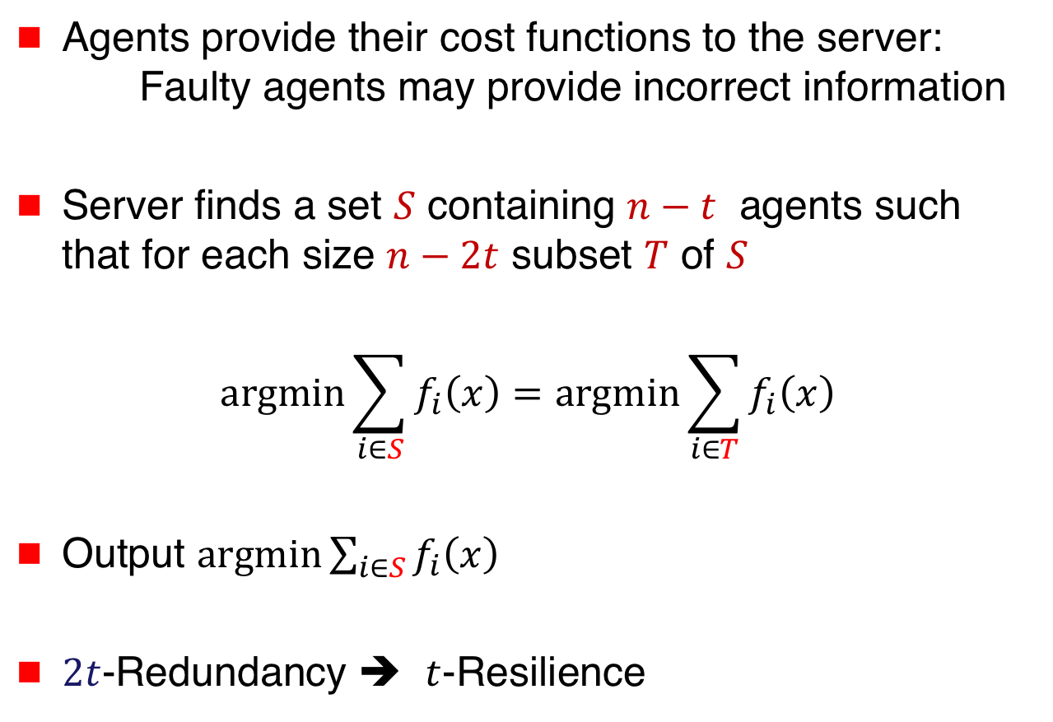
Centralized Algorithm Achieving $t$-Resilience
Agents provide their cost functions to the server: Faulty agents may provide incorrect information
Server finds a set $S$ containing $n−t$ agents such that for each size $n−2t$ subset $T$ of $S$
$$\text{argmin}\sum_{i∈S}{f_{i}\left(x\right)=\text{argmin}\sum_{i∈T}{f_{i}\left(x\right)}}$$
Output $\text{argm}\text{in}\sum_{i∈S}{f_{i}\left(x\right)}$
$2t$-Redundancy ➔ $t$-Resilience

Slide 68
Exact Resilience:
Necessary and Sufficient Condition
[Gupta,Vaidya 2020]
t-Resilience achievable iff
cost functions satisfy
2t-Redundancy

Slide 69
Distributed Algorithm
Later in the tutorial …

Slide 70
$$\text{argmin}\sum_{i∈G}{f_{i}\left(x\right)}$$
Independent
Functions:
No Redundancy
Functions with
Redundancy
Exact
Resilience
Approximate
Resilience

Slide 71
$$\text{argmin}\sum_{i∈G}{f_{i}\left(x\right)}$$
Functions with
Redundancy
Approximate
Resilience
Depends on redundancy
in agents’ cost functions

Slide 72
Slides & Videos
Slides and videos for the tutorial will be made available online
Visit
disc.georgetown.domains
follow the link for Talks

