Slide 1
Tutorial
Security and Privacy in Distributed Optimization and Learning
Nitin Vaidya
Georgetown University
March 2021

Slide 2
Slides & Videos
Slides and videos for the tutorial will be made available online
Visit
disc.georgetown.domains
follow the link for Talks

Slide 3


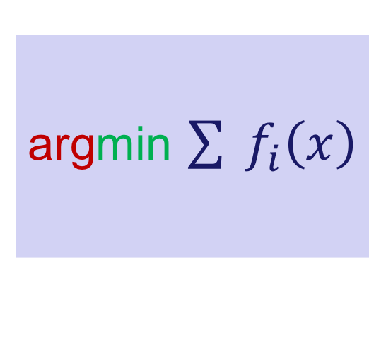





Outline
argmin $\sum{{ f}_{i}\left(x\right)}$
Server
$$1$$
$$3$$
$$5$$
$$2$$
$$4$$
1
$$2$$
$$3$$

Slide 4
Distributed Optimization
Objective

Slide 5
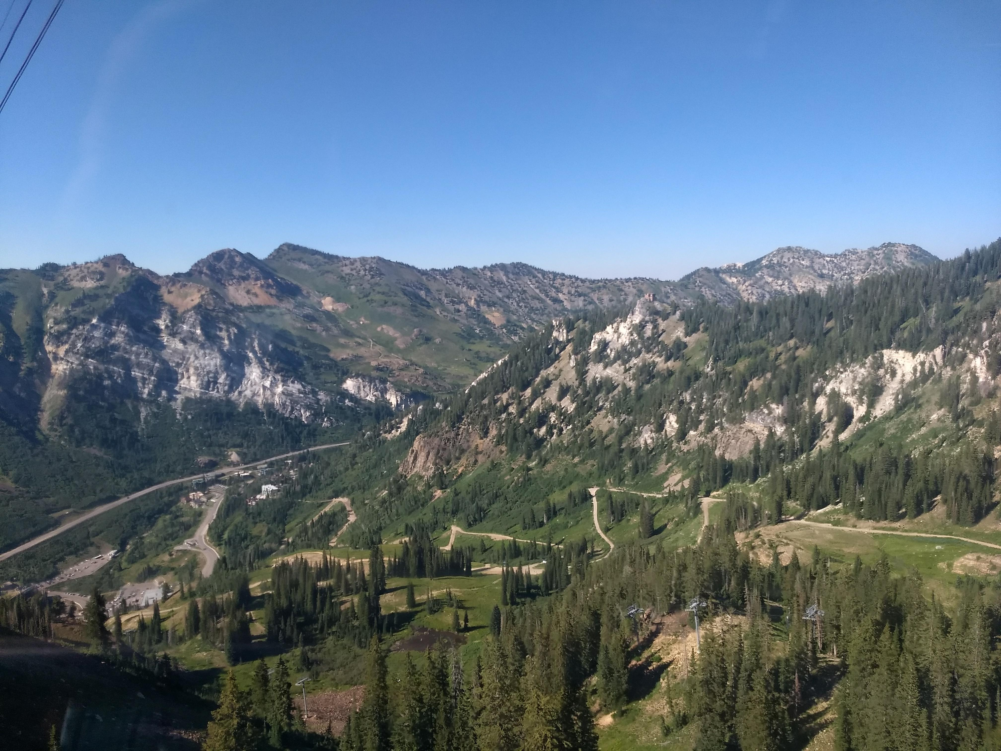

Rendezvous

Slide 6
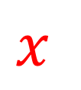



Rendezvous
$$f_{1}\left(x\right)$$
$$f_{2}\left(x\right)$$
$$x$$
$$f_{3}\left(x\right)$$

Slide 7
Rendezvous
Determine the location where the total cost of meeting is minimized

Slide 8
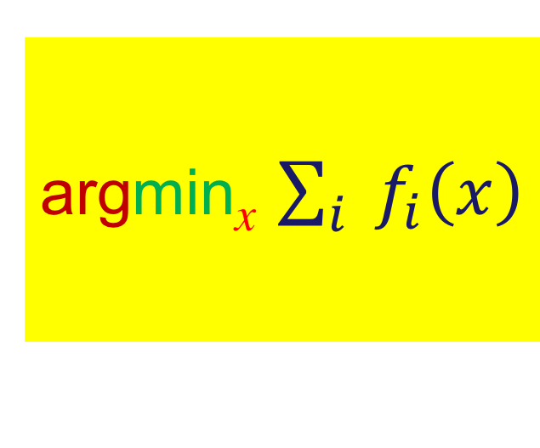
Rendezvous
Determine the location where the total cost of meeting is minimized
argmin_{x} $\sum_{i}{{ f}_{i}\left(x\right)}$

Slide 9
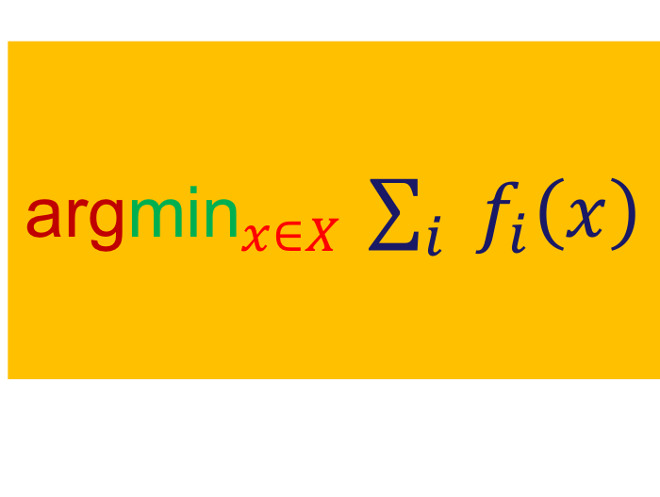
Rendezvous
Determine the location where the total cost of meeting is minimized
argmin_{x} $\sum_{i}{{ f}_{i}\left(x\right)}$
${\text{arg}\text{min}}_{x∈X}$ $\sum_{i}{{ f}_{i}\left(x\right)}$

Slide 10
Rendezvous
$$f_{1}\left(x\right)$$
$$f_{2}\left(x\right)$$
$$x$$
$$f_{3}\left(x\right)$$

Slide 11
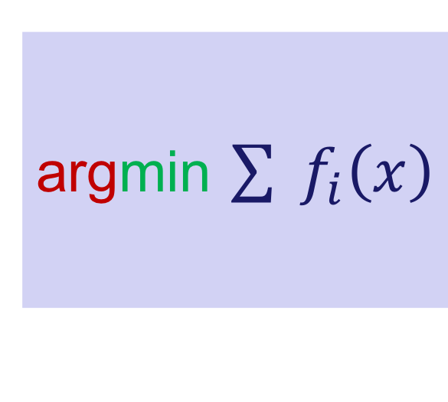
Rendezvous
Determine the location where the total cost of meeting is minimized
argmin_{x} $\sum_{i}{{ f}_{i}\left(x\right)}$
${\text{arg}\text{min}}_{x∈X}$ $\sum_{i}{{ f}_{i}\left(x\right)}$
argmin $\sum{{ f}_{i}\left(x\right)}$

Slide 12
Linear Regression
y₄
y₃
y₂
y₁
a₁ a₂ a₃ a₄

Slide 13
Linear Regression
y₄
y₃
y₂
y₁
a₁ a₂ a₃ a₄

Slide 14
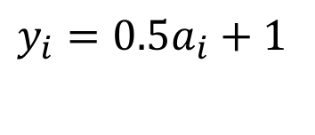
Linear Regression
y₄
y₃
y₂
y₁
$$y_{i}=0.5a_{i}+1$$
a₁ a₂ a₃ a₄

Slide 15
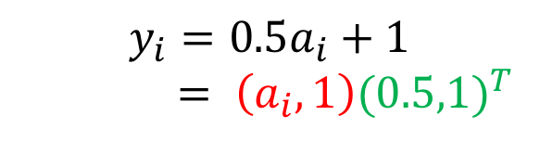
Linear Regression
y₄
y₃
y₂
y₁
$$y_{i}=0.5a_{i}+1$$
$$= \left(a_{i},1\right){(0.5,1)}^{T}$$
a₁ a₂ a₃ a₄

Slide 16
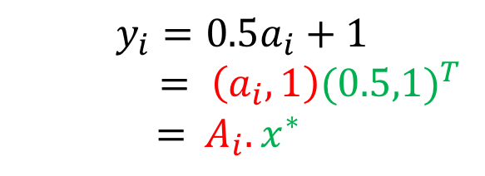
Linear Regression
y₄
y₃
y₂
y₁
$$y_{i}=0.5a_{i}+1$$
$$= \left(a_{i},1\right){(0.5,1)}^{T}$$
$$={ A}_{i}.x^{∗}$$
a₁ a₂ a₃ a₄

Slide 17
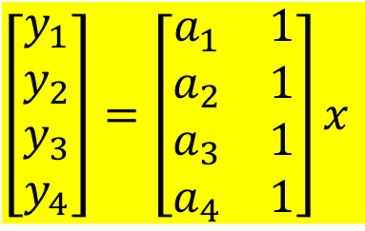

Linear Regression
$$\left[\begin{aligned}y_{1} \\ y_{2} \\ y_{3} \\ y_{4}\end{aligned}\right]=\left[\begin{matrix}a_{1} & 1 \\ a_{2} & 1 \\ a_{3} & 1 \\ a_{4} & 1\end{matrix}\right]x$$
y₄
y₃
y₂
y₁
$$y_{i}=0.5a_{i}+1$$
$$= \left(a_{i},1\right){(0.5,1)}^{T}$$
$$={ A}_{i}.x^{∗}$$
a₁ a₂ a₃ a₄

Slide 18
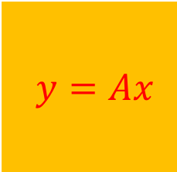
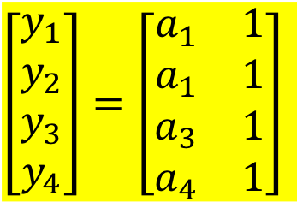
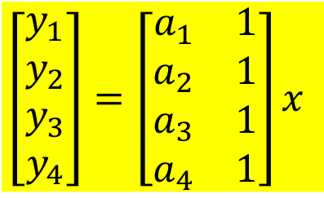
Linear Regression
$$\left[\begin{aligned}y_{1} \\ y_{2} \\ y_{3} \\ y_{4}\end{aligned}\right]=\left[\begin{matrix}a_{1} & 1 \\ a_{2} & 1 \\ a_{3} & 1 \\ a_{4} & 1\end{matrix}\right]x$$
$y=Ax$
$$\left[\begin{aligned}y_{1} \\ y_{2} \\ y_{3} \\ y_{4}\end{aligned}\right]=\left[\begin{matrix}a_{1} & 1 \\ a_{1} & 1 \\ a_{3} & 1 \\ a_{4} & 1\end{matrix}\right]$$
➔
y₄
y₃
y₂
y₁
$$y_{i}=0.5a_{i}+1$$
$$= \left(a_{i},1\right){(0.5,1)}^{T}$$
$$={ A}_{i}.x^{∗}$$
a₁ a₂ a₃ a₄

Slide 19

Uniqueness
In general, $x=x^{∗}$ may not be the only solution for
$y_{i}=$ ${ A}_{i}x$
Example: ${ A}_{i}=\left[\begin{matrix}2 & 0 & 1\end{matrix}\right] x=\left[\begin{matrix}x_{1} & x_{2} & x_{3}\end{matrix}\right]$

Slide 20

Linear Regression
Given $y$ and $A$
determine $x$
such that $y=Ax$

Slide 21
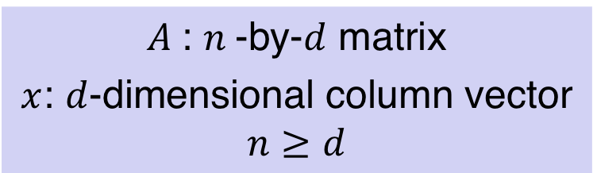

Linear Regression
Given $y$ and $A$
determine $x$
such that $y=Ax$
If matrix $A$ full-rank, $x=x^{∗}$ is the unique solution
$A$: $n$-by-$d$ matrix
$x$: $d$-dimensional column vector
$$n≥d$$

Slide 22

Distributed Linear Regression
Agent $i$ knows ${(A}_{i} ,$ $y_{i})$ where
$y_{i}= A_{i}x^{∗}$
In general, an agent knows a set of ${(A}_{i} ,$ $y_{i})$’s

Slide 23
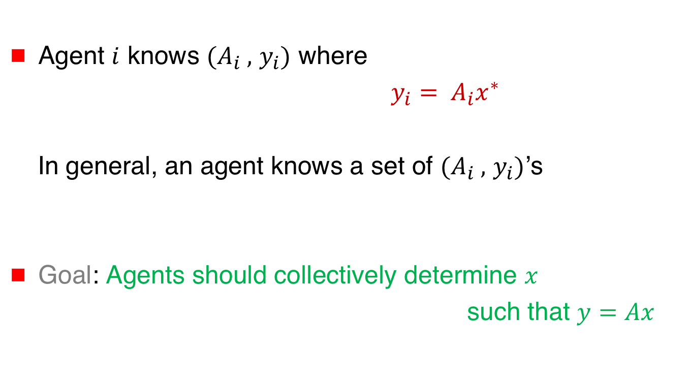
Distributed Linear Regression
Agent $i$ knows ${(A}_{i} ,$ $y_{i})$ where
$y_{i}= A_{i}x^{∗}$
In general, an agent knows a set of ${(A}_{i} ,$ $y_{i})$’s
Goal: Agents should collectively determine $x$
such that $y=Ax$

Slide 24

Optimization for Linear Regression
Agent $i$ knows ${(A}_{i} ,$ $y_{i})$ where $y_{i}= A_{i}x^{∗}$
Define cost
$$f_{i}\left(x\right)={(y_{i}−A_{i}x)}^{2}$$

Slide 25

Optimization for Linear Regression
Agent $i$ knows ${(A}_{i} ,$ $y_{i})$ where $y_{i}= A_{i}x^{∗}$
Define cost
$$f_{i}\left(x\right)={(y_{i}−A_{i}x)}^{2}$$
➔ $f_{i}\left(x^{∗}\right)=0$

Slide 26

Optimization for Linear Regression
Agent $i$ knows ${(A}_{i} ,$ $y_{i})$ where $y_{i}= A_{i}x^{∗}$
Define cost
$$f_{i}\left(x\right)={(y_{i}−A_{i}x)}^{2}$$
➔ $f_{i}\left(x^{∗}\right)=0$
min_{x} $f_{i}\left(x\right)=0$

Slide 27

Optimization for Linear Regression
Agent $i$ knows ${(A}_{i} ,$ $y_{i})$ where $y_{i}= A_{i}x^{∗}$
Define cost
$$f_{i}\left(x\right)={(y_{i}−A_{i}x)}^{2}$$
➔ $f_{i}\left(x^{∗}\right)=0$
min_{x} $f_{i}\left(x\right)=0$
$x^{∗} ∈$ argmin_{x} $f_{i}\left(x\right)$

Slide 28
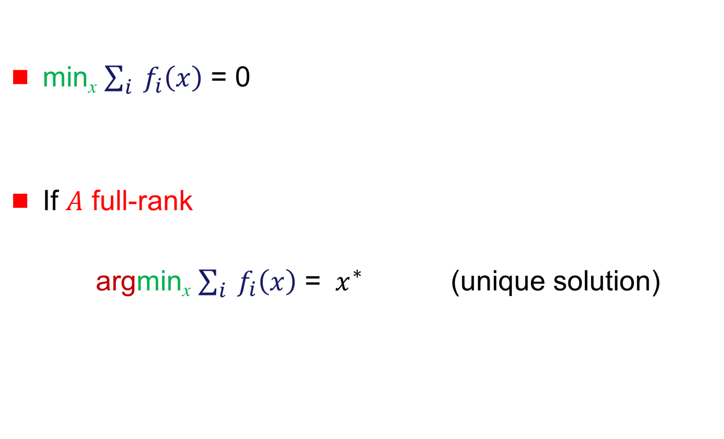
Distributed Linear Regression
min_{x} $\sum_{i}{{ f}_{i}\left(x\right)}$ = 0
If $A$ full-rank
argmin_{x} $\sum_{i}{{ f}_{i}\left(x\right)}$ = ${ x}^{∗}$ (unique solution)

Slide 29
Linear Regression
y₄
y₃
y₂
y₁
a₁ a₂ a₃ a₄

Slide 30
Linear Regression
y₄
y₃
y₂
y₁
a₁ a₂ a₃ a₄

Slide 31



Linear Regression
y₄
y₃
y₂
y₁
$$ε_{4}$$
$$ε_{2}$$
$$ε_{3}$$
a₁ a₂ a₃ a₄

Slide 32

Distributed Linear Regression
$y_{i}= A_{i}{ x}^{∗}+ε_{i}$ Agent $i$ knows ${(A}_{i} ,$ $y_{i})$

Slide 33
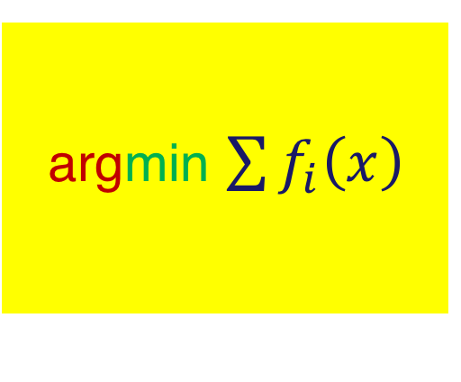

Distributed Linear Regression
$y_{i}= A_{i}{ x}^{∗}+ε_{i}$ Agent $i$ knows ${(A}_{i} ,$ $y_{i})$
$f_{i}\left(x\right)={(y_{i}−A_{i}x)}^{2}$
argmin $\sum{f_{i}\left(x\right)}$

Slide 34
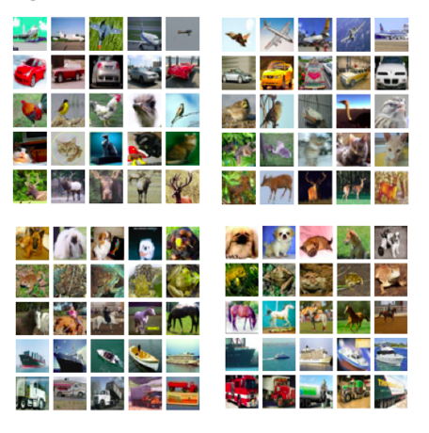
Machine Learning

Slide 35
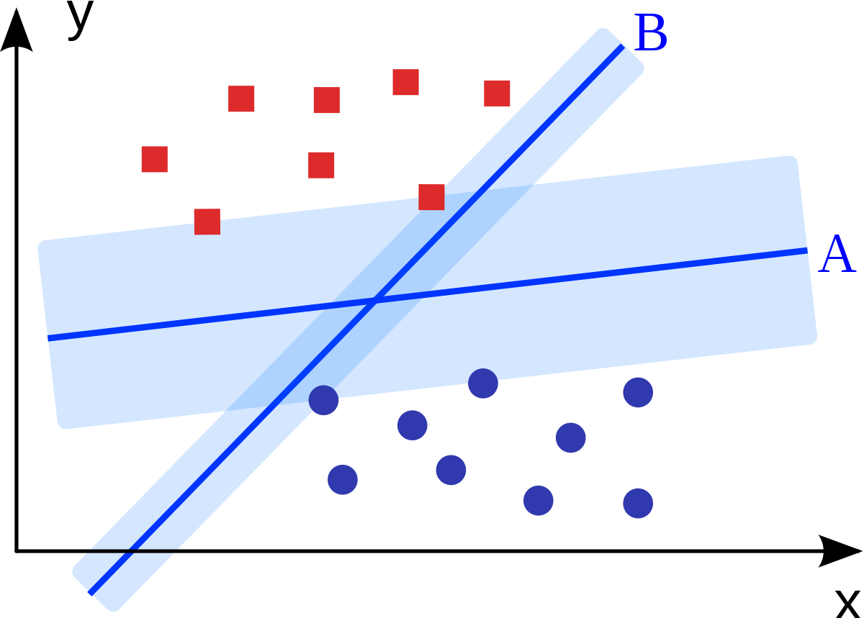
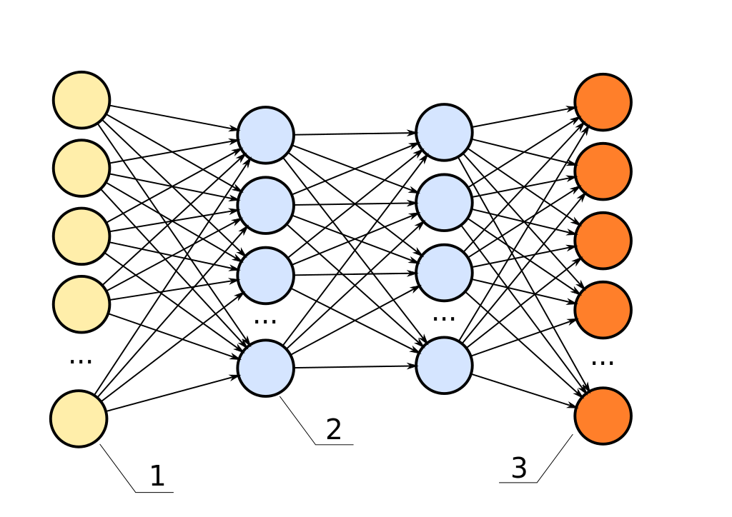
Machine Learning

Slide 36
Machine Learning
Train a neural network
for a classifier

Slide 37

Machine Learning
Train a neural network
for a classifier
Data $\left({d_{j}, y}_{j}\right)$ pairs
$d_{j}$ = image
${ y}_{j}$ = class

Slide 38
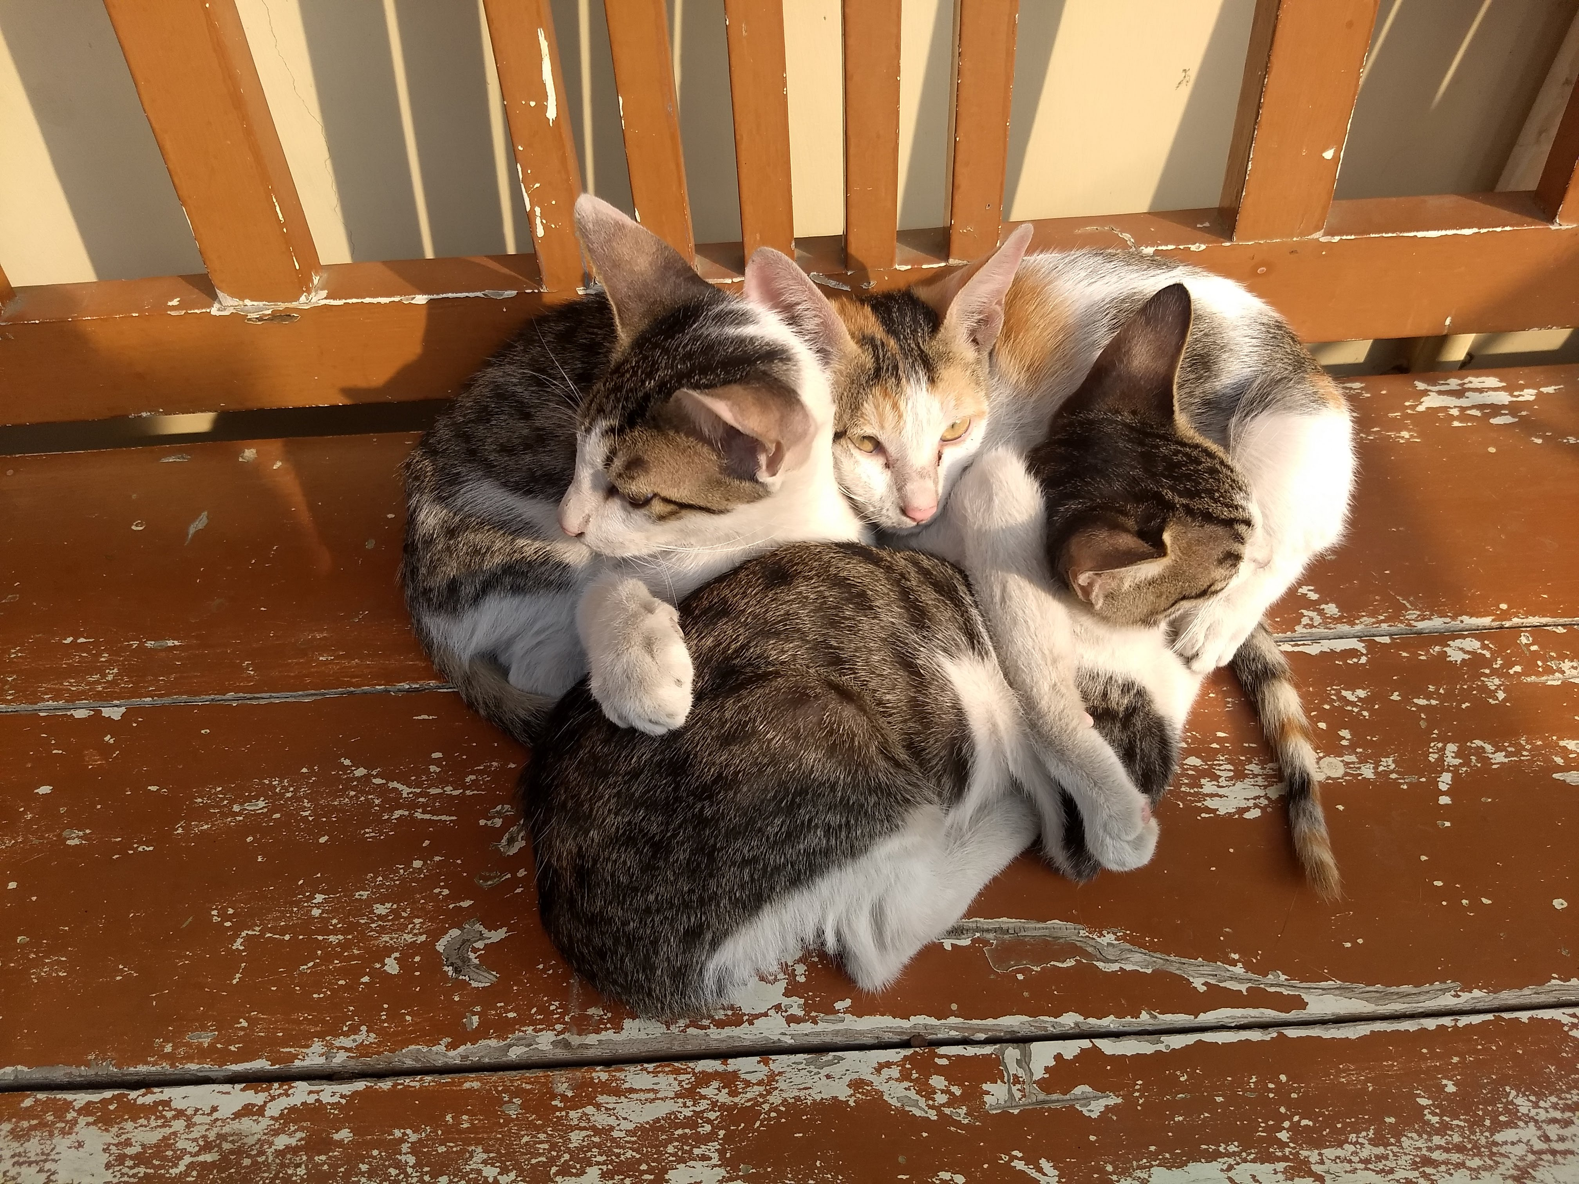

Machine Learning
Train a neural network
for a classifier
Data $\left({d_{j}, y}_{j}\right)$ pairs
$d_{j}$ = ${ y}_{j}$ = Cat

Slide 39

Machine Learning
$x=$ vector of neural net parameters (weights, biases)
$Y=$function implemented by the neural net
input $d_{j}$
output = estimate of $y_{j}$

Slide 40
Machine Learning
$x=$ vector of neural net parameters (weights, biases)
$Y=$function implemented by the neural net
input $d_{j}$
output = estimate of $y_{j}$

Slide 41

Machine Learning
$x=$ vector of neural net parameters (weights, biases)
$Y=$function implemented by the neural net
input $d_{j}$
output = estimate of $y_{j}$
Loss $L_{j}$ measures how well
the network classifies $d_{j}$
“quadratic loss” for binary classifier:
$L_{j}={(y_{j}−Y(d_{j}))}^{2}$

Slide 42

Machine Learning
Training a neural network
➔ Choose machine parameters $x$ such that total loss
$\sum_{j}{L_{j}}$ is minimized

Slide 43
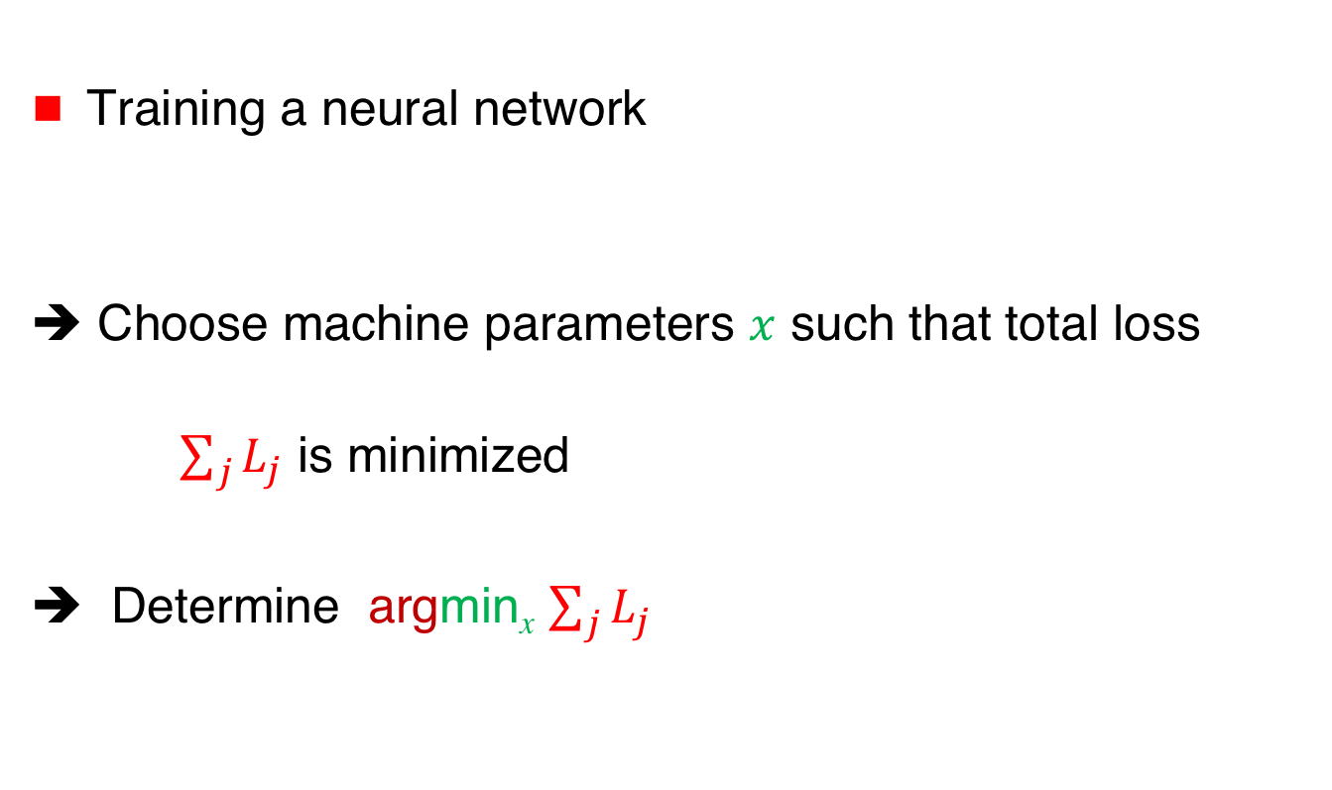
Machine Learning
Training a neural network
➔ Choose machine parameters $x$ such that total loss
$\sum_{j}{L_{j}}$ is minimized
➔ Determine argmin_{x} $\sum_{j}{L_{j}}$

Slide 44



Distributed Machine Learning
Data distributed across different agents
➔ Agents collaborate to train
a neural net
Agent 1
$$\text{Agent}\text{ 2}$$
$$\text{Agent}\text{ 3}$$
$$\text{Agent}\text{ 4}$$

Slide 45

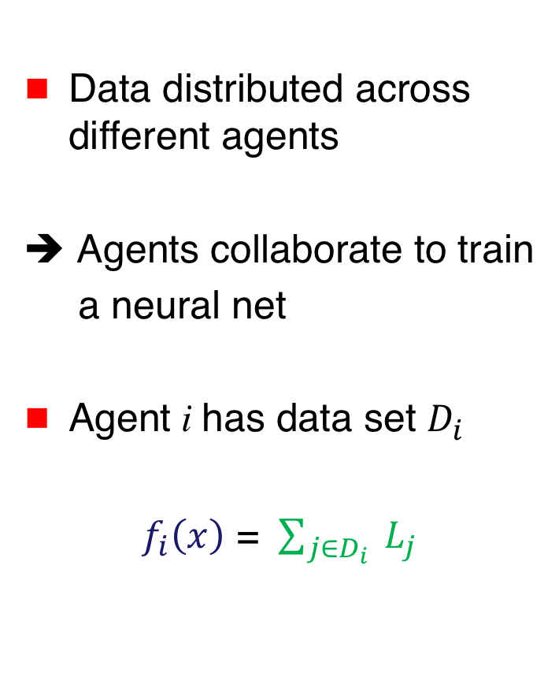



Distributed Machine Learning
Data distributed across different agents
➔ Agents collaborate to train
a neural net
Agent i has data set $D_{i}$
$f_{i}\left(x\right)$ = $\sum_{j∈D_{i}}{ L_{j}}$
$$f_{1}\left(x\right)$$
$$f_{2}\left(x\right)$$
$$f_{3}\left(x\right)$$
$$f_{4}\left(x\right)$$

Slide 46
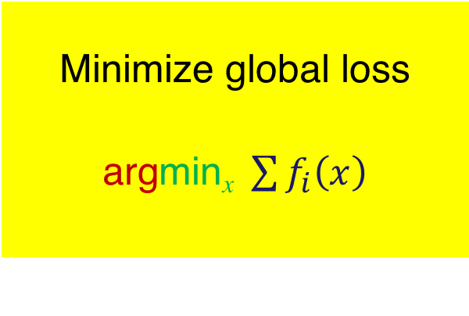
Machine Learning
$$f_{1}\left(x\right)$$
$$f_{2}\left(x\right)$$
Minimize global loss
argmin_{x} $\sum{f_{i}\left(x\right)}$
$$f_{3}\left(x\right)$$
$$f_{4}\left(x\right)$$

Slide 47
Convex Functions
📖

Slide 48



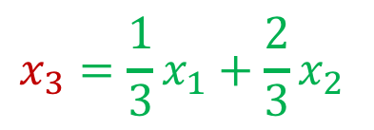

Convex Function
$f\left(ax_{1}+(1−a)x_{2}\right)$ $≤af\left(x_{1}\right)+\left(1−a\right)f\left(x_{2}\right)$
$0≤a≤$ 1
$$f(x)$$
$$x_{1}$$
$${x_{3}=\frac{1}{3}x}_{1}+\frac{2}{3}x_{2}$$
$$x_{2}$$

Slide 49

Convex Function
$f\left(y\right)−f\left(x\right)≥ ∇{f\left(x\right)}^{T}\left(y−x\right)$
When ${y=x}^{∗}$is a minimum, $0≥f\left(y\right)−f\left(x\right)$
➔ $0≥∇{f\left(x\right)}^{T}$ $\left(x^{∗}−x\right)$
➔ $(−∇{f\left(x)\right)}^{T}\left(x^{∗}−x\right)≥$ 0

Slide 50




Convex Function
$f\left(y\right)−f\left(x\right)≥ ∇{f\left(x\right)}^{T}\left(y−x\right)$
When ${y=x}^{∗}$is a minimum, $0≥f\left(y\right)−f\left(x\right)$
➔ $0≥∇{f\left(x\right)}^{T}$ $\left(x^{∗}−x\right)$
➔ $(−∇{f\left(x)\right)}^{T}\left(x^{∗}−x\right)≥$ 0
$$−∇f(x)$$
$$x$$
acute angle
$$\left(x^{∗}−x\right)$$
$$x^{∗}$$

Slide 51

Convex Function
${\left(∇f\left(y\right)−∇f\left(x\right)\right)}^{T}(y−x) ≥0$

Slide 52

Strongly Convex Function
${\left(∇f\left(y\right)−∇f\left(x\right)\right)}^{T}\left(y−x\right)≥β{\left\|y−x\right\|}^{2} β>0$
$\left\|(a,b,c)\right\|=\sqrt{a^{2}+b^{2}\text{+ }c^{2}}$ L₂-norm
➔ $β$-strongly convex $f(x)$

Slide 53
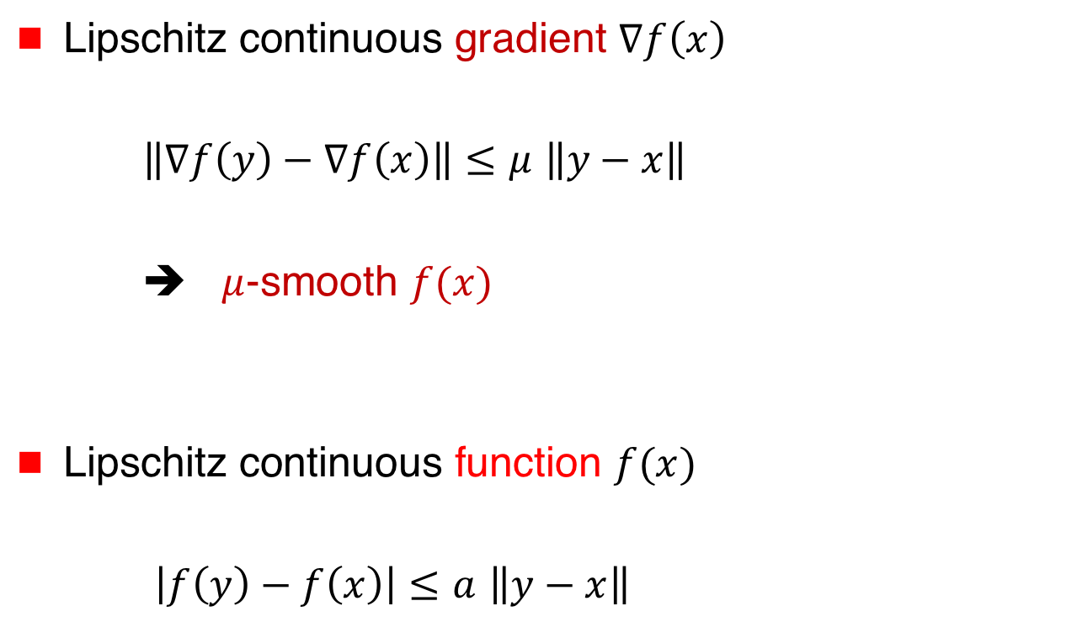
Lipschitz Continuity
Lipschitz continuous gradient $∇f\left(x\right)$
$\left\|∇f\left(y\right)−∇f\left(x\right)\right\|≤μ$ $\left\|y−x\right\|$
➔ $μ$-smooth $f(x)$
Lipschitz continuous function $f(x)$
$\left|f\left(y\right)−f\left(x\right)\right|≤a$ $\left\|y−x\right\|$

Slide 54
Gradients
We will assume that gradient exists
When functions are not smooth,
optimization algorithms using “subgradients” exist

Slide 55

Gradient
$f\left(x\right)=4u^{2}+2v^{3}+5$ $x=(u,v)$

Slide 56

Gradient
$f\left(x\right)=4u^{2}+2v^{3}+5$ $x=(u,v)$
➔ $\frac{∂f}{∂u}=8u$ and $\frac{∂f}{∂v}=6v^{2}$

Slide 57

Gradient
$f\left(x\right)=4u^{2}+2v^{3}+5$ $x=(u,v)$
➔ $\frac{∂f}{∂u}=8u$ and $\frac{∂f}{∂v}=6v^{2}$
➔ gradient $∇f\left(x\right)={\left(\frac{∂f}{∂u} \frac{∂f}{∂v}\right)}^{T}={\left(8u 6v^{2}\right)}^{T}$

Slide 58
Back-Propagation
“Back-propagation” in neural networks computes gradient

Slide 59
Computing Minimum of
Convex Functions
[Bubeck 2015]

Slide 60


Gradient Method
$$f\left(x\right)$$
x₀
x₁
  $$x_{k+1}⟵x_{k}−λ_{k }∇f\left(x_{k}\right)$$

Slide 61
Gradient Method
$$f\left(x\right)$$
x₀
x₁
x₂
  $$x_{k+1}⟵x_{k}−λ_{k }∇f\left(x_{k}\right)$$

Slide 62
Gradient Method
$$f\left(x\right)$$
x₀
x₁
x₂
x₃
  $$x_{k+1}⟵x_{k}−λ_{k }∇f\left(x_{k}\right)$$

Slide 63
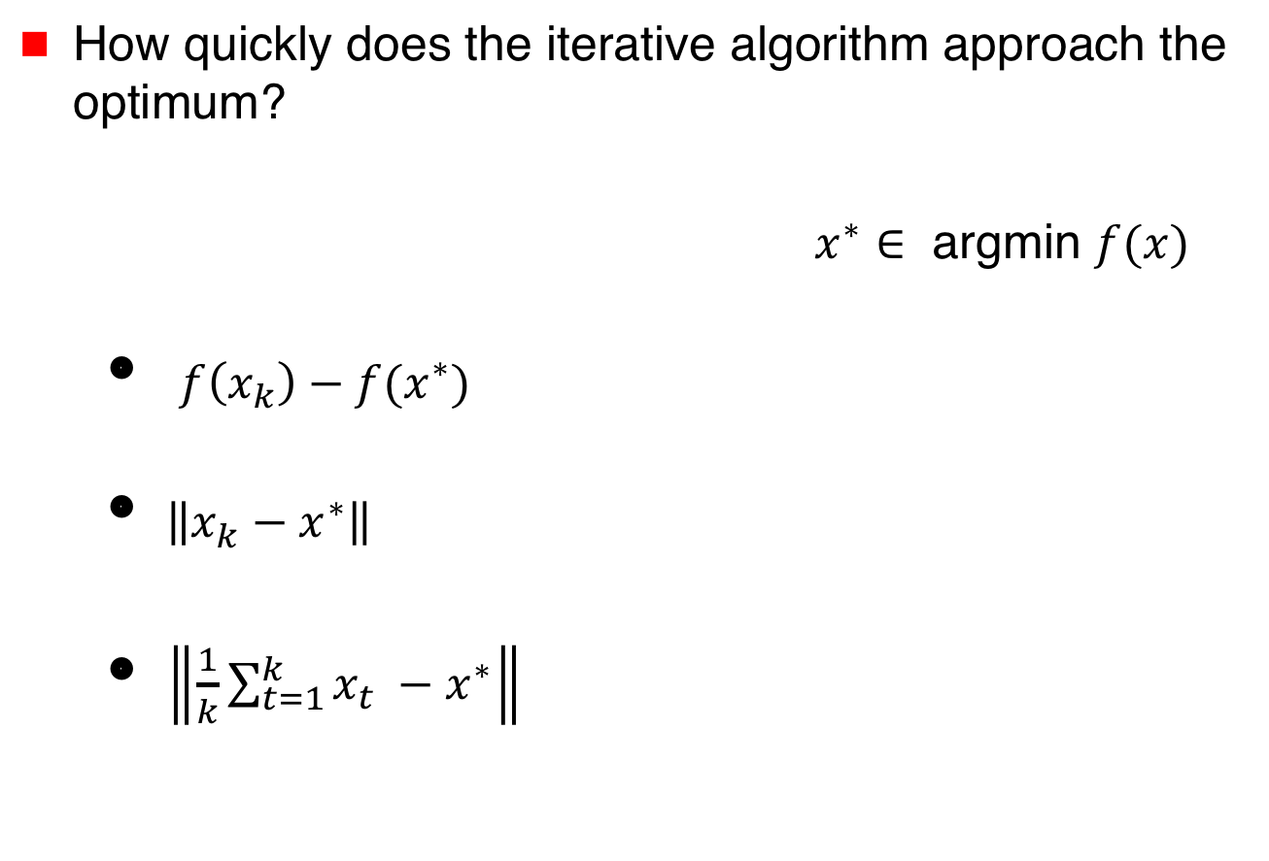
Convergence
How quickly does the iterative algorithm approach the optimum?
$x^{∗}∈$ argmin $f(x)$
  ${f\left(x_{k}\right)−f(x}^{∗})$
  $\left\|{x_{k}−x}^{∗}\right\|$
  $\left\|{\frac{1}{k}\sum_{t=1}^{k}{x_{t}} −x}^{∗}\right\|$

Slide 64
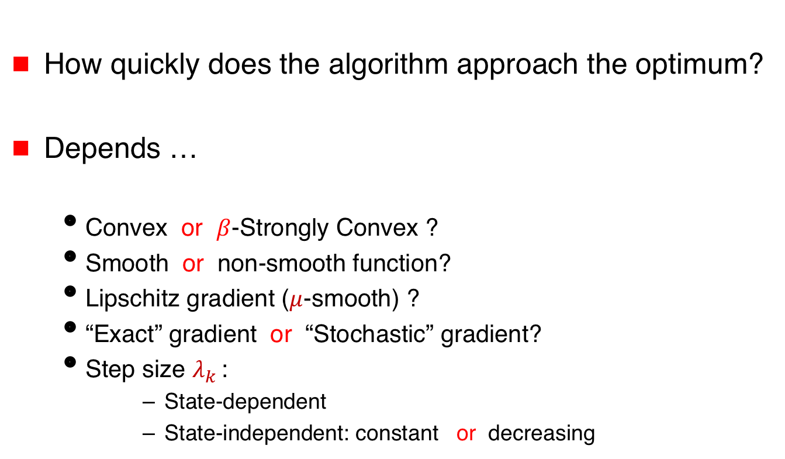

Convergence
$$x_{k+1}⟵x_{k}−λ_{k }∇f\left(x_{k}\right)$$
How quickly does the algorithm approach the optimum?
Depends …
  Convex or $β$-Strongly Convex ?
  Smooth or non-smooth function?
  Lipschitz gradient ($μ$-smooth) ?
  “Exact” gradient or “Stochastic” gradient?
  Step size $λ_{k }$:
      State-dependent
      State-independent: constant or decreasing

Slide 65

Linear (or Geometric) Convergence
$$∃c\text{, }0<c<1 \text{such} \text{that} f\left(x_{k}\right)−{f(x}^{∗}) = O\left(c^{k}\right)$$
➔ $\log\left(f\left(x_{k}\right)−{f(x}^{∗})\right)=O(k)$ linear in k

Slide 66

Linear (or Geometric) Convergence
$$∃c\text{, }0<c<1 \text{such} \text{that} f\left(x_{k}\right)−{f(x}^{∗}) = O\left(c^{k}\right)$$
➔ $\log\left(f\left(x_{k}\right)−{f(x}^{∗})\right)=O(k)$ linear in k
Strongly convex $f(x)$, and
$λ_{k }$ by exact line search, or
$μ$-smooth $f(x)$, constant $λ_{k }< \frac{1}{μ}$

Slide 67


Sublinear convergence
$$f\left(x_{k}\right)−{f(x}^{∗})= O\left(\frac{1}{k}\right)$$
Convex functions (but not strongly convex)
$μ$-smooth $f(x)$ ➔ Lipschitz gradients
constant step size $λ_{k }≤\frac{1}{μ}$

Slide 68


$O\left(\frac{1}{k}\right)$ convergence
Strongly convex Lipschitz functions
$λ_{k }∝ \frac{1}{k}$

Slide 69

Nesterov Acceleration
Nesterov Accelerated Gradient Descent
$$z_{k}⟵x_{k}−β_{k }(x_{k}−x_{k−1})$$
$$x_{k+1}⟵x_{k}−λ_{k }∇f\left(z_{k}\right)$$
Convex functions with Lipschitz Gradients
$O\left(\frac{1}{k^{2}}\right)$ convergence

Slide 70

Stochastic Gradient Method
$$x_{k+1}⟵x_{k}−λ_{k }g\left(x_{k}\right)$$
where $E(g\left(x_{k})\right)=$ $∇f\left(x_{k}\right)$

Slide 71

Stochastic Gradient Method
$$x_{k+1}⟵x_{k}−λ_{k }g\left(x_{k}\right)$$
where $E(g\left(x_{k})\right)=$ $∇f\left(x_{k}\right)$
Example:
$f\left(x\right)= \sum{f_{i}\left(x\right)}$
Choose $i_{k}$ uniformly at random
$g\left(x_{k})\right)=$ $∇f_{i_{k}}\left(x_{k}\right)$

Slide 72
Stochastic Gradient Method
Advantage
… in each iteration, less work than
computing full gradient

Slide 73






Stochastic Gradient Method
Advantage
… in each iteration, less work than
computing full gradient
Example: $f_{i}\left(x\right)$= distance of $x$from $u_{i}$
$$u_{1}$$
$$u_{2}$$
$$−∇f_{1}\left(x\right)$$
$$x$$
$$u_{3}$$

Slide 74

Stochastic Gradient Method
Advantage
… in each iteration, less work than
computing full gradient
Example: $f_{i}\left(x\right)$= distance of $x$from $u_{i}$
$$u_{1}$$
$$u_{2}$$
$$x$$
$$u_{3}$$

Slide 75


Stochastic Gradient Method
Advantage
… in each iteration, less work than
computing full gradient
Example: $f_{i}\left(x\right)$= distance of $x$from $u_{i}$
$$u_{1}$$
$$u_{2}$$
$$−∇f_{2}\left(x\right)$$
$$x$$
$$u_{3}$$

Slide 76

Stochastic Gradient Method
Advantage
… in each iteration, less work than
computing full gradient
Example: $f_{i}\left(x\right)$= distance of $x$from $u_{i}$
$$u_{1}$$
$$u_{2}$$
$$−∇f_{2}\left(x\right)$$
$$x$$
$$u_{3}$$

Slide 77


Stochastic Gradient Method
Advantage
… in each iteration, less work than
computing full gradient
Example: $f_{i}\left(x\right)$= distance of $x$from $u_{i}$
$$u_{1}$$
$$u_{2}$$
$$x$$
$$−∇f_{3}\left(x\right)$$
$$u_{3}$$

Slide 78


Stochastic Gradient Method
Advantage
… in each iteration, less work than
computing full gradient
Example: $f_{i}\left(x\right)$= distance of $x$from $u_{i}$
$$x^{∗}$$
$$\sum{∇f_{i}\left(x^{∗}\right)=0}$$

Slide 79

Stochastic Gradient Method
Advantage
… in each iteration, less work than
computing full gradient
Example: $f_{i}\left(x\right)$= distance of $x$from $i$-th line

Slide 80

Stochastic Gradient Method
Downside … variance of stochastic gradient
$$x$$

Slide 81
Stochastic Gradient Method
Downside … variance of stochastic gradient
$$x$$

Slide 82

Stochastic Gradient Method
Downside … variance of stochastic gradient
$$x$$

Slide 83
Stochastic Gradient Method
Downside … variance of stochastic gradient
$$x^{∗}$$
$$\sum{∇f_{i}\left(x^{∗}\right)=0}$$

Slide 84
Stochastic Gradient Method
Downside … variance of stochastic gradient
  Decreasing step size
  Variance reduction

Slide 85
Survey
Convex Optimization: Algorithms and Complexity
Sébastien Bubeck
2015

Slide 86
Distributed Optimization

Slide 87
Slides & Videos
Slides and videos for the tutorial will be made available online
Visit
disc.georgetown.domains
follow the link for Talks

Slide 88
Attribution for Images
Krishnavedala, CC BY-SA 3.0 <https://creativecommons.org/licenses/by-sa/3.0>,
via Wikimedia Commons
https://upload.wikimedia.org/wikipedia/commons/1/12/Paraboloid_of_Revolution.svg
https://commons.wikimedia.org/wiki/File:Paraboloid_of_Revolution.svg
Ennepetaler86, CC BY 3.0 <https://creativecommons.org/licenses/by/3.0>,
via Wikimedia Commons
https://upload.wikimedia.org/wikipedia/commons/f/f2/Svm_intro.svg
https://commons.wikimedia.org/wiki/File:Svm_intro.svg
Zufzzi, Public domain, via Wikimedia Commons
https://commons.wikimedia.org/wiki/File:Neural_network_bottleneck_achitecture.svg
https://upload.wikimedia.org/wikipedia/commons/8/8b/Neural_network_bottleneck_achitecture.svg

Slide 89
Continue to part II …

Slide 90
Additional Slides

Slide 91

Linear Regression
$d$-dimensional${ x}^{∗}$
$n$-by-$d$ matrix $A$

Slide 92

Linear Regression
$d$-dimensional${ x}^{∗}$
$n$-by-$d$ matrix $A$
$n$-dimensional $y$

Slide 93

Linear Regression
$d$-dimensional${ x}^{∗}$
$n$-by-$d$ matrix $A$
$n$-dimensional $y$
$$y=A{ x}^{∗}$$
=

Slide 94




Distributed Linear Regression
Agent $i$ knows $A_{i}$ and $y_{i}$ where
$y_{i}= A_{i}{ x}^{∗}$
$$y_{1}$$
$$A_{1}$$
$${ x}^{∗}$$
=

Slide 95



Distributed Linear Regression
Agent $i$ knows $A_{i}$ and $y_{i}$ where
$y_{i}= A_{i}{ x}^{∗}$
$$y_{1}$$
$$A_{1}$$
$${ x}^{∗}$$
$${ x}^{∗}$$
=
$$y_{2}$$
$$A_{2}$$
=

Slide 96


Distributed Linear Regression
$$y$$
$${ x}^{∗}$$
Agent $i$ knows $A_{i}$ and $y_{i}$ where
$y_{i}= A_{i}{ x}^{∗}$
=
$$y_{1}$$
$$A_{1}$$
$${ x}^{∗}$$
$${ x}^{∗}$$
=
$$y_{2}$$
$$A_{2}$$
=

Slide 97



Distributed Linear Regression
Agent $i$ knows $A_{i}$ and $y_{i}$ where
$y_{i}= A_{i}{ x}^{∗}$
Goal: Determine ${ x}^{∗}$
$$y$$
$${ x}^{∗}$$
=

Slide 98

Distributed Linear Regression
Special case: $A_{i}$ is a row vector and $y_{i}$ is a scalar
$$f_{i}\left(x\right)={(y_{i}−A_{i}x)}^{2}$$
General case:
$$f_{i}\left(x\right)={|\left|y_{i}−A_{i}x\right||}^{2}$$
where || . || denotes L₂ norm

Slide 99

Distributed Linear Regression
Special case: $A_{i}$ is a row vector and $y_{i}$ is a scalar
$$f_{i}\left(x\right)={(y_{i}−A_{i}x)}^{2}$$
General case:
$$f_{i}\left(x\right)={|\left|y_{i}−A_{i}x\right||}^{2}$$
where || . || denotes L₂ norm
$${||(r}_{1}, r_{2},r_{3})||= \sqrt{r_{1}^{2}+r_{2}^{2}+r_{3}^{2}}$$

Slide 100

Distributed Linear Regression
Special case: $A_{i}$ is a row vector and $y_{i}$ is a scalar
${ f}_{i}\left(x\right)={(y_{i}−A_{i}x)}^{2}$ “error”
General case:
$$f_{i}\left(x\right)={|\left|y_{i}−A_{i}x\right||}^{2}$$
where || . || denotes L₂ norm
Example: $f_{i}\left(x\right)={(y_{i1}−A_{i1}x)}^{2}$ + ${(y_{2i}−A_{i2}x)}^{2}$

Slide 101

Example
$$\left[\begin{matrix}x_{1} \\ x_{2}\end{matrix}\right]$$
=

Slide 102

Example
$$y A x$$
$$\left[\begin{matrix}x_{1} \\ x_{2}\end{matrix}\right]$$
=

Slide 103


Example
$$y_{1}$$
$$A_{1}$$
$$\left[\begin{matrix}x_{1} \\ x_{2}\end{matrix}\right]$$
=

Slide 104

Example
$f_{1}\left(x\right)={(1−{1.x}_{1}−{0.x}_{2})}^{2}$ + ${(1.3−{0.8x}_{1}−{0.5x}_{2})}^{2}$
= ${(1−x_{1})}^{2}$ + ${(1.3−{0.8x}_{1}−{0.5x}_{2})}^{2}$
$$y_{1}$$
$$A_{1}$$
$$\left[\begin{matrix}x_{1} \\ x_{2}\end{matrix}\right]$$
=

Slide 105


Distributed Linear Regression
Goal: Determine ${ x}^{∗}$
Minimize the sum of squared errors
argmin $\sum{f_{i}\left(x\right)}$

Slide 106


$$\left[\begin{matrix}1 \\ 1\end{matrix}\right]$$
argmin_{x} $\sum_{i}{{ f}_{i}\left(x\right)}$ =
$$y_{1}$$
$$A_{1}$$
$$\left[\begin{matrix}x_{1} \\ x_{2}\end{matrix}\right]$$
=

Slide 108

$O\left(\frac{1}{\sqrt{k}}\right)$ Convergence
Non-smooth Lipschitz functions
using subgradient descent
Iteration replaces gradient by subgradient

