Slide 1
Tutorial
Security and Privacy in Distributed Optimization and Learning
Nitin Vaidya
Georgetown University
March 2021

Slide 2
Slides & Videos
Visit disc.georgetown.domains and follow the link for Talks
  Slides for this tutorial
  Video and slides for a longer version of the tutorial

Slide 3
Distributed Optimization

Slide 4
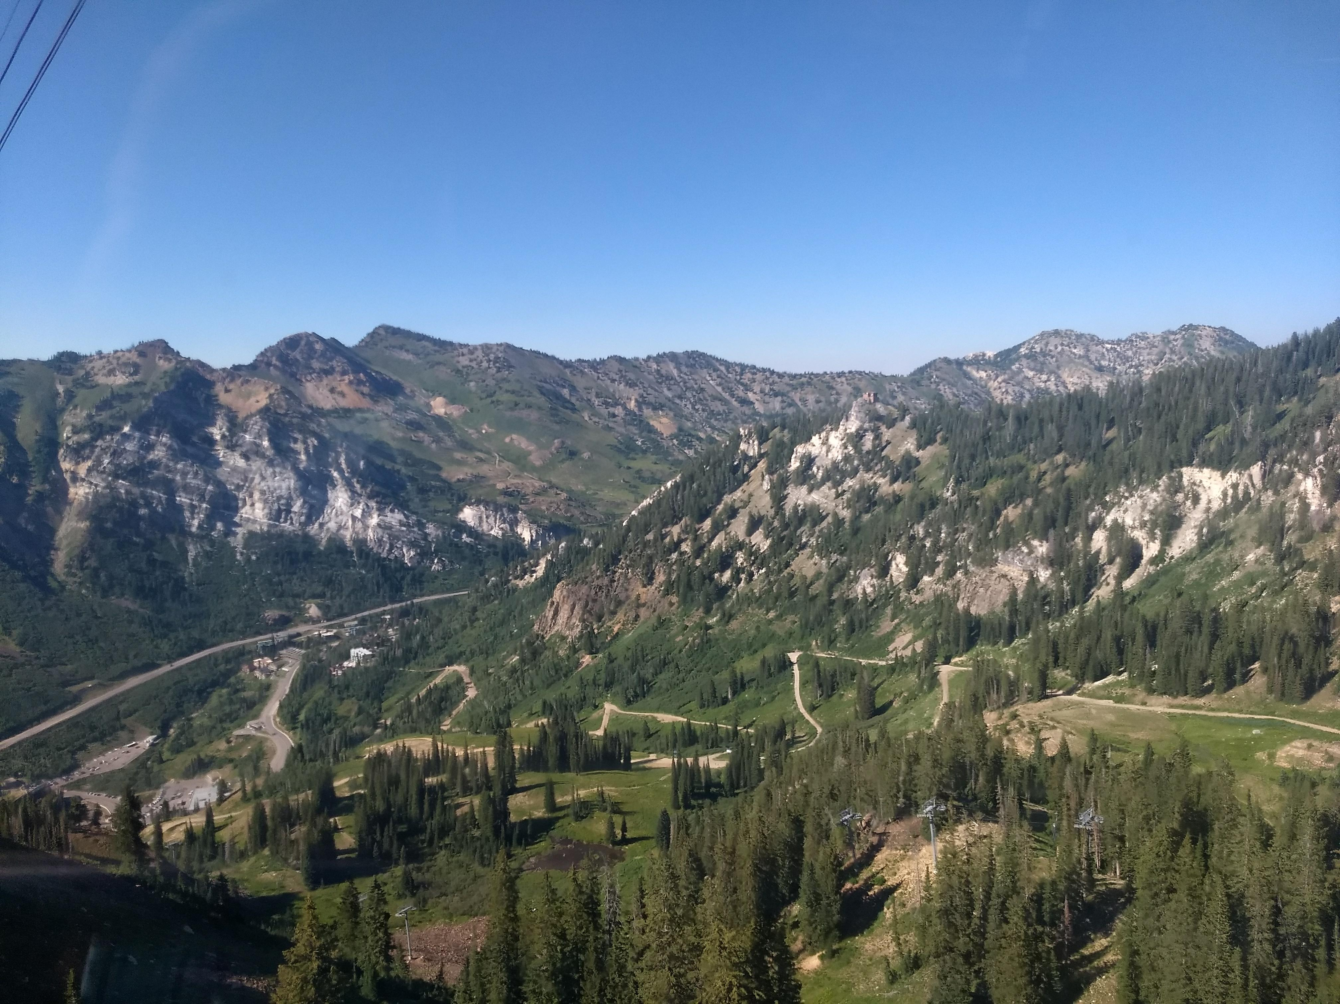

Rendezvous

Slide 5
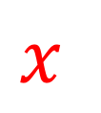



Rendezvous
$$f_{1}\left(x\right)$$
$$f_{2}\left(x\right)$$
$$x$$
$$f_{3}\left(x\right)$$

Slide 6
Rendezvous
Determine the location where the total cost of meeting is minimized

Slide 7
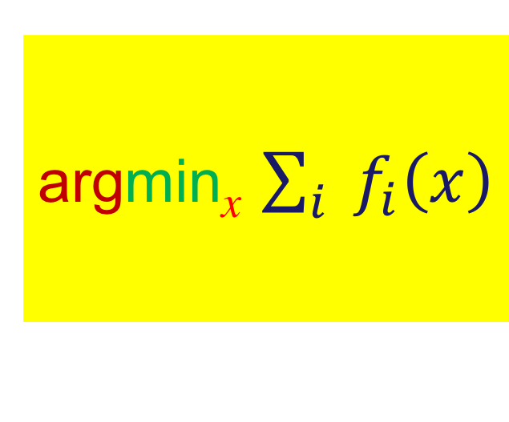
Rendezvous
Determine the location where the total cost of meeting is minimized
argmin_{x} $\sum_{i}{{ f}_{i}\left(x\right)}$

Slide 8
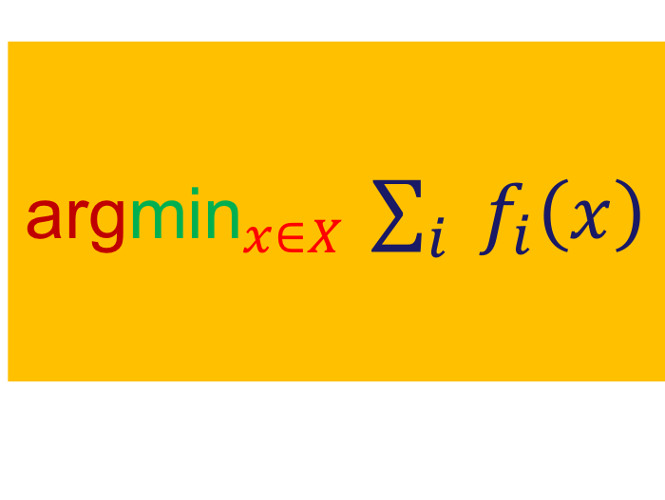
Rendezvous
Determine the location where the total cost of meeting is minimized
argmin_{x} $\sum_{i}{{ f}_{i}\left(x\right)}$
${\text{arg}\text{min}}_{x∈X}$ $\sum_{i}{{ f}_{i}\left(x\right)}$

Slide 9
Rendezvous
$$f_{1}\left(x\right)$$
$$f_{2}\left(x\right)$$
$$x$$
$$f_{3}\left(x\right)$$

Slide 10
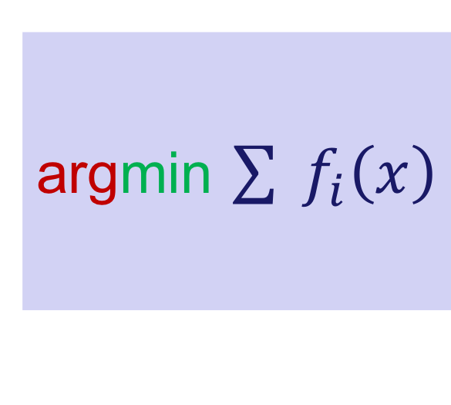
Rendezvous
Determine the location where the total cost of meeting is minimized
argmin_{x} $\sum_{i}{{ f}_{i}\left(x\right)}$
${\text{arg}\text{min}}_{x∈X}$ $\sum_{i}{{ f}_{i}\left(x\right)}$
argmin $\sum{{ f}_{i}\left(x\right)}$

Slide 11
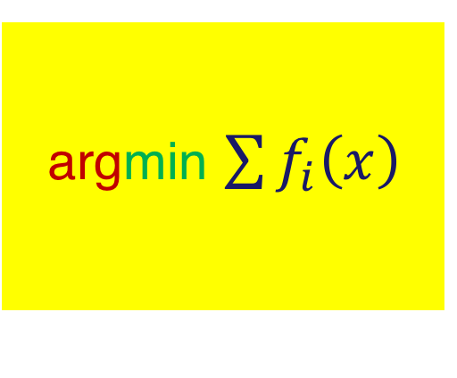

Distributed Linear Regression
$y_{i}= A_{i}{ x}^{∗}+ε_{i}$ Agent $i$ knows ${(A}_{i} ,$ $y_{i})$
$f_{i}\left(x\right)={(y_{i}−A_{i}x)}^{2}$
argmin $\sum{f_{i}\left(x\right)}$

Slide 12
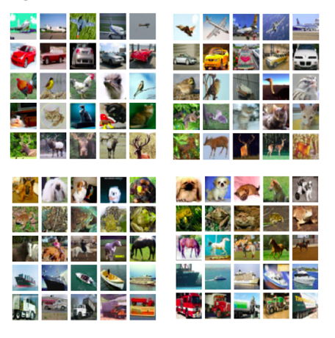
Machine Learning

Slide 13
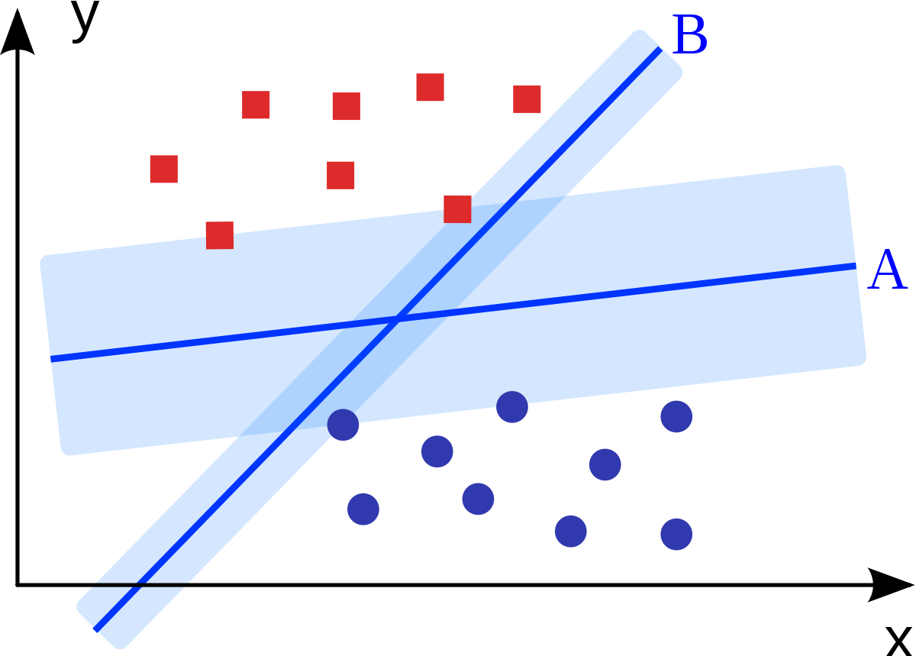
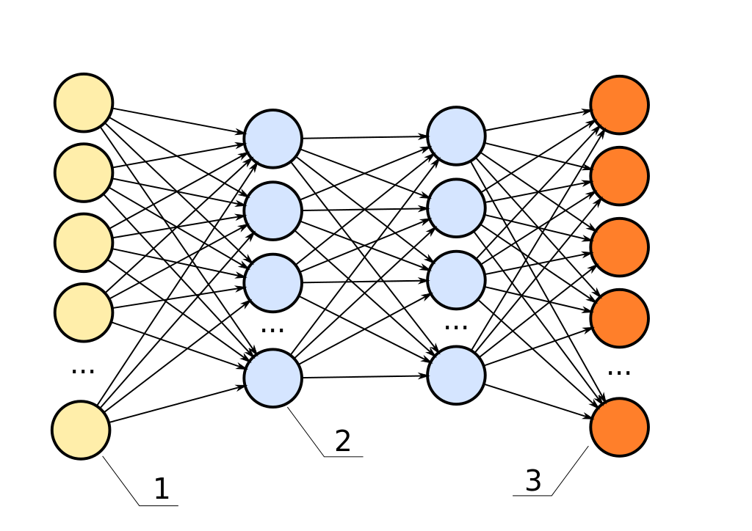
Machine Learning

Slide 14
Machine Learning
Train a neural network
for a classifier

Slide 15

Machine Learning
Train a neural network
for a classifier
Data $\left({d_{j}, y}_{j}\right)$ pairs
$d_{j}$ = image
${ y}_{j}$ = class

Slide 16
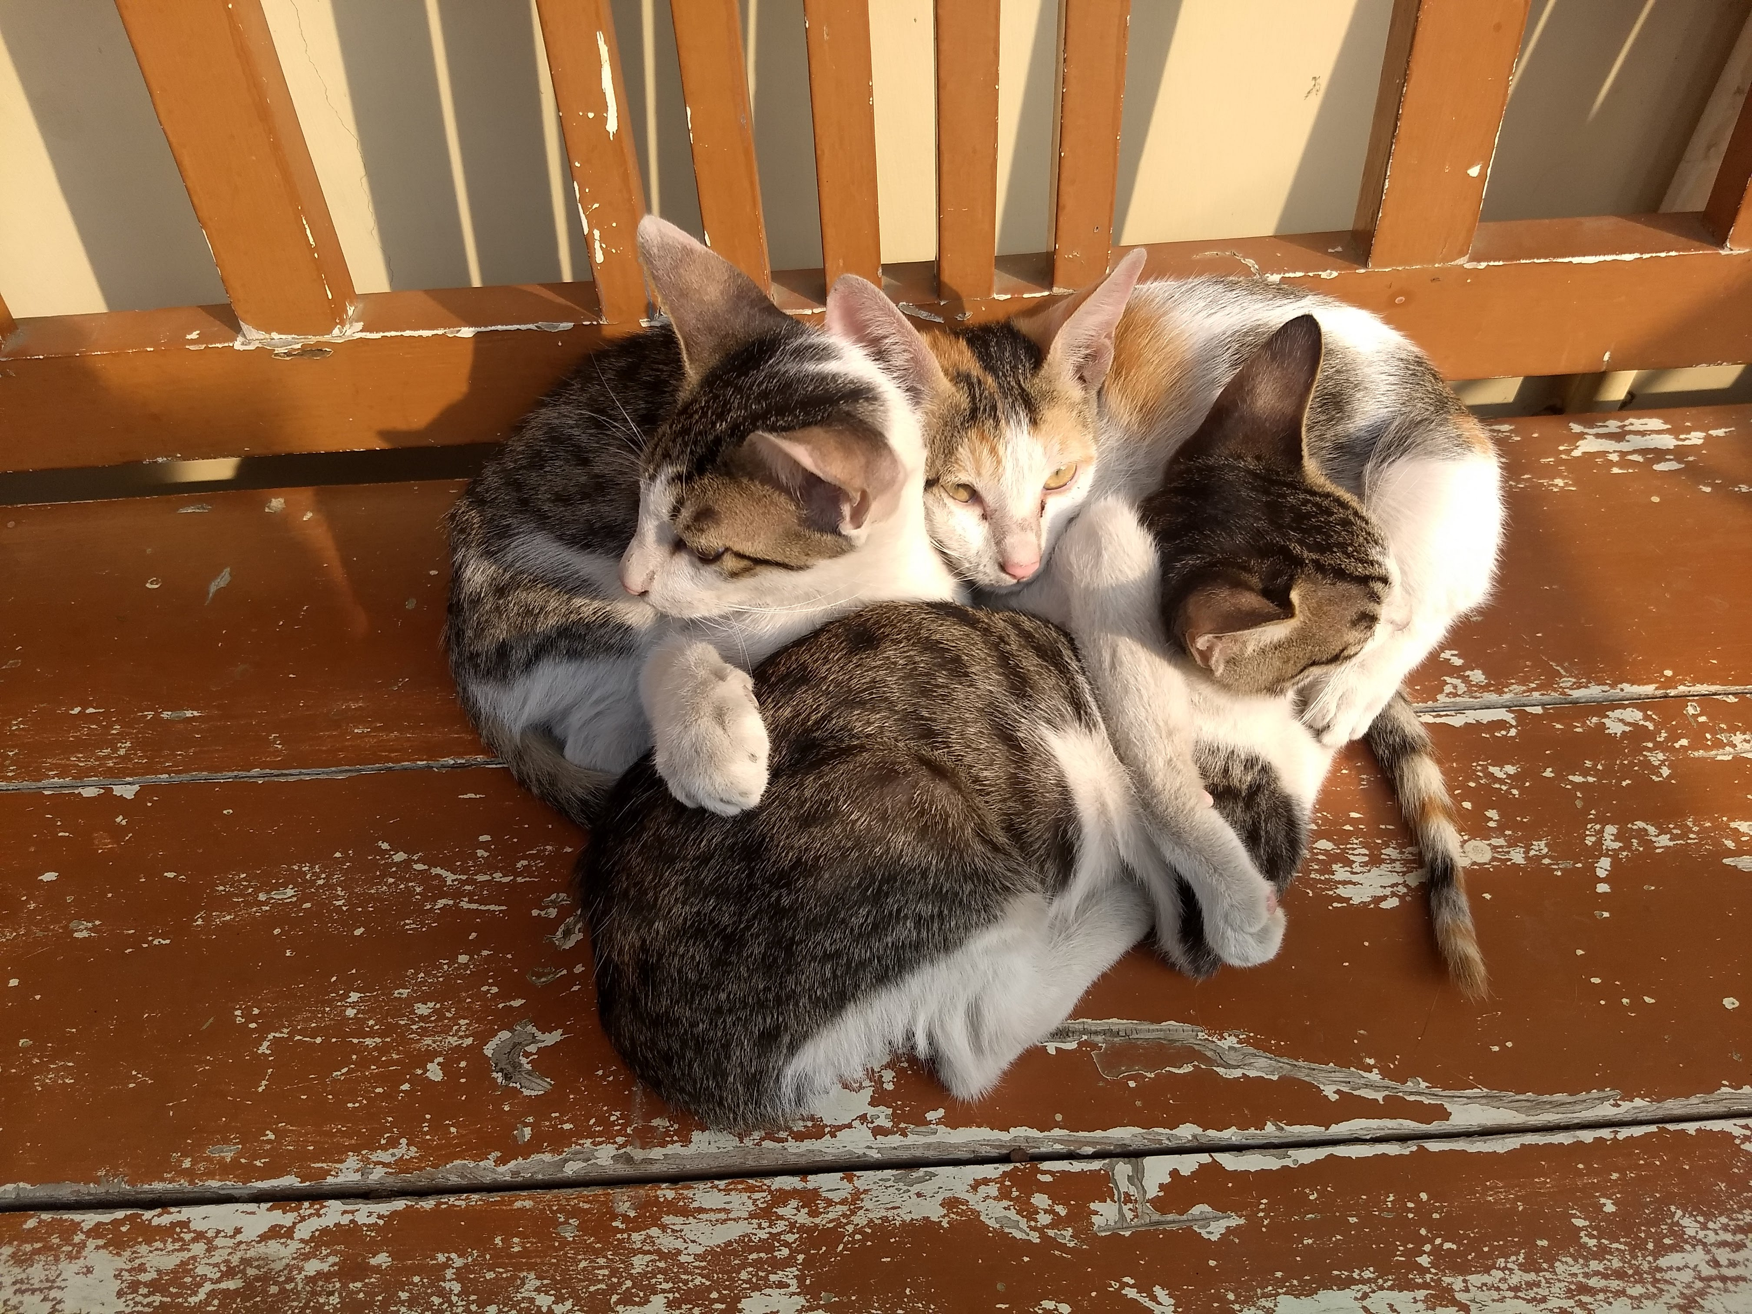

Machine Learning
Train a neural network
for a classifier
Data $\left({d_{j}, y}_{j}\right)$ pairs
$d_{j}$ = ${ y}_{j}$ = Cat

Slide 17

Machine Learning
$x=$ vector of neural net parameters (weights, biases)
$Y=$function implemented by the neural net
input $d_{j}$
output = estimate of $y_{j}$

Slide 18
Machine Learning
$x=$ vector of neural net parameters (weights, biases)
$Y=$function implemented by the neural net
input $d_{j}$
output = estimate of $y_{j}$

Slide 19

Machine Learning
$x=$ vector of neural net parameters (weights, biases)
$Y=$function implemented by the neural net
input $d_{j}$
output = estimate of $y_{j}$
Loss $L_{j}$ measures how well
the network classifies $d_{j}$
“quadratic loss” for binary classifier:
$L_{j}={(y_{j}−Y(d_{j}))}^{2}$

Slide 20

Machine Learning
Training a neural network
➔ Choose machine parameters $x$ such that total loss
$\sum_{j}{L_{j}}$ is minimized

Slide 21
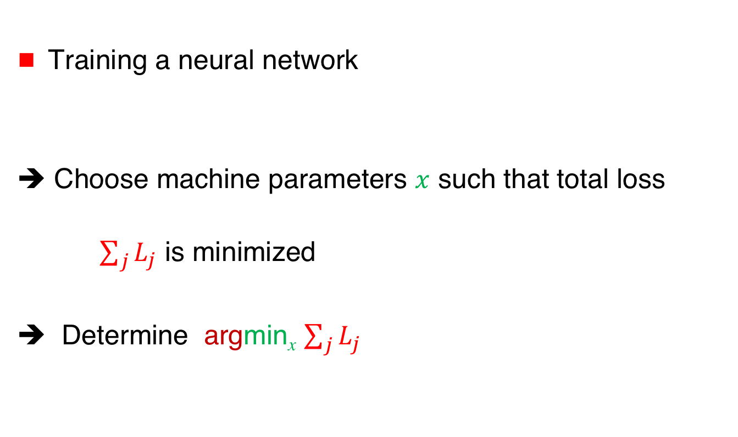
Machine Learning
Training a neural network
➔ Choose machine parameters $x$ such that total loss
$\sum_{j}{L_{j}}$ is minimized
➔ Determine argmin_{x} $\sum_{j}{L_{j}}$

Slide 22



Distributed Machine Learning
Data distributed across different agents
➔ Agents collaborate to train
a neural net
Agent 1
$$\text{Agent}\text{ 2}$$
$$\text{Agent}\text{ 3}$$
$$\text{Agent}\text{ 4}$$

Slide 23

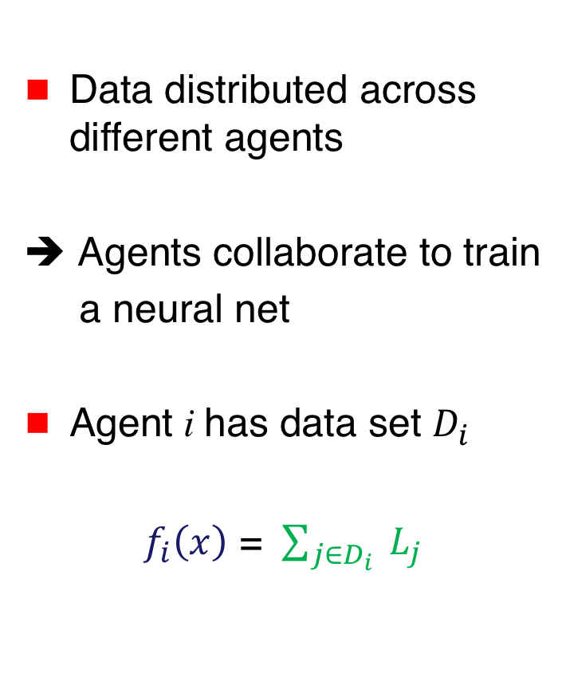



Distributed Machine Learning
Data distributed across different agents
➔ Agents collaborate to train
a neural net
Agent i has data set $D_{i}$
$f_{i}\left(x\right)$ = $\sum_{j∈D_{i}}{ L_{j}}$
$$f_{1}\left(x\right)$$
$$f_{2}\left(x\right)$$
$$f_{3}\left(x\right)$$
$$f_{4}\left(x\right)$$

Slide 24
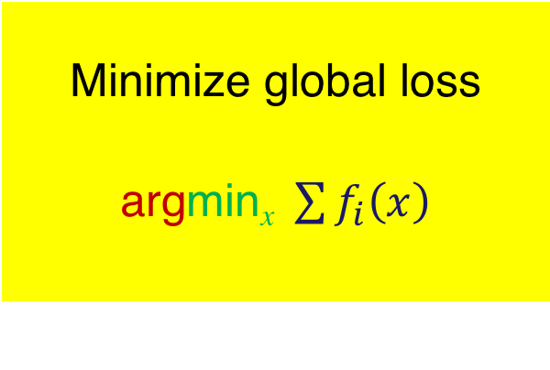
Machine Learning
$$f_{1}\left(x\right)$$
$$f_{2}\left(x\right)$$
Minimize global loss
argmin_{x} $\sum{f_{i}\left(x\right)}$
$$f_{3}\left(x\right)$$
$$f_{4}\left(x\right)$$

Slide 25
Computing Minimum of
Convex Functions
[Bubeck 2015]

Slide 26


Gradient Method
$$f\left(x\right)$$
x₀
x₁
  $$x_{k+1}⟵x_{k}−λ_{k }∇f\left(x_{k}\right)$$

Slide 27
Gradient Method
$$f\left(x\right)$$
x₀
x₁
x₂
  $$x_{k+1}⟵x_{k}−λ_{k }∇f\left(x_{k}\right)$$

Slide 28
Gradient Method
$$f\left(x\right)$$
x₀
x₁
x₂
x₃
  $$x_{k+1}⟵x_{k}−λ_{k }∇f\left(x_{k}\right)$$

Slide 29
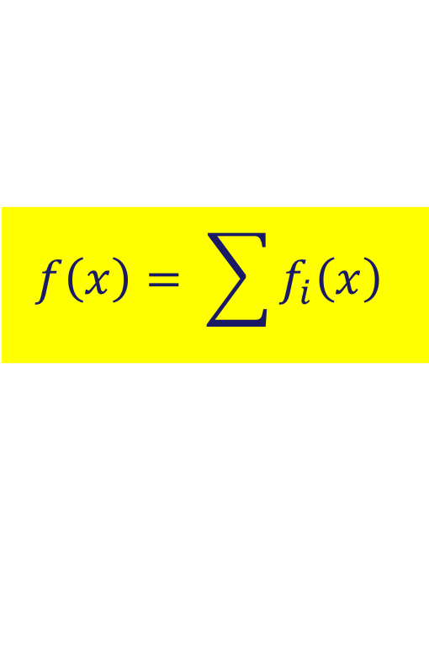
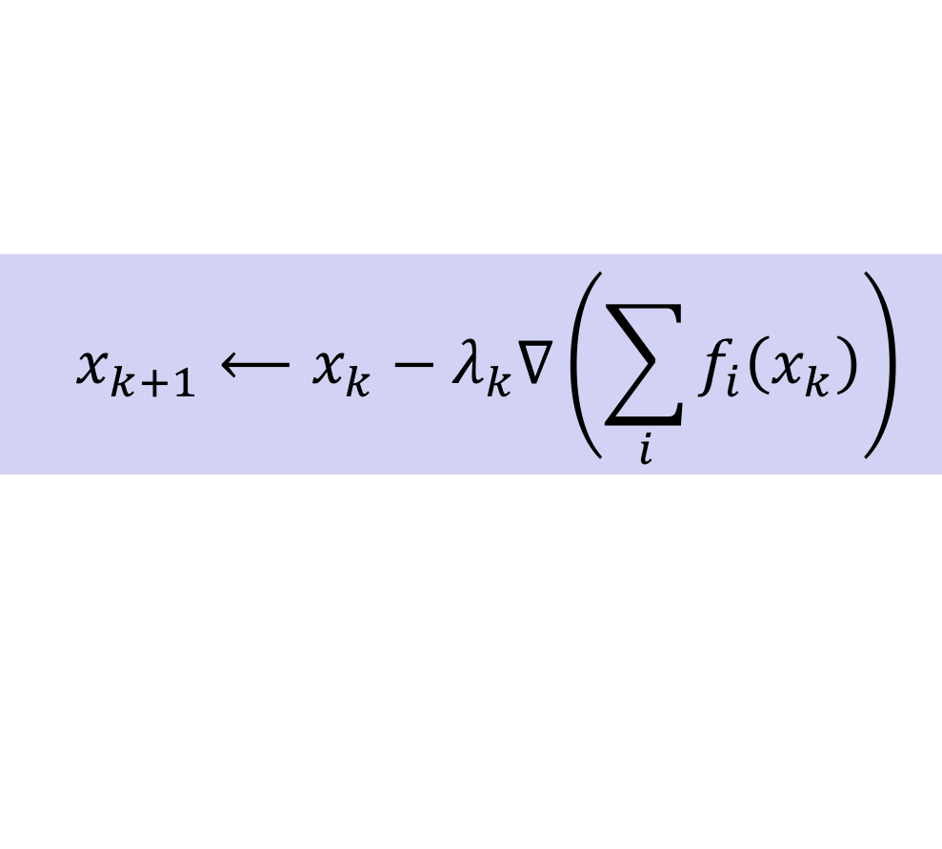
Gradient Method
$$f\left(x\right)= \sum{f_{i}\left(x\right)}$$
x₀
x₁
x₂
  $$x_{k+1}⟵x_{k}−λ_{k}∇\left(\sum_{i}{f_{i}\left(x_{k}\right)}\right)$$
x₃

Slide 30
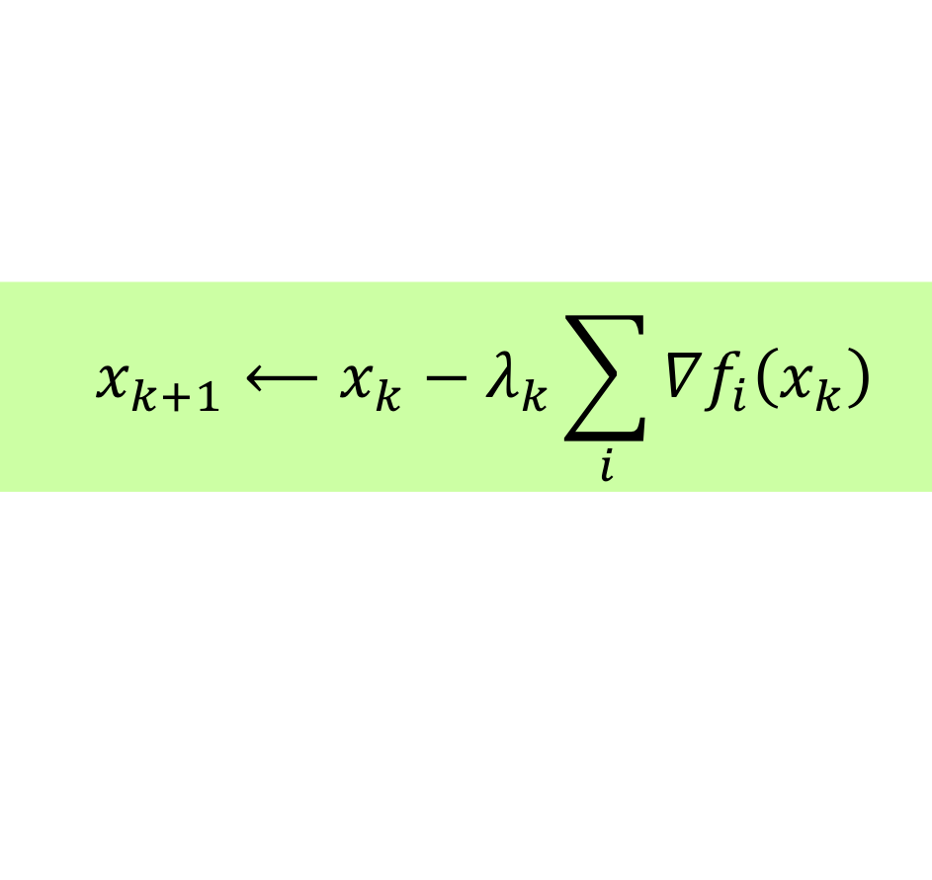
Gradient Method
$$f\left(x\right)= \sum{f_{i}\left(x\right)}$$
x₀
x₁
x₂
  $$x_{k+1}⟵x_{k}−λ_{k}∇\left(\sum_{i}{f_{i}\left(x_{k}\right)}\right)$$
x₃
  $$x_{k+1}⟵x_{k}−λ_{k}\sum_{i}{∇f_{i}\left(x_{k}\right)}$$

Slide 31
Gradient Method
$$f\left(x\right)= \sum{f_{i}\left(x\right)}$$
x₀
x₁
x₂
  $$x_{k+1}⟵x_{k}−λ_{k}∇\left(\sum_{i}{f_{i}\left(x_{k}\right)}\right)$$
x₃
  $$x_{k+1}⟵x_{k}−λ_{k}\sum_{i}{∇f_{i}\left(x_{k}\right)}$$

Slide 32
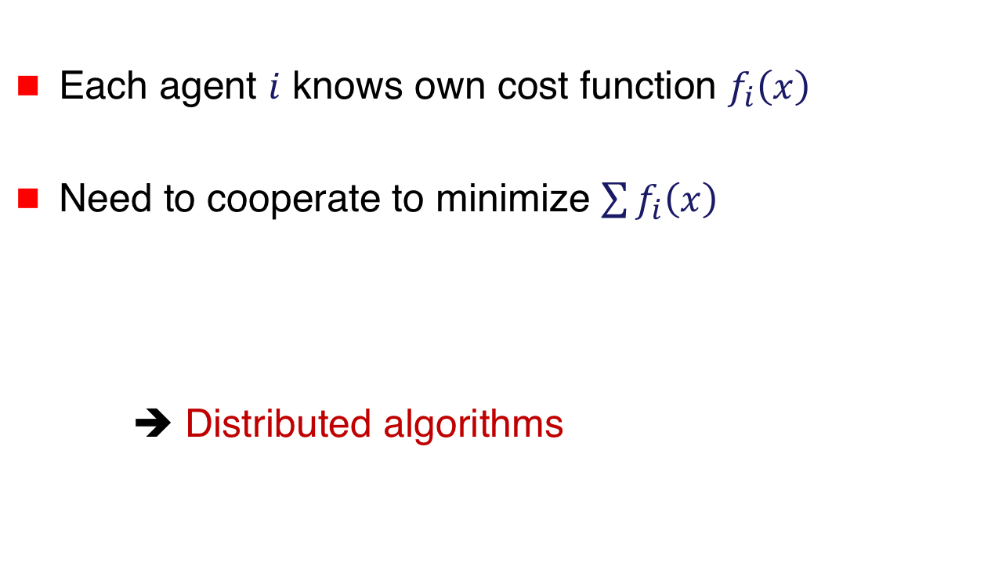
Distributed Optimization
Each agent $i$ knows own cost function $f_{i}\left(x\right)$
Need to cooperate to minimize $\sum{f_{i}\left(x\right)}$
➔ Distributed algorithms

Slide 33







Architectures
$$1$$
$$3$$
$$5$$
$$2$$
$$4$$
Server
1
$$2$$
$$3$$

Slide 34
Architectures
Server
1
$$2$$
$$3$$

Slide 35
Jargon
I tend to refer to to all the variants as “distributed”,
but the literature uses three terminologies
Decentralized … Peer-to-peer
Distributed … Server-based (clients supply gradients)
Federated … Server-based (clients supply estimates)
… all are distributed algorithms

Slide 36


Distributed Optimization
Server maintains estimate $x_{k}$
$$x_{k}$$
Server

Slide 37



Distributed Optimization
Server maintains estimate $x_{k}$
In each iteration
Each agent i
  Receives $x_{k}$ from server
$$x_{k}$$
Server
$x_{k}$
$x_{k}$

Slide 38

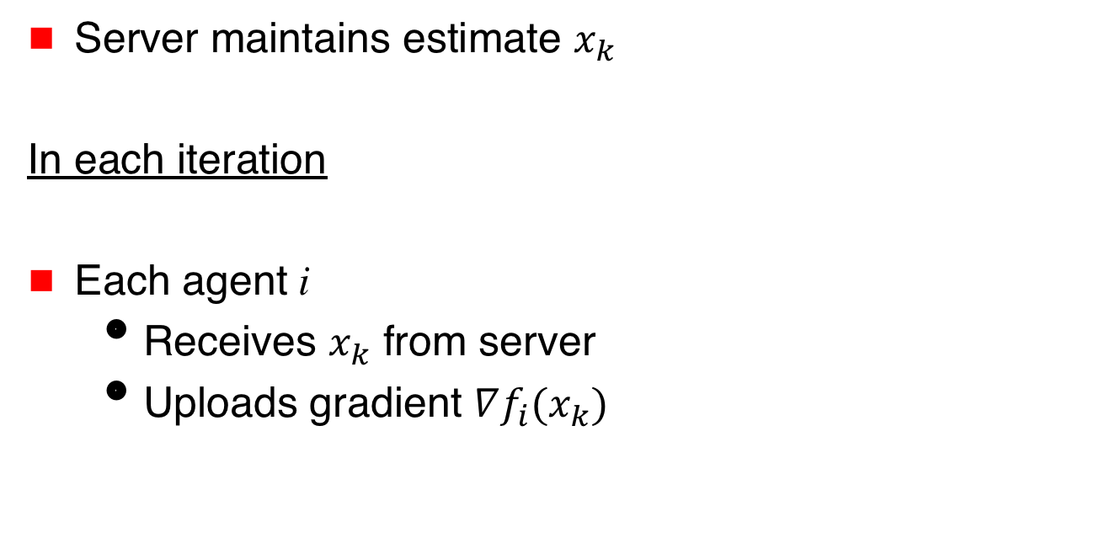

Distributed Optimization
Server maintains estimate $x_{k}$
In each iteration
Each agent i
  Receives $x_{k}$ from server
  Uploads gradient $∇f_{i}(x_{k})$
$$x_{k}$$
Server
$∇f_{1}(x_{k})$
$∇f_{3}(x_{k})$

Slide 39
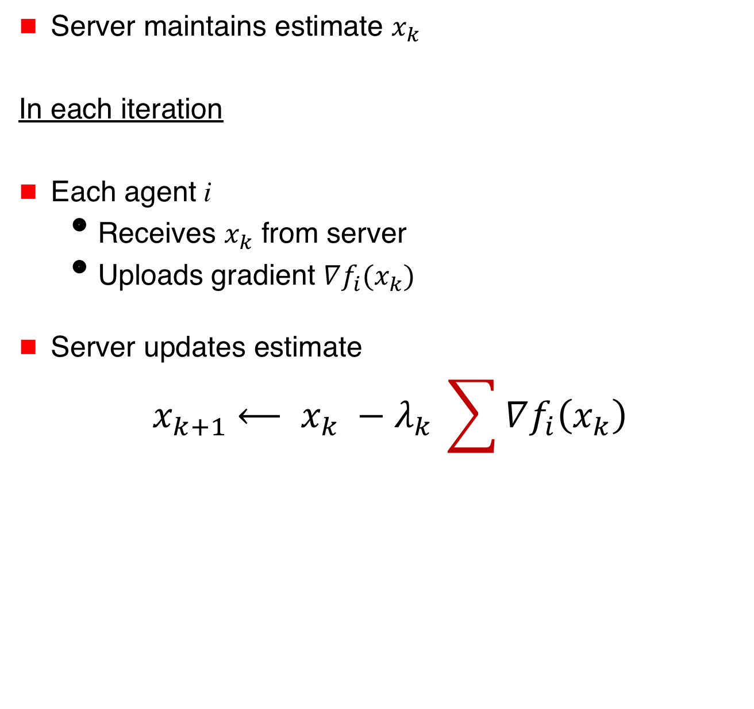
Distributed Optimization
Server maintains estimate $x_{k}$
In each iteration
Each agent i
  Receives $x_{k}$ from server
  Uploads gradient $∇f_{i}(x_{k})$
Server updates estimate
$${ x}_{k+1} ⟵ x_{k} −{λ_{k}}_{ }\sum{∇f_{i}\left(x_{k}\right)}$$
$$x_{k}$$
Server
$∇f_{1}(x_{k})$
$∇f_{3}(x_{k})$

Slide 40
Other Variations
… stochastic
… asynchronous
… gradient compression
… shared memory
Server

Slide 41
Architectures
$$1$$
$$3$$
$$5$$
$$2$$
$$4$$
Server
1
$$2$$
$$3$$

Slide 42
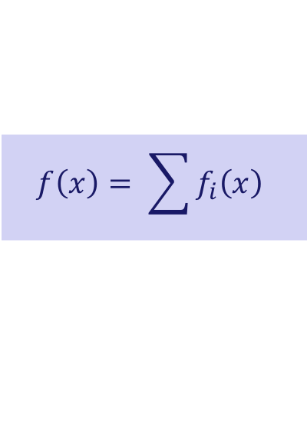
Distributed Optimization
$$f\left(x\right)= \sum{f_{i}\left(x\right)}$$
Iterative algorithm
Each agent maintains an estimate
Local estimates shared with neighbors & updated in each iteration
Estimates converge to optimum

Slide 43
x₁
x₂
x₃
x₃
x₃
Example based on [Nedic and Ozdaglar, 2009]

Slide 44
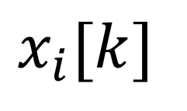
x₁
x₂
x₃
x₃
x₃
Change of notation
$$x_{i}[k]$$
agent identifier
Iteration index

Slide 45

x₁
x₂
x₃
x₃
x₃
$$f_{1}$$

Slide 46

x₁
x₂
x₃
x₃
x₃
$$f_{1}$$
$$f_{3}$$

Slide 47
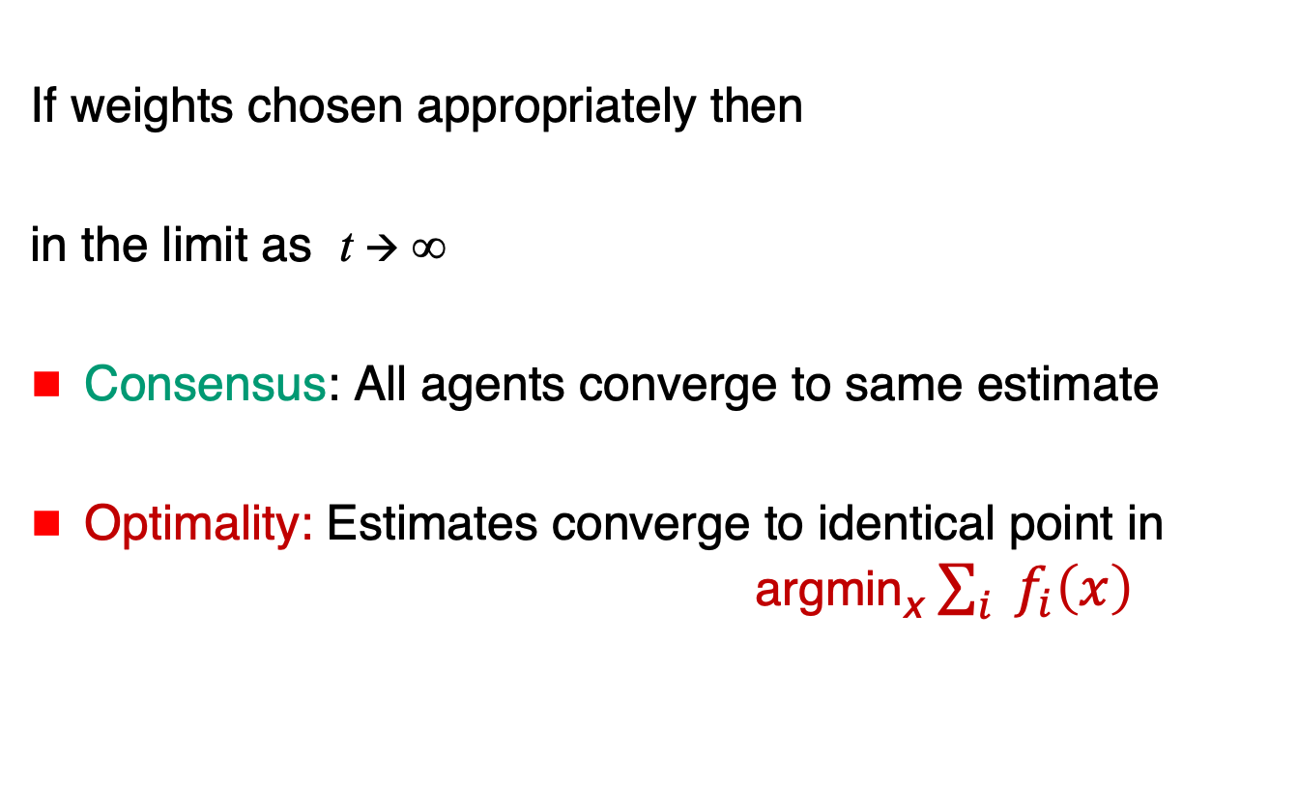
Decentralized Optimization
If weights chosen appropriately then
in the limit as t → ∞
Consensus: All agents converge to same estimate
Optimality: Estimates converge to identical point in
argmin_{x} $\sum_{i}{{ f}_{i}\left(x\right)}$

Slide 48
Suitable Weights
W_{ij} = weight assigned by agent i to estimate of agent j
The weight matrix should be doubly stochastic, and the (undirected) network should be connected

Slide 49

Why does this work?

Slide 50

Challenges
What happens if clients are compromised, adversarial or faulty ?
How to perform
optimization
if agents inject
bogus information?
Server
$∇f_{1}(x_{k})$
$∇f_{3}(x_{k})$

Slide 51
Challenges
Privacy-preserving
distributed optimization
How to collaborate
without revealing
own cost function?
$∇f_{1}(x_{k})$
$∇f_{3}(x_{k})$

Slide 52
Fault-Tolerance / Security

Slide 53
Rendezvous
Determine the location where the total cost of meeting is minimized
argmin_{x} $\sum_{i}{{ f}_{i}\left(x\right)}$
argmin $\sum{{ f}_{i}\left(x\right)}$

Slide 54
Rendezvous
$$f_{1}\left(x\right)$$
$$f_{2}\left(x\right)$$
X
$$f_{3}\left(x\right)$$

Slide 55
Rendezvous
$$f_{1}\left(x\right)$$
$$f_{2}\left(x\right)$$
X
$$f_{3}\left(x\right)$$

Slide 56
Machine Learning
$$f_{1}\left(x\right)$$
$$f_{2}\left(x\right)$$
Minimize global loss
$$\sum{f_{i}\left(x\right)}$$
$$f_{3}\left(x\right)$$
$$f_{4}\left(x\right)$$

Slide 57
Machine Learning
Faulty agent can
adversely affect
model parameters
$$f_{1}\left(x\right)$$
$$f_{2}\left(x\right)$$
Minimize global loss
$$\sum{f_{i}\left(x\right)}$$
$$f_{3}\left(x\right)$$
$$f_{4}\left(x\right)$$

Slide 58
Fault-Tolerant / Secure
Optimization & Machine Learning
2015 …

Slide 59
Outline
Basics
Fault-Tolerant
Algorithms
$$\text{argmin}\sum_{i∈G}{f_{i}\left(x\right)}$$
Independent
Functions:
No Redundancy
Functions with
Redundancy
Exact
Resilience
Approximate
Resilience
$$x_{k}$$
Server
$∇f_{1}(x_{k})$
$∇f_{3}(x_{k})$

Slide 60
Fault-Tolerance
What should be the objective of fault-tolerant optimization?

Slide 61
Fault-Tolerance
What should be the objective of fault-tolerant optimization?
Optimize over just the good agents … set G

Slide 62
Fault-Tolerance
What should be the objective of fault-tolerant optimization?
Optimize over just the good agents … set G
$$\text{argmin}\sum_{i∈G}{f_{i}\left(x\right)}$$

Slide 63
Rendezvous
$$f_{1}\left(x\right)$$
$$f_{2}\left(x\right)$$
X
$$f_{3}\left(x\right)$$

Slide 64
Rendezvous
$$f_{1}\left(x\right)$$
$$f_{2}\left(x\right)$$
argmin $f_{1}\left(x\right)+f_{2}\left(x\right)$

Slide 65
Machine Learning
Faulty agent can
adversely affect
model parameters
$$f_{1}\left(x\right)$$
$$f_{2}\left(x\right)$$
Minimize global loss
$$\sum{f_{i}\left(x\right)}$$
$$f_{3}\left(x\right)$$
$$f_{4}\left(x\right)$$

Slide 66
Machine Learning
$$f_{1}\left(x\right)$$
argmin $f_{1}\left(x\right)$+ $f_{3}\left(x\right)$+ $f_{4}\left(x\right)$
$$f_{3}\left(x\right)$$
$$f_{4}\left(x\right)$$

Slide 67
$$\text{argmin}\sum_{i∈G}{f_{i}\left(x\right)}$$
Is this achievable?
Depends on redundancy
in agents’ cost functions

Slide 68
$$\text{argmin}\sum_{i∈G}{f_{i}\left(x\right)}$$
Is this achievable?
The Spectrum
Independent
functions
Redundancy

Slide 69
$$\text{argmin}\sum_{i∈G}{f_{i}\left(x\right)}$$
Independent
Functions:
No Redundancy

Slide 70
$$\text{argmin}\sum_{i∈G}{f_{i}\left(x\right)}$$
Independent
Functions:
No Redundancy
Functions with
Redundancy

Slide 71
$$\text{argmin}\sum_{i∈G}{f_{i}\left(x\right)}$$
Independent
Functions:
No Redundancy
Functions with
Redundancy
Exact
Resilience
Approximate
Resilience

Slide 72
$$\text{argmin}\sum_{i∈G}{f_{i}\left(x\right)}$$
Independent
Functions:
No Redundancy
Depends on redundancy
in agents’ cost functions

Slide 73
Independent Functions
a
b
c
[Su and Vaidya 2015: part 1, part 2, part 3, part 4]

Slide 74
Independent Functions
a
b
c
[Su and Vaidya 2015: part 1, part 2, part 3, part 4]

Slide 75
Independent Functions
a
b
c

Slide 76
Independent Functions
a
b
c

Slide 77
Independent Functions
Provably impossible to compute
$$\text{argmin}\sum_{i∈G}{f_{i}\left(x\right)}$$

Slide 78
How to Approximate ?
$$\text{argmin}\sum_{i∈G}{f_{i}\left(x\right)}$$
$\text{argmin}\sum_{i∈G}{f_{i}\left(x\right)}$ = $\text{argmin}\sum_{i∈G}{ \frac{1}{|G|}f_{i}\left(x\right)}$

Slide 79
How to Approximate ?
$$\text{argmin}\sum_{i∈G}{f_{i}\left(x\right)}$$
Ideal goal: Equal weight for all non-faulty agents
$\text{argmin}\sum_{i∈G}{f_{i}\left(x\right)}$ = $\text{argmin}\sum_{i∈G}{ \frac{1}{|G|}f_{i}\left(x\right)}$

Slide 80
How to Approximate ?
$$\text{argmin}\sum_{i∈G}{f_{i}\left(x\right)}$$
Ideal goal: Equal weight for all non-faulty agents
Approximation: Unequal weights
$\text{argmin}\sum_{i∈G}{f_{i}\left(x\right)}$ = $\text{argmin}\sum_{i∈G}{ \frac{1}{|G|}f_{i}\left(x\right)}$

Slide 81
Distributed Optimization
Server maintains estimate $x_{k}$
In each iteration
Agent i
  Downloads $x_{k}$ from server
  Uploads gradient $∇f_{i}(x_{k})$
Server updates estimate
$${ x}_{k+1} ⟵ x_{k} −{λ_{k}}_{ }\sum{∇f_{i}\left(x_{k}\right)}$$
$$x_{k}$$
Server
$∇f_{1}(x_{k})$
$∇f_{3}(x_{k})$

Slide 82
Fault-Tolerant Distributed Optimization
Server maintains estimate $x_{k}$
In each iteration
Agent i
  Downloads $x_{k}$ from server
  Uploads gradient $∇f_{i}(x_{k})$
Server updates estimate
$$x_{k}$$
Server
$∇f_{1}(x_{k})$
$∇f_{3}(x_{k})$
$${ x}_{k+1} ⟵ x_{k} −{λ_{k}}_{ } \text{Filtered}\text{−}\text{Gradient}$$

Slide 83
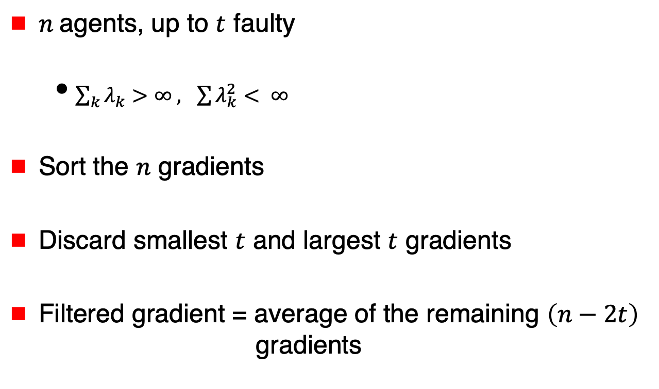
Su and Vaidya [arXiv 2015, PODC 2016]
Scalar Argument
$n$ agents, up to $t$ faulty
  $\sum_{k}{λ_{k}>∞ , \sum{λ_{k}^{2}}}< ∞$
Sort the $n$ gradients
Discard smallest $t$ and largest $t$ gradients
Filtered gradient = average of the remaining $\left(n−2t\right)$
gradients

Slide 84
Results for Scalar Argument $\left(x\right)$
For each faulty agent,
a good agent may be sacrificed (i.e., ignored)
➔ $t$ good agents may have weight 0

Slide 85
Results for Scalar Argument $\left(x\right)$
For each faulty agent,
a good agent may be sacrificed (i.e., ignored)
➔ $t$ good agents may have weight 0
But remaining $(n−2t)$ agents get
almost uniform weight
$n$ agents,
up to $t$ faulty

Slide 86
Results for Scalar Argument $\left(x\right)$
Computes
for some unknown weights ($α_{i}$)
where at least $(n−2t$) good agents have weight
$$α_{i} ≥\frac{1}{2(n−2t)}$$
argmin $\sum_{i∈G}{{α_{i} f}_{i}\left(x\right)}$

Slide 87
Results for Scalar Argument $\left(x\right)$
Computes
for some unknown weights ($α_{i}$)
where at least $(n−2t$) good agents have weight
$$α_{i} ≥\frac{1}{2(n−2t)}$$
argmin $\sum_{i∈G}{{α_{i} f}_{i}\left(x\right)}$
Note that weight for
faulty agents is 0

Slide 88
Degradation for High Dimensional $x$
For $d$-dimensional arguments, $dt$ agents may have
to be sacrificed in the worst case
➔ 0 weight for up to $dt$ agents, for arbitrary functions

Slide 89

Degradation for High Dimensional $x$
For $d$-dimensional arguments, $dt$ agents may have
to be sacrificed in the worst case
➔ 0 weight for up to $dt$ agents, for arbitrary functions
In general, the cost functions are not entirely “arbitrary”
➔ With redundancy (or correlation), better outcome

Slide 90
$$\text{argmin}\sum_{i∈G}{f_{i}\left(x\right)}$$
Independent
Functions:
No Redundancy
Functions with
Redundancy
Exact
Resilience
Approximate
Resilience

Slide 91
$$\text{argmin}\sum_{i∈G}{f_{i}\left(x\right)}$$
Functions with
Redundancy
Exact
Resilience
Depends on redundancy
in agents’ cost functions

Slide 92
Exact Resilience
t-Resilience
Output in $\text{argmin}\sum_{i∈G}{f_{i}\left(x\right)}$ despite
the presence of up to t faulty agents

Slide 93
t-Resilience: Extreme Case
Full replication
All agents have identical cost function (identical data)
$$a\text{rgmin}f_{j}\left(x\right)= \text{argmin}\sum_{i∈G}{f_{i}\left(x\right)}$$

Slide 94
t-Resilience: Extreme Case
Full replication
All agents have identical cost function (identical data)
➔ Each client j can compute $a\text{rgmin}f_{j}\left(x\right)$ independently
and the server can take majority vote
(majority agents being fault-free suffices)
$$a\text{rgmin}f_{j}\left(x\right)= \text{argmin}\sum_{i∈G}{f_{i}\left(x\right)}$$

Slide 95
Parameter Server
Server maintains estimate $x_{k}$
In each iteration
Agent i
  Downloads $x_{k}$ from server
  Uploads gradient $∇f_{i}(x_{k})$
Server updates estimate
$${ x}_{k+1} ⟵ x_{k} −{λ_{k} }_{ }majority(gradients)$$
$$x_{k}$$
Server
$∇f_{1}(x_{k})$
$∇f_{3}(x_{k})$

Slide 96
t-Resilience: Extreme Case
We will return to this case later
This extreme form of redundancy assumed in much
of the work on fault-tolerant stochastic learning
Stochastic gradients make this case interesting

Slide 97
Exact Resilience:
Necessary and Sufficient Condition
[Gupta,Vaidya 2020]
t-Resilience achievable iff
cost functions satisfy
2t-Redundancy

Slide 98
2t-Redundancy
[Gupta,Vaidya 2020]
$n$ agents
$t$ bad agents
argmin of aggregate of any $n−2t$ non-faulty costs
=
argmin of aggregate of all non-faulty costs

Slide 99
2t-Redundancy
[Gupta,Vaidya 2020]
$S$ = all non-faulty agents
$T$ = at least $n−2t$ non-faulty agents
➔ $\text{argmin}\sum_{i∈S}{f_{i}\left(x\right)=\text{argmin}\sum_{i∈T}{f_{i}\left(x\right)}}$

Slide 100
Centralized Algorithm Achieving $t$-Resilience
Agents provide their cost functions to the server: Faulty agents may provide incorrect information

Slide 101
Centralized Algorithm Achieving $t$-Resilience
Agents provide their cost functions to the server: Faulty agents may provide incorrect information
Server finds a set $S$ containing $n−t$ agents such that for each size $n−2t$ subset $T$ of $S$
$$\text{argmin}\sum_{i∈S}{f_{i}\left(x\right)=\text{argmin}\sum_{i∈T}{f_{i}\left(x\right)}}$$

Slide 102
Centralized Algorithm Achieving $t$-Resilience
Agents provide their cost functions to the server: Faulty agents may provide incorrect information
Server finds a set $S$ containing $n−t$ agents such that for each size $n−2t$ subset $T$ of $S$
$$\text{argmin}\sum_{i∈S}{f_{i}\left(x\right)=\text{argmin}\sum_{i∈T}{f_{i}\left(x\right)}}$$
Output $\text{argm}\text{in}\sum_{i∈S}{f_{i}\left(x\right)}$

Slide 103
Centralized Algorithm Achieving $t$-Resilience
Agents provide their cost functions to the server: Faulty agents may provide incorrect information
Server finds a set $S$ containing $n−t$ agents such that for each size $n−2t$ subset $T$ of $S$
$$\text{argmin}\sum_{i∈S}{f_{i}\left(x\right)=\text{argmin}\sum_{i∈T}{f_{i}\left(x\right)}}$$
Output $\text{argm}\text{in}\sum_{i∈S}{f_{i}\left(x\right)}$
$2t$-Redundancy ➔ $t$-Resilience

Slide 104
Exact Resilience:
Necessary and Sufficient Condition
[Gupta,Vaidya 2020]
t-Resilience achievable iff
cost functions satisfy
2t-Redundancy

Slide 105
Distributed Algorithm
Later in the tutorial …

Slide 106

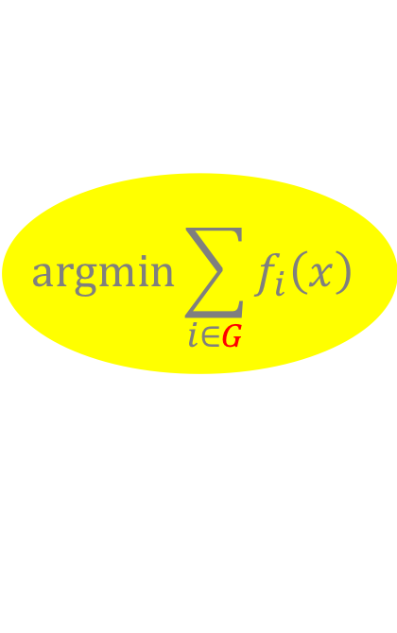
Approximate Resilience
[Liu,Gupta,Vaidya 2021]
Intuition: Compute a point within distance $ε$ of
$\text{argmin}\sum_{i∈G}{f_{i}\left(x\right)}$ $G$ = all good agents
$$\text{argmin}\sum_{i∈G}{f_{i}\left(x\right)}$$
ε

Slide 107

Approximate Resilience
Intuition: Compute a point within distance $ε$ of
$\text{argmin}\sum_{i∈G}{f_{i}\left(x\right)}$ $G$ = all good agents
Potentially, any $n−t$ (or more) agents form set $G$
$$\text{argmin}\sum_{i∈G}{f_{i}\left(x\right)}$$
ε

Slide 108


Approximate Resilience
$(t,ε)$-Resilience
$$\text{argmin}\sum_{i∈S}{f_{i}\left(x\right)}$$
ε

Slide 109

Approximate Resilience
$(t,ε)$-Resilience
Compute a point within distance $ε$ of $\text{argmin}\sum_{i∈S}{f_{i}\left(x\right)}$
for every non-faulty subset $S$of size $n−t$
$$\text{argmin}\sum_{i∈S}{f_{i}\left(x\right)}$$
ε

Slide 110
Fault-Tolerant Distributed Optimization

Slide 111
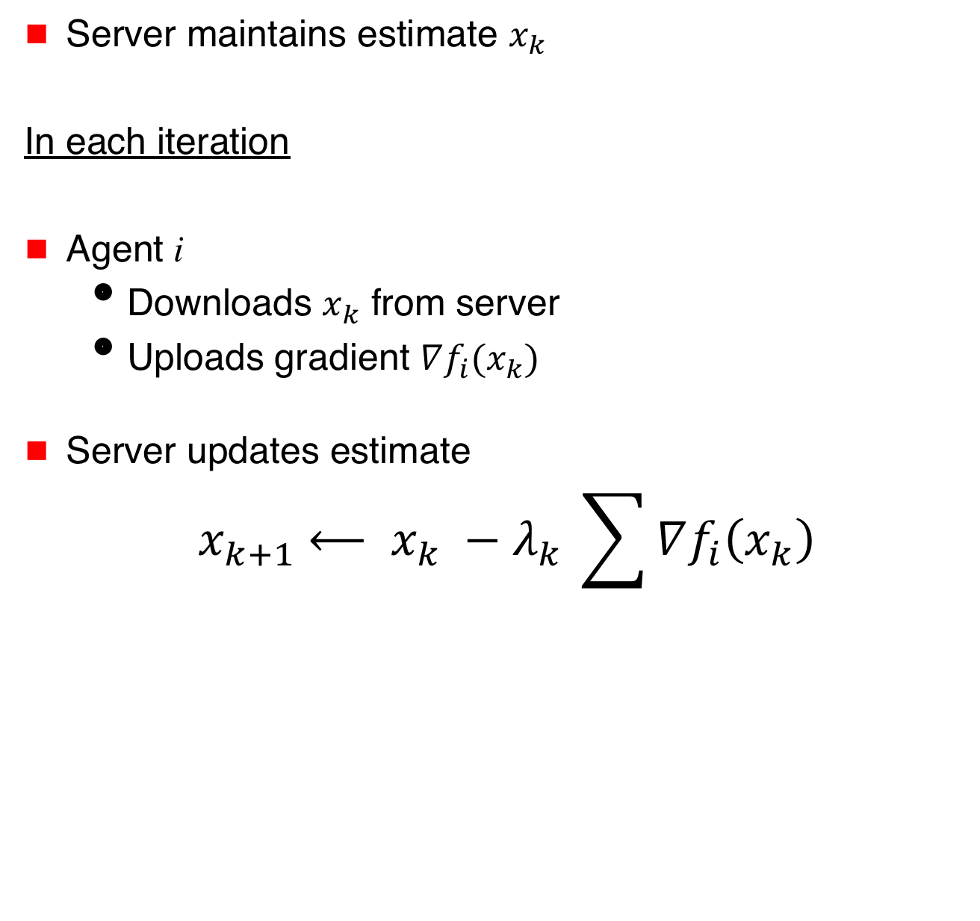


Distributed Optimization
Server maintains estimate $x_{k}$
In each iteration
Agent i
  Downloads $x_{k}$ from server
  Uploads gradient $∇f_{i}(x_{k})$
Server updates estimate
$${ x}_{k+1} ⟵ x_{k} −{λ_{k}}_{ }\sum{∇f_{i}\left(x_{k}\right)}$$
$$x_{k}$$
Server
$∇f_{1}(x_{k})$
$∇f_{3}(x_{k})$

Slide 112
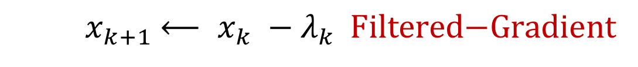
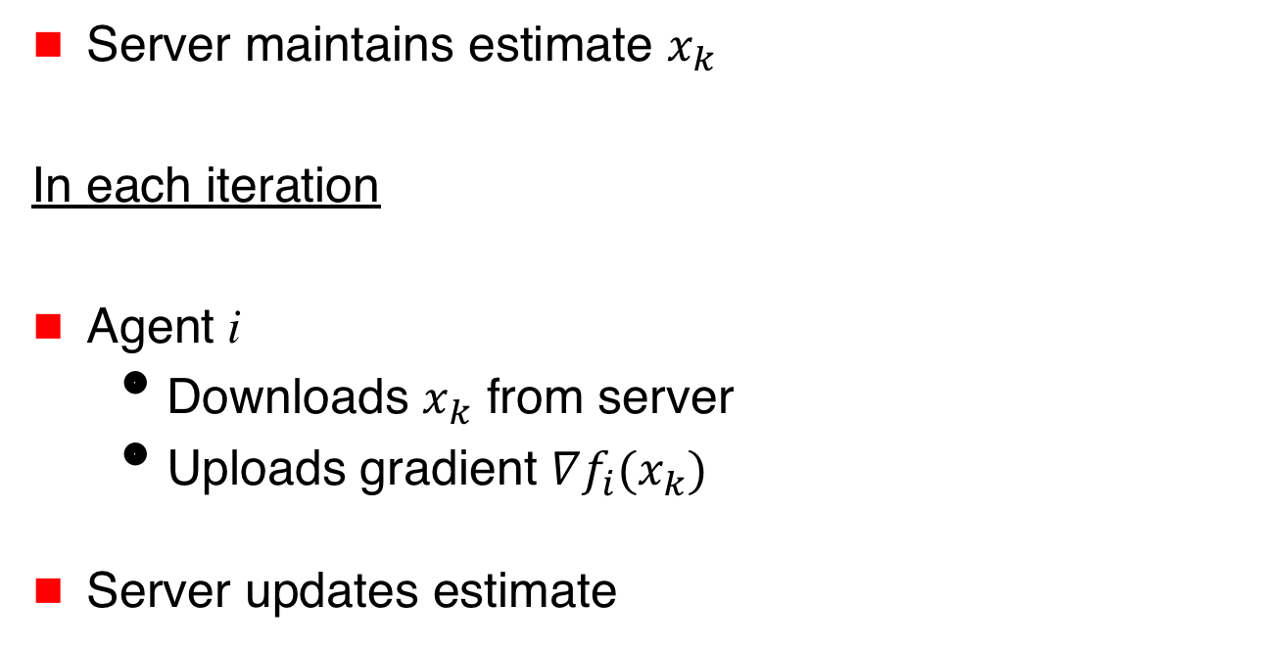
Fault-Tolerant Distributed Optimization
Server maintains estimate $x_{k}$
In each iteration
Agent i
  Downloads $x_{k}$ from server
  Uploads gradient $∇f_{i}(x_{k})$
Server updates estimate
$$x_{k}$$
Server
$∇f_{1}(x_{k})$
$∇f_{3}(x_{k})$
$${ x}_{k+1} ⟵ x_{k} −{λ_{k}}_{ } \text{Filtered}\text{−}\text{Gradient}$$

Slide 113
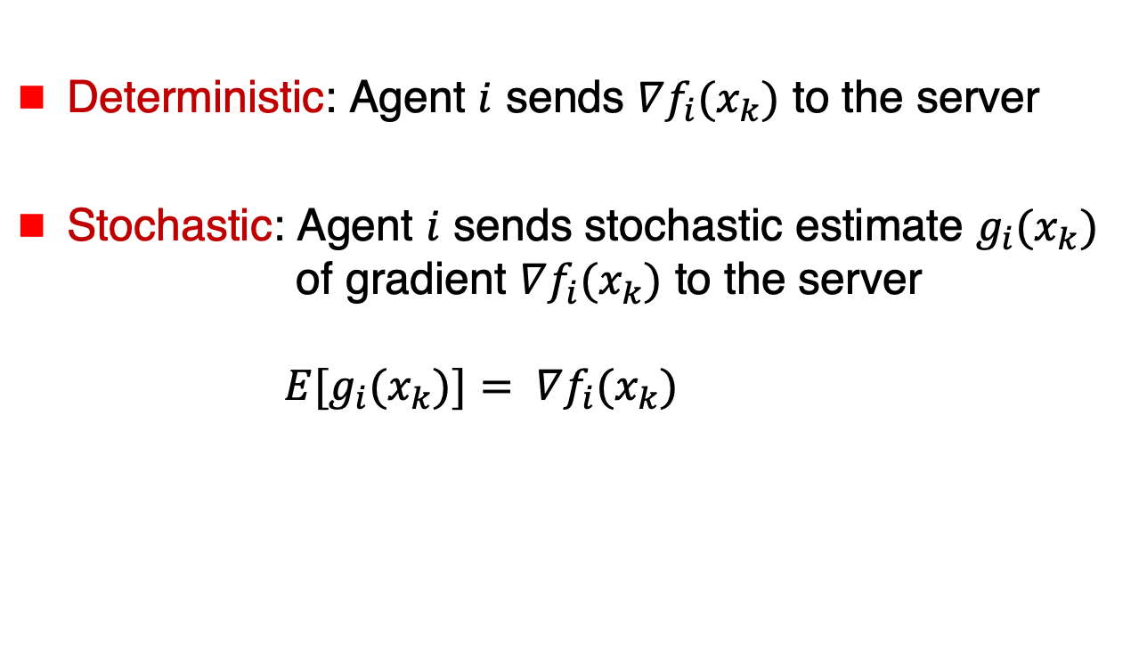
Deterministic versus Stochastic Gradients
Deterministic: Agent $i$ sends $∇f_{i}(x_{k})$ to the server
Stochastic: Agent $i$ sends stochastic estimate $g_{i}(x_{k})$ of gradient $∇f_{i}(x_{k})$ to the server
${E[g}_{i}(x_{k})]= ∇f_{i}(x_{k})$

Slide 114

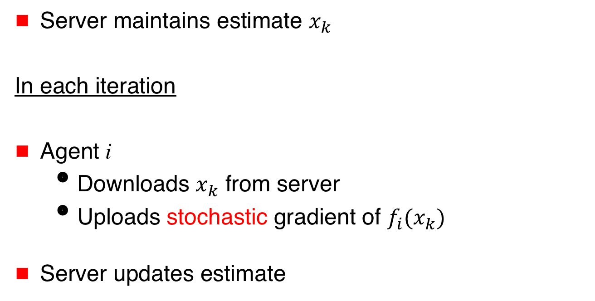


Fault-Tolerant Distributed Optimization
$$x_{k}$$
Server maintains estimate $x_{k}$
In each iteration
Agent i
  Downloads $x_{k}$ from server
  Uploads stochastic gradient of $f_{i}(x_{k})$
Server updates estimate
Server
$g_{1}(x_{k})$
$g_{3}(x_{k})$
$${ x}_{k+1} ⟵ x_{k} −{λ_{k}}_{ } \text{Filtered}\text{−}\text{Stochastic}\text{−}\text{Gradient}$$

Slide 115
Variations
 | Identical cost functions | Non-identical cost functions
Deterministic gradients | Trivial: majority vote on gradients | With or without redundancy
Stochastic gradients | i.i.d. model (commonly assumed in fault-tolerant machine learning) | non-i.i.d. model

Slide 116
Variations
 | Identical cost functions | Non-identical cost functions
Deterministic gradients | Trivial: majority vote on gradients | With or without redundancy
Stochastic gradients | i.i.d. model (commonly assumed in fault-tolerant machine learning) | non-i.i.d. model

Slide 117
Variations
 | Identical cost functions | Non-identical cost functions
Deterministic gradients | Trivial: majority vote on gradients | With or without redundancy
Stochastic gradients | i.i.d. model (commonly assumed in fault-tolerant machine learning) | non-i.i.d. model

Slide 118
Variations
 | Identical cost functions | Non-identical cost functions
Deterministic gradients | Trivial: majority vote on gradients | With or without redundancy
Stochastic gradients | i.i.d. model (commonly assumed in fault-tolerant machine learning) | non-i.i.d. model

Slide 119
Stochastic Distributed Machine Learning
(i.i.d. model)
Agents draw samples from
identical data distribution
Filter on stochastic gradients
Agent 1
Agent 2

Slide 120
Variations
 | Identical cost functions | Non-identical cost functions
Deterministic gradients | Trivial: majority vote on gradients | With or without redundancy
Stochastic gradients | i.i.d. model (commonly assumed in fault-tolerant machine learning) | non-i.i.d. model

Slide 121
Variations
 | Identical cost functions | Non-identical cost functions
Deterministic gradients | Trivial: majority vote on gradients | With or without redundancy
Stochastic gradients | i.i.d. model (commonly assumed in fault-tolerant machine learning) | non-i.i.d. model

Slide 122
Gradient Filters

Slide 123
Scalar Case
First gradient filter used for scalar argument
[Su & Vaidya 2015]
Extends to vector case by applying the scalar filter elementwise

Slide 124
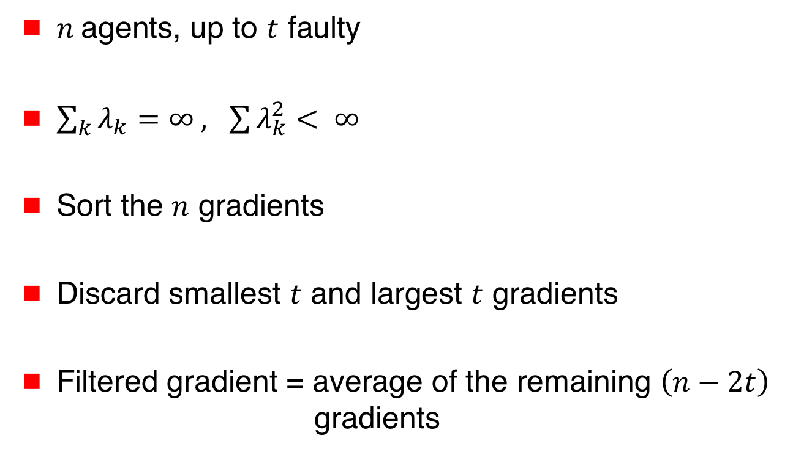
Su and Vaidya [arXiv 2015, PODC 2016]
Scalar Argument
$n$ agents, up to $t$ faulty
$\sum_{k}{λ_{k}=∞ , \sum{λ_{k}^{2}}}< ∞$
Sort the $n$ gradients
Discard smallest $t$ and largest $t$ gradients
Filtered gradient = average of the remaining $\left(n−2t\right)$
gradients

Slide 125
Su and Vaidya [arXiv 2015, PODC 2016]
Scalar Argument
$n$ agents, up to $t$ faulty
$\sum_{k}{λ_{k}=∞ , \sum{λ_{k}^{2}}}< ∞$
Sort the $n$ gradients
Discard smallest $t$ and largest $t$ gradients
Filtered gradient = average of the remaining $\left(n−2t\right)$
gradients
Trimmed mean: Used previously for Byzantine consensus

Slide 126

Su and Vaidya [arXiv 2015, PODC 2016]
Scalar Argument
$$n=7 t=2$$
Gradients received by the server:
-4 -2 0 1 6 8 9

Slide 127

Su and Vaidya [arXiv 2015, PODC 2016]
Scalar Argument
$$n=7 t=2$$
Filtered gradient = $\frac{0+1+6}{3}= \frac{7}{3}$
-4 -2 0 1 6 8 9

Slide 128
Su and Vaidya [arXiv 2015, PODC 2016]
Scalar Argument
[Su Vaidya arXiv 2015] simulates a server-based solution using Byzantine broadcast
[Su Vaidya PODC 2016] does not use Byzantine broadcast

Slide 129
Variations
 | Identical cost functions | Non-identical cost functions
Deterministic gradients | Trivial: majority vote on gradients | With or without redundancy
Stochastic gradients | i.i.d. model (commonly assumed in fault-tolerant machine learning) | non-i.i.d. model

Slide 130
Variations
 | Identical cost functions | Non-identical cost functions
Deterministic gradients | Trivial: majority vote on gradients | With or without redundancy
Stochastic gradients | i.i.d. model (commonly assumed in fault-tolerant machine learning) | non-i.i.d. model
We identify the setting for which each filter
was originally proposed.
The filters may be useful in other settings too.

Slide 131
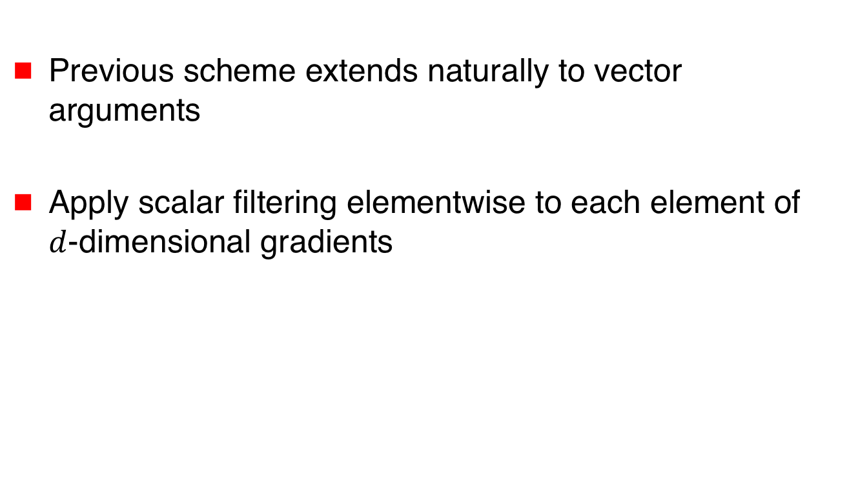
Elementwise Filtering
[Yang,Bajwa 2019, 2019]
Previous scheme extends naturally to vector arguments
Apply scalar filtering elementwise to each element of $d$-dimensional gradients

Slide 132
Elementwise Filtering
[Yang,Bajwa 2019, 2019]
$$n=4 t=1 d=3$$
Gradients received by the server: $\left[\begin{aligned}0 \\ −2 \\ 3\end{aligned}\right],\left[\begin{aligned}−1 \\ 5 \\ 0\end{aligned}\right],$ $\left[\begin{aligned}6 \\ −1 \\ −5\end{aligned}\right]$, $\left[\begin{aligned}7 \\ 8 \\ 2\end{aligned}\right]$

Slide 133
Elementwise Filtering
[Yang,Bajwa 2019, 2019]
$$n=4 t=1 d=3$$
Gradients received by the server: $\left[\begin{aligned}0 \\ −2 \\ 3\end{aligned}\right],\left[\begin{aligned}−1 \\ 5 \\ 0\end{aligned}\right],$ $\left[\begin{aligned}6 \\ −1 \\ −5\end{aligned}\right]$, $\left[\begin{aligned}7 \\ 8 \\ 2\end{aligned}\right]$
Filtered gradient $\left[\begin{aligned}3 \\ 2 \\ 1\end{aligned}\right]$

Slide 134
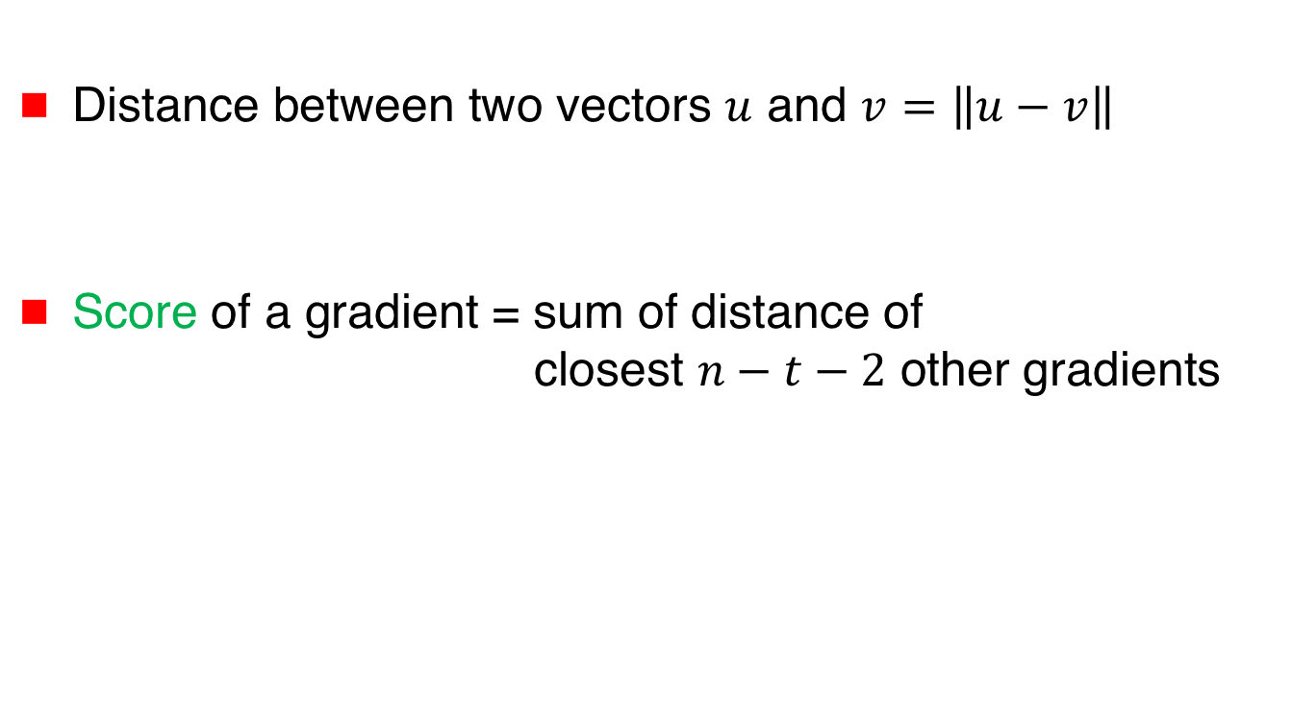
Krum and Multi-Krum
[Blanchard et al NeurIPS 2017]
Distance between two vectors $u$ and $v=$ $\left\|u−v\right\|$
Score of a gradient = sum of distance of
closest $n−t−2$ other gradients

Slide 135
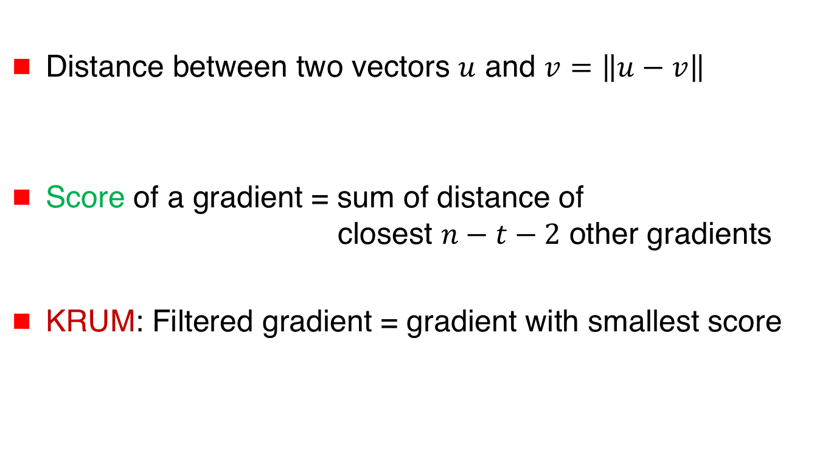
Krum and Multi-Krum
[Blanchard et al NeurIPS 2017]
Distance between two vectors $u$ and $v=$ $\left\|u−v\right\|$
Score of a gradient = sum of distance of
closest $n−t−2$ other gradients
KRUM: Filtered gradient = gradient with smallest score

Slide 136
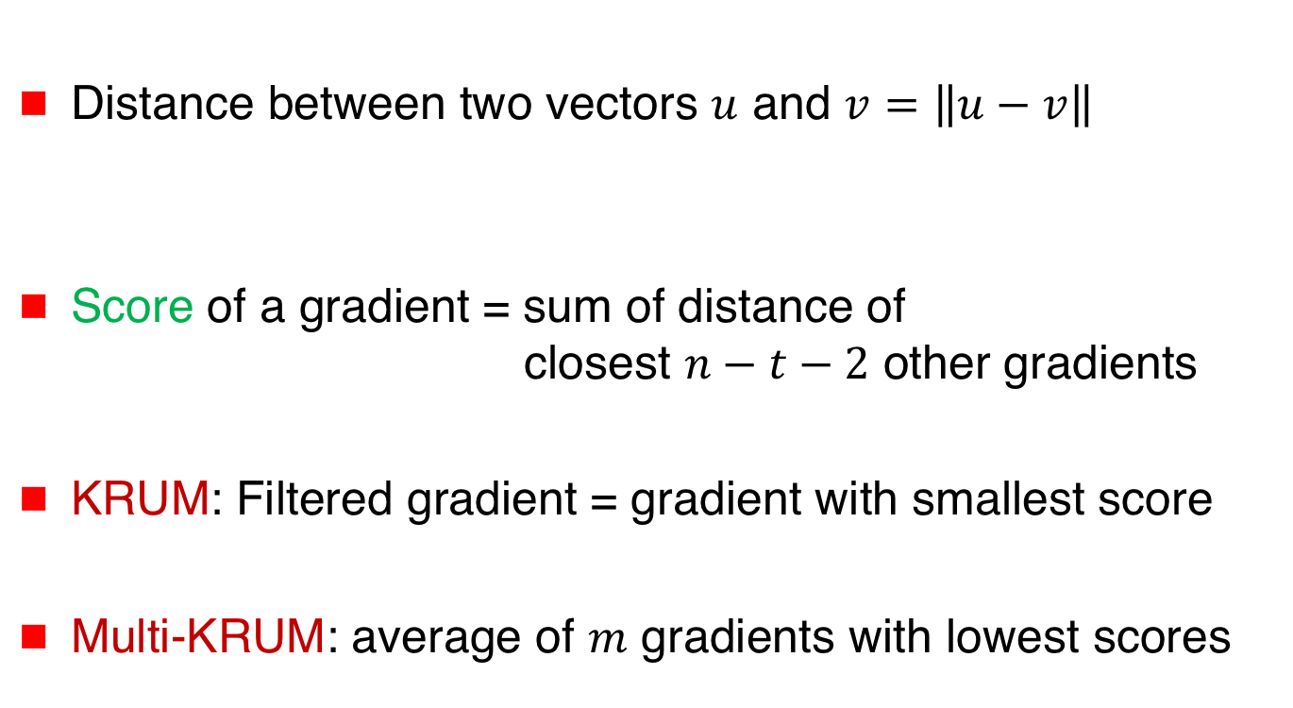
Krum and Multi-Krum
[Blanchard et al NeurIPS 2017]
Distance between two vectors $u$ and $v=$ $\left\|u−v\right\|$
Score of a gradient = sum of distance of
closest $n−t−2$ other gradients
KRUM: Filtered gradient = gradient with smallest score
Multi-KRUM: average of $m$ gradients with lowest scores

Slide 137

Krum and Multi-Krum
[Blanchard et al NeurIPS 2017]
$n=5 t=1 n−t−2=2$

Slide 138
Krum and Multi-Krum
[Blanchard et al NeurIPS 2017]
$n=5 t=1 n−t−2=2$

Slide 139
Krum and Multi-Krum
[Blanchard et al NeurIPS 2017]
 | Identical cost functions | Non-identical cost functions
Deterministic gradients | Trivial: majority vote on gradients | With or without redundancy
Stochastic gradients | i.i.d. model (commonly assumed in fault-tolerant machine learning) | non-i.i.d. model

Slide 140

Additional Assumptions
Typical assumptions
  A bound on the variance of stochastic gradient
  (for stochastic optimization/learning)
  An upper bound on $t/n$ that depends on properties of the cost functions (the bound can be much smaller than $½)$
Different filters often incomparable due to differences in assumptions made

Slide 141




Norm-Based Comparative Gradient Elimination
[Gupta,Vaidya 2020, Gupta,Liu,Vaidya 2020]
Clip the largest $t$ norms to equalize with $t+1$^{th} norm
$\left|∇f_{1}\left(x_{k}\right)\right|=1$
$\left|∇f_{2}\left(x_{k}\right)\right|=3$
$\left|∇f_{3}\left(x_{k}\right)\right|=2$

Slide 142




Norm-Based Comparative Gradient Elimination
[Gupta,Vaidya 2020, Gupta,Liu,Vaidya 2020]
Clip the largest $t$ norms to equalize with $t+1$^{th} norm
Filtered gradient =
$\left|∇f_{1}\left(x_{k}\right)\right|=1$
$\left|∇f_{2}\left(x_{k}\right)\right|=3$
$\left|∇f_{3}\left(x_{k}\right)\right|=2$
$∇f_{1}(x_{k})$
$+ \frac{2}{3}∇f_{2}(x_{k})$
$+ ∇f_{3}(x_{k})$

Slide 143
Norm-Based Comparative Gradient Elimination
[Gupta,Vaidya 2020, Gupta,Liu,Vaidya 2020]
 | Identical cost functions | Non-identical cost functions
Deterministic gradients | Trivial: majority vote on gradients | With or without redundancy
Stochastic gradients | i.i.d. model (commonly assumed in fault-tolerant machine learning) | non-i.i.d. model
Under exact &
approximate redundancy
defined earlier

Slide 144

Geometric Median of Means
[Chen,Su,Xu 2017]
Geometric median of $u_{1},u_{2}$,…, $u_{m}$
= argmin_{v} $\sum_{i}{ \left\|u_{i}−v\right\|}$
Filtered gradient = geometric median of $n$ gradients
More generally, geometric median of
the mean of gradients for $\frac{n}{b}$ batches (batch size $b$)

Slide 145
Geometric Median of Means
[Chen,Su,Xu 2017]
 | Identical cost functions | Non-identical cost functions
Deterministic gradients | Trivial: majority vote on gradients | With or without redundancy
Stochastic gradients | i.i.d. model (commonly assumed in fault-tolerant machine learning) | non-i.i.d. model

Slide 146
Robust Mean Estimation
[Data,Diggavi 2020] use a robust mean estimation method from [Steinhardt et al. 2017] as the gradient filter

Slide 147
Fault-Tolerant Optimization & Learning
This is not a comprehensive survey. Other gradient filters and other algorithms have been proposed.
A couple of notable omissions:
  Reactive redundancy [Gupta Vaidya – Reactive 2019]: Deploys redundancy selectively, to reduce overhead significantly
  Learning from history [Kamireddi, He, Jaggi 2020]: Keeping history (memory) helps improve fault tolerance

Slide 148
Trade-Off
“Simpler” filters need to make more stringent assumptions
  Variance of gradients
  Fraction of faulty clients

Slide 149




Summary
Basics
Fault-Tolerant
Algorithms
$$\text{argmin}\sum_{i∈G}{f_{i}\left(x\right)}$$
Independent
Functions:
No Redundancy
Functions with
Redundancy
Exact
Resilience
Approximate
Resilience
$$x_{k}$$
Server
$∇f_{1}(x_{k})$
$∇f_{3}(x_{k})$

Slide 150
Privacy

Slide 151
Architectures
$$1$$
$$3$$
$$5$$
$$2$$
$$4$$
Server
1
$$2$$
$$3$$

Slide 152
Distributed Optimization
Server maintains estimate $x_{k}$
In each iteration
Each agent i
  Receives $x_{k}$ from server
  Uploads gradient $∇f_{i}(x_{k})$
Server updates estimate
$${ x}_{k+1} ⟵ x_{k} −{λ_{k}}_{ }\sum{∇f_{i}\left(x_{k}\right)}$$
$$x_{k}$$
Server
$∇f_{1}(x_{k})$
$∇f_{3}(x_{k})$

Slide 153



$$x_{k}$$
Server
$∇f_{1}(x_{k})$
$∇f_{3}(x_{k})$
Server observes gradients ➔ privacy compromised

Slide 154
$$x_{k}$$
Server
$∇f_{1}(x_{k})$
$∇f_{3}(x_{k})$
Server observes gradients ➔ privacy compromised
Achieve privacy and yet collaboratively optimize

Slide 155





Decentralized Optimization
Each agent maintains local estimate x
In each iteration
Compute weighted average with neighbors’ estimates
Apply own gradient to own estimate
Local estimates converge to
i
$$f_{1}$$
$$f_{3}$$
$$f_{5}$$
$$f_{2}$$
$$f_{4}$$

Slide 156
x₁
x₂
x₃
x₃
x₃
$$f_{1}$$
$$f_{3}$$

Slide 157
Peer-to-Peer Architecture
Neighbors can potentially learn information about an agent’s cost function
$$f_{1}$$
$$f_{3}$$
$$f_{5}$$
$$f_{2}$$
$$f_{4}$$

Slide 158
Approaches for Privacy

Slide 159
Approaches for Privacy
Cryptographic methods
Differential privacy
Function transformation

Slide 160



Encryption
Basic idea: Agents send encrypted information to the server (or peers)
Server performs computation on encrypted data
Need practical/efficient encryption mechanisms
$$x_{k}$$
Server
$∇f_{1}(x_{k})$
$∇f_{3}(x_{k})$

Slide 161


Differential Privacy
[Shokri, Shmatikov 2015]
Agents add Laplace distributed noise to the gradients
$$x_{k}$$
Server
$$∇f_{1}(x_{k})+εk$$

Slide 162
Differential Privacy for Machine Learning
[Shokri, Shmatikov 2015]
Agents add Laplace distributed noise to the gradients
$$x_{k}$$
Server
$$∇f_{1}(x_{k})+εk$$
Goal: Make it difficult to determine if a particular
data item was used during training

Slide 163




Differential Privacy
Server
$$∇f_{i}\left(x_{k}\right)+εk$$
$$f_{1}$$
$$f_{2}$$
$$f_{3}$$
Trade-off privacy with accuracy

Slide 164
Decentralized Optimization
Each agent maintains local estimate x
In each iteration
Compute weighted average with neighbors’ estimates
Apply own gradient to own estimate
Local estimates converge to
i
$$f_{1}$$
$$f_{3}$$
$$f_{5}$$
$$f_{2}$$
$$f_{4}$$

Slide 165
x₁
x₂
x₃
x₃
x₃
$$f_{1}$$
$$f_{3}$$

Slide 166
Differential Privacy for
Peer-to-Peer Architecture
[Huang, Mitra, Vaidya 2015 , 2014]
Agents add noise to their estimate before sharing with the neighbors

Slide 167
Other Work
Several other papers on differential privacy for optimization (such as Dobbe et al. 2020, Showkatbakhsh et al. 2015)

Slide 168
Federated Architecture
[Kairouz et al 2018]
Server maintains estimate $x_{k}$
$$x_{k}$$
Server

Slide 169

Federated Architecture
[Kairouz et al 2018]
Server maintains estimate $x_{k}$
In each iteration
Each agent i
  Receive $x_{k}$ from server
$$x_{k}$$
Server

Slide 170



Federated Architecture
Server maintains estimate $x_{k}$
In each iteration
Each agent i
  Receive $x_{k}$ from server
  Compute $y_{k}=x_{k}−λ_{k}∇f_{i}(x_{k})$
  Send $y_{k}$ to server
$$x_{k}$$
Server
$$y_{1}$$
$$y_{3}$$

Slide 171

Federated Architecture
Server maintains estimate $x_{k}$
In each iteration
Each agent i
  Receive $x_{k}$ from server
  Compute $y_{k}=x_{k}−λ_{k}∇f_{i}(x_{k})$
  Send $y_{k}$ to server
Server updates estimate
$${ x}_{k+1} ⟵\frac{1}{n}\sum{y_{i}}$$
$$x_{k}$$
Server
$$y_{1}$$
$$y_{3}$$

Slide 172
Federated Architecture
Server maintains estimate $x_{k}$
In each iteration
Each agent i
  Receive $x_{k}$ from server
  Compute $y_{k}=x_{k}−λ_{k}∇f_{i}(x_{k})$
  Send $y_{k}$ to server
Server updates estimate
$${ x}_{k+1} ⟵\frac{1}{n}\sum{y_{i}}$$
$$x_{k}$$
Server
$$y_{1}$$
$$y_{3}$$

Slide 173
Federated Architecture
Server maintains estimate $x_{k}$
In each iteration
Each agent i
  Receive $x_{k}$ from server
  Compute $y_{k}=x_{k}−λ_{k}∇f_{i}(x_{k})$
  Send $y_{k}$ to server
Server updates estimate
$${ x}_{k+1} ⟵\frac{1}{n}\sum{y_{i}}$$
$$x_{k}$$
Server
$$y_{1}$$
$$y_{3}$$
Replace single step
by multiple steps

Slide 174

Private Federated Learning
[Bonawitz et al. 2016]
Agents cooperate to compute $\sum{y_{i}}$ while preserving privacy of individual $y_{i}$ values
Each pair of users communicates over secure channels to agree on matched pair of “noise”
  User u sends noise s_{u,v} to user v
  User u obfuscates on y_{u} value as below, for “large enough” R
  z_{u} = ( y_{u} + ∑_{v} s_{v,u} - ∑_{v} s_{u,v} ) mod R
  Server can compute ∑_{u} y_{u} correctly as ∑_{u} z_{u} mod R without being able to learn individual agent’s estimate
  Further improvement described in [Bonawitz et al. 2016]

Slide 175
Secure Sum
Similar concept introduced in [Abbe et al. 2012] for secure aggregation

Slide 176
Balanced Noise
Exploit diversity … Multiple servers / neighbors
Introduce noise that is “cancellable”
  [Bonawitz et al. 2016, Abbe 2012] also introduce balanced noise, but it is utilized differently (also, no modulo operation used in schemes to be presented next)

Slide 177



Server-Based Architecture: Balanced Noise
[Gade,Vaidya 2016, 2016a]
Server 1
Server 2
$$f_{1}$$
$$f_{2}$$
$$f_{3}$$
Privacy if subset of servers adversarial

Slide 178
Balanced Noise
Structured noise that
“cancels” over servers/neighbors

Slide 179



Intuition
x¹
x²
Server 1
Server 2
$$f_{1}$$
$$f_{2}$$
$$f_{3}$$

Slide 180






Intuition
x¹
x²
Server 1
Server 2
$$f_{11}$$
$$f_{12}$$
$$f_{21}$$
$$f_{22}$$
$$f_{31}$$
$$f_{32}$$
Each client
simulates
multiple clients

Slide 181


Intuition
x¹
x²
Server 1
Server 2
$$f_{11}$$
$$f_{12}$$
$$f_{21}$$
$$f_{22}$$
$$f_{31}$$
$$f_{32}$$
$f_{11}(x)$ + $f_{\begin{aligned}12 \\ \end{aligned}}\left(x\right)=f_{\begin{aligned}1 \\ \end{aligned}}\left(x\right)$
$f_{ij}(x)$ not necessarily convex

Slide 182

Algorithm
Each server maintains an estimate
In each iteration
Client i
  Download estimates from corresponding server
  Upload gradient of $f_{i}$
Each server updates estimate using received gradients

Slide 183

Algorithm
Each server maintains an estimate
In each iteration
Client i
  Download estimates from corresponding server
  Upload gradient of $f_{i}$
Each server updates estimate using received gradients
Servers periodically exchange estimates to perform a consensus step

Slide 184
Claim
Under suitable assumptions, servers eventually reach consensus in
i

Slide 185








Privacy
$f_{11}$+ $f_{21}$+$f_{31}$
$f_{12}$+ $f_{22}$+$f_{32}$
Server 1
Server 2
$$f_{11}$$
$$f_{12}$$
$$f_{21}$$
$$f_{22}$$
$$f_{31}$$
$$f_{32}$$

Slide 186

Privacy
$f_{11}$+ $f_{21}$+$f_{31}$
$f_{12}$+ $f_{22}$+$f_{32}$
Server 1 may learn $f_{11},$ $f_{21}, f_{31}$, $f_{12}$+ $f_{22}$+$f_{32}$
Not sufficient to learn $f_{i}$
Server 1
Server 2
$$f_{11}$$
$$f_{12}$$
$$f_{21}$$
$$f_{22}$$
$$f_{31}$$
$$f_{32}$$

Slide 187

$f_{11}(x)$ + $f_{\begin{aligned}12 \\ \end{aligned}}\left(x\right)=f_{\begin{aligned}1 \\ \end{aligned}}\left(x\right)$
Function splitting not necessarily practical
Structured randomization as an alternative

Slide 188
Structured Randomization
Multiplicative or additive noise in gradients
Noise cancels over servers

Slide 189


Multiplicative Noise
x¹
x²
Server 1
Server 2
$$f_{1}$$
$$f_{2}$$
$$f_{3}$$

Slide 190
Multiplicative Noise
x¹
x²
Server 1
Server 2
$$f_{1}$$
$$f_{2}$$
$$f_{3}$$

Slide 191



Multiplicative Noise
x¹
x²
Server 1
Server 2
$α∇f_{1}$(x¹)
$$β∇f_{1}(x2)$$
$$f_{1}$$
$$f_{2}$$
$$f_{3}$$
$α$+$β$=1

Slide 192
Multiplicative Noise
x¹
x²
Server 1
Server 2
$α∇f_{1}$(x¹)
$$β∇f_{1}(x2)$$
$$f_{1}$$
$$f_{2}$$
$$f_{3}$$
Suffices for this invariant to hold
over a larger number of iterations
$α$+$β$=1

Slide 193
Multiplicative Noise
x¹
x²
Server 1
Server 2
$α∇f_{1}$(x¹)
$$β∇f_{1}(x2)$$
$$f_{1}$$
$$f_{2}$$
$$f_{3}$$
$α$+$β$=1
Noise from client i to server j
not zero-mean

Slide 194
Claim
Under suitable assumptions, servers eventually reach consensus in
i

Slide 195
Peer-to-Peer Architecture
[Gade, Vaidya 2016, 2017,
Gupta,Chopra 2019, Gupta et al. 2020]
$$f_{1}$$
$$f_{3}$$
$$f_{5}$$
$$f_{2}$$
$$f_{4}$$

Slide 196
Balanced Noise
[Gade, Vaidya 2016, 2017]
Each agent shares noisy estimate with neighbors
    Scheme 1 – Noise cancels over neighbors
    Scheme 2 – Noise cancels network-wide
$$f_{1}$$
$$f_{3}$$
$$f_{5}$$
$$f_{2}$$
$$f_{4}$$

Slide 197
Balanced Noise
[Gade, Vaidya 2016, 2017]
Each agent shares noisy estimate with neighbors
    Scheme 1 – Noise cancels over neighbors
    Scheme 2 – Noise cancels network-wide
x + ε₁
ε₁ + ε₂ = 0 (over iterations)
$$f_{1}$$
$$f_{3}$$
$$f_{2}$$
x + ε₂
$$f_{5}$$
$$f_{4}$$

Slide 198

Locally Balanced Noise
Perturbations
Add to zero (locally per node)
Algorithm
Node j selects $d_{k}^{j,i}$ such that $\sum_{i}{d_{k}^{j,i}}=0$ and $\left|d_{k}^{j,i}\right|≤Δ$
Share $w_{k}^{j,i}=x_{k}^{j}+d_{k}^{j,i}$ with node I
Weighted averaging and gradient descent

Slide 199
x₁
x₂
x₃
x₃
x₃
$$f_{1}$$
$$f_{3}$$

Slide 200

Network Balanced Noise
Perturbations
Add to zero (over network)
Algorithm
Node j computes perturbation $d_{k}^{j}$
  - sends $s^{j,i}$ to i
  - add received $s^{i,j}$ and subtract sent $s^{j,i}$ $⇒d_{k}^{j}=\sum{rcvd −\sum{sent}}$
Obfuscate state $w_{k}^{j}=x_{k}^{j}+d_{k}^{j}$ shared with neighbors
Weighted averaging and gradient descent

Slide 201

Function Sharing
Let $f_{i}(x)$ be bounded degree polynomials
Algorithm
Node j shares $s^{j,i}\left(x\right)$ with node i
Node j obfuscates using $p_{j}\left(x\right)=∑s^{i,j}\left(x\right) −∑s^{j,i}(x)$
Use ${\hat{f}}_{j}\left(x\right)=f_{j}\left(x\right)+p_{j}(x)$and use distributed gradient descent

Slide 202

Function Sharing
Function Sharing iterates converge to correct optimum ($∑{\hat{f}}_{i}\left(x\right)=f(x)$)
Privacy: If vertex connectivity of graph $≥$f+1 then no group of f nodes can estimate function $f_{i}$ (or sum of functions of any subset of functions)

Slide 203
Summary
Several different approaches for privacy in optimization/learning
More work needed to develop practical schemes that maintain accuracy and yet achieve strong privacy guarantees

Slide 204
Summary
Tutorial provides only a limited overview of past work
Longer version of the tutorial available from http://disc.georgetown.domains/talks.htm

Slide 205
Acknowledgements
Some of our results presented in the tutorial resulted from work supported in part by the National Science Foundation and Army Research Laboratory. The views and conclusions presented are those of the authors and should not be interpreted as representing the official policies, either expressed or implied, of the Army Research Laboratory, National Science Foundation or the U.S. Government.

Slide 206
Attribution for Images
Krishnavedala, CC BY-SA 3.0 <https://creativecommons.org/licenses/by-sa/3.0>,
via Wikimedia Commons
https://upload.wikimedia.org/wikipedia/commons/1/12/Paraboloid_of_Revolution.svg
https://commons.wikimedia.org/wiki/File:Paraboloid_of_Revolution.svg
Ennepetaler86, CC BY 3.0 <https://creativecommons.org/licenses/by/3.0>,
via Wikimedia Commons
https://upload.wikimedia.org/wikipedia/commons/f/f2/Svm_intro.svg
https://commons.wikimedia.org/wiki/File:Svm_intro.svg
Zufzzi, Public domain, via Wikimedia Commons
https://commons.wikimedia.org/wiki/File:Neural_network_bottleneck_achitecture.svg
https://upload.wikimedia.org/wikipedia/commons/8/8b/Neural_network_bottleneck_achitecture.svg

